Slide 1
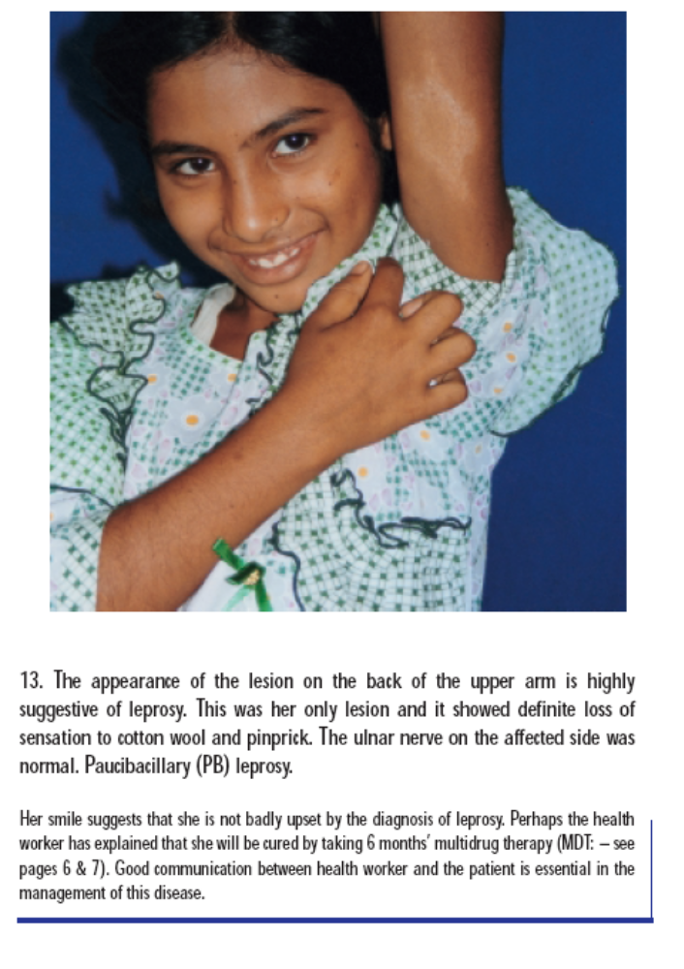
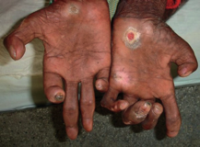
Tropical and Geographic Medicine
Short Course 2018
Leprosy
Hansen’s Disease
Jan Hajek
Tropical and Geographic Medicine Intensive Short Course 2018

Slide 2
Take home points
What are the 3 cardinal (diagnostic) signs of leprosy?
What is the difference between
  Tuberculoid, Borderline, and Lepromatous?
What is a reaction?
What to look for on exam of patient with leprosy
What is the treatment for leprosy?
What are indications for steroids?
Notes:
Koch – 1882
Hansen – 1873
M. leprae
CMI – spectrum
Treatment
MDT
Diagnosis
Late presentation
Stigma
Disease of poverty

Slide 3
What is Leprosy Hansen’s Disease?
Chronic mycobacterial disease cause by Mycobacterium leprae
Affects the skin and peripheral nerves
  Can be disabling, disfiguring, blinding and stigmatizing
  Clinical manifestations depend on the cell mediated immune response

Slide 4
Mycobacterium leprae
Relatively avirulent bacteria
Cannot be cultured in vitro
  Divides slowly (14 days)
Prefers cool areas of the body (25 – 30ºC)
  Skin (earlobes)
  Superficial peripheral nerves
Natural reservoirs
  Humans, non-human primates, armadillos
Notes:
tropism for macrophages and Schwann cells.
preference for growth in cooler regions of the body
Schwann cells can express HLA class 2 molecules and present mycobacterial peptides to CD4 cells.
Swelling within the inflexible perineurium leads to ischaemia, further nerve damage, and eventually fibrosis with axonal death
Survives for 9 days in the environment

Slide 5
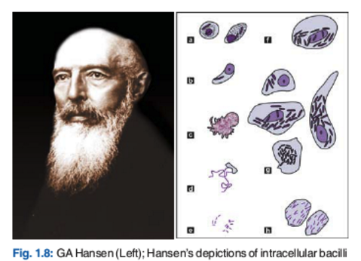
Hansen’s Disease
Hansen
1873

Slide 6
How is Hansen’s Disease transmitted?
Likely spread through respiratory droplets
Incubation
  6 months – 30 years (average 3 years)
Most people exposed/infected do not get disease
Risk of disease is increased in:
  Household contacts (3%)
  HIV?
Notes:
M. leprae PCR positive in 5% of household contacts
The carriage of
5-10X higher in MB contacts
2-4x higher in PB contacts

Slide 7
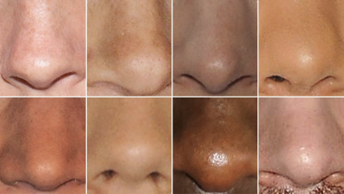
Transmission
Asymptomatic carriers
In Brazil, 50% of asymptomatic household contacts had M. leprae detectable by PCR in their nasal mucosa
Clinical Infectious Diseases 2016;63(11):1412– 20
Notes:
Beyene D, Aseffa A, HarboeMet al. Nasal carriage of Mycobacterium leprae DNA in healthy individuals in Lega Robi village, Ethiopia. Epidemiol Infect, 2003; 131: 841–848.

Slide 8
Epidemiology
Has leprosy been eliminated?
  Yes
  No

Slide 9
Epidemiology
Has leprosy been eliminated?
  Yes
  No
  Elimination of leprosy as public health problem:
    a registered prevalence of < 1 case per 10 000
    achieved globally in 2000

Slide 10
Epidemiology
2 - 3 million people living with permanent disability from leprosy
Prevalence has decreased in last 30 years:
  5 million in 1985
  500,000 in 2000
  175,000 in 2014
Incidence has not changed as much
200,000 new cases are being reported every year
  3 new cases / 100, 000
Pockets of high endemicity still remain in many countries
Disease of poverty
WHO leprosy
Notes:
The global statistics show that 220 810 (95%) of new leprosy cases were reported from 16 countries and only 5% of new cases are from the rest of the world.
Pockets of high endemicity still remain in some areas of many countries but a few are mentioned as reference: Angola, Bangladesh, Brazil, China, Democatic Republic of Congo, Ethiopia, India, Indonesia, Madagascar, Mozambique, Myanmar, Nepal, Nigeria, Philippines, South Sudan, Sri Lanka, Sudan and the United Republic of Tanzania.
In 1991 WHO's governing body, the World Health Assembly (WHA) passed a resolution to eliminate leprosy by the year 2000. Elimination of leprosy is defined as a prevalence rate of less than 1 case per 10 000 persons. The target was achieved on time and the widespread use of MDT reduced the disease burden dramatically.
Since 1995, the World Health Organization (WHO) has provided treatment free of charge to all leprosy patients worldwide
Over the past 20 years, more than 14 million leprosy patients have been cured, about 4 million since 2000.
The prevalence rate of the disease has dropped by 90% – from 21.1 per 10 000 inhabitants to less than 1 per 10 000 inhabitants in 2000.
Dramatic decrease in the global disease burden: from 5.2 million in 1985 to 805 000 in 1995 to 753 000 at the end of 1999 to 189 018 cases at the end of 2012.
Leprosy has been eliminated from 119 countries out of 122 countries where the disease was considered as a public health problem in 1985.
So far, there has been no resistance to antileprosy treatment when used as MDT.
Efforts currently focus on eliminating leprosy at a national level in the remaining endemic countries and at a sub-national level from the others.

Slide 11
Historical Trends
pre-1950
  Incurable → isolation and stigma
1950’s
  Dapsone monotherapy
  Taken for life
1980’s
  Multidrug therapy (MDT) introduced (6 – 24 months)
1990’s
  WHO called for eliminating leprosy as a public health problem by 2000
    < 1 case on treatment/10,000)
2000’s
  WHO simplified the diagnosis
  Shortened duration of MDT to 6 – 12 months
  Integrated, decentralized approach
Notes:
Lockwood DN. Rifampicin/minocycline and ofloxacin (ROM) for
single lesions: what is the evidence? Lepr Rev 1997; 68: 299–300.
Since 1995, WHO has provided free multidrug therapy worldwide in collaboration with private foundations. As treatment improved and became more widely available, in 1991, the World Health Assembly passed a resolution with the goal of eliminating leprosy as a public health problem by the year 2000, just 9 years later. In that resolution, the elimination of leprosy was defined as decreasing the prevalence rate to less than 1 case per 10,000 persons (from the then current figure of 21.1 per 10,000 persons). It is believed that this target was met as scheduled

Slide 12
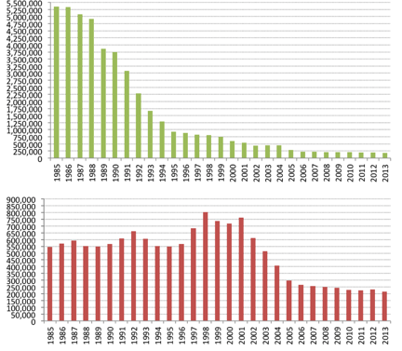
Historical Trends
Multidrug therapy was very effective
Prevalence quickly dropped
But, the incidence of new cases has been slower to change
India
Brazil
Global trends in Registered Prevalence and New Case Detection (1985–2013) – WHO
Notes:
620,000 cases in 2002 to
212, 000 cases in 2006 – coincided with the WHO deciiosn to decrease treatment duration from 2 years to 1 year

Slide 13
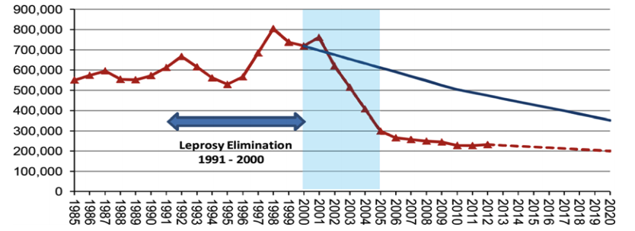
Millions of missed cases
Massive under-reporting
More than 2.5 million missing (2000 – 2012)...
Smith WC, PLoS Negl Trop Dis 9(4)
Notes:
The resulting difference between the expected and observed numbers of new cases of leprosy between 2000 and 2012 is approximately over 2.6 million. This number will increase to over 4 million by 2020. This analysis implies that there may be a large accumulation of people with leprosy in the community who remain undiagnosed and untreated. This assertion is supported by evidence from recent sample surveys in endemic areas detecting many as yet untreated cases in Bangladesh [10] and in India [11]. This large number of undetected cases represents a major threat to leprosy control and contributes to the increased burden of infection in the community and an increased pressure on transmission. This has major consequences for the road map for NTDs in the London Declaration [12–14], which targets “interruption of transmission” and “global elimination” of leprosy by 2020.

Slide 14
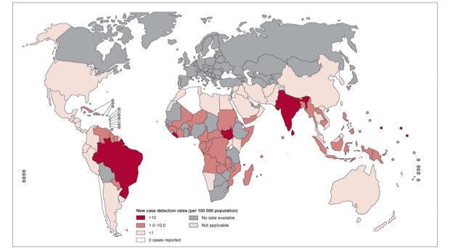
Incidence
200,000 new cases reported to WHO in 2015
  80% in 3 countries (India, Brazil, Indonesia)
  95% in 14 countries
WHO
Notes:
It should be noted that 6 countries reported >1000 cases annually in the Region, while India alone accounted for 58.85% of the global leprosy burden
India reported the highest number of new cases (126,913) followed by Brazil (31,044) and Indonesia (16 856
pockets of high endemicity still remain in some foci in Angola, Brazil, the Central African Republic, India, Madagascar, Nepal and the United Republic of Tanzania
5 countries > 80% of cases
The leprosy burden is now concentrated in the five most endemic countries
(Brazil, India, Madagascar, Mozambique, and Nepal)
account for > 80% of prevalence
The combined prevalence rate in these countries is about 4 per 10 000 inhabitant

Slide 15
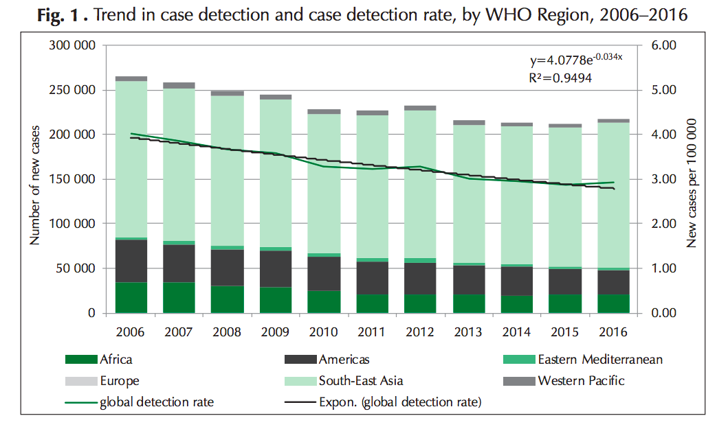

Slide 16
Number of new cases with visible disability have not changed…
WHO
Notes:
Despite availability of effective MDT for over 30 years:
Prevalence and incidence have remained unchanged since 2005
New cases with grade 2 disability and new cases in childen have remained unchanged since 2010
This reflects a failure in early leprosy case detectin and indicates that transmission is stil crarly ongoing

Slide 17
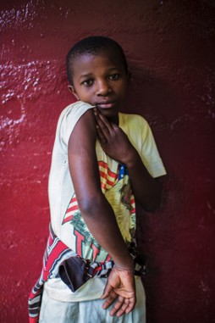
Number of new cases among children have also not changed…
ILEP; Novartis Foundation

Slide 18
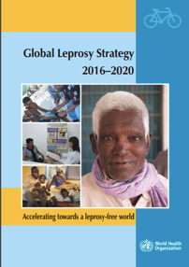
2016 - New strategy
Increased emphasis on:
  Contact tracing and case finding
  Prophylaxis
  Reducing stigma
New targets
  Neurological disabilities:
    Zero disabilities among new child cases
    Reduction in new diagnosis with disability to < 1 / million people.
  Stigma
    Zero countries with discriminatory legislation
Notes:
“Accelerating towards a leprosyfree world”
Yet the current strategy is innovative as it gives, in addition to a solid medical component, increased visibility and weight to the human and social aspects affecting leprosy control. Reducing stigma and promoting inclusiveness will reinforce better and earlier diagnosis. Innovative approaches include focus on children, women and other vulnerable populations, strengthened referral systems, systematic tracing of household contacts, monitoring drug resistance, working towards a simplified treatment approach and assessing the role of post-exposure prophylaxis. It provides linkages with broader health and development agendas including universal health coverage and the sustainable development goals.
The target of G2D rate is less than one per million population.

Slide 19
Clinical features…

Slide 20
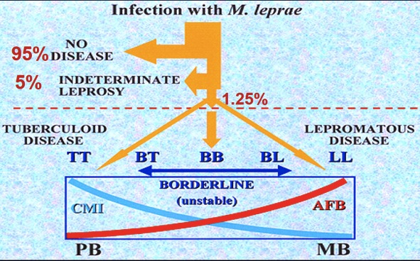
Leprosy Spectrum
Notes:
Tuberculoid leprosy (TT stage)
Sharply demarcated hypopigmented macular skin lesions
Lepromatous leprosy (LL).
skin involvement is extensive and bilateral across the host's body, with polymorphic lesions -- nodules, macules, papules, and plaques

Slide 21
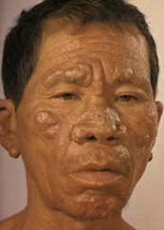
Leprosy Spectrum
Notes:
Tuberculoid leprosy (TT stage)
Sharply demarcated hypopigmented macular skin lesions
Lepromatous leprosy (LL).
skin involvement is extensive and bilateral across the host's body, with polymorphic lesions -- nodules, macules, papules, and plaques

Slide 22
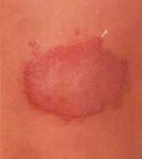
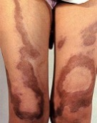
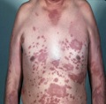
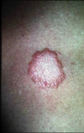
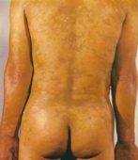
Ridley Jopling classification
TT | BT | BB | BL | LL
Tuberculoid | Borderline |  |  | Lepromatous
Well-defined (1–3) Anaesthetic Nerve thickening | Ill-defined Satellite | Circinate, Bizarre Punched out Multiple nerves | Symmetrical Skin infiltration Innumerable | Symmetrical Skin infiltration Madrosis, Leonine Normal sensation
1 – 5 lesions |  | > 5 lesions
No AFB, well formed granulomas |  |  | Many AFB

Slide 23
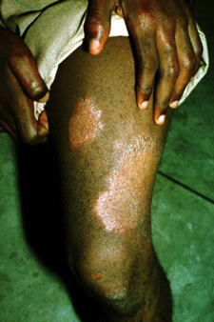
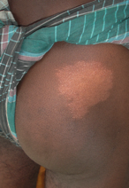
Tuberculoid
Few lesions (1 – 5)
Asymmetric
Well-defined
Hypo-aesthetic
May be thickening of nearby nerve

Slide 24
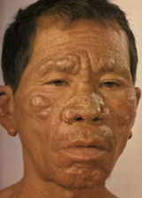

Lepromatous
Many lesions, diffuse
Symmetrical
Normal sensation in the skin lesions
Glove stocking sensory loss
Skin infiltration
  Leonine facial appearance
  Thickened earlobes
  Loss of eyebrows

Slide 25
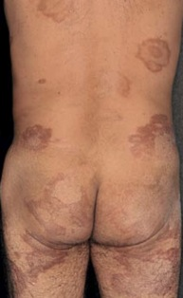

Borderline
Features in between or mixed between tuberculoid and lepromatous poles

Slide 26
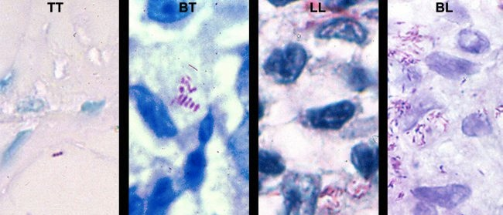
Skin slit smears
A measure of bacillary burden
Tuberculoid
Paucibacillary
0 – few AFB
Lepromatous
Multibacillary
Many AFB

Slide 27
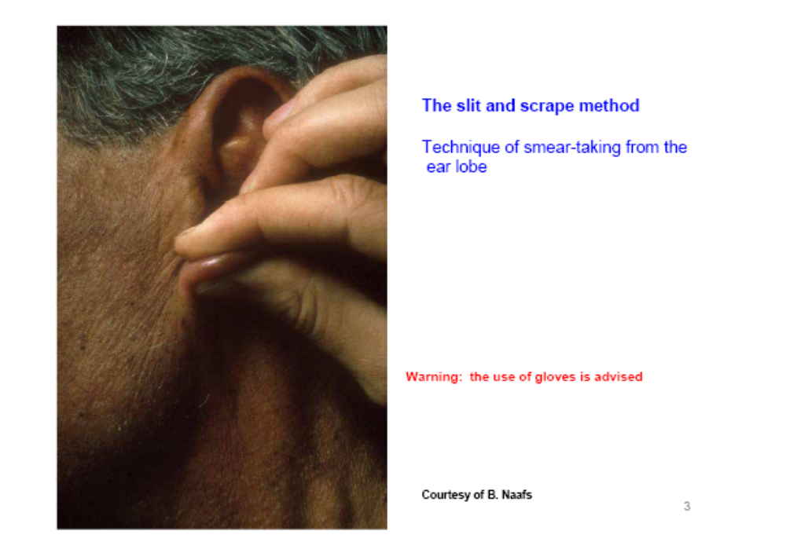
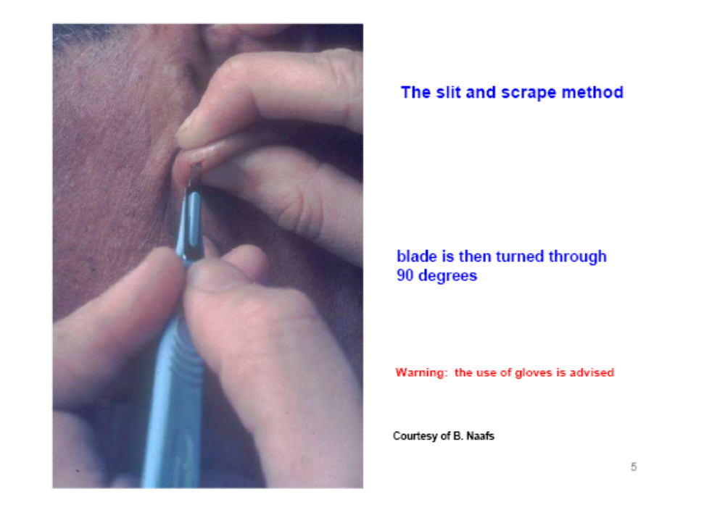
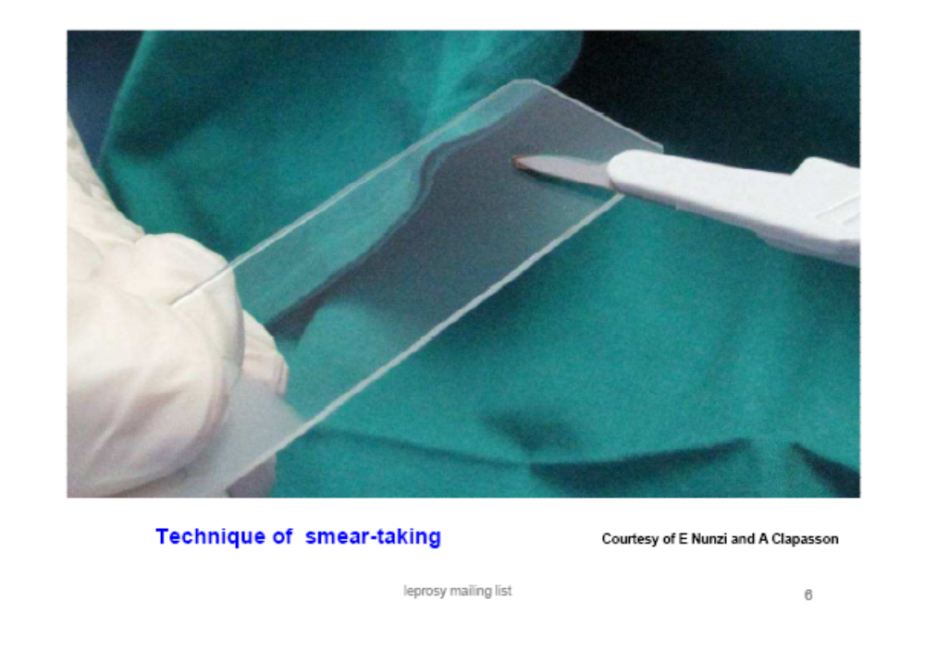
Performing skin slit smears
Take samples from earlobe and skin lesion

Slide 28
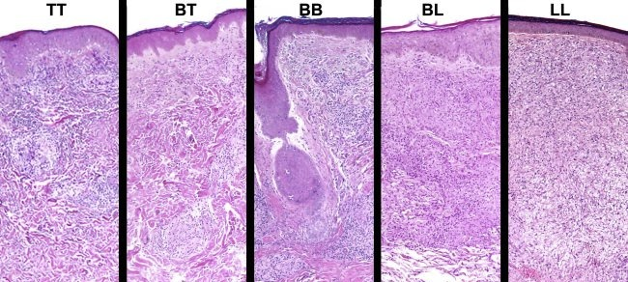
Skin biopsy
Biopsies can be used for diagnosis and classification
If AFB seen and nerve involvement = leprosy
Notes:
Lepromatous leprosy (LL): When macrophage and foam cell collections present with numerous bacilli interspersed with sparse number of lymphocytes.
Borderline lepromatous (BL) leprosy: When there were macrophage granulomas, numerous lymphocytes and moderate numbers of bacilli.
Borderline tuberculoid (BT) leprosy: When lympho-epithelioid granuloma presents with occasional Langhans giant cells.
Tuberculoid leprosy (TT): When immature epithelioid cells are present together with Langhans giant cells and numerous lymphocytes.

Slide 29
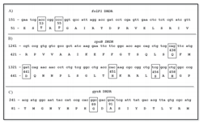
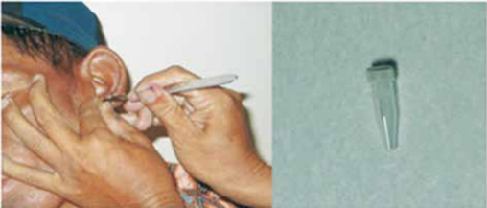
Resistance
Molecular testing (PCR) for point mutations
      Dapsone folP1
      Rifampin rpoB
      FQ gyrA

Slide 30
Diagnosis
3 cardinal signs of leprosy
  Anaesthetic skin patch
  Thickened peripheral nerve
  Positive skin slit smear (AFB)

Slide 31
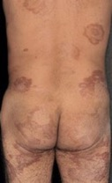
WHO Simplified Diagnosis
1. Hypo-aesthetic patch of skin → Leprosy
2. How many lesions?
1 – 5 = Paucibacillary
> 5 = Multibacillary
No need for biopsy or skin slit smears
But, lepromatous may still need skin slit smears

Slide 32
Classification
Paucibacillary (PB) case:
  1 to 5 skin lesions,
    Without nerve involvement
    Without bacilli seen in a skin smear;
Multibacillary (MB) case:
  More than 5 skin lesions;
  or
  Nerve involvement
  Bacilli seen on slit-skin smear

Slide 33
Why is classification important?
Treatment *WHO (pre-2018)
  Paucibacillary 6 months, 2 drugs
  Multibacillary 12 months, 3 drugs

Slide 34
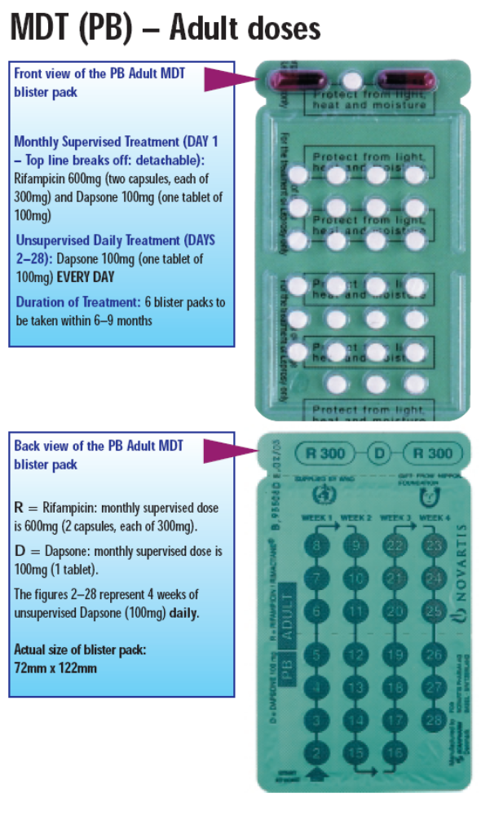
Treatment *WHO (pre-2018)
Paucibacillary – 6 months; 2 drugs
Monthly
Rifampin 600
Dapsone 100
Daily
Dapsone 100

Slide 35
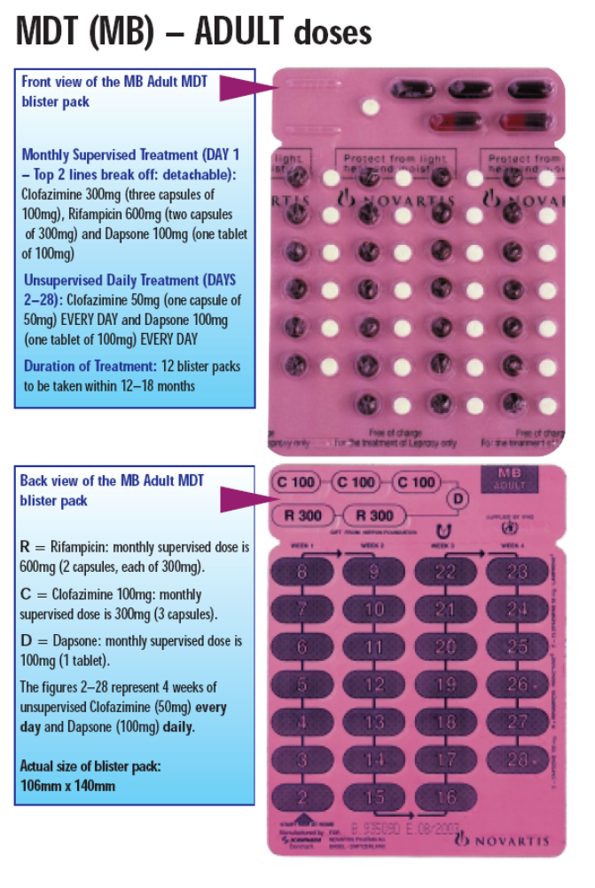
Treatment *WHO
Multibacillary – 12 months; 3 drugs
Monthly
Rifampin 600
Dapsone 100
Clofazamine 300
Daily
Dapsone 100
Clofazamine 50

Slide 36
Variations
Paucibacillary
Drug | WHO (pre-2018) | USA
Dapsone | 100/d | 100/d
Rifampin | 600/month | 600/day
Duration | 6m | 1year

Slide 37
Variations
Multibacillary
Drug | WHO | USA
Dapsone | 100/d | 100/d
Rifampin | 600/m | 600/d
Clofazimine | 300/m+ 50/d | 50/d
Levofloxacin | - | -
Duration | 1y | 2y

Slide 38
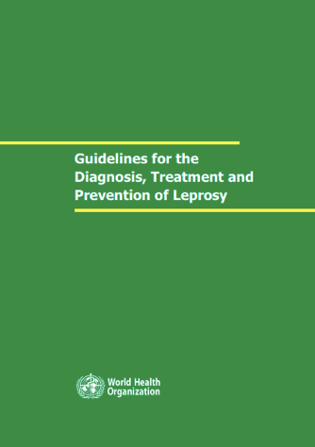
2018 – new guidelines…

Slide 39
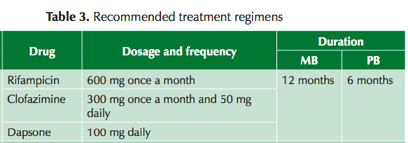
2018 – new guidelines…
Treatment *WHO
  Paucibacillary 6 months, 2 drugs
  Multibacillary 12 months, 3 drugs
3 drugs

Slide 40
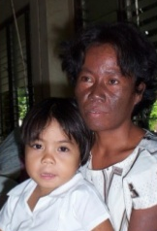
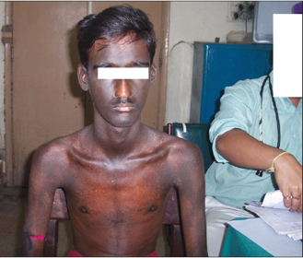
This is a side effect of….
Rifampin
Dapsone
Clofazimine

Slide 41
Newer treatment regimens
ROM
  Rifampin + Ofloxacin (Moxifloxacin) + Minocycline
  Monthly x 6 -24 months for PB -MB leprosy
Uniform MDT (U-MDT)
  6 months of MDT for everyone with leprosy
Notes:
Rifampin 600 mg
Ofloxacin 400 mg
Minocycline 100 mg
single lesion
previously untreated
skin smear negative
peripheral nerves not involved

Slide 42
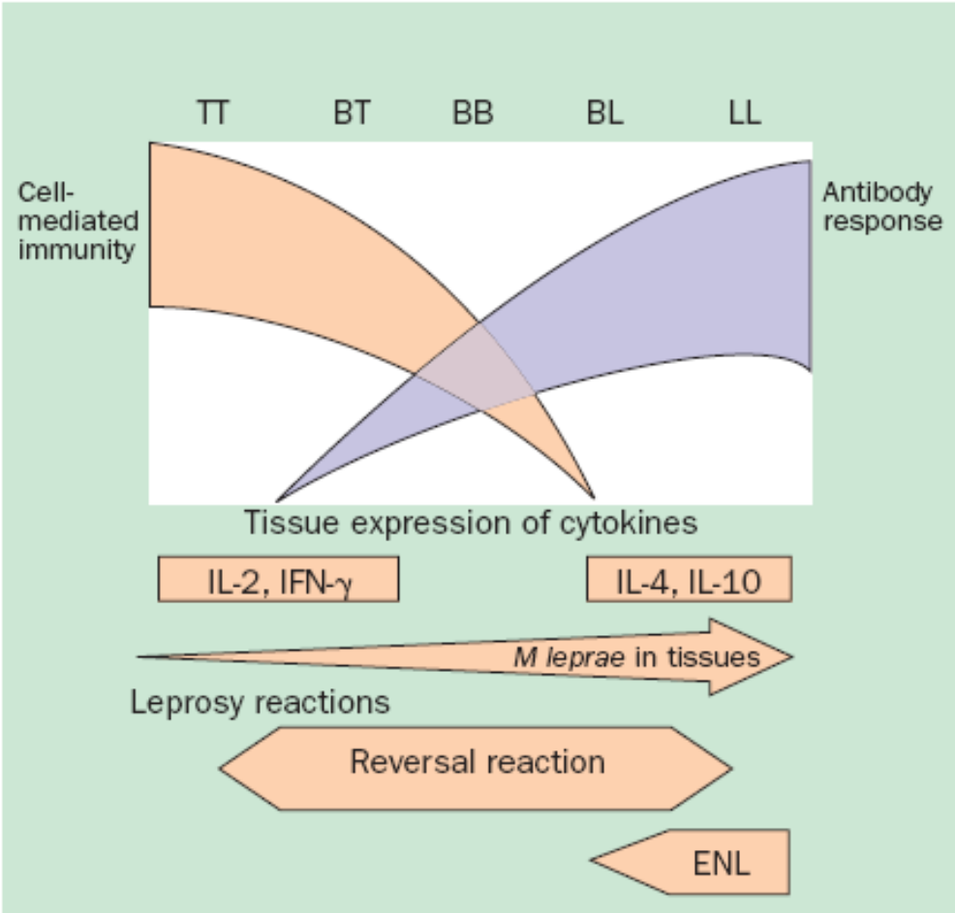

Reactions
Complicate treatment

Slide 43
Reactions
Type 1
  Upgrading of CMI
    Inflammation of pre-existing skin lesions
    Neuritis (tender, painful nerves)
      - Typically within the first 2 months of diagnosis/treatment
Type 2
  Erythema Nodosum Leprosum (ENL) → Ag-Ab complexes
    Crops of new nodules
    Fever, arthalgia, orchitis, nephritis, uveitis, etc
      - May happen years later, often recurs
Notes:
Reactions occur in 30% of MB patients
ENL occurs in 50% of LL patients

Slide 44
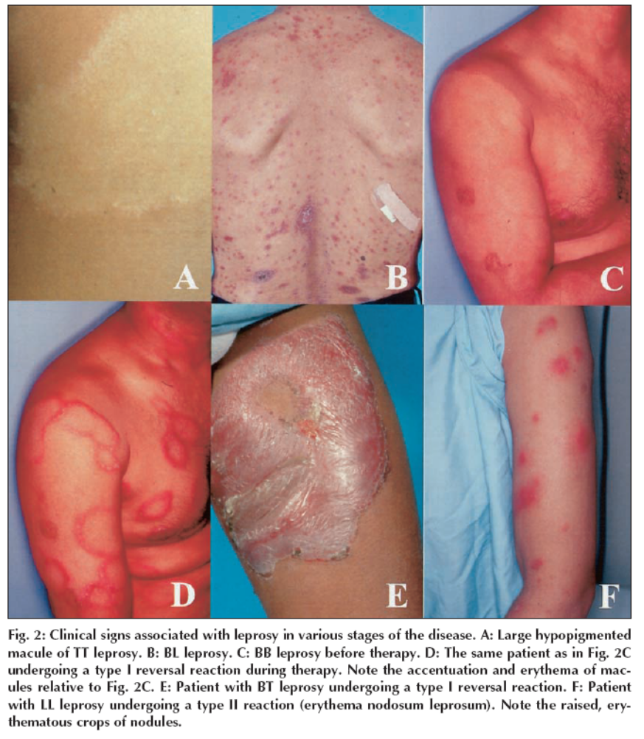
Type 1 reaction
Upgrading CMI
Boggild, CMAJ

Slide 45
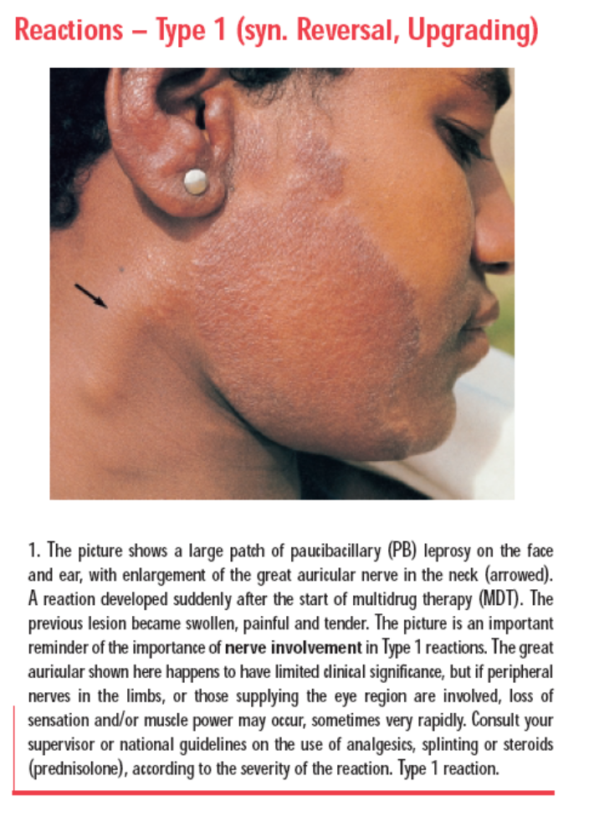
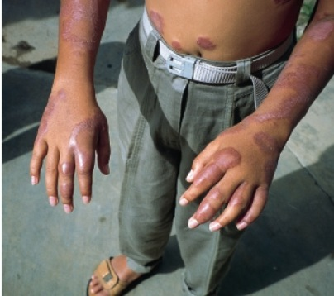
Type 1 reaction
Upgrading CMI
WHO

Slide 46
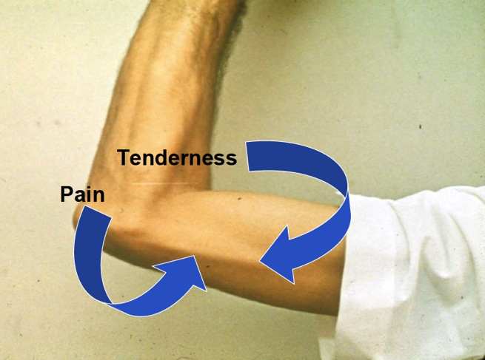
Type 1 reaction
Upgrading CMI
Keystone

Slide 47
Type 1 reaction
Upgrading CMI
Can be present at the time of diagnosis
Nerve involvement = medical emergency
  Occur in ~30% of patients
  Treated with steroids
  Nerve can be tender or painless

Slide 48
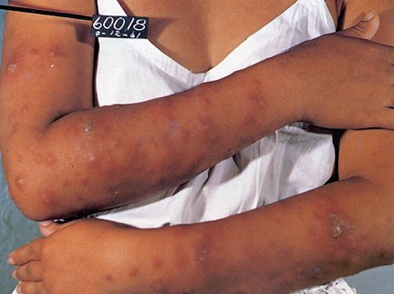
Type 2 reaction
ENL
Keystone

Slide 49
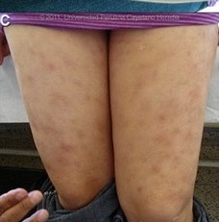
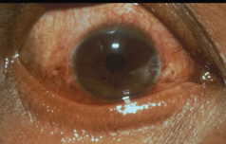
Type 2 reaction
ENL
Gorgas course

Slide 50
Treatment of reactions
Type 1
  Steroids:
    Prednisone 1mg/kg; tapering over 5 months
Type 2
  Steroids
  Thalidomide (anti-TNF properties)
Notes:
No firm consensus on best regimens
Typically prednisone start with 1 – 1.5mg/kg
Begin to taper when symptoms and nerve function begin to improve (e.g., by 5mg q 2weeks)
* strongyloides, TB, hepatitis B, diabetes…
Optimal duration is not clear – some suggest 24 weeks better than 12 weeks
Relapse rate after steroids is 20 – 50%

Slide 51
Indications for steroids
New nerve function impairment (NFI) duration of < 6 months
  Present at diagnosis
  Develop as a reaction while on therapy
Notes:
The fact that the likelihood of full recovery of nerve function with prednisolone is much higher in acute or recent NFI (<6 months duration) than in older NFI, coupled with the fact that up to 80% of all NFI occurs imperceptibly (silent neuropathy), mandates a system of regular clinical screening for NFI even though a patient is asymptomatic.

Slide 52
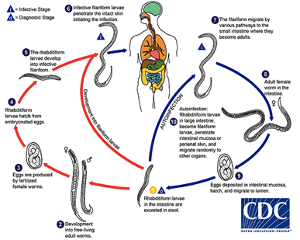
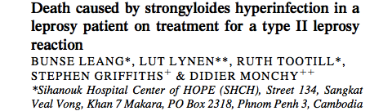
Steroids and Strongyloides
Preventable
Ivermectin or albendazole
Lepr Rev 2004:75;398

Slide 53
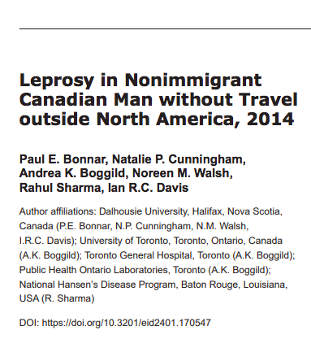
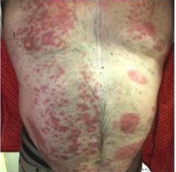
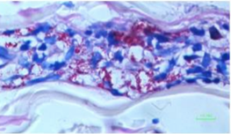
EID 2018

Slide 54
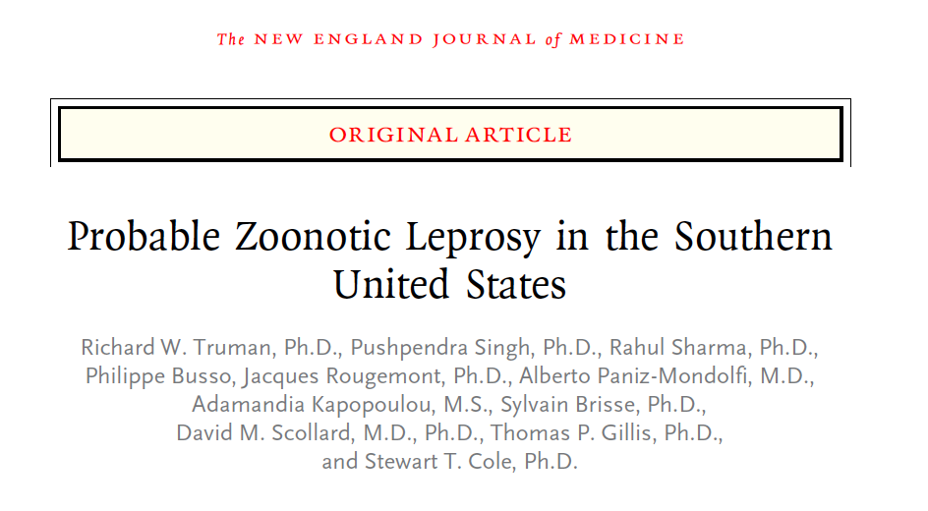
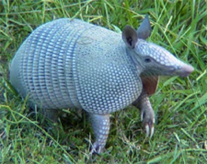

Leprosy – a zoonosis!

Slide 55
Clinical Assessment
4 questions to address:
Is it leprosy?
What is the classification?
Is there any nerve impairment?
Is there need for steroids?

Slide 56
Clinical Assessment
Skin
  Count skin patches
  Check sensation in patches
Nerves
  Examine superficial nerves
  Check sensation in face, hands and feet
  Check strength of face, hands and feet
Skin slits and biopsy
Notes:
First, talk to the person
Examine the patient
Examine the skin
Test the feeling in the skin patches
Feel the nerves
Examine the hands and feet for nerve damage
Perform a skin smear if available

Slide 57

Leprosy Assessment
Skin patch with loss of sensation

Slide 58

Also look for characteristic features of lepromatous leprosy
Gorgas course

Slide 59


Lepromatous leprosy
JAMA. 2017;317(1):81-82.
Notes:
41-year-old man who had immigrated to the United States from Costa Rica 10 years prior presented with a 2-year history of tingling and pain in his hands and feet. He had no other symptoms and reported taking no medications. Findings on skin examination included near-complete loss of eyebrows and eyelashes, a scaly plaque on the right shin, and mild bilateral erythema of the earlobes, distal fingers, and toes (Figure). He also had right axillary and bilateral inguinal lymphadenopathy.

Slide 60



Leprosy Assessment
Examine nerves
Thickened
Tender
Functional deficit

Slide 61




Testing for muscle strength

Slide 62

Testing for sensory deficits

Slide 63


Examine the eyes

Slide 64


Leprosy Assessment
Use a standardized form for documentation
WHO

Slide 65

Story of contact tracing
8 year old girl in Brazil presented to doctor with hypopigmented macule
An. Bras. Dermatol 88 (6 supl.1) 2013

Slide 66

Story of contact tracing
Skin lesion was hypoaesthetic → PB leprosy
Her mother had a similar skin lesion
An. Bras. Dermatol 88 (6 supl.1) 2013

Slide 67

Story of contact tracing
They were shown photos of patients with leprosy
  They recognized that their uncle had features of lepromatous leprosy
An. Bras. Dermatol 88 (6 supl.1) 2013
Notes:
He presented weakness and numbness in both hands, in addition to nasal obstruction. On examination, he showed nodules and tubercles on the face and pinnas, bilateral madarosis, diffuse infiltration in the trunk and lower limbs (Figure 4). There was cubital and auricular nerve thickening, which occurred bilaterally. There was hypoesthesia in bilateral legs and feet, hypoesthesia of the whole left arm and right arm (Figure 5). Skin smears were positive. Multibacillary multidrug therapy was initiated.

Slide 68

Contact tracing and prophylaxis
BMJ 2008; 336: 761-764
Notes:
He presented weakness and numbness in both hands, in addition to nasal obstruction. On examination, he showed nodules and tubercles on the face and pinnas, bilateral madarosis, diffuse infiltration in the trunk and lower limbs (Figure 4). There was cubital and auricular nerve thickening, which occurred bilaterally. There was hypoesthesia in bilateral legs and feet, hypoesthesia of the whole left arm and right arm (Figure 5). Skin smears were positive. Multibacillary multidrug therapy was initiated.

Slide 69
Contact Tracing and Prophylaxis
Bangladesh Trial, Moet et al. 1998
1,000 patients newly diagnosed w leprosy
20,000 contacts
RIFAMPIN
PLACEBO
30/10,000
0.3%
60/10,000
0.6%
30/10,000
0.3%
30/10,000
0.3%
57% effective NNT = 250
BMJ 2008; 336: 761-764
Notes:
Moet, FJ, Pahan D, Oskam L, Richardus JH. Effectiveness of single dose rifampicin in preventing leprosy in close contacts of patients with newly diagnosed leprosy: Cluster randomised controlled trial. BMJ 2008; 336: 761-764

Slide 70

You see this rash..
The next step is:
  Check sensation
  Skin biopsy
  Its probably ringworm – give a trial of topical antifungal therapy
Notes:
Erythematous borderline tuberculoid leprosy macule
with satellite lesions.

Slide 71
The rash has reduced sensation..
The next step is:
  Skin biopsy
  Its Hansen’s – start treatment
  Get blood tests first to confirm the diagnosis
Notes:
Erythematous borderline tuberculoid leprosy macule
with satellite lesions.

Slide 72
One month later she returns with weakness in foot dorsiflexion…
The next step is:
  It is a side effect, stop the treatment
  Continue treatment but add steroids
  Get a biopsy of peroneal nerve
Notes:
Erythematous borderline tuberculoid leprosy macule
with satellite lesions.

Slide 73


Could this be leprosy?
How would you diagnose it?
Blood test (for antibodies)
Skin test (lepromanin skin test)
Skin slit smears (from the ears)
Skin biopsy of the ulcer edge (foot)
Gorgas, Peru

Slide 74



Could this be leprosy?
Skin slit smears were positive (5+)
Gorgas, Iquitos, Peru

Slide 75
Leprosy
Take home points
What are the 3 cardinal signs of leprosy?
What is the difference between
  Tuberculoid, Borderline, and Lepromatous?
What is a type 1 reaction?
What is a type 2 reaction?
What is the treatment for leprosy?
What are indications for steroids?

Slide 76

Questions?
We can endure losing fingers and toes, eyes and nose, but what we cannot endure is to be rejected by those nearest and dearest
Lepr.Rev. 2005; 76:119-26.
Notes:
Rafferty J. Curing the stigma of leprosy. Lepr.Rev. 2005; 76:119-26.

Slide 77
Extra slides…

Slide 78
Type 1 reaction
Upgrading; reversal reaction
Increased inflammation of existing skin lesions and nerves
  Acute neurtitis
    Enlarged tender
    Impaired function
  Swelling of hands and feet
Patient remains generally well – no fevers

Slide 79
Type 2 reaction
Erythema Nodosum Leprosum (ENL)
Generalized immune-complex reaction
  Fevers and malaise
  Crops of painful SQ nodules that come and go
  Can involve:
    Eye inflammation
    Lymph nodes, arthritis, orchitis, hepatitis, nephritis
  Can be chronic and/or recurrent
Only in patients with multibacillary disease

Slide 80
Peripheral nerve involvement
Tuberculoid
  One or two superficial nerves
    Peroneal nerve → Foot drop
Lepromatous
  Generalized peripheral neuropathy
    Glove and stocking distribution
Notes:
Neural tropism of the leprosy bacillus is through its binding and entry into Schwann cells causing demyelination

Slide 81
Relapse vs Reaction
Treated patient with new or worsening lesions
Clue | Relapse | Reaction
Time since completing of MDT | > 3 years | < 3 years
Temporal progression | Slow | Fast
Site of lesions | In new places | Over same places
Pain, tenderness, swelling | No | Yes
Notes:
Speed of onset:
Reactions typically sudden vs. gradual onset of relapse
Timing
Relapse more likely if > 3 years after completing MDT
Site of lesions
New lesions or affected nerves suggests relapse
Histology often not diagnostic with PB, but useful for MB
Relapse is confirmed by increase in BI
Trial of prednisone 40mg x 4 weeks

Slide 82

Classifications

Slide 83
Epidemiology
200,000 new cases per year
  8% are in children
  8% have G2D – grade 2 disability
  60% are MB
Targets
  Zero G2D in children
  G2D cases <1/million
  Zero discrimination
Notes:
The World Health Organization (WHO) classifies leprosy according to the WHO disability grading system, where Grade 0 means no impairment, Grade 1 means loss of sensation in the hand, eyes or foot, and Grade 2 means visible impairment
Before 1998, the duration of MDT was 2 years for multibacillary patients and 1 year for paucibacillary patients.
The reduction in the recommended treatment duration and the introduction of the ROM treatment scheme are controversial, primarily because of concerns of incomplete treatment and relapse with this shorter regimen. The move to ROM treatment for patients with single lesions is motivated in part by a lack of funds to support HD treatment in many countries.
The reduction in treatment time (and, thus, a reduction in the amount of time that patients are registered as active cases of HD) has been misinterpreted by some to represent an attempt to demonstrate dramatic changes in global prevalence

