Slide 1

Soil Transmitted Helminths
Miguel Imperial MD MHSc FRCPC
Miguel.Imperial@tropicalmedicine.ca

Slide 2
Outline
Ascaris lumbricoides
Trichuris trichuria (Whipworm)
Necator americanus and Ancylostoma duodenale (Hookworm)
Strongyloides stercoralis

Slide 3
Question 1
Which organisms are native to N. America?
  Whipworm
  Strongyloides
  Hookworm
  Ascaris
  All of the above
Tropical Medicine Rounds

Slide 4
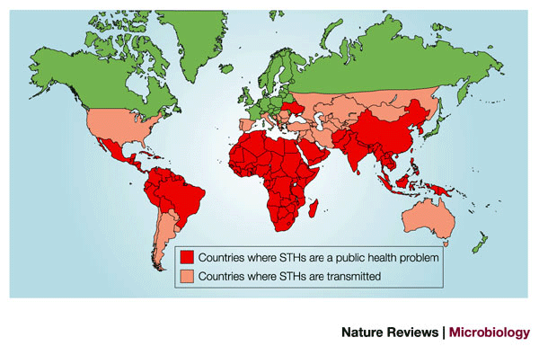
Tropical Medicine Rounds

Slide 5
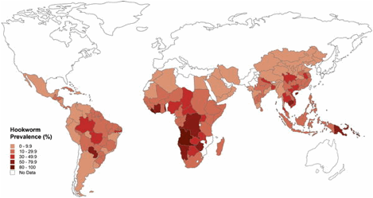
Prevalence
 | Prevalence
Ascaris | 800 - 1,200 million
Whipworm | 600-900 million
Hookworm | 500-700 million
Strongyloides | 30 – 100 million
Tropical Medicine Rounds

Slide 6
WHO Expert Committee on the Prevention and Control of Schistosomiasis and Soiltransmitted Helminthiasis
39.0 million DALYs are lost each year to STH
35.7 million DALY for malaria
46.5 million DALY for tuberculosis
These data show that soil-transmitted helminthiases are one of the most significant parasitic infections of humans.
Tropical Medicine Rounds

Slide 7
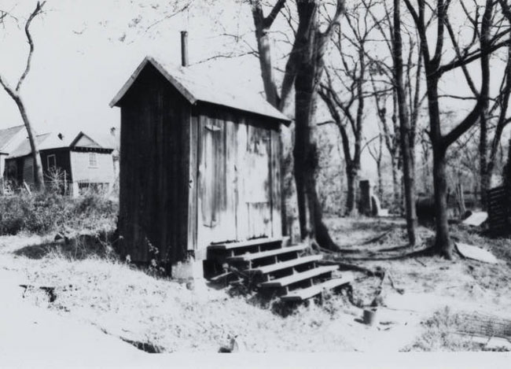
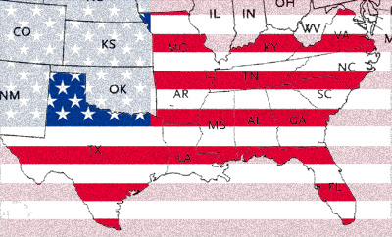
Parasitic Infections in the American South - Historically
A study in 1905 showed that the prevalence of hookworm infection in the South was 40%
Poor waste disposal coupled with infrequent use of footwear contributed to the burden of disease.
A survey of households in 1909 showed less than 50% of homes had some form of toilet/outhouse, and only 10% had a proper toilet/outhouse
Tropical Medicine Rounds

Slide 8
Description of Hookworms Infection in Southern US
“Infected individuals are pale and anemic . . . in children, development, both physical and mental, is retarded and an infected child is dull and backward at school.. “
“Adults may feel weak, tire easily, and have shortness of breath. Also infected persons . . . crave and eat unusual things such as paper, green fruit, chalk, clay and dirt.”
Tropical Medicine Rounds

Slide 9
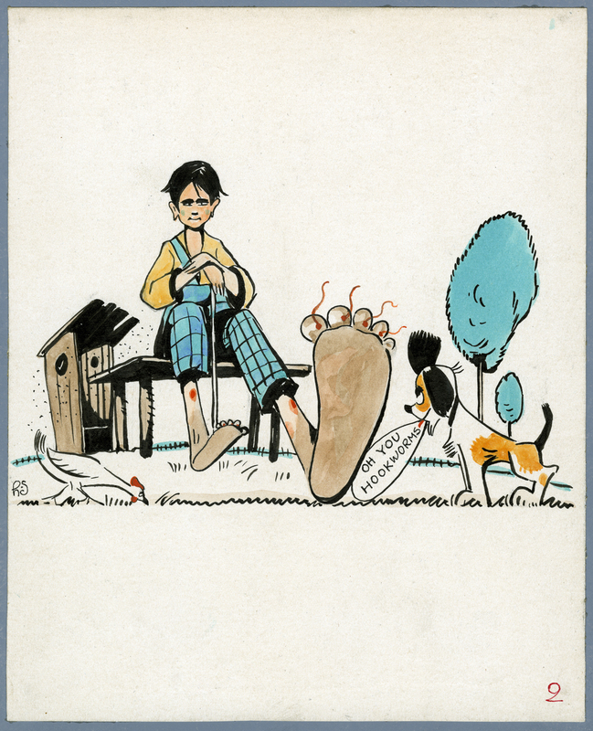
Tropical Medicine Rounds

Slide 10
Socioeconomic impacts
Iron deficiency anemia in children had long term impacts on development.
With the eventual eradication of hookworm infection in the southern US, there was a demonstrable increase in school attendance rates independent of other improvements
An economic analysis of hookworm infection in the southern US estimated that because of its impact on child development, it resulted in a loss of future wage earning potential of about 40%.
Tropical Medicine Rounds

Slide 11
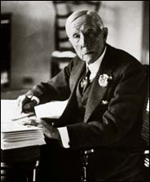

Slide 12
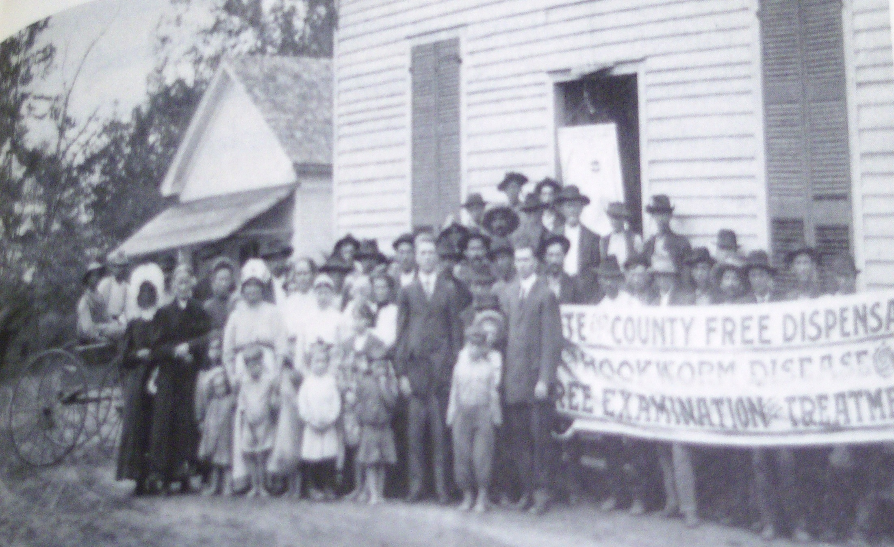
Tropical Medicine Rounds

Slide 13
Americans with tropical diseases
War/Conflict | Years | Major Areas | Tropical Disease | Estimated or Reported Number of Cases | Ref.
World War I | 1917–18 | Americas and Caribbean | Malaria | 27,203 malarial admissions | [1], [2]
World War II | 1942–45 | South Pacific, especially New Guinea, the Philippines, other Pacific Islands | Dysentery and diarrhea | 756,849 | [1]
 |  |  | Malaria | 572,950 | [1]
 |  |  | Dengue | 121,608 | [1]
 |  |  | Hookworm | 19,943 | [1]
 |  |  | Lymphatic filariasis | 14,009 | [1]
 |  |  | Sandfly fever | 12,634 | [1]
 |  |  | Scrub typhus | 7,421 | [1]
 |  |  | Amebic dysentery | 4,504 | [1]
 |  |  | Schistosomiasis | 1,672 | [1]
 |  |  | Endemic typhus | 893 | [1]
 |  |  | Leishmaniasis (Leishmania spp.) | 361 | [1]
 |  |  | Strongyloidiasis | Not determined | [5]
Tropical Medicine Rounds

Slide 14
Worldwide
Tropical Medicine Rounds

Slide 15
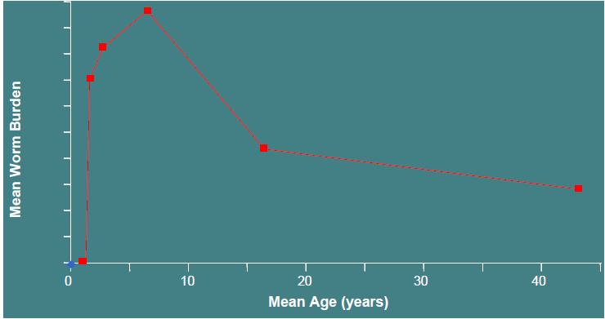
Highest worm burden in school-age children
Tropical Medicine Rounds

Slide 16
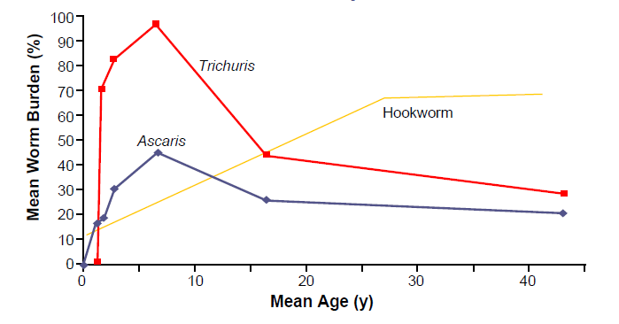
By type of worm
Tropical Medicine Rounds

Slide 17
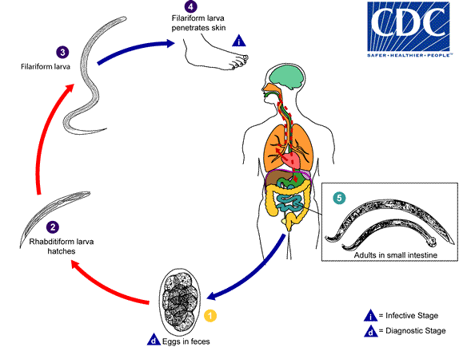
Hookworm Biology - Lifecycle
Tropical Medicine Rounds

Slide 18
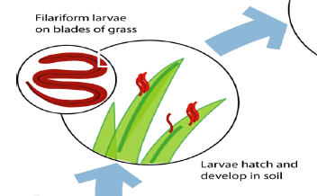
Tropical Medicine Rounds

Slide 19
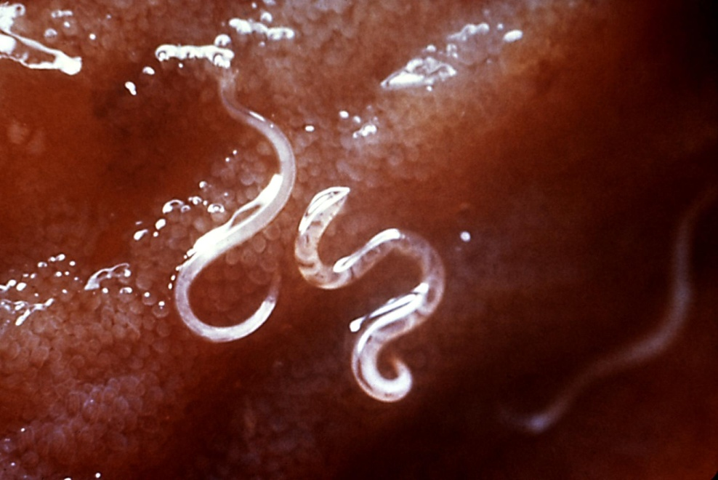
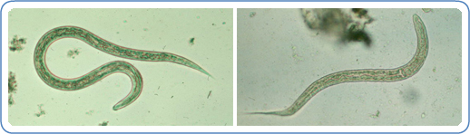
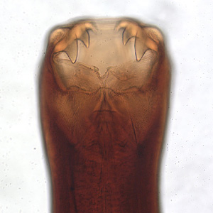
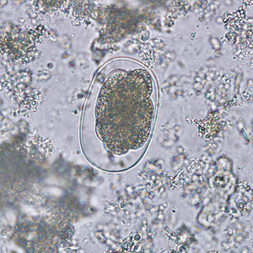
Tropical Medicine Rounds

Slide 20
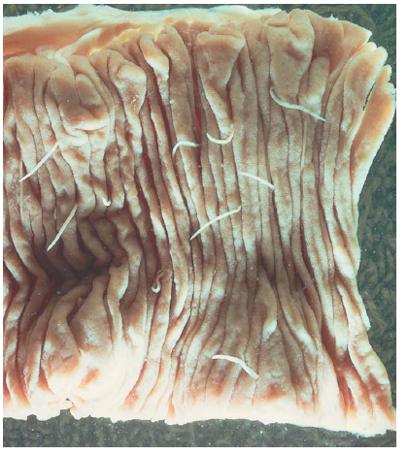
Tropical Medicine Rounds

Slide 21
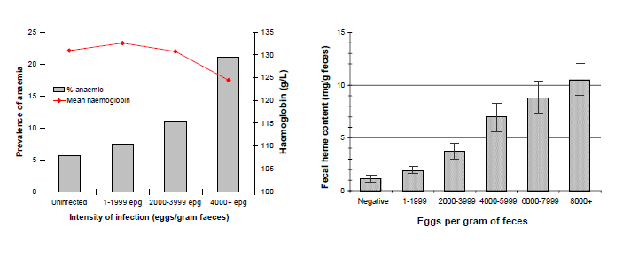
Worm Burden = Anemia
25 Necator americanus = 1ml blood loss / day
Tropical Medicine Rounds

Slide 22
Treatment Hookworm
Albendazole 400mg (1 day)
Mebendazole 100mg bid (3 days)
Pyrantel Pamoate (OTC)
Tropical Medicine Rounds

Slide 23
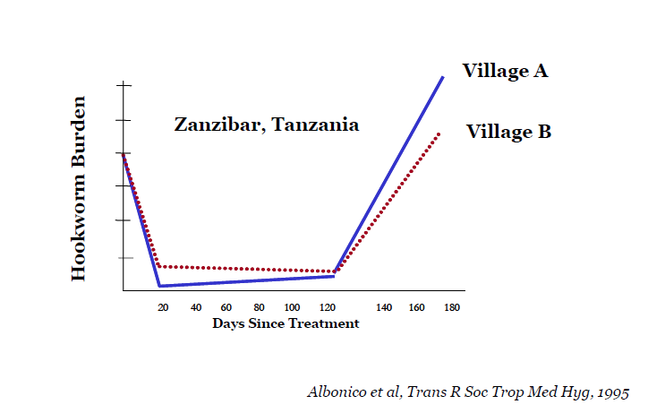
Reinfection
Tropical Medicine Rounds

Slide 24
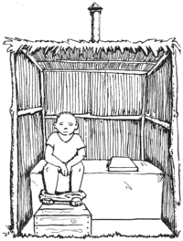

Tropical Medicine Rounds

Slide 25
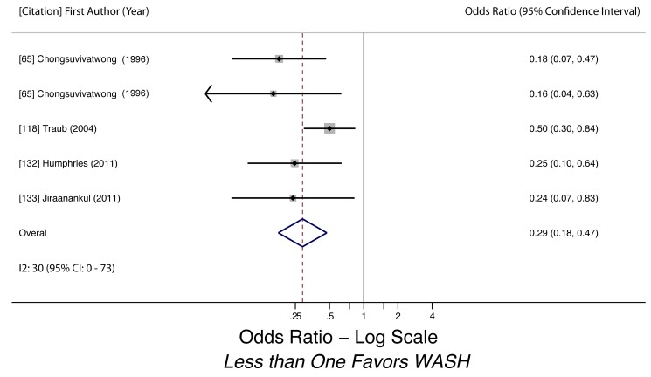
Public Health Interventions
Meta-analysis of the association between wearing shoes and hookworm infection [65],[118],[132],[133]. Note: Chongsuvivatwong et al. [65] reported on two separate studies in their 1996 article.

Slide 26
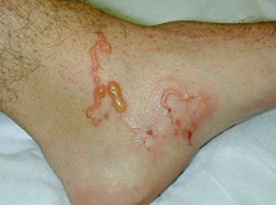
Ancylostoma braziliense
Ancylostoma braziliense
Tx: albendazole, ivermectin, or topical thiabendazole

Slide 27
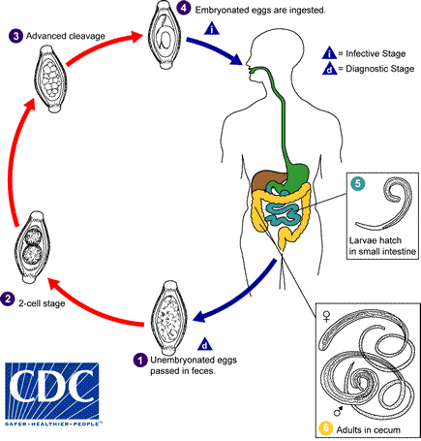
Trichuris trichuria
Tropical Medicine Rounds

Slide 28
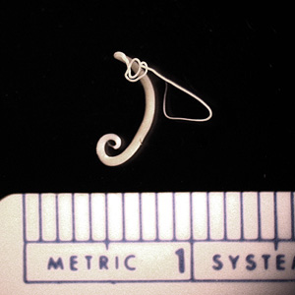

Slide 29
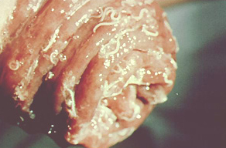
Clinical Manifestations
Asymptomatic in light infection
> 200 worms:
  Diarrhea, with blood
  Anemia
  Rectal prolapse
  Other gastrointestinal co-infections
    Shigella dysentery
    Amoeba dysentery
Tropical Medicine Rounds

Slide 30
Treatment
Mebendazole 100mg po bid x 3 days, longer if heavy worm burden (90% + cure)
Albendazole 400mg x 3 days (80% cure )

Slide 31
Question
A child in an orphanage is diagnosed with Ascaris infection. Does she require isolation?
  Yes, she is infectious to the other children
  No, as long as she gets treatment right away.
  Yes, she can shed eggs for some time even after treatment.
  No, she is not directly infectious to the other children.
Tropical Medicine Rounds

Slide 32
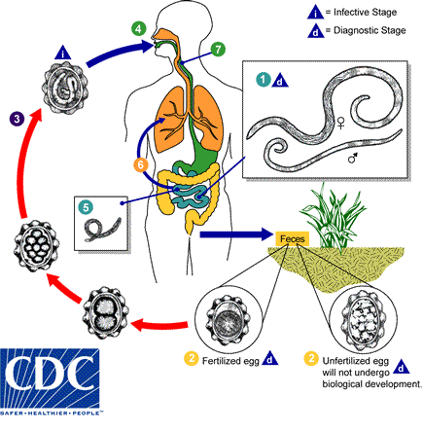
Ascaris lumbricoides
Tropical Medicine Rounds

Slide 33
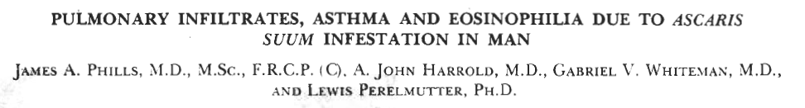
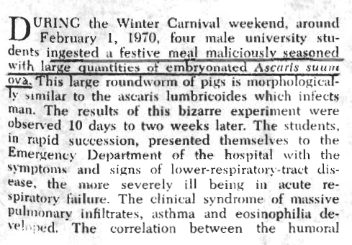
Loffler Syndrome

Slide 34
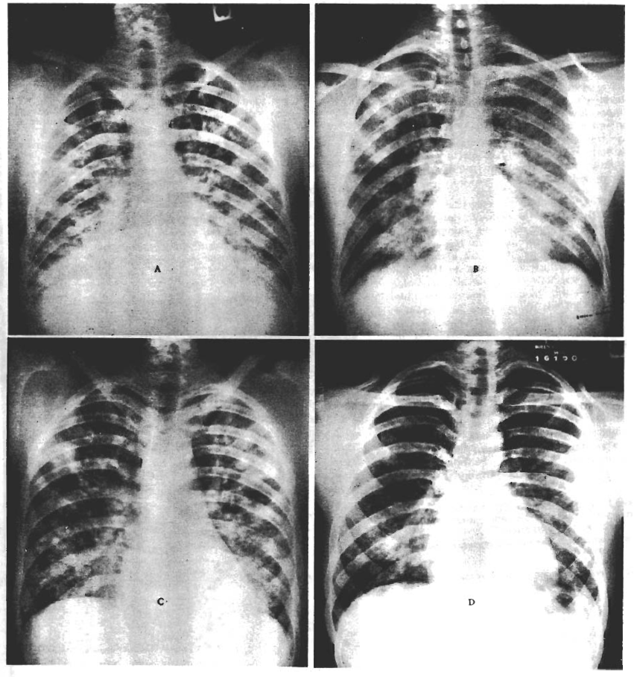
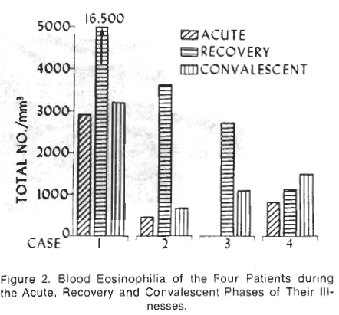

Slide 35
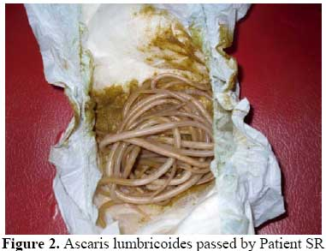
Tropical Medicine Rounds

Slide 36
Case
33 y.o. F from Thailand
Presented with acute pancreatitis and ascending cholangitis, fever 37.5
WBC 11, diff normal.
Tropical Medicine Rounds

Slide 37
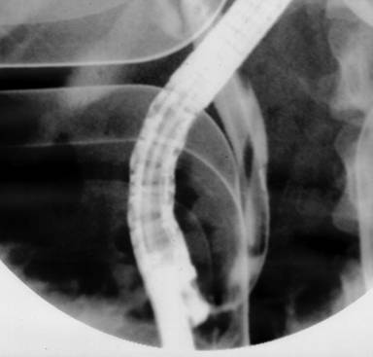
Tropical Medicine Rounds

Slide 38
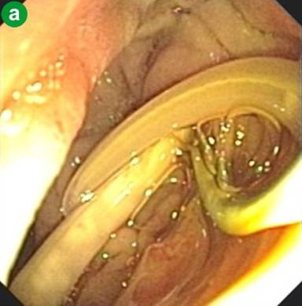
Tropical Medicine Rounds

Slide 39
Table 1. Ascaris lumbricoides-induced surgical complications at the University of Antioquia, Medellin, Colombia, 1963 - 1988
Complication | Number of patients
Intestinal obstruction (total) | 107
Simple obstruction | 34
Volvulus | 18
Volvulus with gangrene and perforation | 48
Intussusception | 7
Extraintestinal migration (total) | 28
Migration to biliary tree | 19
Migration to peritoneal cavity | 9
Appendicitis | 10
Tropical Medicine Rounds

Slide 40
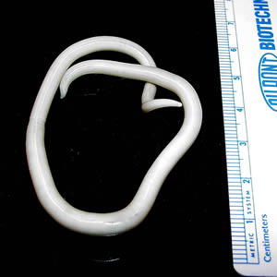
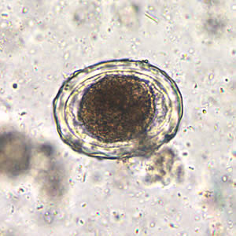
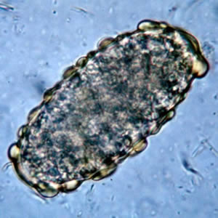
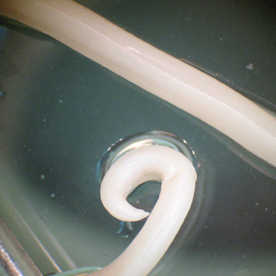
Tropical Medicine Rounds

Slide 41
Treatment
Mebendazole
  100mg bid x 3/7
Albendazole
  400mg x1
WHO allows treatment in 2nd and 3rd trimesters
Tropical Medicine Rounds

Slide 42
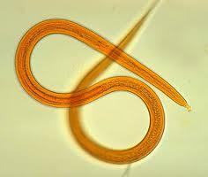
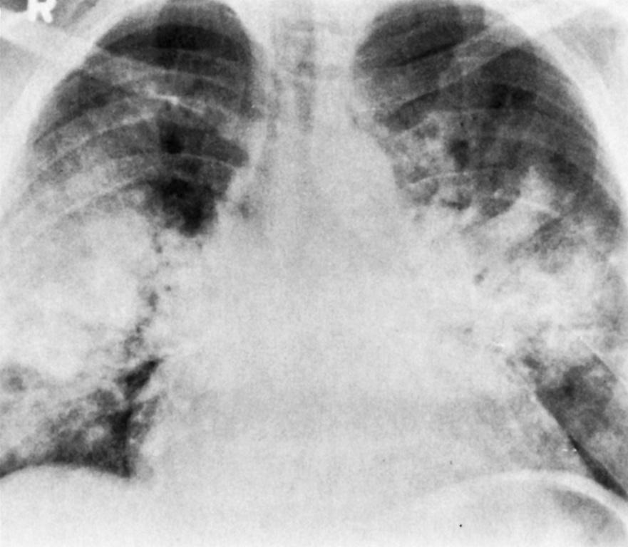
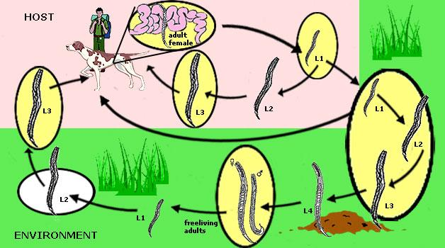
Strongyloides
Epidemiology: human, free living in soil
Modes of Transmission: autoinfection, soil to human
Clinical Syndromes: asymtomatic, vague abdominal pain, larva currans, Loffler’s syndrome, hyperinfection syndromes
Treatment: ivermectin, albendazole

Slide 43
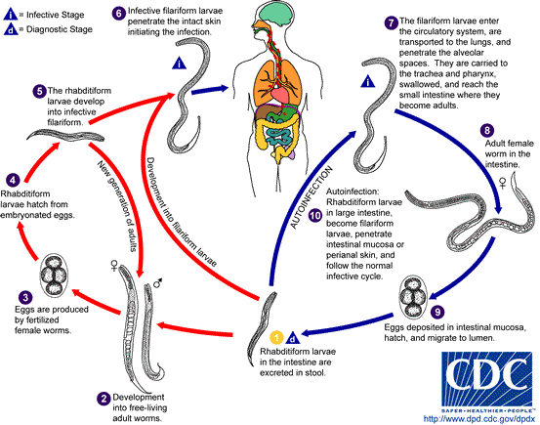
Life Cycle Strongyloides

Slide 44
Which person is least likely to harbor Strongyloides?
A 5 month old child living in Manila
A Vietnam veteran who hasn’t been outside of Arizona in 50 years.
A rice farmer in the Philippines
A 60 year old man who recently immigrated from Haiti

Slide 45
Where would you usually find larva currens?
Eyes
Feet
Buttocks
Liver
Intestine

Slide 46
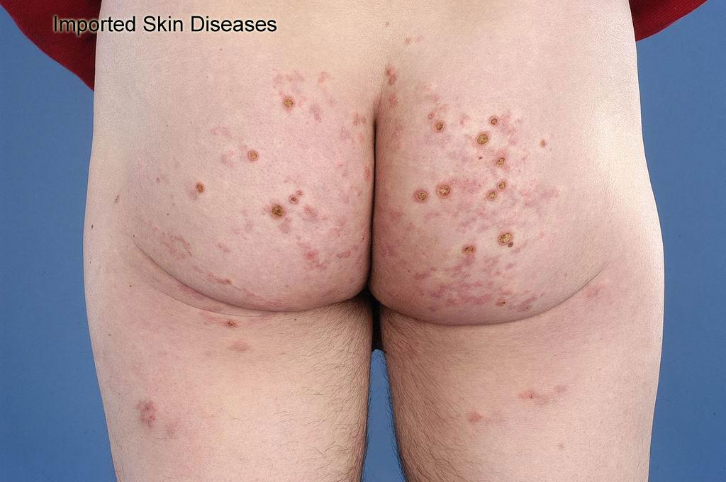

Slide 47
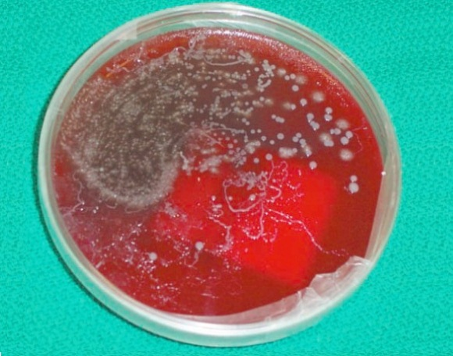
Diagnosis
Stool O&P (unreliable)
Serology
Direct visualization of worms in sputum / tissue

Slide 48
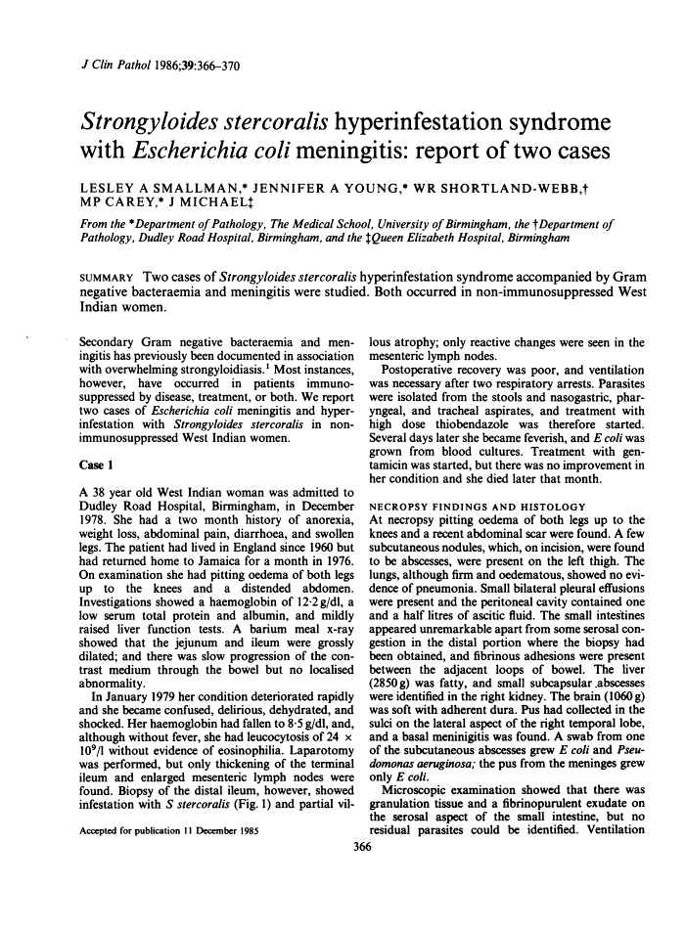

Slide 49
Strongyloides (simple) treatment
Ivermectin 200mcg/kg x 2 doses
Albendazole (less effective)

