Slide 1

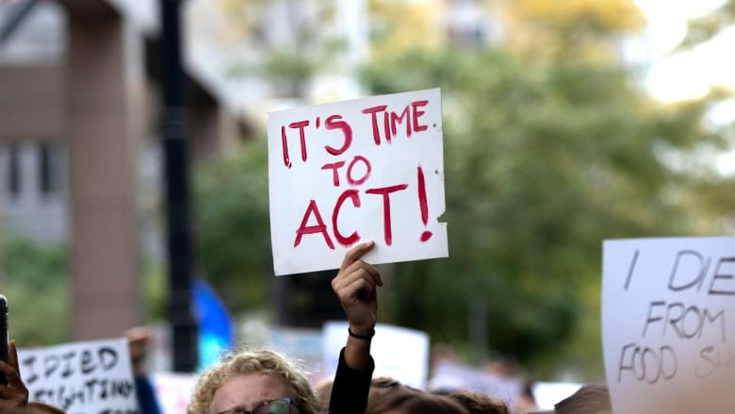
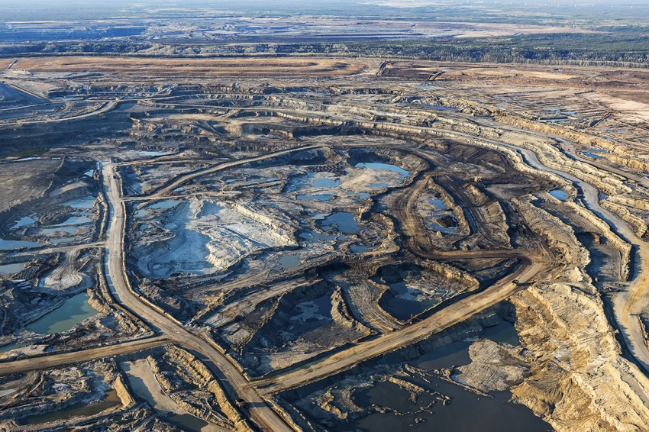
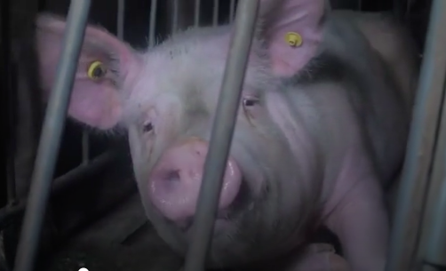
Immigration screening
UBC Tropical medicine rounds
Jan Hajek
Sept 27, 2019
Global Climate Strike
1pm – Vancouver City Hall

Slide 2
Immigration screening
Overview of the numbers and trends of immigrants and refugees
Overview of the Canadian IME
  Difference between legal entry requirements – and those for clinical benefit
TB, HIV, Hepatitis and Strongyloides
Lots of cases to think about….
  Melilla Spain – border fence
  Nell Toussaint case
  VISAs and Ebola 2014
Notes:
Globalism - Is there increasing freedom of mobility for capital/commodities and less for people?

Slide 3
Part of the complete history for every patient
Where were you born?
Have you lived in any countries other than Canada?
Have you travelled anywhere over the last year?

Slide 4
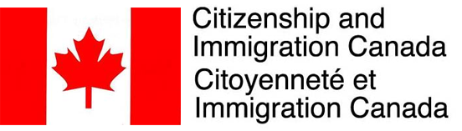
Immigration screening
My background
2009
  Senior medical policy advisor for Citizenship and Immigration Canada
  Recent case of MDR-TB in a new immigrant
    Had completed standard 6-months of TB treatment before immigration
  CIC was motivated to better address TB and infections
  My proposal was to address upstream factors and increase support for TB screening and treatment in medical facilities overseas
  Interesting work
  Challenging political climate

Slide 5
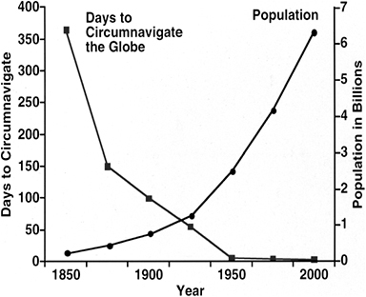
What has changed?
Speed of migration
Number of migrants
  250 million international migrants

Slide 6
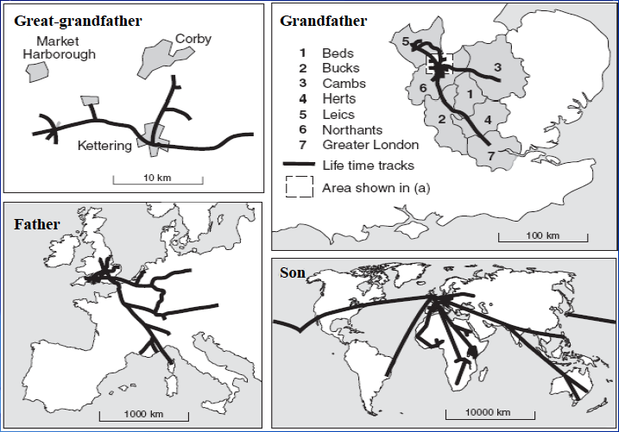
Slide from Dr. Martin Cetron

Slide 7
Immigration
Numbers - Global estimates
250 million international migrants (3% of global population)
  25 million are refugees (10% of all international migrants)
780 million people are internal migrants
  44 million have been forcibly displaced (IDPs)
IOM, 2018

Slide 8
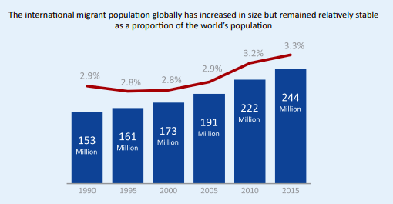
Immigration trends
IOM, 2018
Notes:
Of the roughly 2 million first-instance applications for asylum lodged in 2016, Germany remained the top recipient, with over 720,000 applications, followed by the United States (262,000) and Italy (123,000).

Slide 9
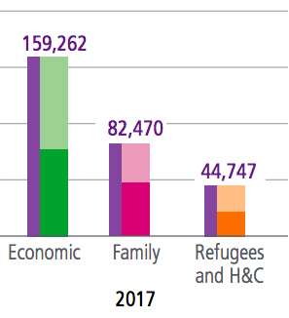
Categories of immigrants to Canada
Permanent resident
  Family class 26%
  Economic class 53%
  Refugee and protected persons
Temporary resident
  Visitor
  Student
  Temporary foreign worker
  Live-in caregiver
Notes:
In Canada there are four categories of immigrants: family class (closely related persons of Canadian residents living in Canada), economic immigrants (skilled workers and business people), other (people accepted as immigrants for humanitarian or compassionate reasons) and refugees (people who are escaping persecution, torture or cruel and unusual punishment). According to the 2001 census by Statistics Canada, Canada has 33 ethnic groups with at least one hundred thousand members each, of which 10 have over 1,000,000 people and numerous others represented in smaller amounts. 16.2% of the population belonged to visible minorities.
Refugee – a person who is forced to flee from persecution and is located outside of their home country.
Convention refugee – a person who meets the refugee definition in the 1951 Geneva Convention relating to the Status of Refugees. This definition is used in Canadian law and is widely accepted internationally. To meet the definition, a person must be outside their country of origin and have a well-founded fear of being persecuted for reasons of race, religion, nationality, membership of a particular social group or political opinion.
Refugee claimant or Asylum Seeker – a person who has fled their country and is asking for protection in another country. We don’t know whether a claimant is a refugee or not until their case has been decided.
'Claimant’ is the term used in Canadian law.
Resettled refugee – a person who has fled their country, is temporarily in a second country and then is offered a permanent home in a third country. Refugees resettled to Canada are selected abroad and become permanent residents as soon as they arrive in Canada.
Resettled refugees are determined to be refugees by the Canadian government before they arrive in Canada. Refugee claimants receive a decision on whether they are refugees after they arrive in Canada.
Protected person – according to Canada’s Immigration and Refugee Protection Act, a person who has been determined to be either (a) a Convention Refugee or (b) a person in need of protection (including, for example, a person who is in danger of being tortured if deported from Canada).
Internally displaced person – a person who is forced to leave their home, but who is still within the borders of their home country.
Stateless person – a person that no state recognizes as a citizen. Some refugees may be stateless but not all are. Similarly, not all stateless people are refugees.
You may also hear… Political refugee, Economic refugee, Environmental refugee – these terms have no meaning in law. They can be confusing because they incorrectly suggest that there are different categories of refugees.
WHAT IS THE DIFFERENCE BETWEEN A REFUGEE AND AN IMMIGRANT?A refugee is forced to flee for their lives. An immigrant chooses to move to another country.
TERMS FOR IMMIGRANTS
Immigrant – a person who has settled permanently in another country.
Permanent resident – a person granted the right to live permanently in Canada. The person may have come to Canada as an immigrant or as a refugee. Permanent residents who become Canadian citizens are no longer permanent residents.
OTHER TERMS FOR PEOPLE OUTSIDE THEIR HOME COUNTRY
Temporary resident – a person who has permission to remain in Canada only for a limited period of time. Visitors and students are temporary residents, and so are temporary foreign workers such as agricultural workers and live-in caregivers.
Migrant – a person who is outside their country of origin. Sometimes this term is used to talk about everyone outside their country of birth, including people who have been Canadian citizens for decades. More often, it is used for people currently on the move or people with temporary status or no status at all in the country where they live.
Economic migrant – a person who moves countries for a job or a better economic future. The term is correctly used for people whose motivations are entirely economic. Migrants’ motivations are often complex and may not be immediately clear, so it is dangerous to apply the “economic” label too quickly to an individual or group of migrants.
Person without status – a person who has not been granted permission to stay in the country, or who has stayed after their visa has expired. The term can cover a person who falls between the cracks of the system, such as a refugee claimant who is refused refugee status but not removed from Canada because of a situation of generalized risk in the country of origin.
You may also hear... Illegal migrant/illegal immigrant/Illegal – these terms are problematic because they criminalize the person, rather than the act of entering or remaining irregularly in a country. International law recognizes refugees may need to enter a country without official documents or authorization. It would be misleading to describe them as “illegal migrants”. Similarly, a person without status may have been coerced by traffickers: such a person should be recognized as a victim of crime, not treated as a wrong-doer.

Slide 10
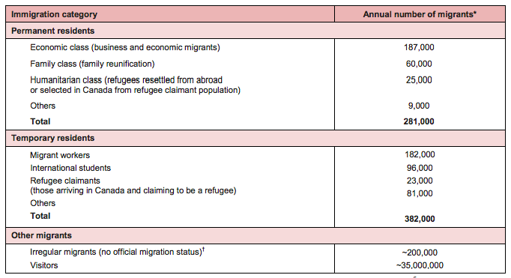
Categories of immigrants to Canada
Canadian TB standards, numbers from 2010

Slide 11
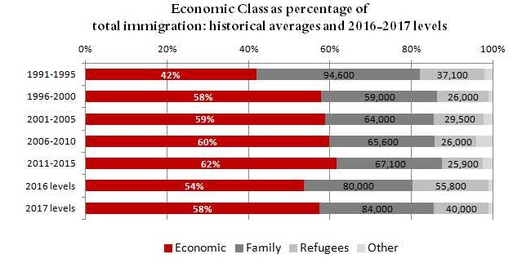
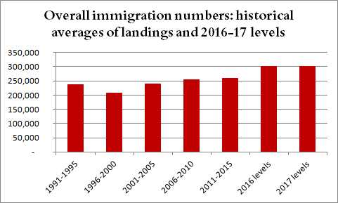
Immigration levels in Canada
http://ccrweb.ca/en/2017-immigration-levels-comments

Slide 12
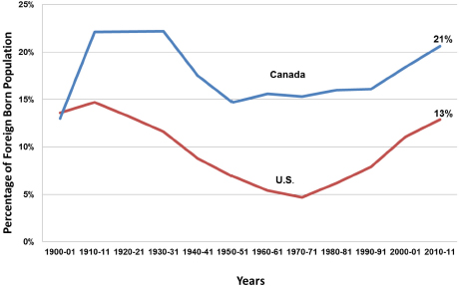

Slide 13
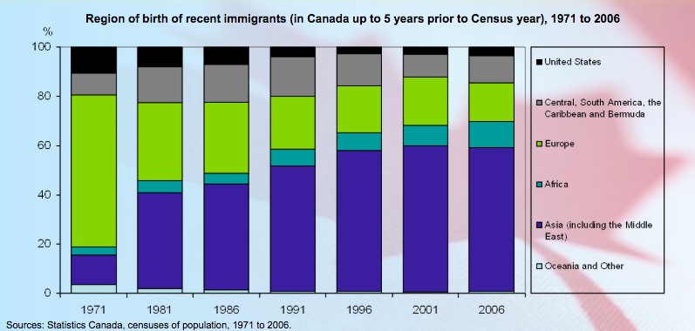

Slide 14
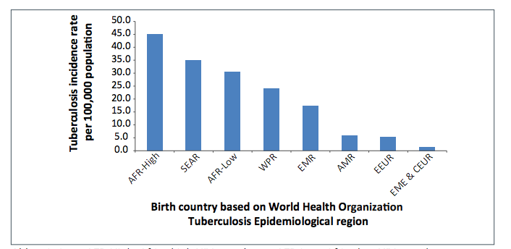
Rate of TB following immigration reflects the rate of TB in country of origin

Slide 15
TB trends in Canada
65% of all cases occur among foreign born
65%

Slide 16
TB trends in Canada
Incidence is declining, except among Aboriginal

Slide 17
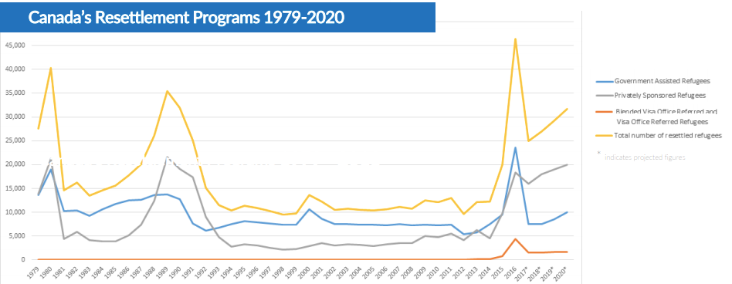
How many refugees does Canada accept?
In 2018:
  28,000
1.4 million that still need to be resettled
Notes:
The UNHCR's annual global trends report shows Canada took in 28,100 of the 92,400 refugees who were resettled in 25 countries during 2018; the United States was second with 22,900.
About 1.4 million refugees were in need of resettlement in 2018, but only 92,400 were resettled.

Slide 18
Refugees
What is a refugee?
How many refugees are there in the world?
What percent of refugees are accepted for resettlement each year?

Slide 19

Refugees
True or False?
Refugees have to repay the cost of their travel/flights to Canada.

Slide 20
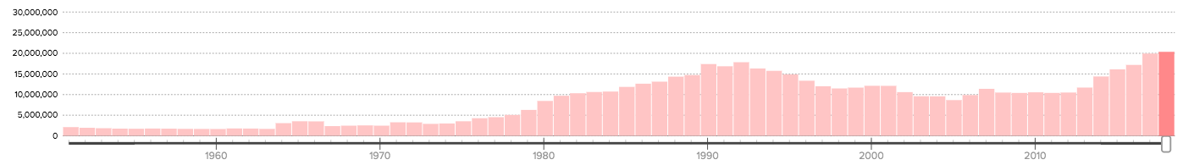
Numbers of refugees
“The alleged increase in migration and forced displacement tells us more about the moral panic on migration than the reality,”
- Nando Sigona, Nature 2017
UNHCR estimates :
  2018 20.3 million refugees
  1990 17.4 million refugees
UNHCR
Notes:
21.3 million refugees in 2015; that is only slightly higher than the 1992 figure of 20.6 million, when the global population was just two-thirds of today’s
“The alleged increase in migration and forced displacement tells us more about the moral panic on migration than the reality,” says Nando Sigona, a social scientist at the University of Birmingham, UK.

Slide 21
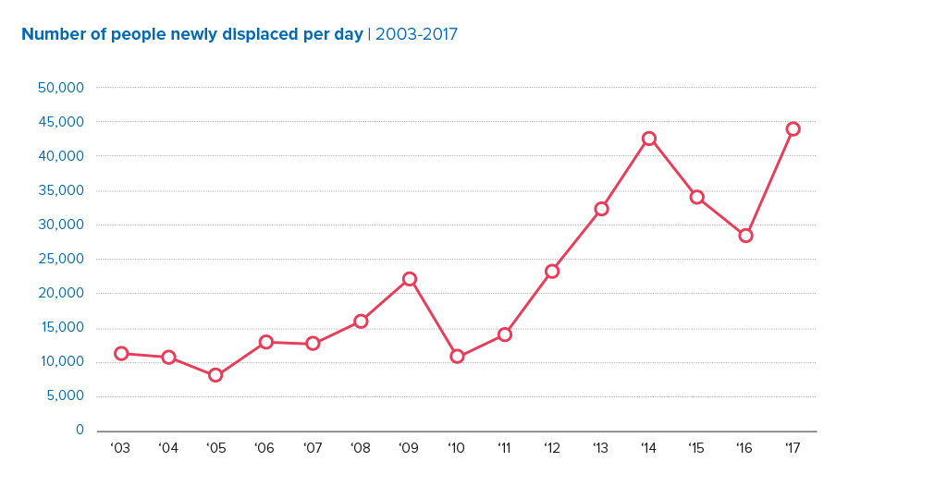
Increase in IDPs
harder to track than number of UNHCR refugees
UNHCR

Slide 22
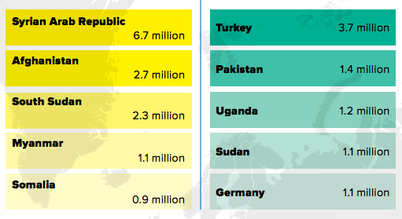
Notes:
"Only 16 per cent of the world's refugees are in developed states," Casasola said.
Turkey hosted the largest number of refugees worldwide, with 3.7 million people in 2018, while Pakistan hosted 1.4 million and Uganda 1.2 million.

Slide 23
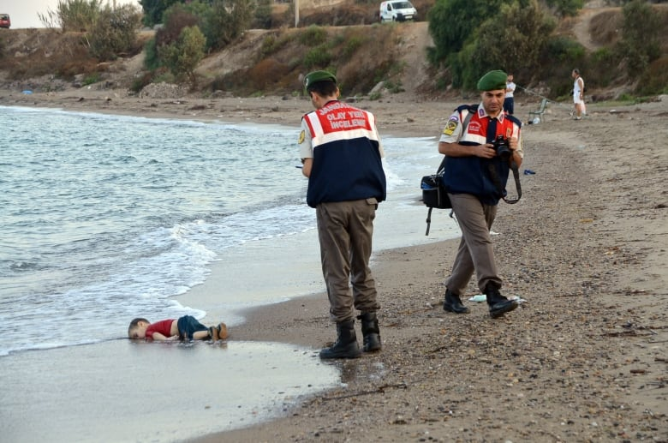
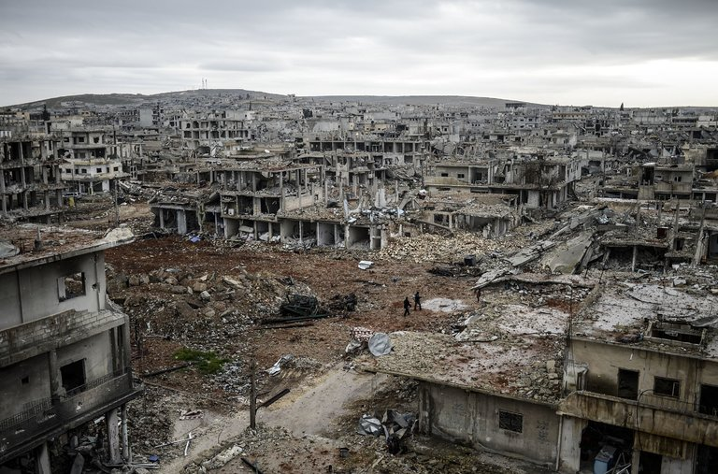
Syria
Alan Kurdi
Notes:
Alan Kurdi drowned along with his five-year-old brother, Galib, and their mother, Reham, as their family attempted to cross the Aegean Sea from Turkey to Greece in an inflatable boat.
The grieving father said he paid smugglers 4,000 euros for the deadly voyage — the money his sister sent to him from Canada.

Slide 24
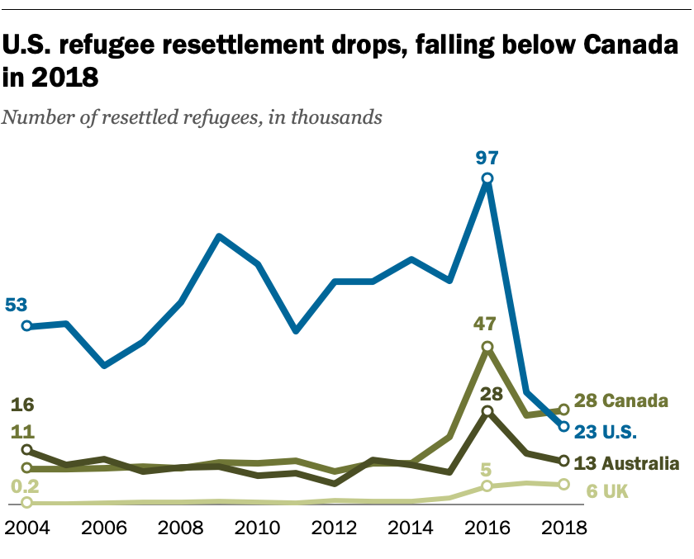
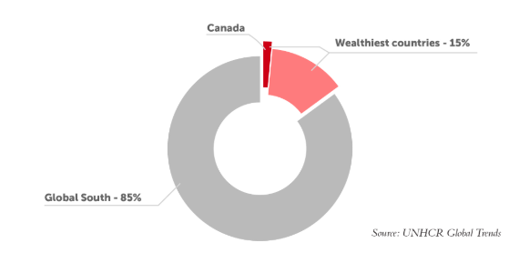
Notes:
https://www.pewresearch.org/fact-tank/2019/06/19/canada-now-leads-the-world-in-refugee-resettlement-surpassing-the-u-s/

Slide 25
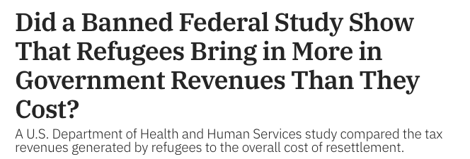
Net fiscal impact of accepting refugees over a 10 year period (2005 – 2014)
- $64 billion net gain
- Refugees paid more in taxes than they consumed in financial assistance
DHSS internal report 2017
Leaked to NY times…
https://www.nytimes.com/2017/09/18/us/politics/refugees-revenue-cost-report-trump.html
Notes:
The internal study, which was completed in late July but never publicly released, found that refugees “contributed an estimated $269.1 billion in revenues to all levels of government” between 2005 and 2014 through the payment of federal, state and local taxes. “Overall, this report estimated that the net fiscal impact of refugees was positive over the 10-year period, at $63 billion.”

Slide 26
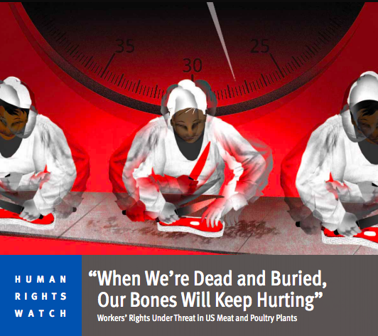
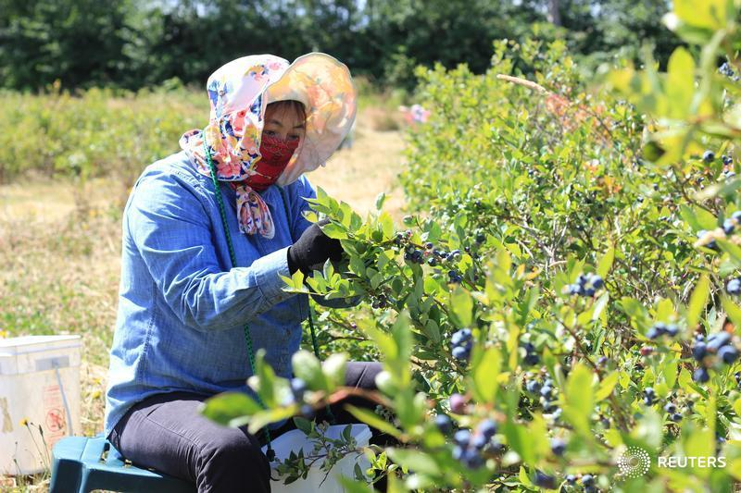
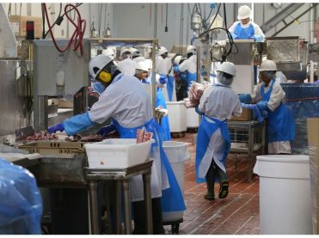
Temporary foreign worker program
“We just can’t find enough Canadians to do the job”
  Slaughterhouse, mushroom pickers
Notes:
said Morreale, whose company has 950 employees, including 70 temporary foreign workers.
“The industry is such that we have difficulties attracting and retaining individuals,” said Morreale. “We have temporary foreign workers, but these are year-round jobs and we want them to stay permanently.”
Mushroom pickers
Slaughterhouse
The industry, mostly unionized, has the same pay scale for both foreign and Canadian workers, who earn between $14 and $18 an hour.
the Harper government raised the application fee employers have to pay for migrant workers from $200 to $1,000
To make the situation worse, the Liberal government changed the immigration selection system and made it more difficult for butchers to become permanent residents.
Under the old system, butchers could qualify as long as they had a job offer in Canada and possessed minimum proficiency in English or French. Now, the job offer doesn’t give them an edge.
Turnover rate around 25%

Slide 27
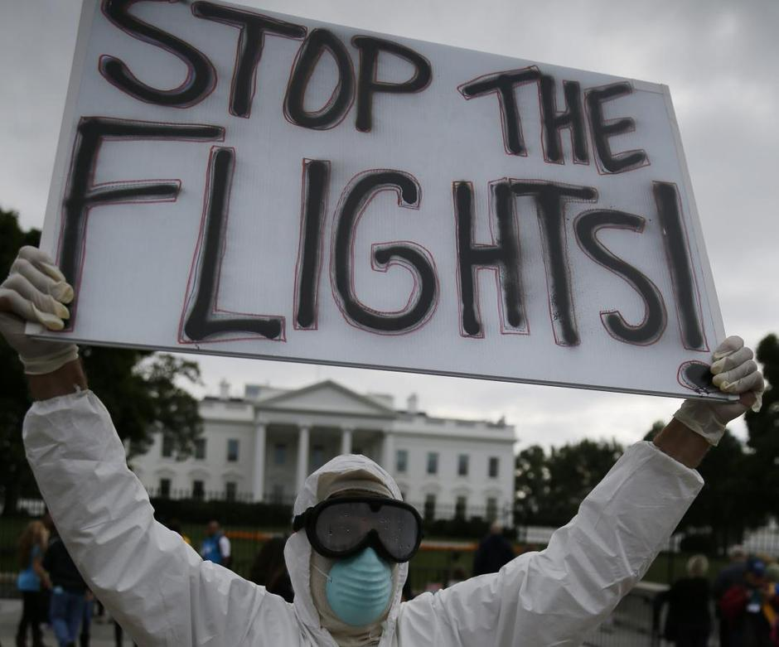
Ebola – should VISAs and immigration from affected countries be temporarily stopped?
Notes:
China took several months to admit it was in the grips of an outbreak of a deadly new disease in 2003, in the process unleashing that disease — SARS — on the world.
8,422 people in a number of different countries contracted SARS
916 died — 44 of them in Canada.
Canada worked to revise the IHR after SARS because of travel warnings against Toronto – cost tourism industry $2 billion
The federal government announced Friday it would not issue new travel visas for residents or citizens of countries with widespread and persistent Ebola transmission. As well, it has put a halt on the processing of permanent residency visas for people from those countries.
Canada’s move contravenes the International Health Regulations which stipulate that in infectious disease outbreaks, countries should not impose trade or travel sanctions against affected countries beyond what the WHO has recommended.
Under that treaty, countries which take measures that are stronger than those approved by the WHO must present the global health agency with the scientific and public health rationale for their actions.
Canada's move contravenes the International Health Regulations which stipulate that in infectious disease outbreaks, countries should not impose trade or travel sanctions against affected countries beyond what the WHO has recommended.

Slide 28

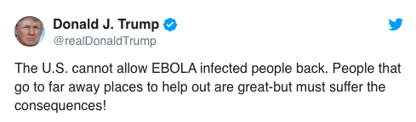
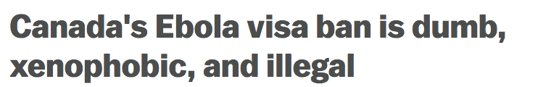
Ebola – should VISAs and immigration from affected countries be temporarily stopped?
2003 – Lastman…
  International Health Regulations
    in infectious disease outbreaks, countries cannot impose trade or travel sanctions against affected countries beyond which the WHO has recommended and are evidence-based
2014 - Harper..
Notes:
China took several months to admit it was in the grips of an outbreak of a deadly new disease in 2003, in the process unleashing that disease — SARS — on the world.
8,422 people in a number of different countries contracted SARS
916 died — 44 of them in Canada.
Canada worked to revise the IHR after SARS because of travel warnings against Toronto – cost tourism industry $2 billion
The federal government announced Friday it would not issue new travel visas for residents or citizens of countries with widespread and persistent Ebola transmission. As well, it has put a halt on the processing of permanent residency visas for people from those countries.
Canada’s move contravenes the International Health Regulations which stipulate that in infectious disease outbreaks, countries should not impose trade or travel sanctions against affected countries beyond what the WHO has recommended.
Under that treaty, countries which take measures that are stronger than those approved by the WHO must present the global health agency with the scientific and public health rationale for their actions.
Canada's move contravenes the International Health Regulations which stipulate that in infectious disease outbreaks, countries should not impose trade or travel sanctions against affected countries beyond what the WHO has recommended.

Slide 29
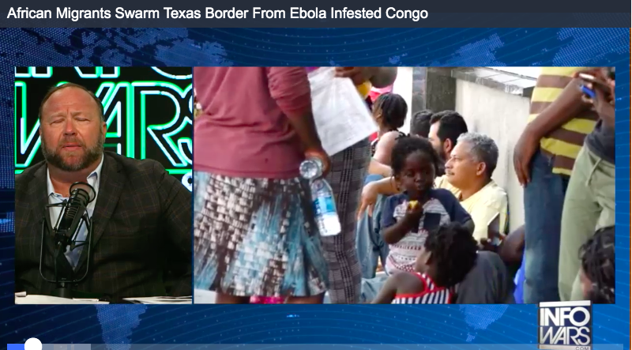
lingula
August 2019

Slide 30

Expat or Immigrant
Notes:
Africans are immigrants. Arabs are immigrants. Asians are immigrants. However, Europeans are expats because they can’t be at the same level as other ethnicities. They are superior. Immigrants is a term set aside for ‘inferior races’.

Slide 31
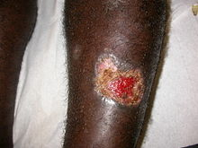
Leish case…
33M with 10 month history of ulcers on left leg and arm
Born in Somalia
Photo- Wikipedia
Case presented by Dr. Patrica Walker

Slide 32
Leish case…
33M with 10 month history of ulcers on left leg and arm
Born in Somalia
  Mogadishu → Nairobi → Sao Paulo, Brazil
  Overland to US
  Diagnosed with cutaneous leishmaniasis
  Lost to follow-up → crossed to Canada….
Photo- Wikipedia
Case presented by Dr. Patrica Walker

Slide 33
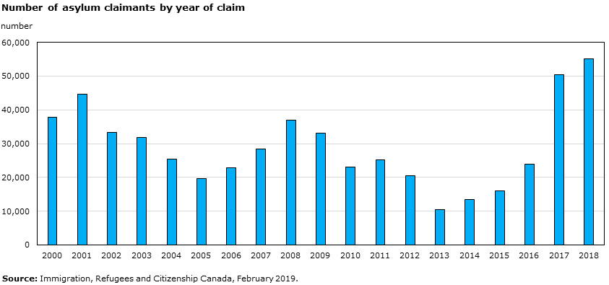
Notes:
https://www150.statcan.gc.ca/n1/pub/89-28-0001/2018001/article/00013-eng.htm
In 2017, the total number of asylum claims received in Canada more than doubled, from approximately 24,000 claims in 2016 to over 50,000 in 2017.
Approximately 40% of all asylum claimants were irregular migrants who crossed between ports of entry along the Canada-U.S. border. Maintaining border integrity and ensuring public safety and security continue to be key guiding principles for the Government of Canada

Slide 34
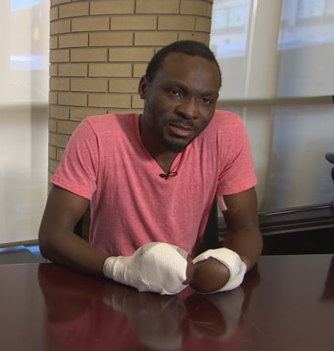
Safe third country
agreement STCA
Introduced in 2004
Cannot claim asylum in Canada if already in the US
If a migrant crosses at a regular border crossing → turned back
If a migrant crosses at an irregular border crossing → refugee claim heard
Seidu had his asylum claims rejected in the U.S. before coming to Canada.
2015 crossed irregularly into Manitoba in the winter to claim asylum in Canada.
2018 granted asylum

Slide 35
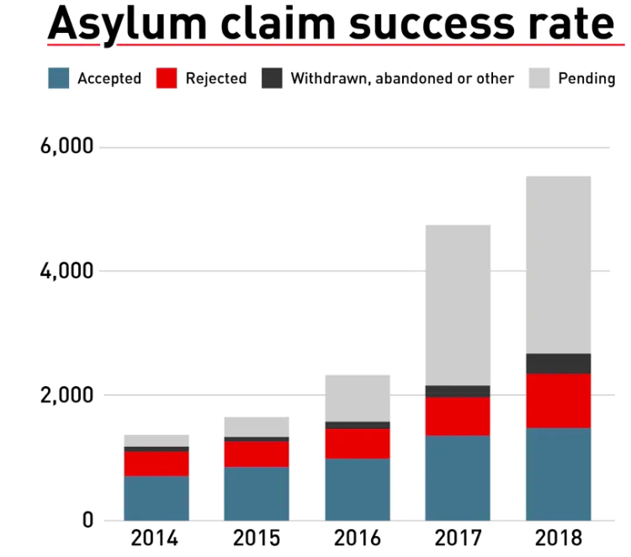
Notes:
https://www.cbc.ca/news/refugees-asylum-seekers-canada-1.5210093

Slide 36
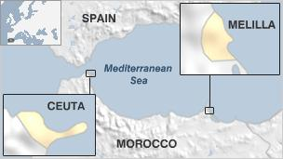
Migration to Spain
Melilla and Ceuta…
Notes:
Refugees, are by definition forcefully displaced, are at highest risk for past exposure to harmful living conditions, violence and trauma.
Refugees undergo medical screening before admission to Canada but are protected by law from exclusion on the basis of noninfectious burden of illness (through the Immigration and Refugee Protection Act).
The health risks of refugees vary greatly depending on exposures and access to care.
Specifically, refugees, low-income immigrants, and immigrants with limited English-language proficiency are at risk for a rapid decline in self reported health after arrival

Slide 37
Canadian Immigration Screening
Starting with a case…
M.T. 34F from South Africa
Immigrated with her husband – Economic class
Developed a persistent cough
What next?

Slide 38
Canadian Immigration Screening
Starting with a case…
M.T. 34F from South Africa
Immigrated with her husband – Economic class
Developed a persistent cough
What next? Was she screened for TB?
- Normal CXR 8 months before travel
Does she have health coverage?
- No - waiting period for 2-3 months after arrival

Slide 39
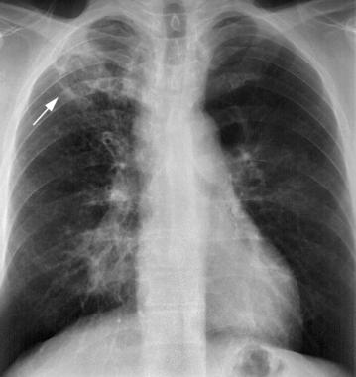
Canadian Immigration Screening
Starting with a case…
M.T. 34F from South Africa
Immigrated with her husband – Economic class
Developed a persistent cough
What next? Was she screened for TB?
- Normal CXR 8 months before travel
Does she have health coverage?
- No - waiting period for 2-3 months after arrival
Sputum – AFB POS MDR-TB

Slide 40
Screening for TB as part of the IME (Immigration medical exam)
Guided by federal legislation (IRPA)
Screening for health grounds for exclusion:
  Is likely to be a danger to public health (communicable disease)
  Is likely to be a danger to public safety (unpredictable or violent behaviour)
  Might reasonably be expected to cause excessive demand on health or social services
  The results of the IME are the property of the Canadian government, and only certain results (e.g., HIV testing) are communicated to settlement workers and public health officials in Canada.

Slide 41
Excessive demand
Inadmissible if health care costs were more than the average Canadian
  $6,400 per year
  Included special education or support services for persons with disability
Only applies to Economic class (Family class and Refugees exempt)
April 2018
  3x increased cost for excessive demands → $20,000
  Removed reference to special education or support services
Currently 0.3% of all applicants are found medically inadmissible
  Expected that now <0.1% will be medically inadmissible
Notes:
The department no longer assesses your need for special education services, social and vocational rehabilitation services, and personal support services as part of the excessive demand decision. The department also does not assess your dependants’ need for these services.

Slide 42
Health criteria for exclusion
United States
Applicants are inadmissible if they are determined:
  to have a communicable disease of public health significance;
  to have a history of a physical or mental disorder associated with behavior which could pose a threat to the property, safety, or welfare of the applicant or others;
  to be a drug abuser or addict
US CDC
Notes:
TB, syphilis, Hansen’s, gonorrhea, then outbreaks - like VHF

Slide 43
Which communicable diseases are specifically tested for in the Canadian IME?

Slide 44
Which communicable diseases are specifically tested for in the IME?
TB
Syphilis
HIV

Slide 45
Who needs an IME?

Slide 46
Who needs an IME?
Permanent resident applicants
Temporary resident (visitor) applicants if:
  Applying for < 6 months and
    Work in a job in which public health must be protected (e.g., hospital, caregiver)
    Agricultural worker from country with > 20/1000,000 TB cases per year
  Applying for > 6 months and
    From a country with >20/100,000 TB cases per year
    So, visitor applying for > 6 month VISA to Canada
      From Germany – no IME or HIV test
      From Brazil – needs IME and HIV test → ? admissible

Slide 47
Components of the IME
History and physical exam
Urinalysis
  ≥ 5 years
TB screening
  ≥ 11 years or positive symptom screen
Syphilis testing
  ≥ 15 years or specific risk factors
HIV testing (2002)
  ≥ 15 years or specific risk factors:
Hepatitis testing (2012)
  Based on risk factors
Stool testing (abandoned in 1981)
Notes:
** substance use (includes sharing, drug snorting, smoking or injection equipment); • high-risk sexual activity or sexual partner with viral hepatitis; • household contact with an infected person especially if personal items (e.g., razors, toothbrushes, nail clippers) are shared; • receiving of unscreened blood products (screening of donated blood products for hepatitis C began in 1990 in Canada); • needle-stick injury or other occupational exposure (e.g., healthcare workers); • children born to mothers with chronic hepatitis B or C infection; • tattoos and body piercing; • history of incarceration; • HIV or other sexually transmitted infection; and • haemodialysis.

Slide 48
TB screening
Canadian guidelines
CXR > 11 years old
    Permanent residents
    Temporary residents > 6 months from higher incidence countries
  If CXR normal → OK
  If CXR abnormal → need to rule-out TB
    Sputum cultures and a repeat CXR in 3 months
    or
    Repeat CXR in 6 months
  If found to have active TB
    Documented completion of TB treatment that meets Canadian guidelines
  If no active TB, but abnormal CXR
    Referred for post-landing immigration surveillance

Slide 49
TB screening
Canada
CXR for:
  Everyone > 11 years of age
  Everyone <11 years of age with a previous history of TB infection/treatment or recent close TB contacts.
IGRA/TST if:
  Close contact with an active TB case within the previous 5 years
    A TB close contact is an individual who has shared the same air space for a prolonged period of time with a person with infectious TB. The exact duration of exposure is traditionally at least 8 hours of cumulative exposure.
  HIV positive serology
  History of cancers originating in the head/neck within the last 5 years
  Chronic renal failure (eGFR of <30 ml/min)
  Solid organ or bone marrow transplant on immunosuppressant therapy.

Slide 50
TB screening overseas
United States
CXR all applicants ≧ 15 years old
          If abnormal sputum AFB
          Sputum culture added in 2007
IGRA 2 - 14 years old living in countries with a TB-incidence rate of ≥ 20 /100,000 population

Slide 51
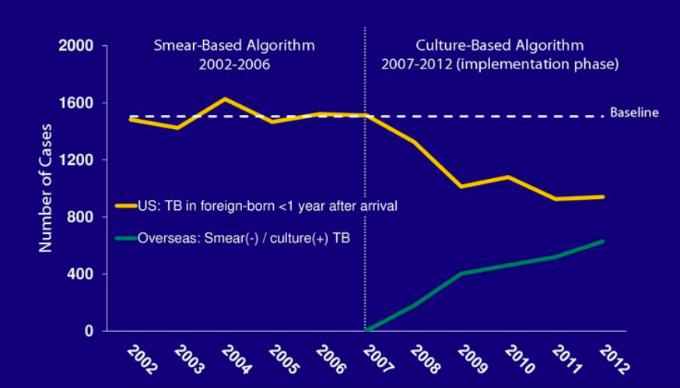
TB screening Overseas (United States)
Added culture to AFB microscopy in 2007
Liu et al. Annals Internal Medicine 2015

Slide 52
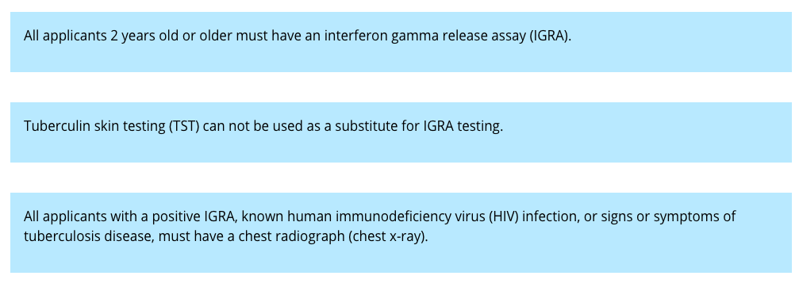
TB screening in the United States
Domestic
IGRA for everyone > 2 years old

Slide 53
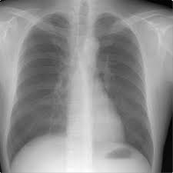
TB screening in Canada
How well does it work?
940,000 immigrants to Ontario underwent IME (2008-2011)
    940 were diagnosed with active TB (100/100,000)
    23,500 (2.5%) were referred for post-landing immigration surveillance
  502 developed active TB within 2 years (50/100,000)
    66% were not referred for PLIS (36/100,000)
    44% were referred for PLIS
      60% of whom complied with PLIS (760/100,00)
      40% did not not comply with PLIS (730/100,00)
3962 cases of TB among immigrants in Ontario (2005 – 11)
  Only 6.7% were referred for PLIS
**Most cases of TB in foreign born in Canada had normal CXR at time of immigration**
Khan et al. CMAJ 2015
Notes:
330,000 immigrants who arrived to Ontario 2008-2011
157 were diagnosed with active TB (47/100,000)

Slide 54
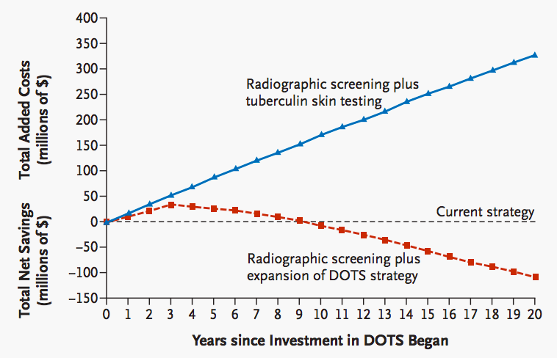
Enlightened self-interest
Investing in TB control efforts overseas is a cost-effectove way to reduce TB rates in the US
NEJM 2005 Sep 8;353(10):1008-20
Notes:
Figure 1. Net Savings or Added Costs of Implementing a Strategy of Radiographic Screening plus Either Expansion of the DOTS Program or Tuberculin Skin Testing over a 20-Year Period among Migrants from Mexico to the United States.
Schwartzman and colleagues⁴ use the tools of decision analysis to argue that, since the majority of new cases of tuberculosis in this country arise among recently infected immigrants, predominantly from Mexico and the Philippines, America's enlightened self-interest would be well served by investing in programs to expand the World Health Organization's directly observed treatment, short course (DOTS), in Mexico and a handful of other countries.

Slide 55
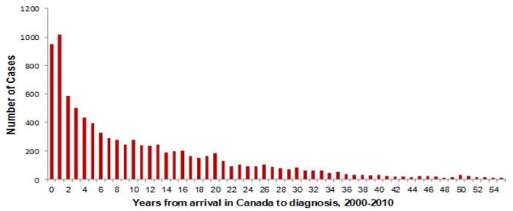
Highest risk of TB occurs shortly after immigration
BUT, new residents must wait at least 2 months before provincial health insurance begins…
https://www2.gov.bc.ca/gov//msp/bc-residents…

Slide 56

Refugee screening
Overseas vs. Domestic
Overseas
Concentrates on screening for the 4 of excludable communicable diseases:
  TB , syphilis, gonorrhea, and Hansen’s disease
Vaccinates
Offers presumptive treatment for parasites
Domestic
More wide ranging screening and health promotion, including addition of:
HIV, HBV, HCV serology
CBC, Urinalysis
Urine for GC and Chlamydia
Children:
  Blood Lead Levels and nutritional assessment
  Prescribe a multivitamin for all

Slide 57
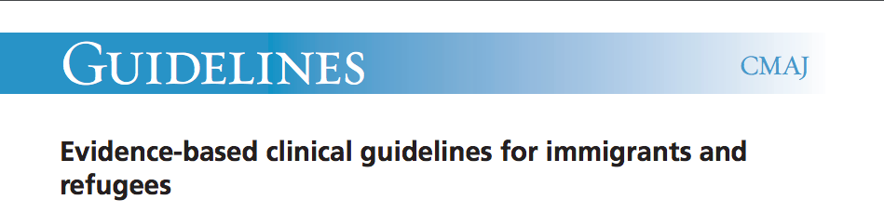
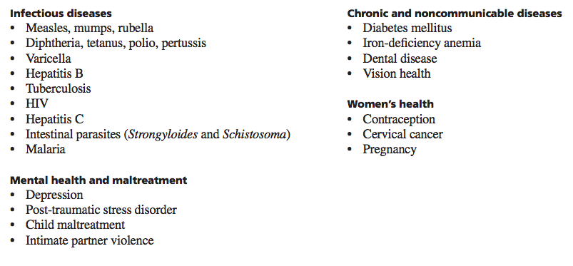
Evidence-based clinical guidelines for immigrants and refugees
Uses EBM to inform immigration screening
CMAJ, September 6, 2011, 183(12)

Slide 58
Evidence-based clinical guidelines for immigrants and refugees
Include recommendations for screening and treatment for LTBI
  TST for select groups:
    Children < 20 years of age from high-incidence countries
    Refugees 20-50 years from high-incidence countries
    Adults with risk factors for progression to active TB
CMAJ, September 6, 2011, 183(12)
Notes:
For several groups, screening for LTBI should be routinely performed, and those with positive results should be offered treatment:
Children from countries with a high incidence of TB
(number needed to treat [NNT] 20–26, number needed to harm [NNH] 134–268)
Adults with risk factors for active tuberculosis
(NNT 3–20, NNH variable)
Refugees < 50 years of age (NNT 15–26, NNH 49).
Screening and treatment for LTBI could also be considered for adult refugees 50–65 years of age (NNT 20–51, NNH 9–18) and other adults without underlying medical conditions < 65 years of age if adherence to treatment can be assured and hepatotoxicity carefully monitored to minimize harms

Slide 59
Required screening…
 | United States | Canada
TB | Yes | Yes
HIV | No Removed 2010 | Yes Introduced 2002
Syphilis | Yes | Yes
Gonorrhea | Introduced in 2016 | Not done
Hansen’s disease | Yes – physical exam | Not specially mentioned
Parasites | Refugees – presumptive treatment | No
Notes:
Chancroid, LGV and granuloma inguinale
Removed in 2016
Not done

Slide 60
HIV
United States
1987 – US designates HIV as a dangerous contagious disease
  Anyone HIV positive in inadmissible to US
Removed in US in 2010
  No longer determined to be grounds for inadmissibility
  Not spread by casual contact, through the air, or from food or water.
  “Is there a significant health risk from casual contact with HIV-infected aliens?”
Canada
Introduced in Canada 2002
  Inadmissible because of excessive demand ($6,000 per year)
  In 2018, excessive demand threshold raised to $20,000 per year
Notes:
In 2010 - Active tuberculosis, infectious syphilis, gonorrhea, infectious leprosy, chancroid, lymphogranuloma venereum, and granuloma inguinale.
In 2016 -- Specifically, this final rule revised the definition of “communicable disease of public health significance” by removing chancroid, granuloma inguinale, and lymphogranuloma venereum as health conditions that prevent entry into the United States;

Slide 61
Stool O&P screening
Removed from the IME in 1981
Before 1981, Canada was the only country in the world that required stool exam for O&P
“The responsibility for diagnosing intestinal parasitic infection rests not with government screening programs but rather with Canadian physicians.”
  Ministry of Health of British Columbia (unpublished, 1981).
Keystone JS. Can Med Assoc J 1981;125:415- 16
Notes:
A Canadian study specifically demonstrated a lack of self-clearance and ongoing local transmission when refugees were tested at 6 months after arrival in Canada without screening or treatment of intestinal parasites.
Effect of screening and treatment on imported intestinal parasite infections: results from a randomized, controlled trial.Gyorkos TW, Frappier-Davignon L, MacLean JD, Viens P
Am J Epidemiol. 1989 Apr; 129(4):753-61.

Slide 62
Screening for Strongyloides
Refugees from SE Asia to Canada
232 SE Asian refugees screened for Strongyloides
    Vietnam, Laos, Indonesia
  77% seropositive
  30% stool positive
 | Stool POSITIVE N= 40 (25%) | Stool NEGATIVE N= 122 (75%)
Serology POSITIVE | 95% | 70%
Serology NEGATIVE | 5% | 30%
Eosiniophilia (<10%) | 30% | 50%
Eosinophilia (>10%) | 70% | 50%
Am J Epidemiol 1990; 132:257-64

Slide 63
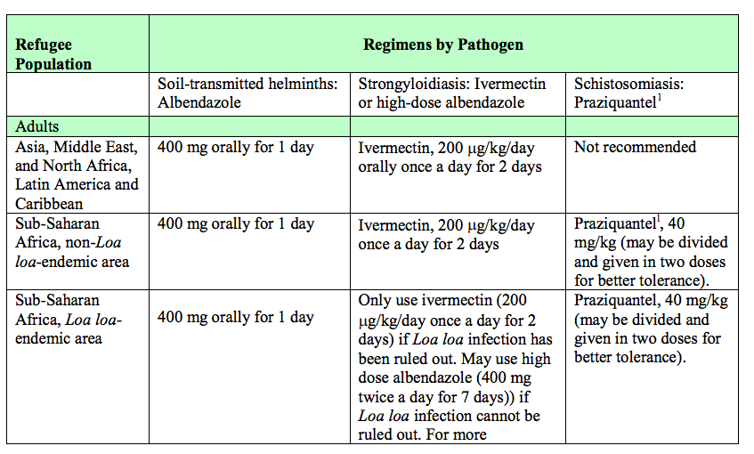
Pre-departure treatment for parasites

Slide 64
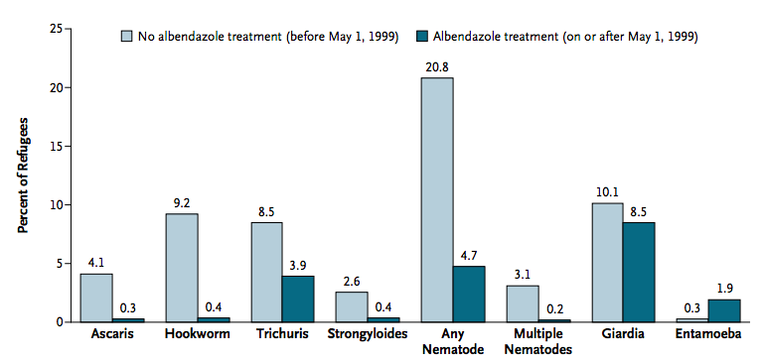
Evaluation of US pre-departure treatment of stool parasites
4,370 untreated refugees
  20.8% had ≥ 1 stool nematode
22,586 albendazole-treated refugees
  4.7% had ≥ 1 stool nematode
Notes:
4,370 untreated refugees
20.8% had ≥ 1 stool nematode
22,586 albendazole-treated refugees
4.7% had ≥ 1 stool nematode
Albendazole-treated refugees had:
Fewer stool positive for nematodes (prevalence ratio, 0.19),
Similar rates of giardia (5% Africa, 17% SE Asia)
2% Schistosomiasis
On the basis of these findings, the CDC has expanded its presumptive therapy recommendations to include treatment with praziquantel and ivermectin in certain refugee populations before departure for the United States

Slide 65
Evidence-based clinical guidelines for immigrants and refugees
Uses EBM to inform immigration screening
CMAJ, September 6, 2011, 183(12)

Slide 66
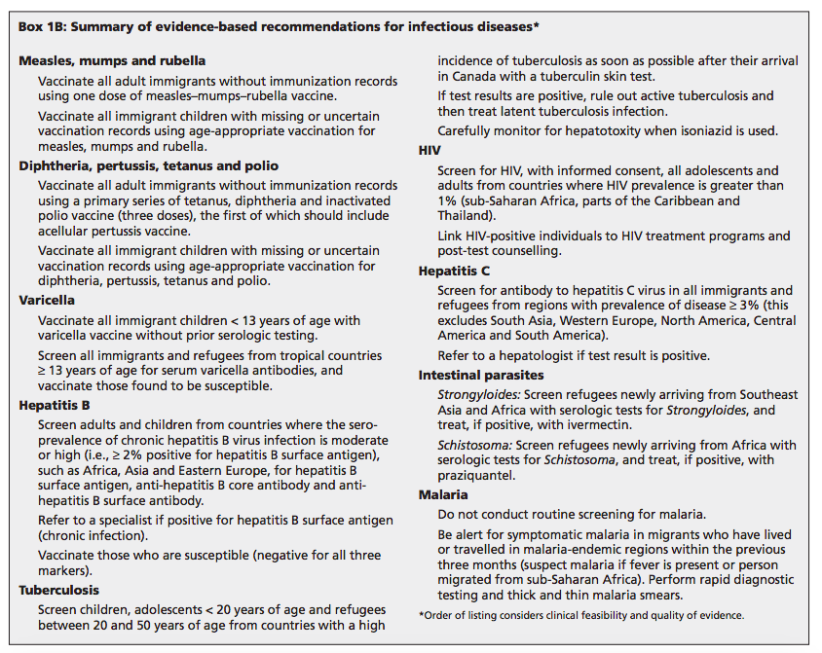

Slide 67
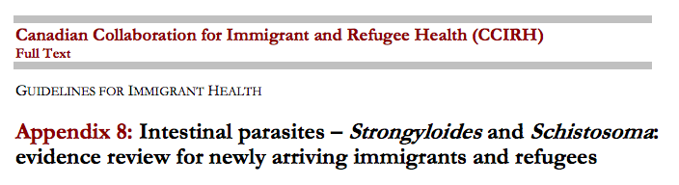
Strongyloidiasis :
  Screen refugees newly arriving from low-income countries in Southeast Asia and Africa with serology for strongyloidiasis
  Treat if positive with ivermectin (first line) or albendazole (if contraindications to ivermectin).
Schistosomiasis:
  Screen refugees newly arriving from Africa with serology for schistosomiasis and treat if positive with praziquantel
CMAJ 2011

Slide 68
Strongyloides screening
High risk of exposure:
  immigrants coming from endemic areas (Africa, Latin America, Asia, and Oceania),
  adopted children who have lived for at least 1 year in highly endemic area,
  expatriates who:
    1) took long trips (more than 1 year) to endemic countries and
    2) had exposure to rural areas.
Individuals with intermediate to low risk of exposure:
  short-term (less than 1 year) travelers to highly endemic areas;
CATMAT 2016

Slide 69
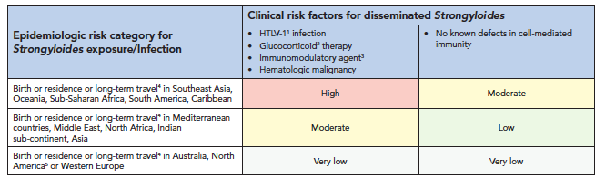
Strongyloides screening
CATMAT 2016

Slide 70
Global prevalence of Strongyloides
Lancet Glob Health. 2019
Strongyloides serology
  Overall 12 %
    Immigrant 12%
    Refugee 12%
  Latin America and Caribean 11%
  Middle East and North Africa 5.5%
Notes:
Seroprevalence was similar when stratified by age and migration class (table 2). Migrants from east Asia and the Pacific (17·3% [95% CI 4·1–37·0]), subSaharan Africa (14·6% [7·1–24·2]), and Latin America and the Caribbean (11·4% [7·8–15·7]) had the highest seroprevalence of strongyloidiasis

Slide 71
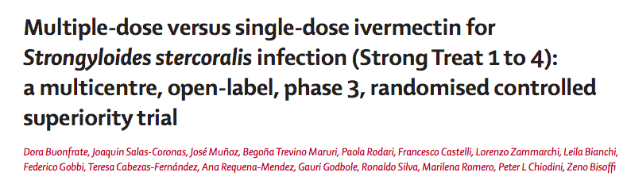
Strongyloides treatment
351 people treated for asymptomatic Strongydloides
Cure at 12 months:
86%. - Single-dose (0.2mg/kg x 1)
85%. - Four-doses (days 0,2 and days 15,16)
Lancet Infectious Diseases Sept 2019

Slide 72
Malaria among refugees and immigrants
August 2000, plane carried 224 refugees from Tanzania → Quebec
  Within 4 weeks 15 cases of malaria (7%)
Introduced screening for 3 groups:
  The remaining 209 refugees already in Quebec
  100 other refugees immediately on arrival
  200 other refugees pre-departure (all empirically treated post-test)
PCR documented 18% positive
  Microscopy 50% sensitive
  RDT 30% sensitive
JCM, June 2004, p. 2694–2700 Vol. 42, No. 6

Slide 73
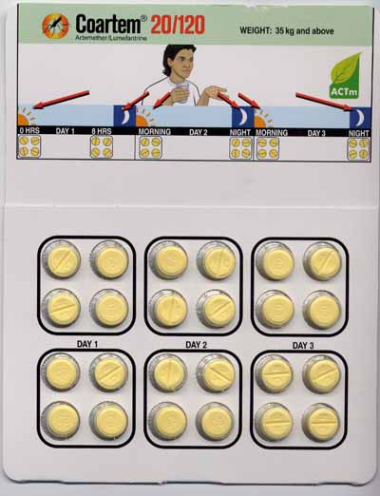
Presumptive treatment for malaria
60% of Liberian refugees, were parasitemic 4 weeks after arrival. (1997-9)
1999 US CDC recommended presumptive therapy for malaria
  All refugees from sub-Saharan Africa
2012 treatment changed from Fansidar (SP) to Coartem (AL)
Canada does not recommend routine screening or pre-departure treatment for malaria
  Rarely provided as part of particular large group refugee movements

Slide 74

Dr. Martin Cetron

Slide 75
Vaccine preventable diseases
Vaccination offered overseas for refugees
Measles, Mumps Rubella Vaccine (MMR)
DTaP
Inactivated Polio Virus (IPV) / Oral Polio (OPV)
Hepatitis B
Haemophilus influenza type B (Hib)
Tdap/TD
Rotavirus
Notes:
https://docs.medaviebc.ca/PDMS/ifhp_pdms_vaccination_manual__en.pdf?mtime=20170501153002

Slide 76

Vaccine preventable diseases

Slide 77


Also offers similar vaccines for refugees
Through the IOM
Recommended – not required

Slide 78
Nell Toussaint
Came to Canada as a visitor from Grenada in 1999
  Found work and stayed after VISA expired.
In 2005 she tried to apply for PR
  Could not afford additional $554 processing fee
  Lost money to dishonest immigration consultant
In 2006 started getting sick
  Developed diabetes and hypertension
  In 2008, she had a ten-day hospital admission for uncontrolled hypertension,
  Denied U/S for leg swelling (DVT) → in 2009 admitted with PE
In 2009
  Free qualified immigration consultant assisted her in filing a PR application on Humanitarian grounds
  While waiting for ruling on PR, qualified for social assistance support → but not healthcare
She went to court
  The Federal Court and the Federal Court of Appeal agreed that her life and long term health had been put at risk
  But they held that the violation of the right to life was justified as a means to promote compliance with immigration law.
  Ruled that Toussaint had suffered “by her own conduct”—by remaining in Canada illegally

Slide 79

Nell Toussaint
In 2018, she went to Human Rights Committee:
  Gov’t is not allowed to deny access to essential health care because of irregular immigration status
    “..required to provide access to existing health care services that are reasonably available and accessible when a lack thereof would expose a person to a reasonably foreseeable risk that can result in death”
    In 2019, the Government of Canada – respectfully disagrees with the ruling….

Slide 80
Immigration screening
Overview of the numbers and trends of immigrants and refugees
Overview of the Canadian IME
  Difference between legal and medical requirements
TB, HIV, Hepatitis and Strongyloides
Things to think about….
  Melilla Spain – border fence
  Nell Toussaint case
  VISAs and Ebola 2014
Notes:
Globalism - Is there increasing freedom of mobility for capital/commodities and less for people?

Slide 81
Other cases….

Slide 82
Aisha
18F, from Grenada, attending college in Toronto in 1999
  3 years ago sponsored by parents to come to Canada → but parents separated, left Canada
  Aisha stayed behind, found part time work, graduated from High School and entered College
  No health insurance
Can Fam Physician. 2012 Jul; 58(7): 725–727.
Notes:
https://www.ncbi.nlm.nih.gov/pmc/articles/PMC3395500/

Slide 83
Aisha
18F, from Grenada, attending college in Toronto in 1999
  3 years ago sponsored by parents to come to Canada → but parents separated, left Canada
  Aisha stayed behind, found part time work, graduated from High School and entered College
  No health insurance
Sickle cell crisis…
  Went to a community health clinic → was unwell and doctor referred her to ER
  Told – only emergency care is free - must pay $350 before being seen
  Sat down and waited outside ER – collapsed – admitted to hospital x 3 days.
  Given $5,000 bill on discharge – had to quit college to pay for the bill
Can Fam Physician. 2012 Jul; 58(7): 725–727.
Notes:
https://www.ncbi.nlm.nih.gov/pmc/articles/PMC3395500/

Slide 84

Live in caregiver
38F from Philipines
2003 - came to Canada in 2003 as a live-in caregiver”,
  grants permanent resident status after 3-year assignment completed
  Husband and kids stayed in Philipines to wait
2006 – had to repeat IME
  Found to have terminal lung cancer
  Denied residdecy
  Appeal also denied – “While I am sympathetic to your situation, I am not satisfied that these circumstances justify granting an exemption”
2012
  LICP changed – no more 2nd medical
Notes:
The 38-year-old came to Canada in 2003 under the federal live-in caregiver program, which grants permanent resident status to domestic workers after they complete their three-year assignments and obtain the necessary medical and criminal-record clearances.

