Slide 1
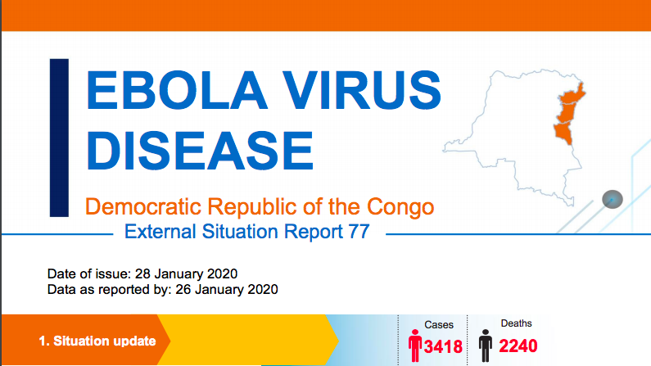
EVD in DRC – 2018-19
UBC Trop Med Rounds
EVD in DRC – Hajek – Jan 31, 2020
Notes:
W africa 28,616 suspected cases and 11,310 deaths
In 2000, Uganda had an outbreak infecting 425 and killing 224; in this case, the Sudan virus was found to be the Ebola species responsible for the outbreak.^{[1]}

Slide 2
Outline
Overview of EVD and the West African outbreak
Context – DRC
Overview of the DRC outbreak
Discussion
"Medicine is a social science, and politics is nothing else but medicine on a large scale”—Rudolf Virchow, 1848
  Responding to outbreak of typhus
  Not just medicines and better hygiene - Virchow called for better employment, higher wages, universal education….
Notes:
Physician, anthropologist, historian Rudolph Carl Virchow’s attempt to control an outbreak of typhus in Upper Silesia and his subsequent 190 page report included the observation that the solution to the outbreak did not lie in individual treatment or small changes in housing, food or clothing provided, but rather in widespread structural changes that directly addressed the issue of poverty. Virchow’s experience in Upper Silesia led to the observation that “Medicine is a social science”. His report led to changes in German public health policy.
Instead of recommending medical changes (i.e., more doctors or hospitals), he outlined a revolutionary program of social reconstruction; including full employment, higher wages, the establishment of agricultural cooperatives, universal education, and the disestablishment of the Catholic Church. This article includes the first English translation of these long-term recommendations. It also locates Virchow's Report within the context of the Medical Reform Movement of 1848 and traces his influence on the subsequent development of social medicine. Parallels are drawn between Virchow's attempts to reform health care and current developments in the political economy of health.

Slide 3
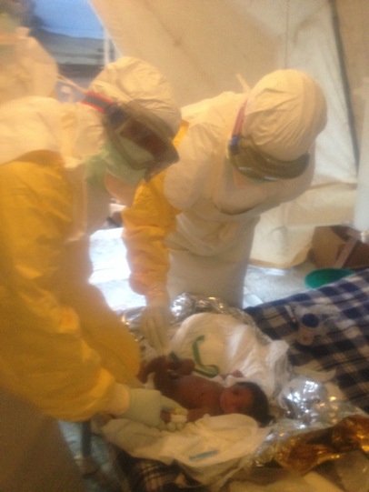
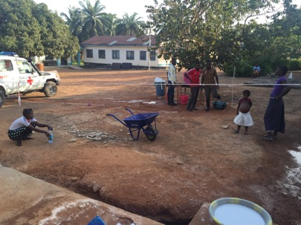
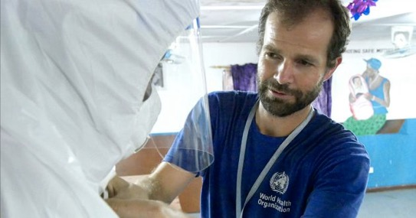
Work in West Africa…
MSF - August 2014
  Clinical care at an ETU in Guckedou, Guinea
WHO – November – January 2015
  Clinical trainer and mentor in Sierra Leone

Slide 4
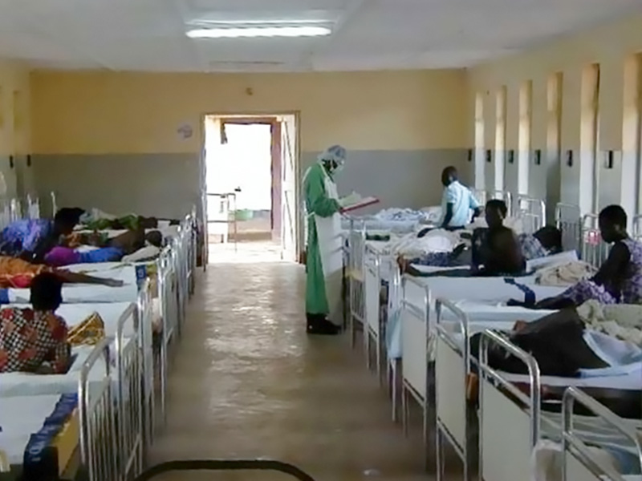
Gulu, Uganda
Ebola outbreak in Gulu, Uganda 2000
  425 cases, 224 deaths
Other smaller outbreaks in Uganda
  Bundibugyo 2007 – 149 cases, 37 deaths
  Kibaale 2012 – 24 cases, 17 deaths . 1
Documentary about the Gulu EVD outbreak, featuring Dr. Bonnie Henry
https://vimeo.com/39885512

Slide 5
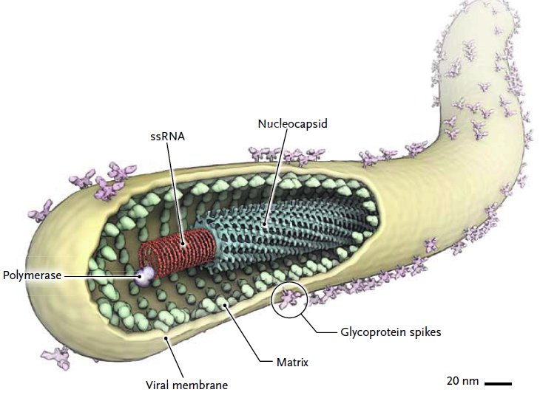
Ebola virus structure
Filamentous virus
Single-strand RNA genome
Enveloped
H Feldmann. DOI: 10.1056/NEJMp1405314,
Notes:
Complex pathogenesis includes virally mediated hepatocellular and renal tubular necrosis and an exuberant host response contributing to disordered coagulation,
increased vascular permeability, and multiorgan dysfunction or failure.

Slide 6
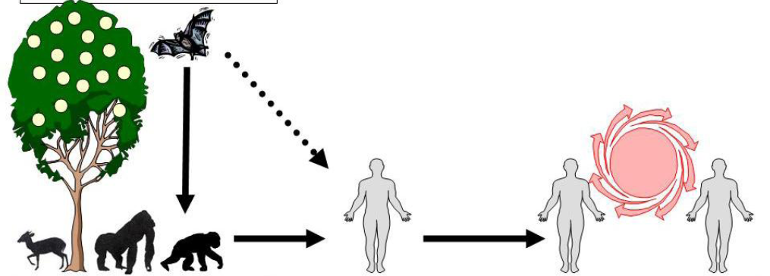
Ebola virus cycle of transmission
Amplification
‘Single pass’ from animal to human
All transmission in Ebola outbreak
P Formenty, World Health Organization, April 2014

Slide 7
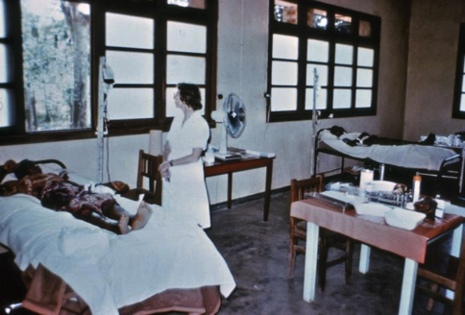
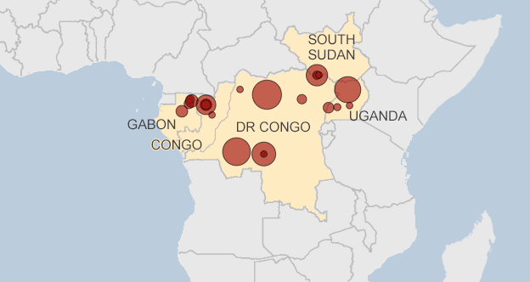

Yambuku; near Ebola river, DRC
First outbreak of Ebola in 1976
1st case 1976 - school headmaster, Yambuku
bought antelope and monkey meat
secondary transmission in hospital
Over 20 outbreaks since 1976
- most small, few cases
- largest 400 cases

Slide 8
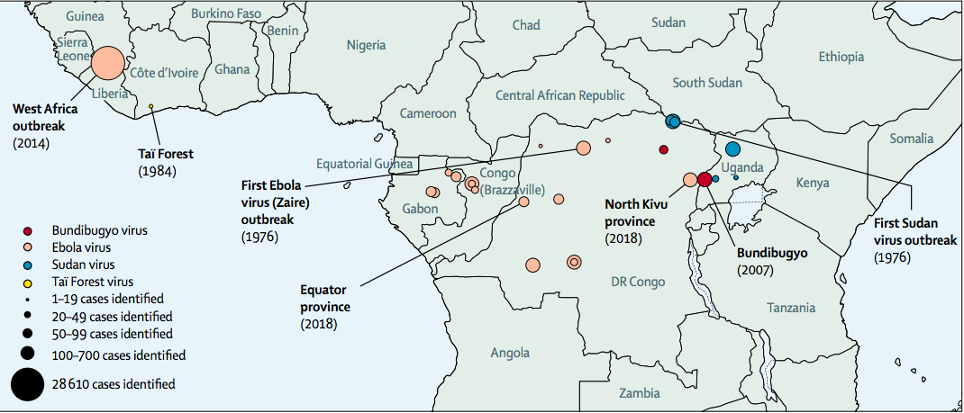
Outbreaks of EVD - Central and Western Africa
Lancet review article – Feb 2019

Slide 9
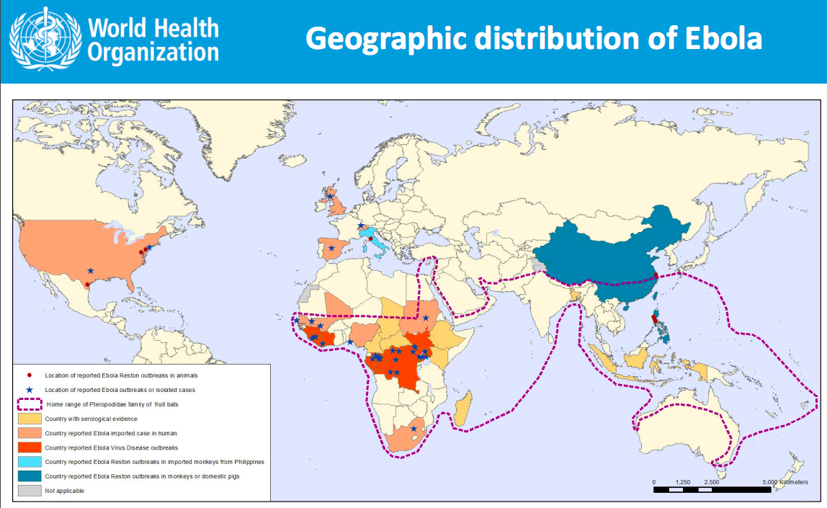

Slide 10
VHF clinical features
Non-specific initially
  Some even lack fever
Hemorrhage in a minority
  VHF → EVD
Not all VHF are spread person-person
Clinical clues:
  Outbreak is going on
  Contact with animals
  Not responding to typical treatments
  Bleeding

Slide 11
Clinical features of EVD
2 – 21 days incubation
  3 – 7 days typical
Starts like malaria:
  Fever, headache, myalgia, sore throat
  N/V/D – can be severe
  Conjunctivitis and uveitis
  Meningoencephalitis
    Hiccups (especially at later stages)
Most people die of multi-organ failure rather than bleeding

Slide 12
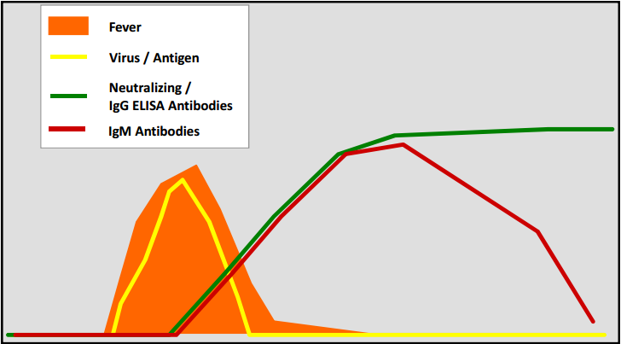
Ebola symptoms and viremia
Severity of symptoms correlates with viremia and infectiousness
PCR may be negative in early phase of illness (first 72 hours)
0
10
20
Days
Adapted from T Ksiazek, CDC
Notes:
The mean time from the onset of symptoms to hospitalization, a measure of the
period of infectiousness in the community, was 5.0 days (Table 2), and was no shorter for
health care workers than for other case patients.
The mean time to death after admission to the hospital was 4.2 days, and the mean time to discharge was 11.8 days.
The mean length of stay in hospital was 6.4 days in Guinea, Liberia, and Sierra Leone (Table 2).

Slide 13
Typical Stages of Illness from EVD
Incubation period is 5-9 days, with a range from 1 to 21 days.
Stage 1
0 – 3 days Nonspecific febrile illness
Stage 2
4 – 10 days Gastrointestinal
Stage 3
10 – 14 days Hypovolemic shock, Neurological, Bleeding
> 14 days Recovery / death
Notes:
5 days
Mean time from the onset of symptoms to hospitalization
4 days
Mean time to death after admission to the hospital
12 days
Mean time to discharge among survivors in hospital

Slide 14
West African outbreak 2014 - 2016
29,000 cases; 11,000 deaths (40% CFR)
  880 HCW; 60% died
Why such a huge outbreak?

Slide 15
West African outbreak 2014 - 2016
29,000 cases; 11,000 deaths
  880 HCW; 60% died
Why such a huge outbreak?
  Delayed recognition (why?)
  Weak primary health care system
  Many affected locations, mobile population
  Distrust and slow community engagement
  Burial practices

Slide 16
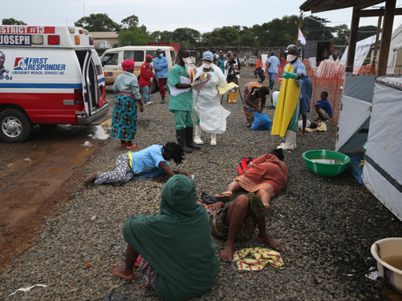
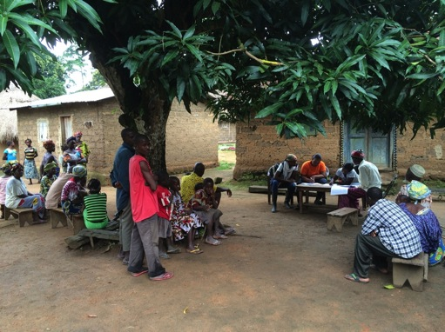
Phases of the response in West Africa
28,646 cases, 11,310 deaths (40% mortality)
Initial response = 3Bs
  Beds
  Burials
  Basic behaviour change
Phase 2 = 3Cs
  Case finding
  Contact tracing
  Community engagement
Phase 3
  More of phase 2
  Heightened surveillance, rapid response
Notes:
Biggest risk is not complacency, not fatigue, but financial and human resources

Slide 17
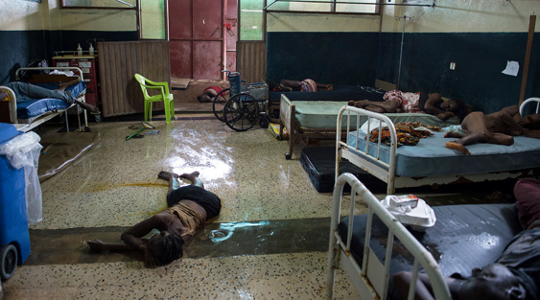
Difficult
Many barriers to care
  Some barriers unnecessary “precautions taken out of an abundance of caution”
Redemption Hospital, Monrovia, Sept 2014
https://www.whnpa.org/main/the-west-african-country-of-liberia-is-crippled-by-a-recent-outbreak-of-the-disease-ebola-8/
Notes:
Two people lay dead on the floor Sept. 20 inside a ward at the Redemption Hospital, which has become a transfer and holding center for Ebola patients in the New Kru Town slum of Monrovia, Liberia.
http://www.washingtonpost.com/sf/national/2014/10/04/how-ebola-sped-out-of-control/?utm_term=.f6d13bbf03a3

Slide 18

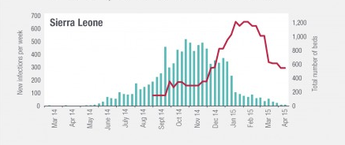
Delayed response
Notes:
https://www.odi.org/opinion/9961-what-ebola-exposed-about-health-systems-west-africa

Slide 19
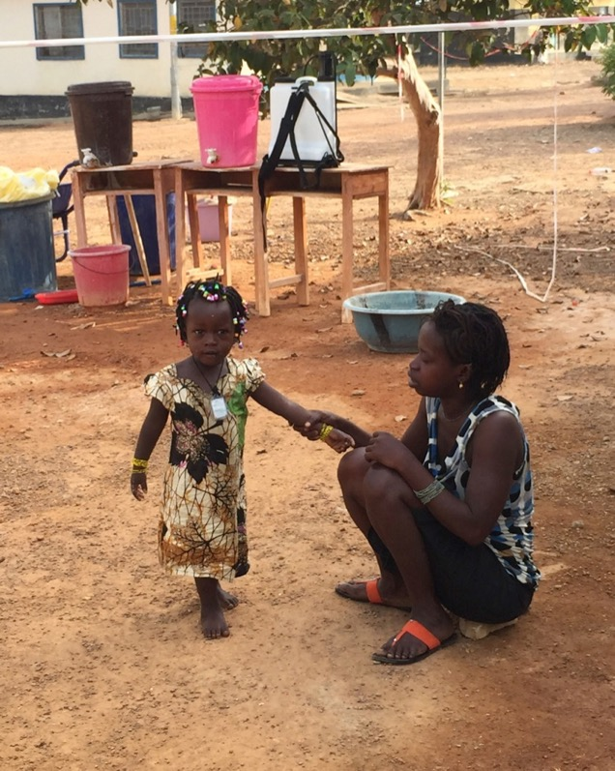
Challenges
Amina came to the ETU with her daughter Isatu
Amina’s husband died last week from Ebola
Amina felt fever, headache and weakness x 2 days
Isatu felt well, happy and playful
Amina and Isatu were both taken in to the ETU
No other family or friends to help
Should Isatu stay in the ETU?
What can we do?
Arab Hospital, Makeni, Dec 2014

Slide 20
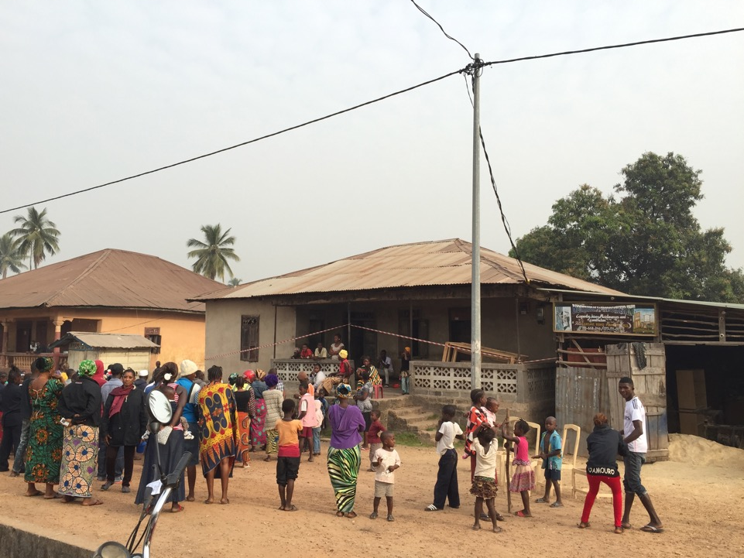
Notes:
contact tracing was impeded by public interpretations

Slide 21
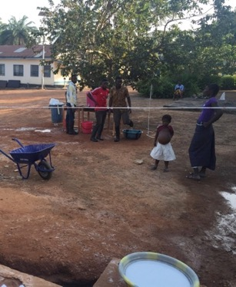
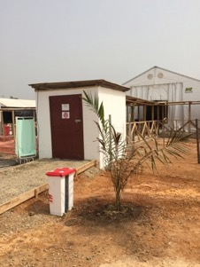
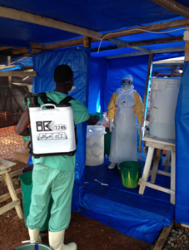
Disparity among Ebola Treatment Centres Sierra Leone
IMC
MSF
Emergency Goderich
MoH

Slide 22
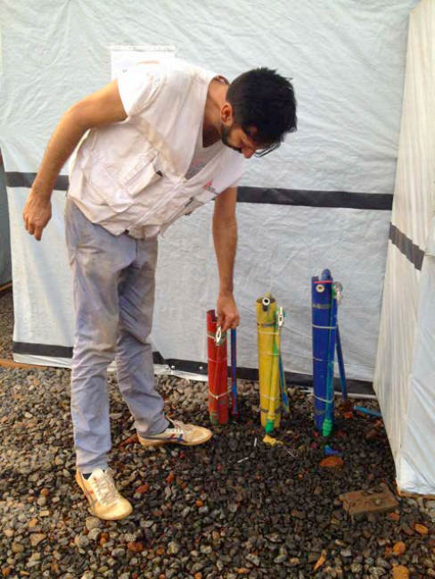
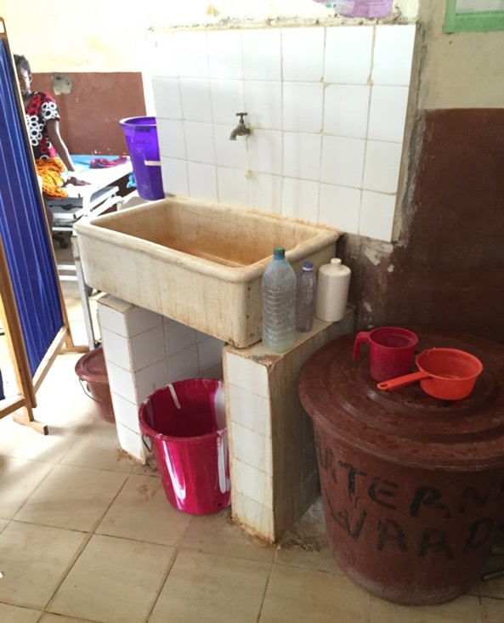
Makeni General Hospital, Sierra Leone
During the Ebola outbreak
Maternity ward
  No running water
  No hand-sanitizer
  No electricity
Goal (NGO), ETU
  Running water – 3 taps:
    5% chlorine
    1% chlorine
    Clean water
Notes:
No running H2O Maternity Ward Makeni General Hospital, SL
Piped in 0.5%, 0.05% and bore hole H2O MSF Kissey ETU, SL

Slide 23
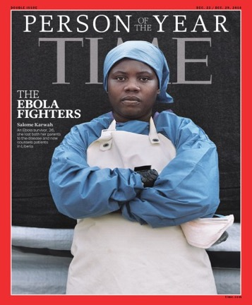
Ebola
Salome
In 2017, Salome died 4 days post-partum of probable eclampsia because lack of medical care
1% of women in Liberia die due to pregnancy
Notes:
Salome Karwah
nytlive.nytimes.com/.../famed-liberian-ebola-nurse-dies-from-childbirth-after-health-...
1% of women in Liberia die due to pregnancy

Slide 24
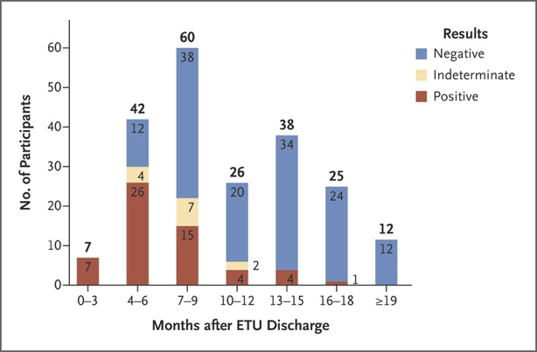
Unusual features
Sexual transmission – rarely > 12 months after recovery
Post-EVD complications in 2/3 of survivors
  Arthritis, headache, fatigue…
  Uveitis – 3 months after recovery
  Meningoencephalitis – 9 months after recovery

Slide 25
Ebola in DRC
Most challenging outbreak ever….
Weak health system
  Very poor area with little health infrastructure
Dense population
Mobile population
  In multiple areas (19 different regions affected – over 700km apart
Mass displacement (>1 million IDPs in North Kivu)
Decades of armed conflict
Ongoing violent attacks
Community mistrust
Less than 50% of Ebola cases have been on known contact lists…
Notes:
The first EC report on Oct 17, 2018, called for “intensified” action, fearing “significant deterioration”.1 The EC’s fears have been prescient. Cases of Ebola virus disease have more than tripled, with an expanded geographical footprint into 18 health zones.
This situation undercuts vital interventions, such as contact investigations, isolation, and safe burials. WHO might have to shift from ring vaccination to vaccination based on geographical location, but doing so effectively will require far more doses; limited vaccine supplies, therefore, are concerning
A PHEIC is an extraordinary event with public health risk to other countries that requires a coordinated international response

Slide 26
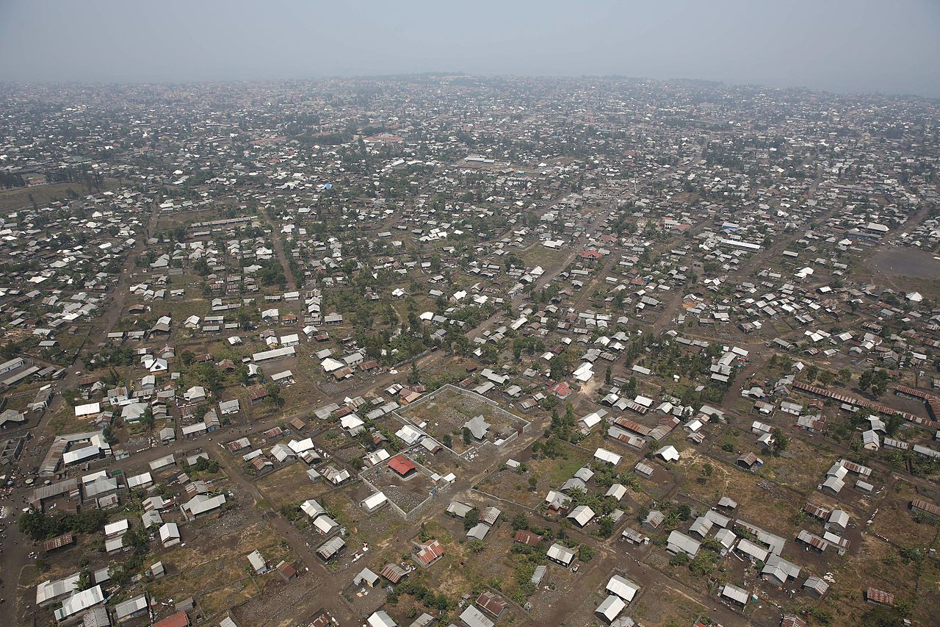
North Kivu

Slide 27
Context
DRC
  one of the poorest countries in per person income
  one of the richest countries in natural resources
Belgian Congo – rubber terror
Rwandan genocide – spillover into Kivu
UN presence for decades – as observers
Mining – 65% of world’s coltan comes from DRC

Slide 28
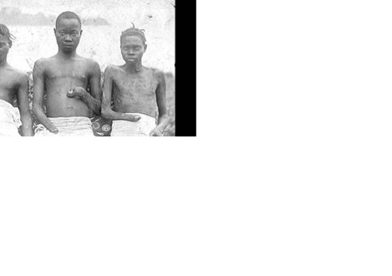
Colonization - atrocities
The rubber terror
Photos from King Leopold’s Ghost

Slide 29
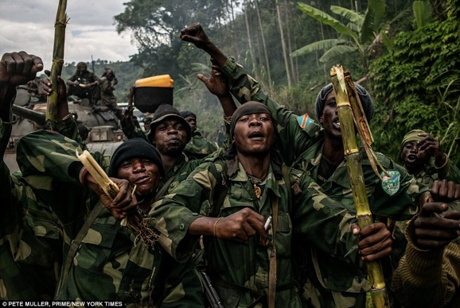
Decades of war
Spillover of conflict from Rwandan Genocide
Congo war 1998-2003
  African World War
  5 million deaths
  9 African countries
2003 – 2019
  Ongoing conflict
  Hundred’s of armed groups – target civilians

Slide 30
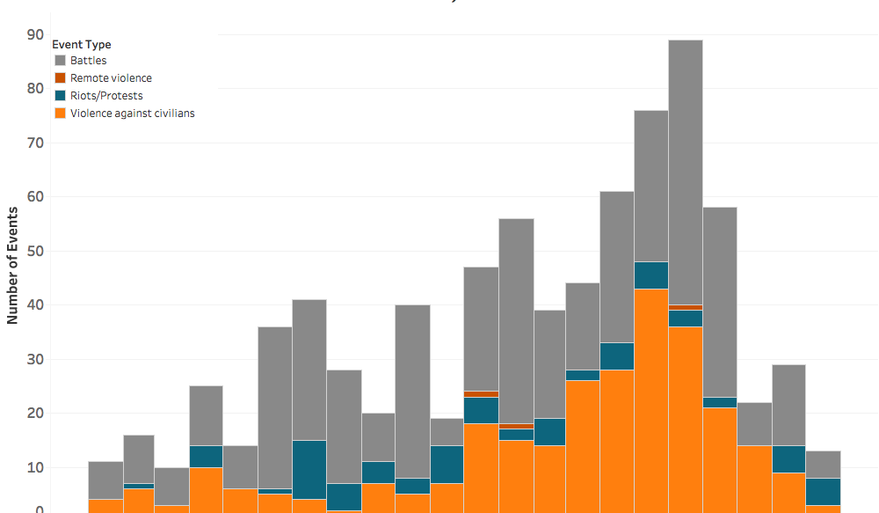
Violent events in N. Kivu (Jan 2017 – Oct 2018)
…violence against civilians… has done little to endear the Congolese government to the local population
https://www.acleddata.com/2018/10/26/layered-insecurity-in-north-kivu-violence-and-the-ebola-response/

Slide 31
SECURITY COUNCIL CONDEMNS ILLEGAL EXPLOITATION OF DEMOCRATIC REPUBLIC OF CONGO’S NATURAL RESOURCES
The Security Council condemned the illegal exploitation of natural resources and wealth of the DRC
…expressed serious concern at those economic activities fuelling the conflict in that country.
https://www.un.org/press/en/2001/sc7057.doc.htm
3 MAY 2001

Slide 32
Documentaries to watch

Slide 33
Documentaries to watch
in nearby Virunga National Park, a park ranger was killed and two British tourists were kidnapped for ransom

Slide 34
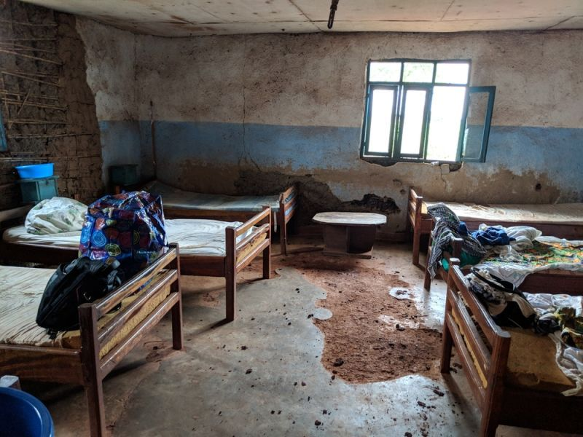
Poor health systems
https://www.msf.org.za/stories-news/news-our-projects/northeast-drc-ebola-outbreak-update-4

Slide 35
IDP camps
Densely populated and desperately poor

Slide 36
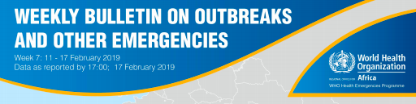
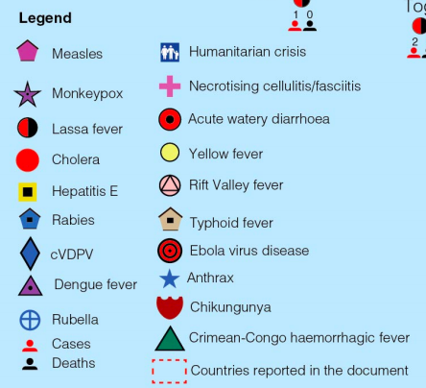
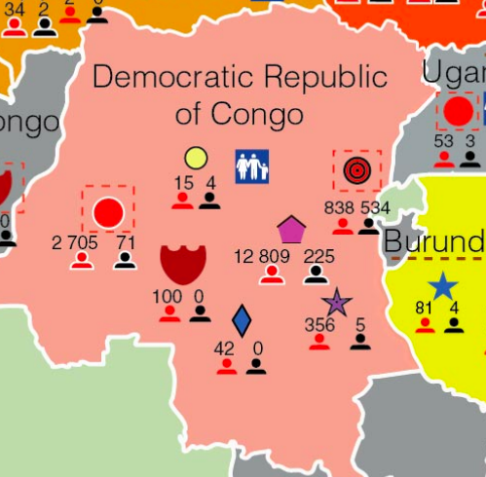

Slide 37
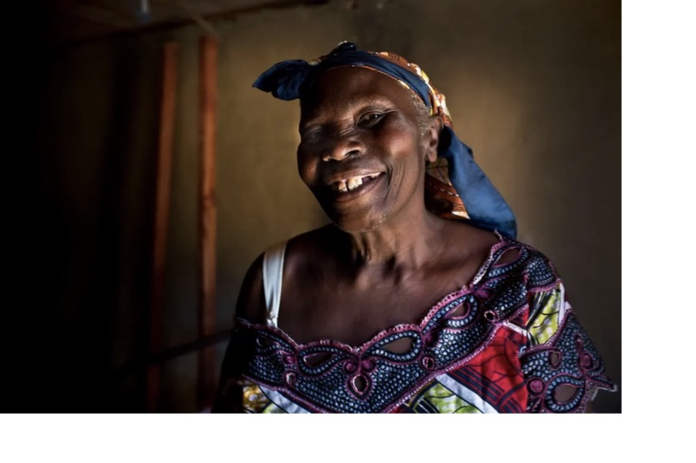
Community mistrust
A lot of people in my community think Ebola isn’t real – they think the government made up the disease to scare people … to stop them voting’
https://www.theguardian.com/global-development/gallery/2019/feb/05/ebola-drc-democratic-republic-of-the-congo

Slide 38
Community mistrust
[People] in Beni saw all this money pouring in to combat Ebola and were frustrated because they have seen their communities suffer and die for years from bullets, malaria and treatable illnesses, yet nobody did anything’
  … greater likelihood that local residents will be raped, tortured, or murdered by rival militias.
  As one local community health worker said, “We think it would be good that as much effort be put into mobilizing teams to end the insecurity. Ebola kills, but the rebels kill more.”
“The UN is judged to be complicit in the massacres here, and for not protecting the population except for a few battalions. And NGOs, people think they are here just to make money.”
Sara Phillips, Medair emergency response coordinator
Notes:
https://www.theguardian.com/global-development/gallery/2019/feb/05/ebola-drc-democratic-republic-of-the-congo

Slide 39
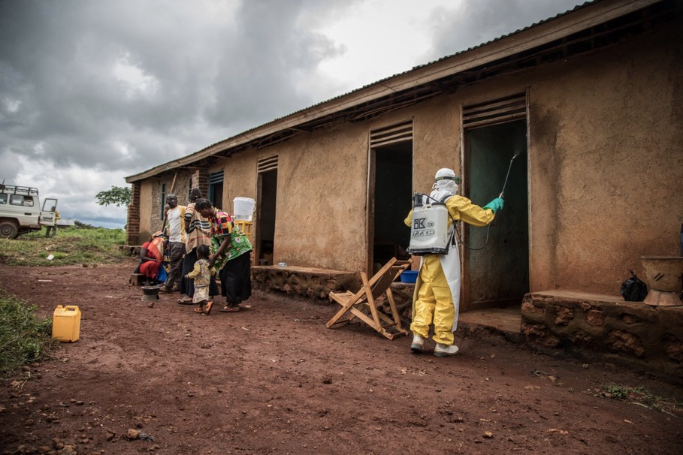
Community mistrust
…people believe the foreigners are using these fever guns to read their minds, discovering how they intend to vote in the upcoming elections.

Slide 40
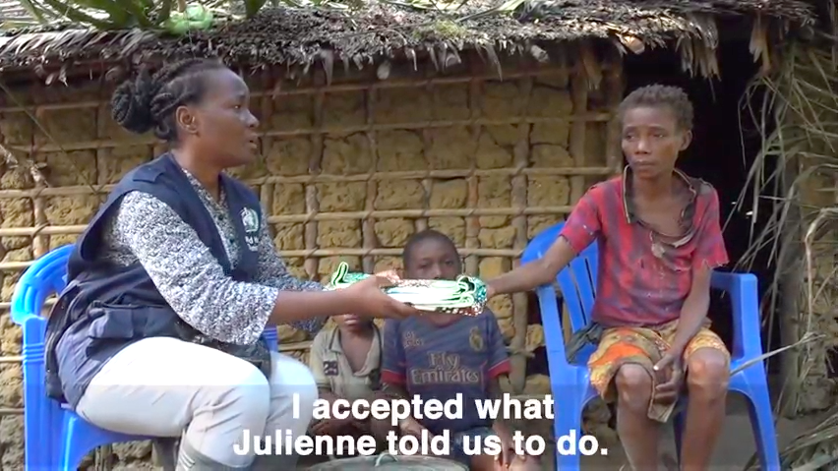
Community Engagement
Safe and Dignified Burials
https://www.afro.who.int/fr/countries/democratic-republic-congo
Notes:
One of the biggest challenges has been the initial resistance from the communities. Some of them question why we're here now. They ask where we were when they were being killed by these armed groups and how we've taken notice once Ebola hit them.

Slide 41
Peter Salama, WHO, Nov 2018

Slide 42
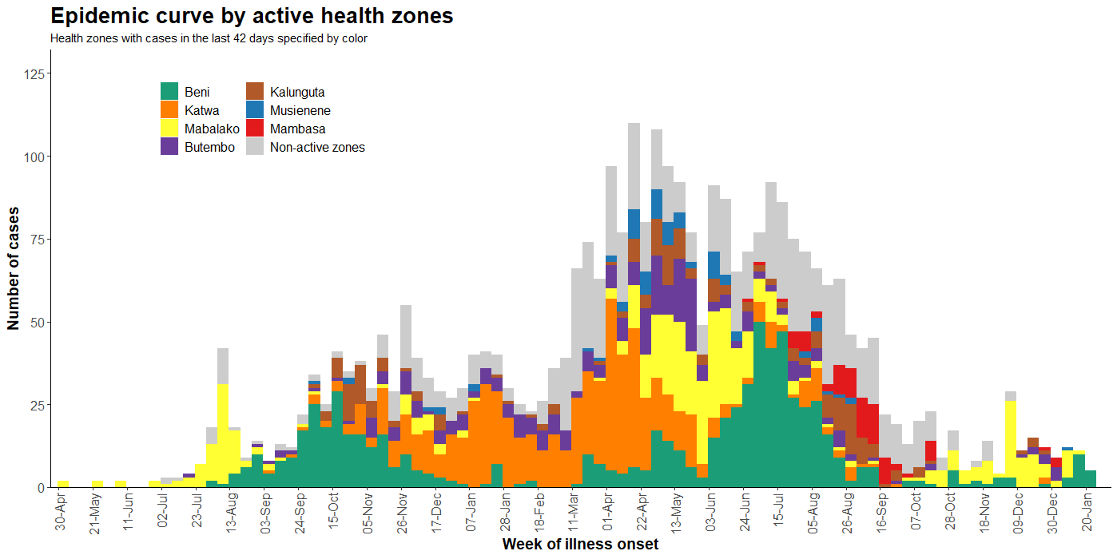

Slide 43
Geographic spread

Slide 44
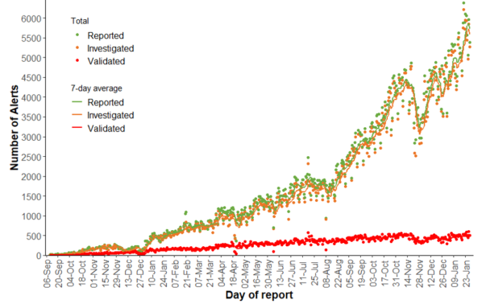
Alerts of Ebola virus disease reported, investigated, and validated daily in the DRC

Slide 45
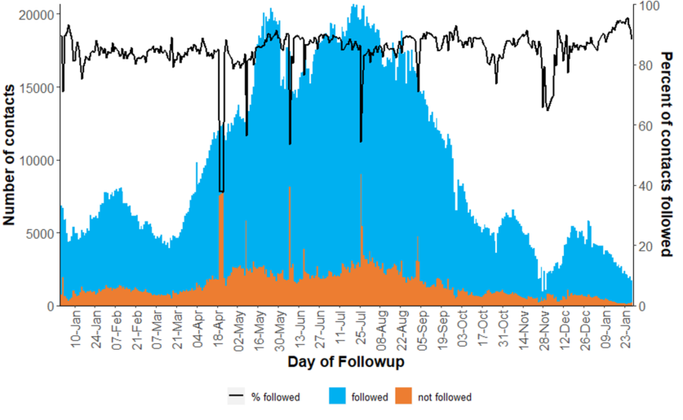
Number of contacts registered and followed up each day, as of 28 January 2020

Slide 46
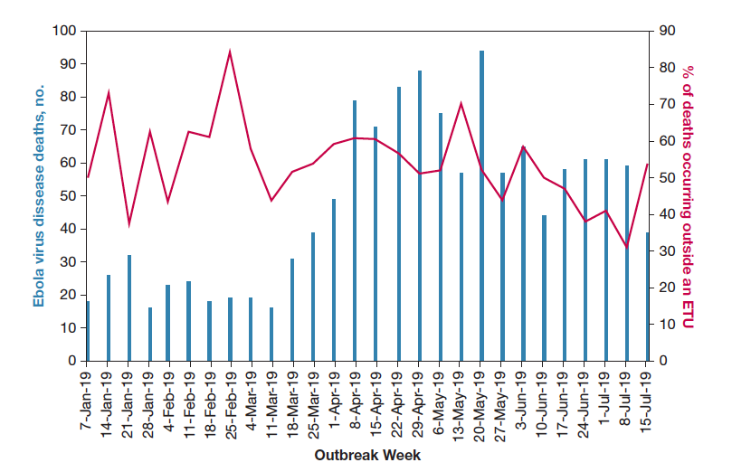
Majority of deaths have occurred outside of ETU…
Notes:
The number of deaths from Ebola virus disease and the percentage of those deaths occurring outside of an ETU in the Democratic Republic
of the Congo, January 6, 2019, to July 15, 2019.

Slide 47
Notable advances
Vaccine
Treatment:
  Design of the ETU/ETC
  Access to supportive care (like IV fluids)
  Access to investigational treatments (like Zmapp)

Slide 48
Vaccination
276,520 people were vaccinated with the rVSVZEBOV-GP Ebola vaccine (August 2018 to January 2020)
7,631 people were vaccinated with the Ad26.ZEBOV/MVA-BN-Filo vaccine (in two health areas near Goma), since its introduction November 14, 2019.
14,600 health workers have been vaccinated in the four neighbouring countries (Burundi, Rwanda, South Sudan and Uganda).
Notes:
Four confirmed EVD cases have been imported from Democratic Republic of the Congo to Uganda since June 2019, with no transmission or secondary cases in Uganda.
Uganda was successful in stopping the spread of EVD and preventing outbreaks by investing USD 18 million in EVD preparedness efforts. A total of 14 600 health workers have been vaccinated in the four priority 1 countries (Burundi, Rwanda, South Sudan and Uganda).

Slide 49
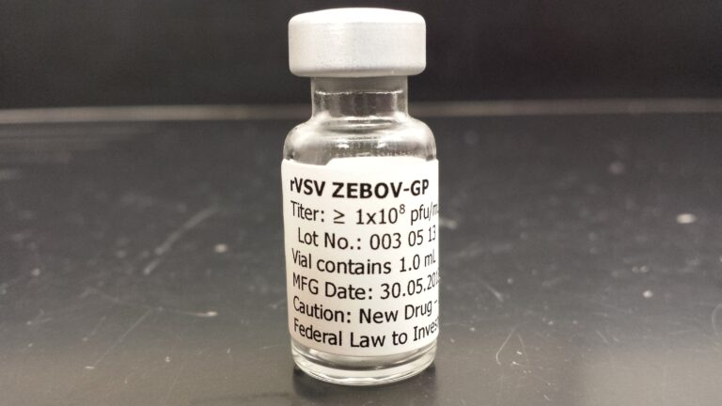
Vaccine
rVSV-ZEBOV
  live, attenuated recombinant vesicular stomatitis virus in which the gene for the native envelope glycoprotein is replaced with that from Ebola, Kikwit 1995 Zaire strain
2003 - Developed in Canada (PHAC)
  Effective in non-human primates
2010 – PHAC licensed to NewLink Genetics for $200,000 and <10% royalties
  NewLink undertook no human trials or vaccine production for the next 4 years
2014 – NewLink licensed to Merk for $50 million plus royalties
  Canadian government donated 500 doses to WHO on compassionate use basis

Slide 50
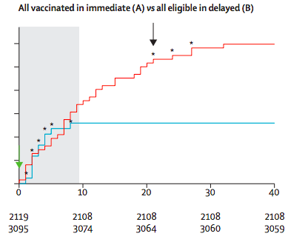
Ring-trials in Guinea (2016) and DRC (2019)
97.5 – 100% effective after 10 days
7,000 people; randomized to immediate vs delayed
  0 cases in immediate
  16 cases in delayed
Lancet 2015
Notes:
In a large trial of ring vaccination in Guinea, the VSV vaccine was safe and effective in inducing rapid immunity against Ebola virus [145]. When a new case of Ebola virus disease was diagnosed, surveillance teams identified all close contacts of the patient and all contacts of those contacts. Each of these clusters was then randomized to receive the VSV vaccine either immediately or after 21 days; 3528 subjects were randomized and 3512 were vaccinated (2014 in the immediate arm and 1498 in the delayed arm). To exclude individuals who were already infected with Ebola virus at entry into the study, only patients who developed disease ≥10 days after randomization were included in the analysis. Among immediately vaccinated individuals, no Ebola virus disease was seen after day 10, while there were 16 new cases among those assigned to delayed vaccination, indicating a clear benefit of immediate vaccination. In addition, no recipient developed Ebola virus disease more than six days after vaccination in either group. One febrile illness was the only serious side effect attributed to vaccination.
https://www.who.int/csr/resources/publications/ebola/ebola-ring-vaccination-results-12-april-2019.pdf

Slide 51
Requirement for cold chain (60-90ºC below)
https://www.sciencenews.org/blog/science-ticker/ebola-vaccine-proves-effective-final-trial-results-show

Slide 52
Another vaccine
Ad26.ZEBOV/MVA-BN-Filo…
Combination vaccine:
  Adenovirus vector expressing the GP of the Zaire Ebola virus
  Modified Vaccinia Virus Ankara (MVA) strain containing multivalent epitopes for EBOV
2-dose regimen
  0, and then 4-12 weeks
June 2019
  The introduction of this vaccine in DRC prompts resignation of head of Ebola response Dr. Oly Ilunga Kalenga

Slide 53
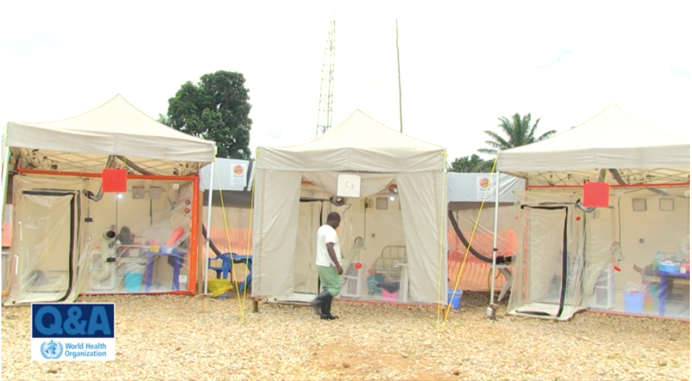
ETU/ETC
https://www.youtube.com/watch?v=sK9POphCYlY

Slide 54
Therapeutics
Monoclonal antibodies:
  Zmapp
  mAb 114
  Regeneron
Nucleoiside anologues
  Remdesivir
  (Favipravir)
Notes:
Preliminary uncontrolled, unrandomized data indicate reduced mortality after compassionate-use treatments with remdesivir, mAb114, ZMapp, or REGN-3470-3471-3479 in this ongoing program at all ETCs.
Separately, a randomized controlled trial began in November 2018 (only in the Beni ETC) to compare mAb114, remdesivir, and ZMapp..
Other positives include the Ministry's November launch of the first randomized control trial for experimental Ebola treatments; 248 patients have received one of the four new drugs as of January 1, according to the WHO. Additionally, 60,715 people have been vaccinated since early August.
Favirpavir
nucleoside analog; inhibits replication of a wide range of RNA viruses

Slide 55
Zmapp
RCT in West Africa
71 patients (planned 200)
37% vs 22% mortality
15% absolute difference in mortality; (95% CI, −36 to 7)
NEJM 2016
Notes:
A Randomized, Controlled Trial of ZMapp for Ebola Virus Infection.AUPREVAIL II Writing Group, Multi-National PREVAIL II Study Team, Davey RT Jr, Dodd L, Proschan MA, Neaton J, Neuhaus Nordwall J, Koopmeiners JS, Beigel J, Tierney J, Lane HC, Fauci AS, Massaquoi MBF, Sahr F, Malvy D SON Engl J Med. 2016;375(15):1448. BACKGROUNDData from studies in nonhuman primates suggest that the triple monoclonal antibody cocktail ZMapp is a promising immune-based treatment for Ebola virus disease (EVD).METHODSBeginning in March 2015, we conducted a randomized, controlled trial of ZMapp plus the current standard of care as compared with the current standard of care alone in patients with EVD that was diagnosed in West Africa by polymerase-chain-reaction (PCR) assay. Eligible patients of any age were randomly assigned in a 1:1 ratio to receive either the current standard of care or the current standard of care plus three intravenous infusions of ZMapp (50 mg per kilogram of body weight, administered every third day). Patients were stratified according to baseline PCR cycle-threshold value for the virus (≤22 vs.>22) and country of enrollment. Oral favipiravir was part of the current standard of care in Guinea. The primary end point was mortality at 28 days.RESULTSA total of 72 patients were enrolled at sites in Liberia, Sierra Leone, Guinea, and the United States. Of the 71 patients who could be evaluated, 21 died, representing an overall casefatality rate of 30%. Death occurred in 13 of 35 patients (37%) who received the current standard of care alone and in 8 of 36 patients (22%) who received the current standard of care plus ZMapp. The observed posterior probability that ZMapp plus the current standard of care was superior to the current standard of care alone was 91.2%, falling short of the prespecified threshold of 97.5%. Frequentist analyses yielded similar results (absolute difference in mortality with ZMapp, -15 percentage points; 95% confidence interval, -36 to 7). Baseline viral load was strongly predictive of both mortality and duration of hospitalization in all age groups.CONCLUSIONSIn this randomized, controlled trial of a putative therapeutic agent for EVD, although the estimated effect of ZMapp appeared to be beneficial, the result did not meet the prespecified statistical threshold for efficacy. (Funded by the National Institute of Allergy and Infectious Diseases and others; PREVAIL II ClinicalTrials.gov number, NCT02363322 .).

Slide 56
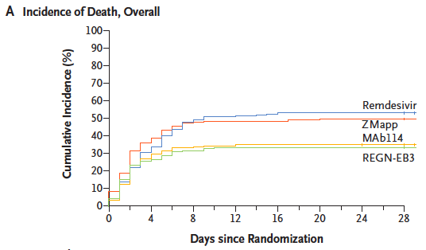
N Engl J Med 2019;381:2293-303.

Slide 57
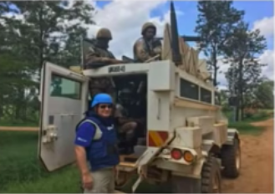
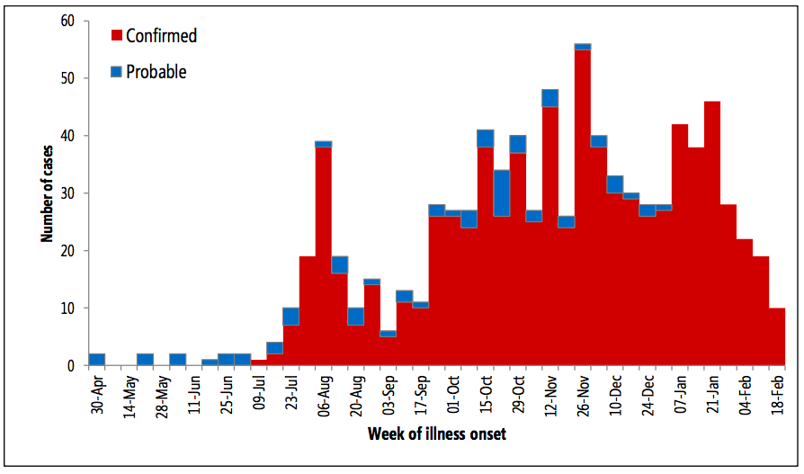
Extremely challenging environment
Highly dense and mobile population
Weak health systems
Decades of conflict causing deep deep community distrust
Ongoing insecurity and violent attacks
?

Slide 58
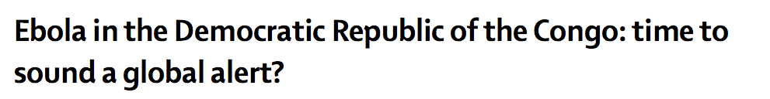
August 1, 2018
  Outbreak declared
October, 2018 and
April, 2019
  Meetings of the WHO/UN committee – decision not to declare a PHEIC
July 17, 2019 – declared a PHEIC …
  June 11, Uganda reported the first case of EVD from the DRC
  July – additional attacks on ETU
  July 14, an EVD case was reported in Goma, population 2 million
www.thelancet.com Vol 393 February 16, 2019
Notes:
Published Online February 4, 2019 http://dx.doi.org/10.1016/ S0140-6736(19)30243-0

Slide 59
Extra slides

Slide 60
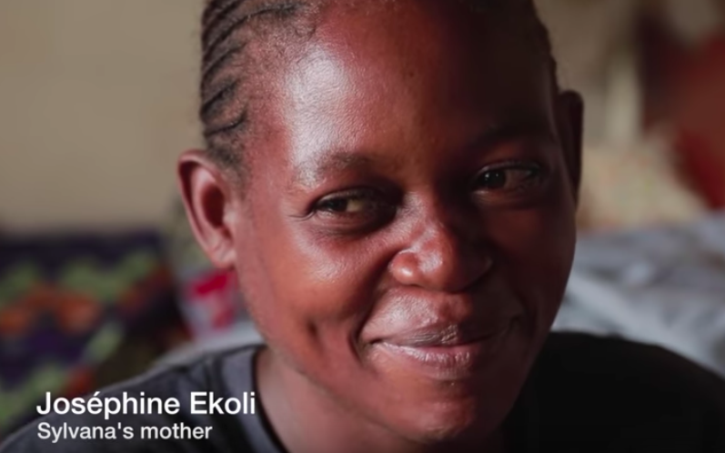
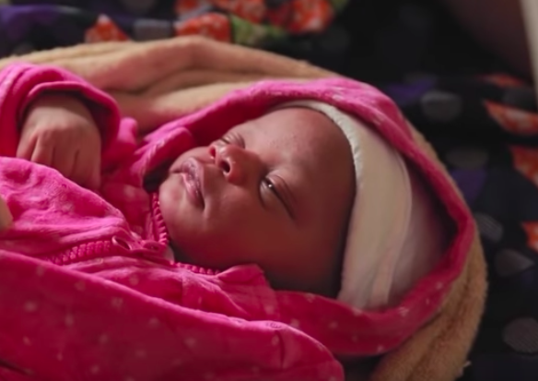
Women and EVD
https://www.youtube.com/watch?v=v21SbOY8QCI

Slide 61
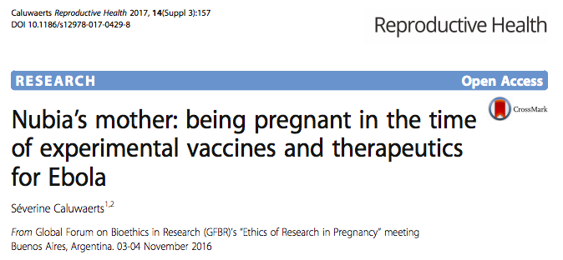
Women and EVD

Slide 62

ETUs…
Notes:
An Ebola treatment facility, Goderich, Sierra Leone, February 2015. (From Leligdowicz
A, Fischer WA, Uyeki TM, et al. Ebola virus disease and critical illness. Crit Care 2016; 20: 2

