Slide 1
Eosinophilia
Wheeze, worms, and weird disease
Jan Hajek
UBC tropical medicine rounds
Sept 11, 2020
Notes:
Most infectious causes are parasitic, self-limited, and benign
But –
Strongyloides stercoralis infection in the immunocompromised can result in a hyperinfestation syndrome with a high mortality, and may present over 50 years after exposure

Slide 2
Eosinophilia
Outline
General principles
  The eosinophil
  Patient’s exposure: Geography, Activities, Timing
Think multicellular, tissue invasive, helminth infection
  Stool → Hookworm
  Serology → Strongyloides, Schistosomiasis, Filaria, Toxocara
Cases - eosinophilia syndromes
  Respiratory – Eosinophilic pneumonia
  Cardiac – Eosinophilic endocarditis
  Neurologic – Eosinophilic meningitis
  Intestinal – Eosinophilic enteritis
Notes:
Ask:
Fresh water exposure – clue for schistosomiasis
Raw fish/crayfish – clue for trematodes

Slide 3
Eosinophilia
Degree of eosinophilia:
  Mild 500- 1,500 cells/μl
  Moderate 1,500 – 5,000 cells/μl
  Severe >5,000 cells/μl
Tissue dwelling cells
Variation by steroids and stress response
  Sepsis (bacterial, viral, malaria) lower eosinophil counts
Activated eosinophils, from any underlying cause, can cause tissue damage → HES
Notes:
The normal range of blood eosinophils is 0 to 500 cells/ mm3 and the typical percentage is less than 5% of WBC. However, the presence of eosinophilia cannot be determined by percentage alone because leukopenia would lead to a relative increase in eosinophil percentage, and vice versa.
The degree of blood eosinophilia is commonly thought to be correlated with the severity or seriousness of disease, but there is no evidence to support this except anecdotal experience in persons with severe eosinophilia and hypereosinophilic syndrome. End-organ damage can occur at moderate levels of eosinophilia. A recent study describes a rare group of people with asymptomatic hypereosinophilia and no evidence of end-organ damage despite exhaustive and regular evaluation for it

Slide 4
Eosinophils
General principles
Th2 response
IL-5 “activator”
- also IL-3, GM-CSF
Granules:
- Cationic granule proteins
- Major basic protein
- Eosinophil peroxidase
- Charcot-Leyden crystal
protein
Notes:
Eosinophils and neutrophils share a common morphology but the eosinophils are a little larger than the neutrophils and measure 12-17 μm in diameter.
They usually have two nuclear lobes and the cytoplasm has distinctive spherical orange granules. The underlying cytoplasm which is usually obscured by granules is pale pink.
The circulating life span of eosinophil is 6-12 hrs before it migrates to tissue but unlike the neutrophils it can recirculate and have a much longer life
Eosinophil development depends on several cytokines, including interleukin (IL)-5, IL-3, and granulocyte-macrophage colony-stimulating factor (GM-CSF). IL-5 is also critical for eosinophil activation and survival. Although eosinophils are found in the circulation, they are thought to be primarily tissue-dwelling cells, where they are 100-fold more abundant. In the blood, eosinophils have a half-life of 8 to 18 hours after departing the bone marrow. It is unclear how long they live in various tissues at homeostasis and it is possible their survival could be extended/sustained by exogenous factors such as IL-5.
Weller PF. The immunobiology of eosinophils. N Engl J Med 1991; 324(16): 1110-8
Rothenberg ME. Eosinophilia. N Engl J Med 1998;338:1592-1699
The eosinophil is an important source of cytotoxic cationic proteins, such as major basic protein (MBP), eosinophil peroxidase, and eosinophil cationic protein. These proteins are potentially two-edged swords; on the one hand, they protect the host against overwhelming helminth infections, but on the other hand, they damage the host's tissues

Slide 5
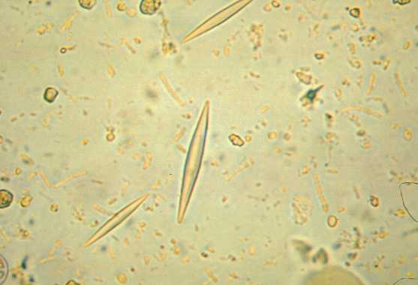
Charcot-Leyden crystal protein (galectin-10)
Notes:
Primary granules are round and uniformly dense, and are composed of Charcot-Leyden crystal protein (galectin-10), which forms the well-known Charcot-Leyden crystals associated with the sputum of patients with asthma, described years before the discovery of eosinophils1 . Despite this wellknown association, it is now appreciated that these crystals are not pathognomonic for asthma but can form anywhere in which there is an excess of eosinophil turnover.

Slide 6

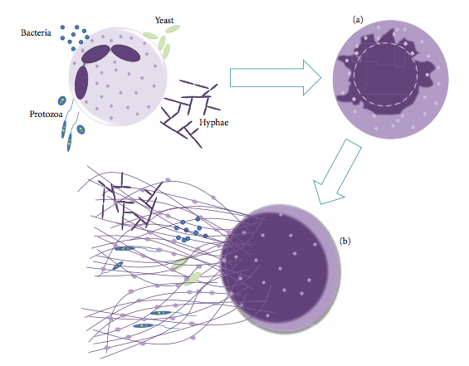
Phagocytosis
Degranulation
ETosis - Regulated Extracellular Trap cell death
  (release of DNA and antimicrobial proteins)
Blood (2018) 132 (20): 2183–2187.
Notes:
regulated pathway of extracellular trap cell death (ETosis)
Netosis was first described in neutrophils, thus the origin of its name. However, other cells such as eosinophils and mast cells also release extracellular traps (ETs) composed by DNA and antimicrobial proteins
Neutrophils then migrate to the inflamed site where they contain and eliminate microorganisms using three basic strategies: phagocytosis, with ingestion and killing of microorganisms inside special compartments of the cell, degranulation, which consists in the extravasation of the granules content to the extracellular milieu, and by a new antimicrobial mechanism named netosis that also occurs in the extracellular milieu, when DNA associated to proteins is expelled from the cell
neutrophils release their chromatin to the extracellular medium, associated with different proteins, forming the so-called NETs
Mechanism of Neutrophil Extracellular Traps release. Neutrophils are stimulated by contact with bacteria, protozoan, fungi (yeast and hyphae forms) or their products (not shown), leading to: (a) ultrastructural alterations of nuclear shape with chromatin decondensation, swollen and fragmentation of the nuclear membrane, which allow the association of granules and cytoplasmic proteins with the chromatin, and (b) release of extracellular structures consisting of a DNA-backbone, decorated with histones, neutrophil granular and cytoplasmatic proteins (NETs), which ensnare and kill microorganisms

Slide 7
Eosinophilia
Differential
Wheeze
  Allergy
    Asthma, eczema and hypersensitivity (medications)
Worms
  Tissue invasive, multicellular helminths
Weird disease
  Eosinophilic granulomatosis with polyangiitis (EGPA)
  Hypereosinophilic syndrome (HES)
Notes:
Hyper-eosinophilic syndrome:
persistent eosinophilia defined as >1500/ml for 6 months
organ involvement/dysfunction
exclusion of other clinical entities

Slide 8
Eosinophilia
Differential
Wheeze
  Allergy
    Asthma, eczema and hypersensitivity (medications)
Worms
  Tissue invasive, multicellular helminths
Weird disease
  Eosinophilic granulomatosis with polyangiitis (EGPA)
  Hypereosinophilic syndrome (HES)
Notes:
Hyper-eosinophilic syndrome:
persistent eosinophilia defined as >1500/ml for 6 months
organ involvement/dysfunction
exclusion of other clinical entities

Slide 9
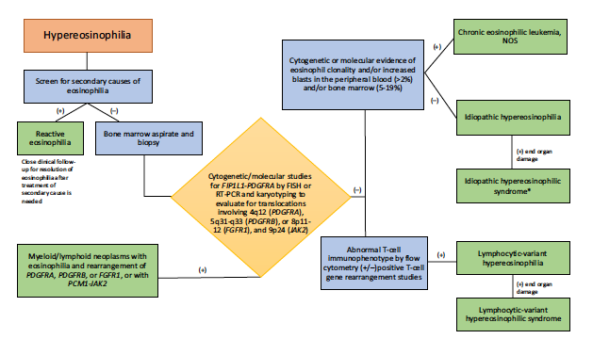
Eosinophilia
Hematology perspective…
Bone marrow biopsy:
  Cytogenetics and flow cytometry
  Screen for myeloid neoplasms
    e.g., FIP1-PDGFR gene rearrangements
    May see increased B12 and tryptase levels
  Screen for abnormal Tcells
    e.g., CD3-CD4+ Tcells
Notes:
If an immediate reactive cause of eosinophilia is not identified, or
findings are concerning for a hematologic neoplasm, then further
workup including bone marrow biopsy with ancillary testing to potentially
include flow cytometry, immunohistochemistry, cytogenetic
testing (including FISH for cryptic aberrations associated with
eosinophilia), and potentially molecular testing, such as T‐cell gene
rearrangement studies, when an aberrant T‐cell population is detected,
or next‐generation sequencing panel, when a myeloid neoplasm
is suspected, should be performed

Slide 10
Eosinophilia
Wheeze, worms, and weird disease
Worms
  Tissue invasive, multicellular helminths
Notes:
Hyper-eosinophilic syndrome:
persistent eosinophilia defined as >1500/ml for 6 months
organ involvement/dysfunction
exclusion of other clinical entities

Slide 11
Eosinophilia
Classification of parasites
Multicellular (Helminths)
  Nematodes
  Cestodes
  Trematodes
Unicellular (Protozoa)
  Intestinal (enteric)
  Tissue (non-enteric)
In general:
Helminths do not replicate in the host
Helminths have limited life-span to (< 5 years)
- important exceptions….
Notes:
Don’t multiply in host
2 exceptions
Infection limited to life span of worm unless reinfection occurs
Lifespan: 2 months – 5 years
Rare Exceptions:
Strongyloides, C. philippinensis: autoinfection
Pinworm: self-reinfection

Slide 12
Eosinophilia
Multicellular (Helminths)
Nematodes
  Intestinal
    Ascaris
    Hookworm
    Strongyloides
    Whipworm, Pinworm
  Tissue and blood
    Strongyloides
    Trichinella
    Toxocara
    Filaria
    Angiostrongylus
Cestodes (Tapeworm)
    Dog
    Pork
    Beef
    Fish
Trematodes (Flukes)
    Schistosomiasis
    Foodborne
      Liver
      Lung
      Intestinal
Notes:
Helminths vs protozoa
Multicellular vs Unicelular
Most helminths do not multiply in the host

Slide 13
General principles
Not all parasites cause eosinophilia
Infections with cysts sequester antigen
  Echinococcus
  Cysticercosis
Non-invasive intestinal helminths
  Ascaris (other than initial period of acute infection)
  Pinworm
  Diphylobothrium latum

Slide 14
Eosinophilia
2 exceptional protozoa
Enteric
  E. histolytica
  Giardia lamblia
  Cryptosporidium
  Cyclospora
  Isospora belli
  D. fragilis
  B. hominis
  Microsporidia
Non-enteric
  Toxoplasmodium spp.
  Plasmodium spp.
  Babesia
  Leishmania
  Trypanosoma
  Trichomonas
  Free-living amoebas
  Microsporidia

Slide 15
General principles
Importance of timing
Eosinophilia typically occurs during the tissue migration
Prepatent period for intestinal worms
  Time from infection → detection of organism in clinical samples
  Stool O&P is negative
  By the time the parasite reaches the gut lumen and stool microscopy becomes positive, eosinophilia may have resolved
Tissue invasive or wandering worms, e.g.:
  Loa loa
  Gnathostoma
  Trichinella
  Toxocara

Slide 16
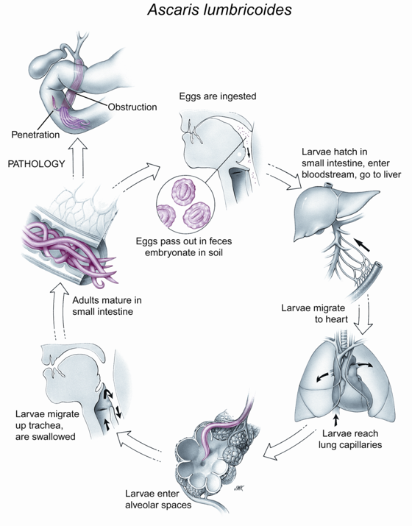
Eosinophilia
Löeffler Syndrome (Pneumonitis)
Pneumonitis:
Occurs: 1–2 week after infection
Lasts: ≈ 3 weeks
Pre-patency: 2 months
Notes:
Transpulmonary passage of helminth larvae (Löffler's syndrome)
Ascaris
Hookworm
Strongyloides
irritating, nonproductive cough and burning substernal discomfort.
Dyspnea, wheezing, fever, and blood-tinged sputum containing eosinophil-derived Charcot-Leyden crystals may also be present
CXR:
round or oval infiltrates ranging in size from several millimeters to several centimeters in both lung field
infiltrates are migratory and may become confluent in perihilar areas
usually clear spontaneously and completely after several weeks

Slide 17
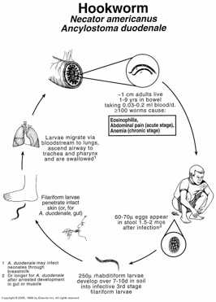
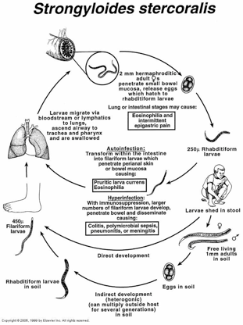
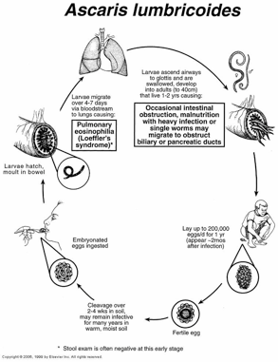
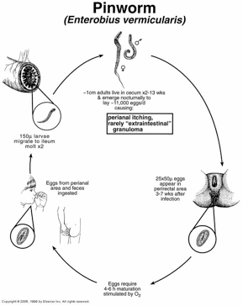
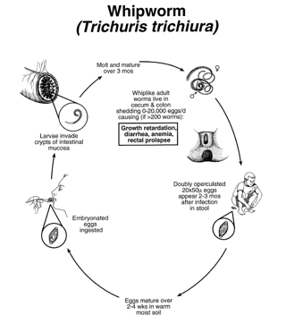
Geohelminths
Intestinal nematodes

Slide 18
Human vs Animal round worms
Ascardis
Ascaris lumbricoides
Hookworm
Ancylostoma duodenale

Slide 19
Human vs Animal round worms
Ascarids
Ascaris lumbricoides → Toxocara canis
Hookworm
Ancylostoma duodenale → Ancylostoma caninum
Notes:
Human: Ancylostoma duodenale and Necator americanus.

Slide 20
Human vs Animal round worms
Ascarids
Ascaris lumbricoides → Toxocara canis
  Human ascariasis – passes through lungs and stays in intestines
  Animal → migrates → Visceral and Ocuar Larva migrans (VLM, OLM)
Hookworm
Ancylostoma duodenale → Ancylostoma caninum
  Human hookworm – passes through lings and stays in intestines
  Animal → migrates → Cutaneous larva migrans

Slide 21
General principles
Importance of patient group
Immigrants
  May be longstanding infections
  Larger burden of infection with chronic complications
  → Portal hypertension with chronic schistosomiasis
Travellers
  May be newly infected
  Intense inflammatory response, but few organisms
  →Katayama syndrome with acute schistosomiasis

Slide 22
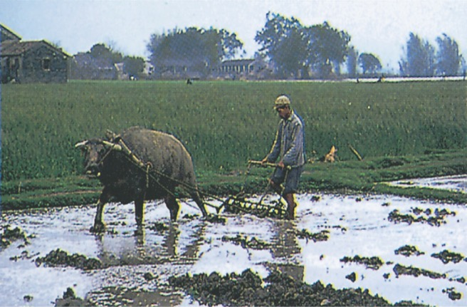

General principles
Importance of patient group/region
Notes:
Whetham J, Day JN, Armstrong M, Chiodini PL, Whitty CJ. Investigation
of tropical eosinophilia; assessing a strategy based
on geographical area. J Infect 2003;46:180e5.

Slide 23
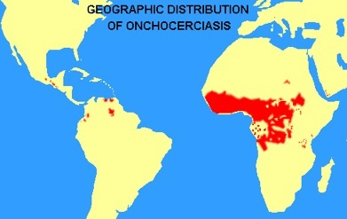
Guess the parasite by the map…

Slide 24
Guess the parasite by the map…
Onchocerciasis

Slide 25
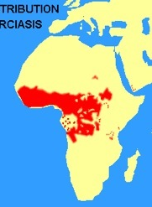
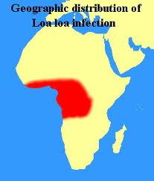
Eosinophilia
Importance of geography…
Onchocerca
Loa loa
Notes:
Diethylcarbamazine (DEC) and lymphatic filariasis and loaisis
DEC is the treatment of choice for lymphatic filariasis and loaisis but can cause severe reactions including blindness in individuals co-infected with onchocerciasis. Onchocerciasis should be excluded by taking skin snips and by giving a test dose of 50 mg DEC.
If onchocerciasis is present, this test dose will precipitate a mild Mazzotti reaction, consisting of pruritis and erythema. Treating with full dose DEC when onchocerciasis is present results in a severe reaction with pruritis, erythema, hypotension and blindness. Alternatively, presumptive pre-treatment of onchocerciasis with ivermectin may be undertaken before treating filariasis.
The dose of DEC is 50 mg day 1 increasing by day 4 to 200 mg tds for 3 weeks (regimen based on expert opinion only).
A combination of ivermectin and albendazole may be used instead of DEC in areas of onchocerciasis endemnicity.
Loa loa: additional points
It is important to establish if an individual infected with Loa loa is microfilaraemic before commencing treatment, as encephalopathy, with a high mortality rate, may develop after treatment with DEC, particularly in individuals with high levels of blood microfilaraemia (>8000/ml). If microfilariae are seen on blood film, corticosteroids should be used in conjunction with DEC (expert opinion149). Albendazole and ivermectin have been used to reduce microfilarial load in these patients, before treating definitively with DEC.

Slide 26
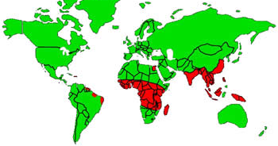
Eosinophilia
Importance of geography…
Lymphatic Filariasis

Slide 27
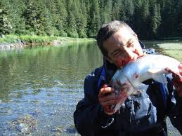
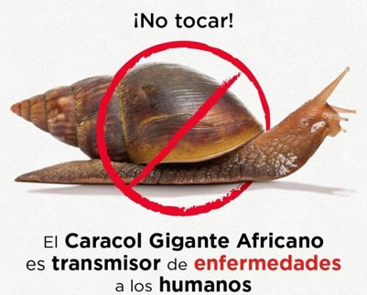

Eosinophilia
Importance of exposures…

Slide 28
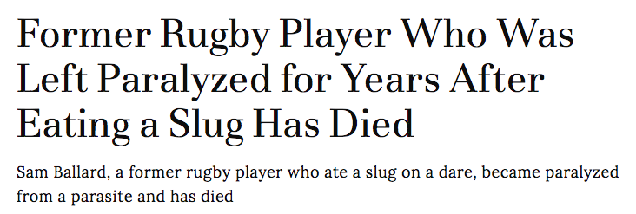


Slide 29
Eosinophilia
Screening for parasites
What is common
  Intestinal nematodes (hookworm) → Stool O&P
What not to miss
  Strongyloides → serology
  Schistosomiasis → serology
  +/- Filaria, Toxocara
Further testing based on:
    Exposure history
    Clinical presentation

Slide 30
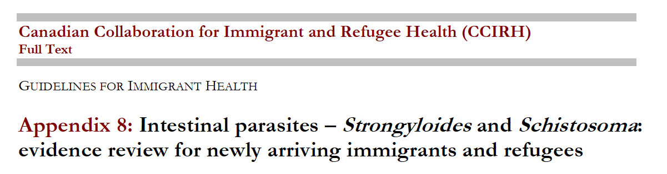
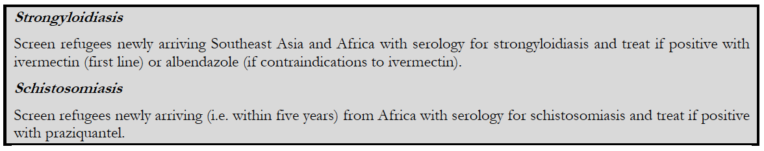
Eosinophilia
In context with refugee screening recommendations
CMAJ 2011

Slide 31
Asymptomatic eosinophilia
McGill tropical medicine clinic review
Retrospective review of 1,605 individuals returning from > 6 month trip to tropics
  10% had an eosinophil count of >450/mm³
  14% with eosinophilia had a parasitic infection
  4% without eosinophilia had a parasitic infection
    Sensitivity of eosinophilia for parasitic infection = 38%
Problem:
  Many had unexplained eosinophilia
  Strongyloides serology was not routinely performed
Normal eosinophil count does NOT rule out a
potentially serious helminth infection
Libman et al. CID ‘93
Notes:
Many had unexplained eosinophilia
Strongyloides serology was not routinely performed
Libman MD, MacLean JD, Gyorkos TW. Screening for schistosomiasis, filariasis, and strongyloidiasis among expatriates returning from the tropics. Clin Infect Dis 1993;17:353-9.
Any individual spending >6 months in an area where parasitic
disease was endemic was eligible for a routine screen
consisting of a microscopic examination of two stool specimens
obtained >24 hours apart, a urinalysis, and a complete
blood count with manual blood smear and eosinophil count.
Areas of endemicity did not include resorts or similar locations
where exposure to parasitic infection was highly unlikely.
All patients who spent time in an area where filaria or
schistosomes are endemic were judged to be at risk for infection
with these organisms unless it was determined that there
had been virtually no exposure to the relevant vector. Serological
tests for these organisms were routinely ordered for
those at risk. If any screening test was abnormal, the patient
was asked to return for further testing. If eosinophilia was
present, two additional stool specimens were requested, and
appropriate serological studies were ordered if they had not
been done at the initial screening visit.
4% without eosinophilia had a parasitic infection

Slide 32
Asymptomatic eosinophilia
Boston medicine clinic review
Retrospective review of 2,224 refugees
  12% had an eosinophil count of >450/mm³
  115 patients had serology for Strongyloides
    39% were positive
    0% had strongyloides in their stool
Stool O&P is NOT at a sensitive test for Strongyloides
Notes:
Region of origin
Africa 118 (44)
Eastern Europe 50 (19)
Southeast Asia 35 (13)
Caribbean/Latin America 26 (10)
Middle East 37 (14)

Slide 33
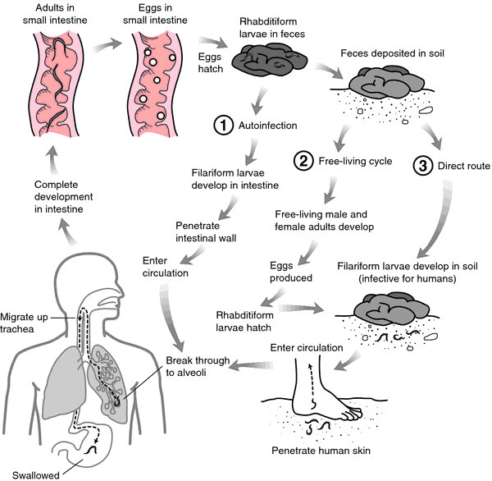
Strongyloides
Auto-infection…
Mahon and Manuselis, 2000.

Slide 34
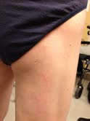
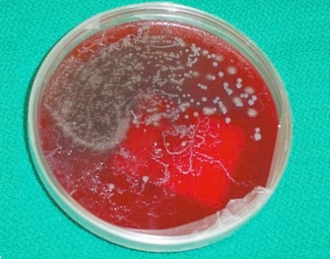
Strongyloides
Cutaneous larva currens
42M
Immigrated from Vietnam 20 years ago
Steroids for brain mets from lung cancer
Started to get an itchy rash
Bronchoscopy showed incidental finding of…

Slide 35
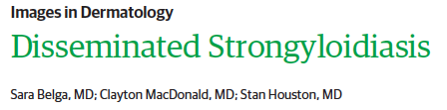
Strongyloides
Recognition of the risk
JAMA DERM 2019

Slide 36
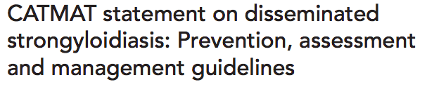
Risk of hyperinfection/disseminated disease
  Steroids!
  Steroids and sepsis – suppress eosinophil count…
Screening/treating persons who were residents of tropical countries for strongyloides is considered mandatory prior to immunosuppression
There is no evidence to support that a “test and treat” strategy is superior or more cost-effective compared to empiric administration of ivermectin to at risk individuals about to undergo immune suppression
CATMAT 2016

Slide 37
Strongyloides
Treatment (ivermectin)
Uncomplicated:
  Ivermectin, 0.2 mg/kg, for 2 days.
  (Albendazole, 400 mg, BID for 7 days)
Complicated (Hyperinfection or disseminated):
  Oral
    Ivermectin, 0.2 mg/kg/day, until negative stool exam persists for 2 weeks;
  Subcutaneous
  Patients unable to tolerate orally or deteriorating clinical status
    Ivermectin, 0.2 mg/kg/day, SQ, divided doses, each arm, until negative stool exam persists for 2 weeks or until can tolerate PO

Slide 38
Strongyloides
RCT
309 randomized
  50% positive stool tests; the rest on basis of serology)
Treatment
  Single dose (day 1) vs 4-dose (day 1,2 and 15,16)
Clearances at 12 month follow-up (230 patients completed)
  86% single dose vs 85% 4-dose
  100% vs 96% for stool clearance
Lancet 2019
Notes:
The primary outcome was the proportion of participants with clearance of S stercoralis infection at 12 months, defined by negative agar plate culture or PCR and negative serology or positive serology with a decrease in titre (defined as a decrease of two titres in IFAT, a two-fold reduction of normalised optical density in the case of ELISA).¹¹
Stool test clearance of S stercoralis infection was noted in:
100% in the single-dose group and
98% in the multiple-dose who had positive faecal tests at baseline

Slide 39
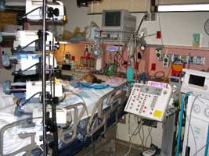
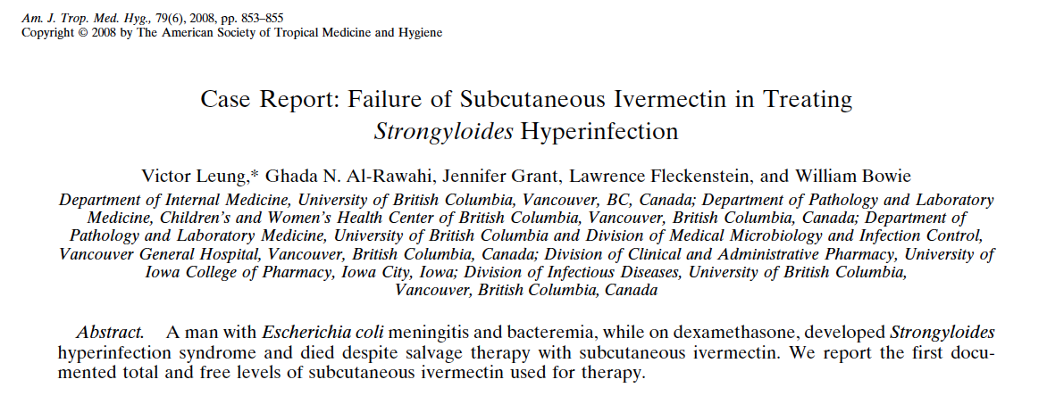
Strongyloides
Recognition of the risk
SQ ivermectin (from veterinarian clinic)
Leung et al. AJTMH ‘08
Notes:
67M, Laos
Craniophayngioma
6 weeks post starting decadron – to ICU with E.Coli meningitis
Discharged after 2 weeks
1 week later – returns with N/V, bloating, constipation
Develops septic shock in hospital
BAL = strongyloides
Dies despite PO and SQ ivermectin

Slide 40
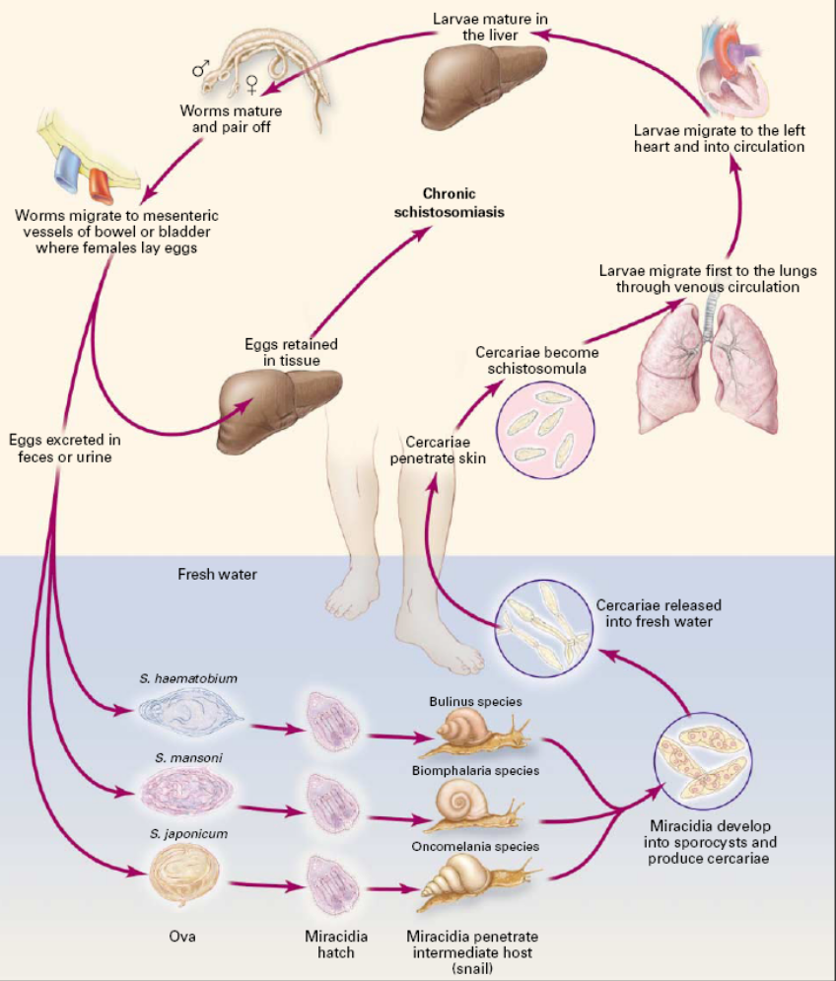

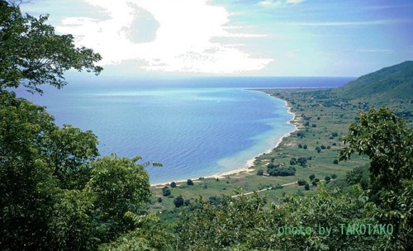
Schistosomiasis
Notes:
Cercariae penetrate skin
Schistosomula migrate to the lungs (3-4 days)
Enter circulation and migrate to the portal system.
Mature to adults in the hepatic circulation
Form pairs and migrate:
mesenteric veins (S.japonicum and mansoni)
Eggs after 35 days
Excreted in stool
vesical plexus (S.haematobium)
Eggs after 70 days
Excreted in urine.

Slide 41
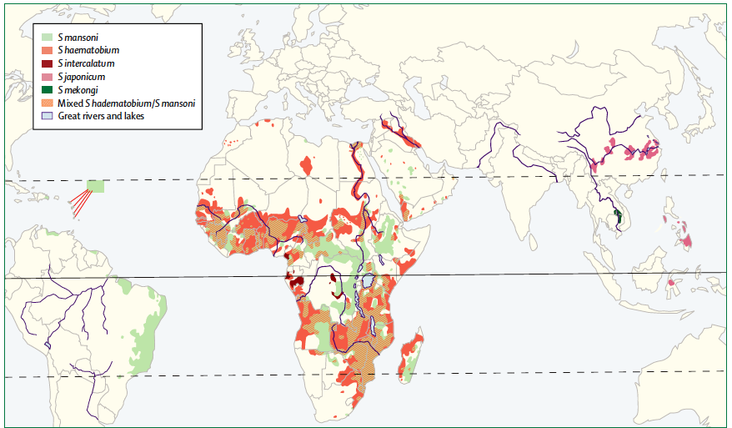
Schistosomiasis

Slide 42
Schistosomiasis
Clinical presentations
Acute:
Swimmer’s itch (cercarial dermatitis)
  Hours after swimming
Katayama fever (acute schistosomiasis)
  2 – 8 weeks
Chronic:
  Months - Years
  Intestinal
  Hepatic
  Genito-Urinary

Slide 43
Pulmonary nodules and eosinophilia
2 women, travelled to Uganda for studies (January – April 2018)
  Both developed fever and chest pain 1 month after return
  Both had eosinophilia (5.2 and 4.2)
  Both had abnormal CT chest…..
22F
  Symptoms started late April
    Admitted and BAL May 18 → CT chest = pulmonary nodules
20F
  Symptoms started early May
    Admitted and BAL May 28 --> CT chest = pulmonary nodules

Slide 44
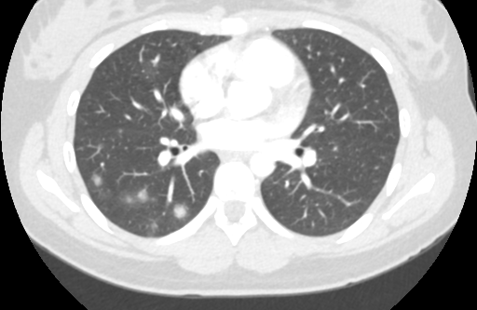
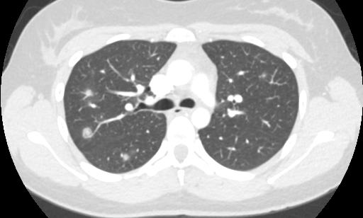
20F
CT chest May 2018

Slide 45
Pulmonary nodules and eosinophilia
2 women, travelled to Uganda for studies January 20 – April 20, 2018
  Both developed fever, chest pain and SOB after return
  22F
    Symptoms started end of April
      Admitted and BAL May 18
    Schistosomiasis Serology: May 16 NEG (Eosinophils 5.2)
  20F
    Symptoms started early May
      Admitted and BAL May 28
    Schistosomiasis Serology: May 28 NEG (Eosinophils 4.2)

Slide 46
Pulmonary nodules and eosinophilia
2 women, travelled to Uganda for studies January 20 – April 20, 2018
  Both developed fever, chest pain and SOB after return
  22F
    Symptoms started end of April
      Admitted and BAL May 18
    Serology: May 16 NEG. (Eosinophils 5.2)
    July 16 NEG
    Sept 5 POS
  20F
    Symptoms started early May
      Admitted and BAL May 28
    Serology: May 28 NEG (Eosinophils 4.2)
    July 13 POS

Slide 47
Schistosomiasis
Treatment
Praziquantel
Only active against
adult worms
Not active against
earlier stages
Notes:
Praziquantel
40 – 60 mg/kg x one day

Slide 48
Schistosomiasis
Why screen if asymptomatic?
Traveler, left Africa, completely asymptomatic, just positive serology…
Notes:
5 – 50% of non-traumatic spinal cord injury
In SSA may be due to schistosomiasi

Slide 49
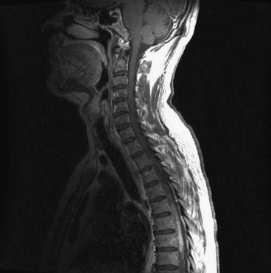
Schistosomiasis
Why screen if asymptomatic?
Adults can live for 10 years and lay eggs
Rarely aberrant migration of eggs (to CNS)
  Prevent complications even in those with few organisms
CNS schistosomiasis
Notes:
5 – 50% of non-traumatic spinal cord injury
In SSA may be due to schistosomiasi

Slide 50
Filariasis
Lymphatic filariasis
  Wuchereria bancrofti (90%)
  Brugia malayi, Brugia timori
Onchocerciasis
  West Africa; River blindness
Loasis
  West Africa; Eye worm
Mansonella perstans
Notes:
Mansonella infections are often asymptomatic
They can be associated with angioedema (similar to Calabar swellings of loaisis), recurrent pruritic subcutaneous lesions, fever, headaches, arthralgia.

Slide 51
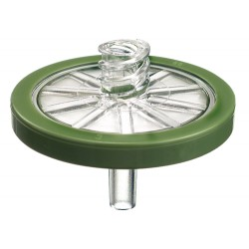
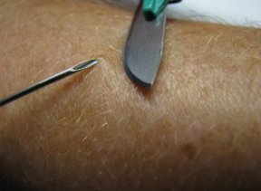
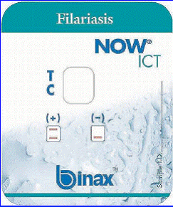
Filariasis
Diagnotic tests
Blood smear
  Millipore filter
Skin snips
Serology (McGill, NIH)
Antigen detection (McGill, NIH)

Slide 52
Case 1
Eosinophilic pneumonia
45M, Korean, previously well
Pleuritic chest pain and a dry cough
  No fever
  No rash
  No arthalgias
Began 1 week after returning from trip to Northern Mexico
Notes:
His chest pain and cough were initially managed symptomatically with an analgesic and a cough supressant. However, the symptoms persisted and, after one week, he was referred to a respirologist for further investigations and management. His physical exam was normal. His CBC revealed marked eosinophilia (6.0 x 10⁹/L). His CXR documented a right lung infiltrate. A CT scan confirmed consolidation in the right upper lobe and revealed centrilobular nodules in a tree-in-bud pattern, right hilar and mediastinal lymphadenopathy and small (<0.5mm) nodules scattered throughout both lungs.
He underwent bronchoscopic alveolar lavage (BAL) and transbronchial biopsy. Cytology of the BAL fluid revealed marked eosinophilia. Gram stain and calcofluor white (fungal) stain were negative. Histopathology of the biopsy documented non-specific eosinophilic bronchitis. There were no identifiable organisms seen on hematoxylin and eosin (H&E), periodic acid–Schiff (PAS), and Grocott–Gomori methenamine silver (GMS) stains of the tissue. A microbiologic test was performed.
What was the diagnosis and how was it made?

Slide 53
Case 1
Eosinophilic pneumonia
Exam: Normal
Labs: Eosinophilia (6.0 x 10⁹/L)
CXR: right lung infiltrate

Slide 54
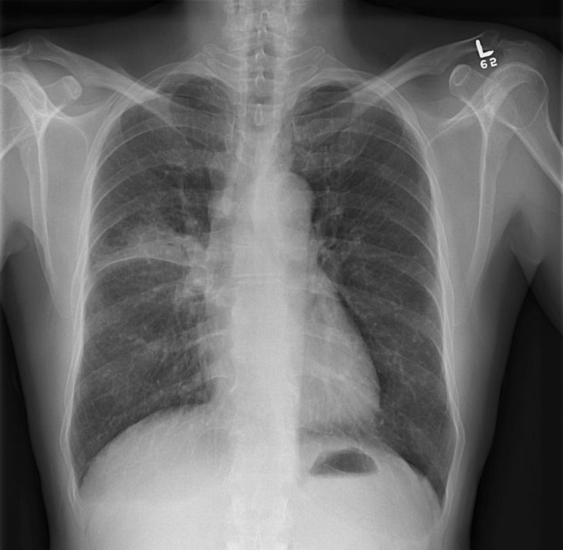
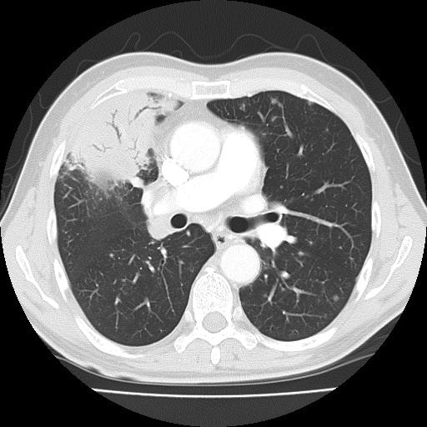
Case 1
Eosinophilic pneumonia
Notes:
CT scan confirmed consolidation in the right upper lobe and revealed centrilobular nodules in a tree-in-bud pattern, right hilar and mediastinal lymphadenopathy and small (<0.5mm) nodules scattered throughout both lungs.

Slide 55
Case 1
Eosinophilic pneumonia
Bronchoscopy (BAL)
  Cytology: marked eosinophilia
    Gram stain, AFB, calcofluor white stain: negative
  Histopathology: non-specific eosinophilic bronchitis
    H&E, Gram, AFB, PAS, GMS stains negative
A microbiologic test was performed.
What was the diagnosis and how was it made?

Slide 56
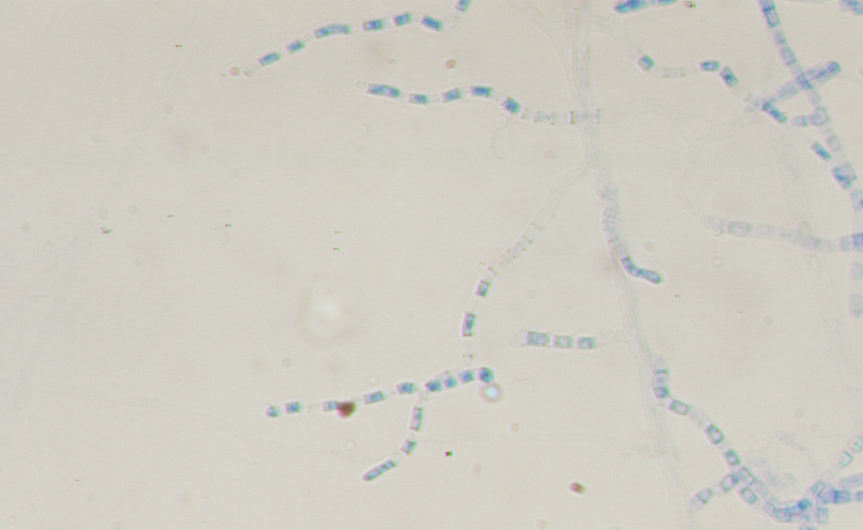
After 5 days, cultures were identified on blood agar plates….

Slide 57
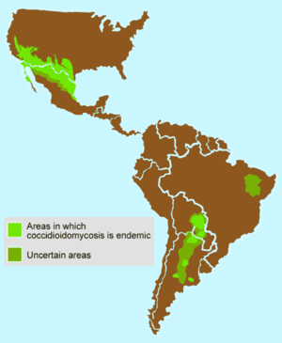
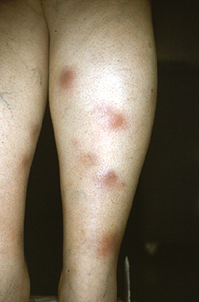
Coccidioides
Valley Fever…

Slide 58
Causes of pulmonary eosinophilia
Drug reactions
Infections
  Parasitic
    Transpulmonary passage (ascaris)
    Pulmonary parenchymal invasion (paragonimus, schistosomiasis)
    Heavy hematogenous seeding (strongyloides)
    Tropical pulmonary eosinophilia
  Fungal
    Coccidioides
    ABPA
Other
  Acute eosinophilic penumonia
  Eosinophilic granulomatosis with polyangiitis (EGPA)

Slide 59
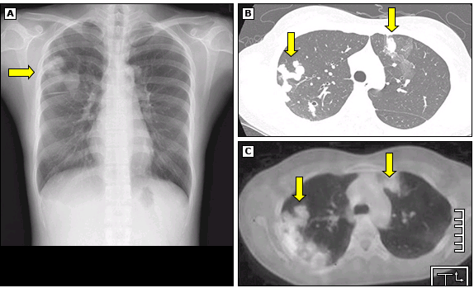

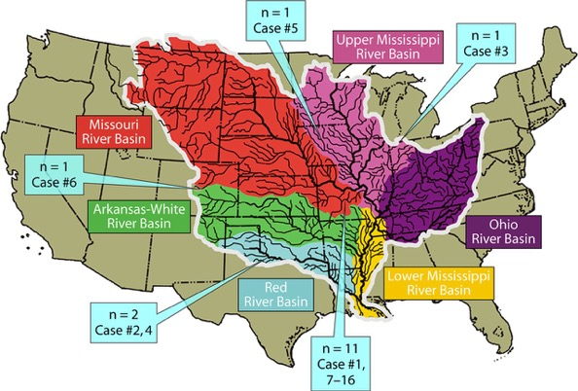
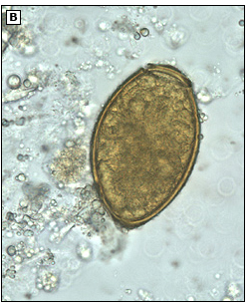
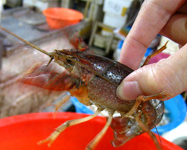
Causes of Pulmonary Eosinophilia
Paragonomiasis

Slide 60
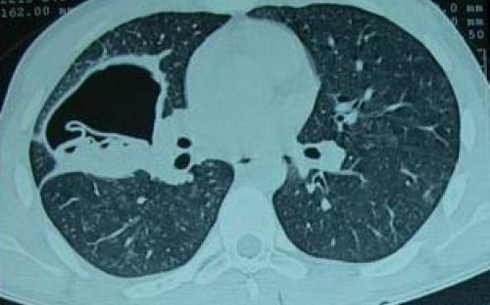
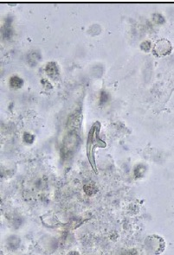
Spot diagnosis
Cough, eosinophilia, abnormal CT...
And salty-tasting sputum…
Notes:
An echinococcal hooklet was seen on a wet prep- aration of the patient’s sputum (unstained, 1000x).

Slide 61
Case 2
Refugee from Sri Lanka
62M
  Immigrated from Sri Lanka to Canada Oct 2017
Cough and shortness of breath
  Chest x-ray clear lung fields
Eosinophil count = 11,000!

Slide 62
Case 2
Refugee from Sri Lanka
62M
  Immigrated from Sri Lanka to Canada Oct 2017
Cough and shortness of breath
  Chest x-ray clear lung fields
Eosinophil count = 11,000!
Stool O and P negative (Blastocystis)
Strongyloides serology negative
Schistosomiasis serology negative

Slide 63
Case 2
Refugee from Sri Lanka
62M
  Immigrated from Sri Lanka to Canada Oct 2017
Cough and shortness of breath
  Chest x-ray clear lung fields
Eosinophil count = 11,000!
Stool O and P negative (Blastocystis)
Strongyloides serology negative
Schistosomiasis serology negative
Filaria serology positive!

Slide 64
Tropical pulmonary eosinophilia
Hypersensitivity response to microfilaria within the lung
Characteristics:
  Respiratory symptoms that mimic asthma
  Marked eosinophilia
  High anti-filarial antibodies
  Negative blood microfilaria
  Rapid response to DEC
Notes:
Microfilaria found on biopsies of lung tissue

Slide 65
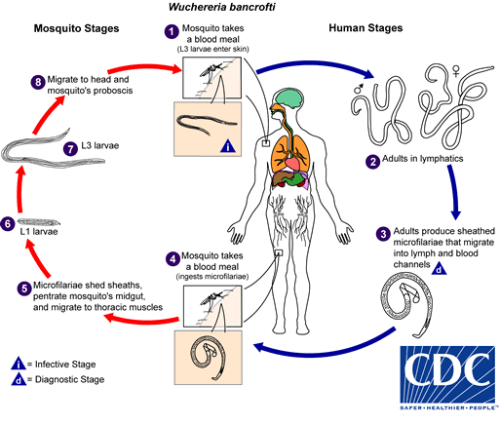



Slide 66
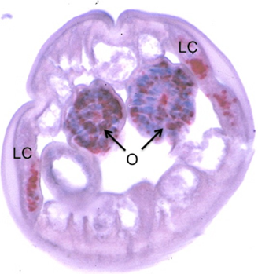
Filaria and Wolbachia
Wolbachia is a bacterial endosymbiont
Doxycline 200mg/day x 6-12 weeks
  Lymphatic filariasis
  Onchocerciasis
Notes:
Fig 1 Distribution of Wolbachia in filarial nematodes. Cross section of adult female B. malayi stained with antibody to Wolbachia surface protein (WSP). Wolbachia (red) are present in the lateral cords (LC) and ovaries (O)

Slide 67
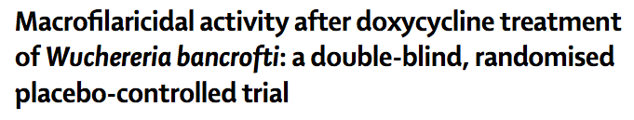
RCT of 72 people with lymphatic filariasis in Tanzania
8 weeks of doxycycline
  Cleared microfilaremia
  Reduced the number of adult worms

Slide 68
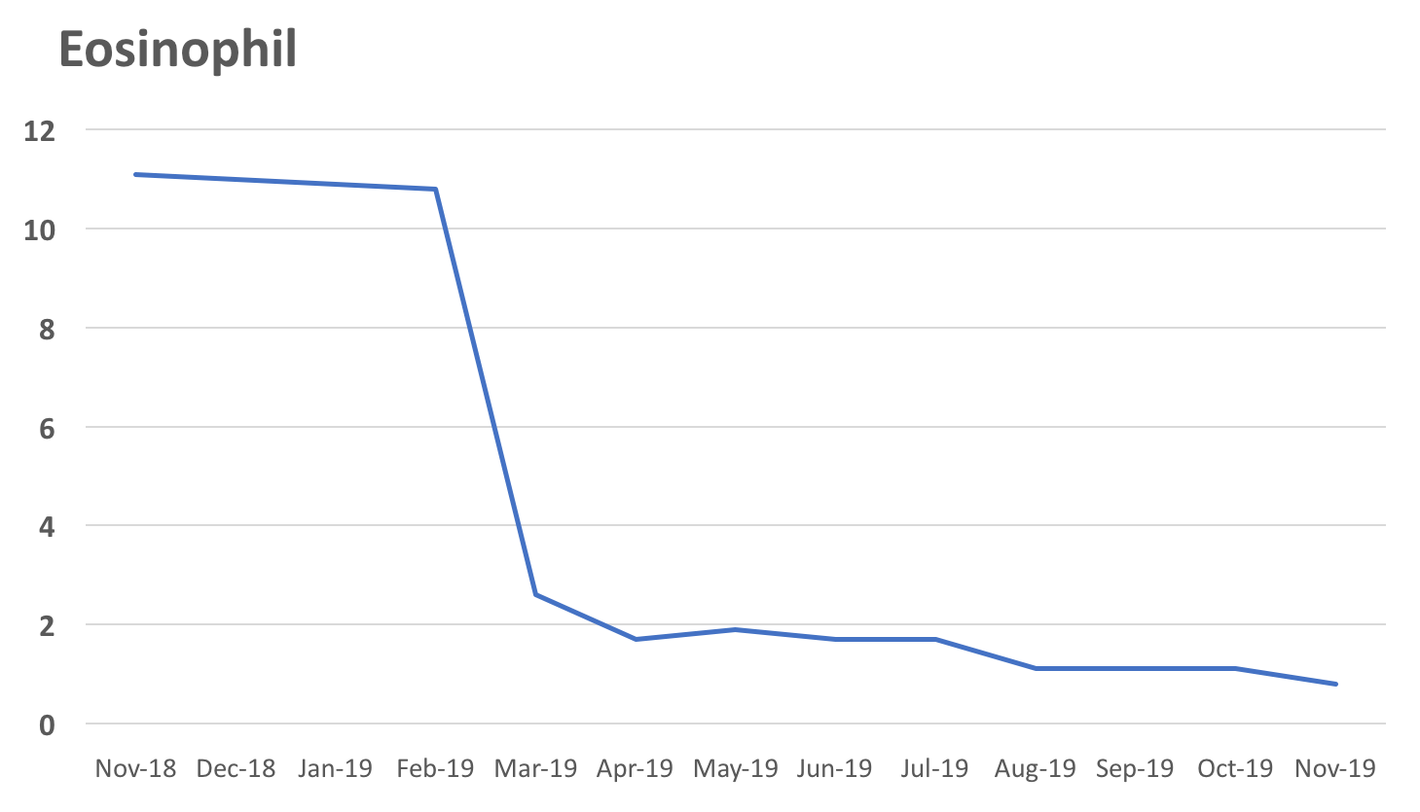
Case 2
Refugee from Sri Lanka
62M from Sri Lanka
  Cough and shortness of breath, normal CT chest
  Eosinophilia, high IgE and positive filaria serology
Starts DOXYCYCLINE 100mg BID x 12 weeks
  Clear clinical improvement within 1 week
  Less short of breath

Slide 69
Case 3
Eosinophilia, endocarditis, and multiple strokes
52F previously well
10 day history of gradually progressive confusion
  Preceded by a diarrheal illness about 3 weeks previously
On examination
  Well, no fever, no murmurs, and normal motor and sensory exam
  Splinter hemorrhages
Eosinophilia 4.9X109 cells/L
Blood cultures negative
Notes:
To describe a case of hypereosinophilic syndrome (HES) causing multifocal embolic strokes.
Background:
HES is a rare and heterogenous group of disorders. This can be a result of clonal expansion of eosinophilic progenitors (primary eosinophilia), polyclonal expansion of eosinophils in response to cytokine release (secondary eosinophilia) or idiopathic. Neurologic manifestations are relatively rare in these conditions however encephalopathy, strokes and peripheral neuropathy can occur.
Design/Methods:
This is a case report describing neurological complications of hypereosinophilia in a patient admitted to a tertiary centre.
Results:
A previously healthy 52 year old woman experienced a 10 day history of insidiously progressive confusion with preceding GI upset and diarrhea. On examination, she was afebrile with normal vital signs and a normal neurological examination. Splinter hemorrhages were found in both hands. Bloodwork showed a persistently elevated eosinophil count (4.9X109 cells/L) and MRI revealed multi-focal acute cerebral infarcts. Flow cytometry revealed a persistently increased population CD4 positive/CD7 negative lymphocytes and T cell clonality by PCR was negative. An echocardiogram revealed cardiac valve inflammatory thickening. Blood cultures were persistently negative as was investigation for parasites, vasculitis and malignancy and a working diagnosis of lymphocyte variant hypereosinophilic syndrome (L-HES) was made. Treatment with both anticoagulation and corticosteroids were required to prevent further micro-embolic events. She improved clinically with no recurrent neurologic symptoms at time of follow up.
Serology for parasites included:
1. Filaria-borderline positive, OD 0.34 (cutoff 0.30). Her filaria antigen
at the national reference laboratory in Montreal was negative.
2. Strongyloides-nonreactive.
3. Schistosomiasis-nonreactive.
4. Toxocara-nonreactive.
5. Trichinella-nonreactive.
Additional serology for infectious agents and causes of culture-negative
endocarditis included:
1. Bartonella henselae-nonreactive.
2. Brucella-nonreactive.
3. Coccidioides-nonreactive.
Mrs. Svensson was born in Sweden, and her travels included several months in
Thailand and Malaysia in 1982; a visit to India and Nepal in 1994, including
the Himalayas for several months; then in 2011, a several week trip to Vietnam
and Cambodia; in June 2014, she had traveled to Mexico; and shortly before
then, a 3-week stay in NCosta Rica.
he MRI of the head
showed numerous scattered foci of restricted diffusion throughout the cerebral
cortex and subcortical white matter, in keeping with numerous tiny subacute
infarcts likely from an embolic source. More specifically, the infarcts were
seen in bilateral frontal and parietal distribution, left cerebellum, left
caudate nucleus and possibly bilateral occipital pole lesions.
In addition,
on admission she had a slightly elevated troponin at 0.94, which peaked at
1.13 by 3 a.m. the next day.
The consultation and investigations organized by the Cardiology team revealed
thickening of the aortic valve, as well as the metrial valve leaflets and
filamentous mobile echo densities attached to the cord immediately below the
tip of the anterior leaflet. There was also papillary muscle in chordae
thickening indicative of a inflammatory process on transesophageal
echocardiogram.

Slide 70
Case 3
Eosinophilia, endocarditis, and multiple strokes
52F previously well
10 day history of gradually progressive confusion
  Preceded by a diarrheal illness about 3 weeks previously
On examination
  Appeared well, no fever, no murmurs, and normal motor and sensory exam
  Splinter hemorrhages
Eosinophilia 4.9X109 cells/L
Blood cultures negative
CT head normal
Notes:
To describe a case of hypereosinophilic syndrome (HES) causing multifocal embolic strokes.
Background:
HES is a rare and heterogenous group of disorders. This can be a result of clonal expansion of eosinophilic progenitors (primary eosinophilia), polyclonal expansion of eosinophils in response to cytokine release (secondary eosinophilia) or idiopathic. Neurologic manifestations are relatively rare in these conditions however encephalopathy, strokes and peripheral neuropathy can occur.
Design/Methods:
This is a case report describing neurological complications of hypereosinophilia in a patient admitted to a tertiary centre.
Results:
A previously healthy 52 year old woman experienced a 10 day history of insidiously progressive confusion with preceding GI upset and diarrhea. On examination, she was afebrile with normal vital signs and a normal neurological examination. Splinter hemorrhages were found in both hands. Bloodwork showed a persistently elevated eosinophil count (4.9X109 cells/L) and MRI revealed multi-focal acute cerebral infarcts. Flow cytometry revealed a persistently increased population CD4 positive/CD7 negative lymphocytes and T cell clonality by PCR was negative. An echocardiogram revealed cardiac valve inflammatory thickening. Blood cultures were persistently negative as was investigation for parasites, vasculitis and malignancy and a working diagnosis of lymphocyte variant hypereosinophilic syndrome (L-HES) was made. Treatment with both anticoagulation and corticosteroids were required to prevent further micro-embolic events. She improved clinically with no recurrent neurologic symptoms at time of follow up.

Slide 71
Case 3
Eosinophilia, endocarditis, and multiple strokes
MRI
  numerous scattered foci suggestive of tiny subacute infarcts
  likely from an embolic source …
Echocardiogram
  Mitral valve and chordae thickening

Slide 72
Case 3
Eosinophilia, endocarditis, and multiple strokes
52F previously well
10 day history of gradually progressive confusion
  TTE = cardiac valve thickening
  MRI = multifocal acute cerebral infarcts
Eosinophilia 4.9X109 cells/L
  What next?

Slide 73
Case 3
Eosinophilia, endocarditis, and multiple strokes
52F previously well
10 day history of gradually progressive confusion
  TTE = cardiac valve thickening
  MRI = multifocal acute cerebral infarcts
Eosinophilia 4.9X109 cells/L
  Stool O&P Presence of Dientamoeba fragilis
  Serology - Strongyloides - NEG
  - Schistosomiaisis - NEG
  - Filaria - POS/NEG
  - Toxocara - NEG

Slide 74


Case 3
Eosinophilia, endocarditis, and multiple strokes
Dientamoeba fragilis and Charcot leyden crsytals seen in stool

Slide 75
Case 3
Eosinophilia, endocarditis, and multiple strokes
52F previously well
10 day history of gradually progressive confusion
  TEE = valves thickened and filamentous mobile densities
  MRI = multifocal acute cerebral infarcts
Hematology work-up including bone marrow → “normal”
Treatment
  Prednisone 1mg/kg x 2 weeks then taper
  Heparin/Warfarin x 3 months
  Metronidazole x 2 weeks
Recovered fully!

Slide 76
Case 4
Eosinophilic meningitis
6 year old boy
  Autistic
  Otherwise healthy
Presented in the summer to Sick Kids Hospital with increasing lethargy and irritability
  Started with “fussy eating” 2 weeks ago
  Much worse the last 2 days
    Lethargic, crying, refusing to eat, incontinent

Slide 77
Case 4
Eosinophilic meningitis
In the ER
  Lethargic – “nil focal”
Investigations
  WBC 11.6, Eosinophils 2.78
  Abdo U/S – normal
Dx: constipation
    given IV fluids and enema → home
    “check stool for parasites if symptoms persist”

Slide 78
Case 4
Eosinophilic meningitis
Returned to ER
  Condition worsening – more lethargic/crying
  IV fluids and admitted for observed
In hospital became obtunded; GCS 8
  Remained afebrile, no meningeal signs
  CT head - normal
Notes:
In hospital became obtunded
Unresponsive to verbal stimuli; GCS 8
Remained afebrile, no meningeal signs
CT head - normal

Slide 79
Case 4
Eosinophilic meningitis
Investigations
  Complete blood count
    WBC 12.9, Eosoinophils 3.62
  LFTs and creatinine - normal
LP
  Cell count (cells/μl)
    0 RBC
    22 WBC - 30% eosinophils
Notes:
protein 0.38 g/L
glucose 3.9 mM-
CSF = 30% eos, 49% lymphs, 16% monos

Slide 80
Case 4
Eosinophilic meningitis
Summary:
  Progressive lethargy and irritability
    Lower limb hypertonicity, decorticate posturing
    No neck stiffness
  Laboratory investigations
    Peripheral eosinophilia
    CSF eosinophilia
  ? Travel history
  ? Exposure history
Notes:
Exposure history
Lives with parents and 5 year old brother in the beaches district in Toronto
No pets
No raw foods, seafood, snails
Going to summer day camp in Markham
Swimming in a pool
Visit farm in Collingwood 2 weeks before symptoms
Travel history
UK at age 2
St Lucia at age 3 – hotel/resort

Slide 81


Case 4
Eosinophilic meningitis
  “Lots of raccoons in the backyard”
  “Often puts his hands in his mouth, even if they are covered in dirt”

Slide 82


Baylisascaris procyonis
Neural larva migrans (similar to Toxocara)
Baylisascaris (racoon roundworm) like Toxocara (dog roundworm)
cannot complete normal life cycle in the human, and migrates from the
gut to other tissues…

Slide 83
Case 4
Eosinophilic meningitis
Diagnosis
    Serology and field investigation
Management
    Methylprednisone + Albendazole
  Some improvement
    Could eat independently
    Non-verbal
    Seizure disorder

Slide 84
Eosinophilic meningitis
Top parasitic causes
Angiostrongyliasis
    SE Asia, Caribean
    Snails, shrimp
    Headaches
Gnathostomiasis
    SE Asia
    Fish, meats
    Painful radiculopathy
Baylisascariasis
    N America
    Racoon stool
    CNS changes, also OLM
Toxocariasis
    Worldwide
    Dog and cat stool

Slide 85

Daptomycin….
Notes:
diffuse bilateral patchy consolidations and multiple nodules in the peripheral regions
(1) concomitant exposure to DAP, (2) a fever, (3) dyspnea either with increased oxygen requirement, or requiring mechanical ventilation, (4) new infiltrates on chest X-ray or CT, (5) BAL with ＞25% eosinophils, and (6) clinical improvement following discontinuation of DAP.
2-6 weeks

Slide 86
Eosinophilia in BC
27F, previously well
  2 weeks of nausea, diarrhea, muscle weaknes
  Began:
    a few hours after eating pork
    2 weeks after starting a probiotic and fish oil
Date | Eosinophil count | IgE (< 430 ug/L)
June 28 | 6.0
June 29 | 4.0 | 77
August 26 | 0.4 | 17
Notes:
Toxic oil syndrome and eosinophilia-myalgia syndrome are two disease entities with similar courses, for which the etiology is associated with the consumption of contaminated food. Both of these entities were described in the 1980s and were epidemic. The epidemic of toxic oil syndrome began in 1981 in Spain. The cause was the consumption of rapeseed oil contaminated with aniline, which was intended for use in industry, but was illegally sold for human consumption. In turn, eosinophilia-myalgia syndrome appeared in 1989 for the first time in the United States. Its presence is associated with the consumption of L-tryptophan, which was a popular nutritional supplement at that time. Probably, contamination of L-tryptophan by 3-(phenylamino)-alanine led to the occurrence of the epidemic.N

Slide 87
Recap
Eosinophilia = marker of a tissue invasive helminth infection
  Normal eosinophil count does not rule out a potentially serious helminth infection (strongyloides)
  Sepsis and steroids lowers eosinophil counts
  Protozoa and fungi don’t cause eosinophilia *important exceptions*
Investigations:
  Stool O&P
    May be negative in pre-patent period
    Common soil transmitted helminths
  Serology
    Strongyloides is not to be missed
    Schistosomiasis considered for all from Africa
    Consider filaria
    Consider toxocara (esp in children)
Further testing based on:
    Exposure history
    Clinical presentation

Slide 88
Additional sides

Slide 89


Chest pain and Eosinophilia in a Traveler to Canada
30M, “survivalist challenge” in N Canada
  Hunted animals including fish, foxes and rabbits
2 weeks into trip – episode of diarrhea
5 weeks into trip – fever and pleuritic chest pain
  Returned to US/hospital
  Fever, eosinophil count 11,000 , troponin 0.37
  Cardiac MRI →
AJM August, 2020

Slide 90

Eosinophilia case
? probiotic
55F, previously well
  Sudden onset of myalgia, arthalgia, malaise, night sweats, asymmetric leg weakness, and right foot drop
    WBC 29.7, with 56% eosinophils (16.6)
    EMG and NCS → mononeuritis multiplex
    Sural nerve biopsy → necrotizing eosinophilic vasculitis
  Normal blood flow cytometry and cytogenetics
  ANCA negative
2 weeks earlier started a new probiotic….
Notes:
probiotics described as an “extra-strength concentration” in a boxed blister pack, purchased overthe-counter in a Philadelphia metropolitan area pharmacy
Anti–IL-5 is now an approved therapy for EGPA. It remains to be seen whether eosinophil-targeted therapy would be helpful in other autoimmune diseases with associated blood eosinophilia.

Slide 91
Eosinophilia-myalgia syndrome
L-tryptophan
1989 - outbreak of new syndrome in the US
  1,500 case and 30 deaths
Characterized by:
  subacute onset of myalgias and eosinophilia
  chronic muscle, nerve, fascia, and skin changes
Traced to contaminated L-tryptophan supplements
Arthritis Rheum. 2011;63(11):3633-3639
Notes:
Allen JA, Peterson A, Sufit R, et al. Post-epidemic eosinophilia-myalgia syndrome associated with L-tryptophan. Arthritis Rheum. 2011;63(11):3633-3639. doi:10.1002/art.30514

