Slide 1
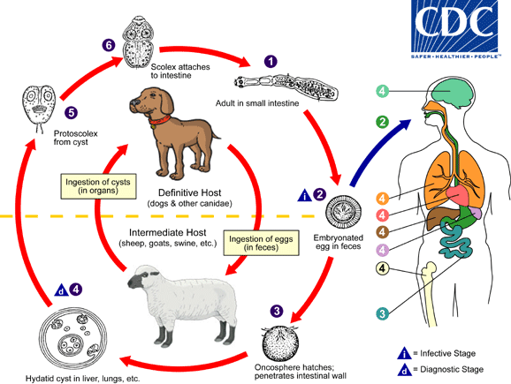
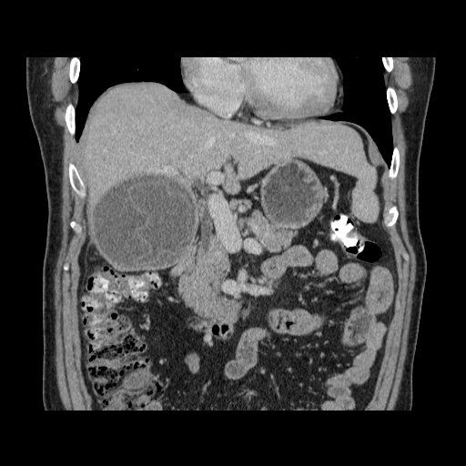
Echinococcosis
Nov 2024
Jan Hajek
Notes:
Horton RJ. Albendazole in treatment of human cystic echinococcosis: 12 years of experience. Acta Trop 1997;64:79-93.
McManus DP, Gray DJ, Zhang W, Yang Y. 2012. Diagnosis, treatment, and management of echinococcosis. BMJ 344:e3866. https://doi.org/10.1136/bmj.e3866.

Slide 2
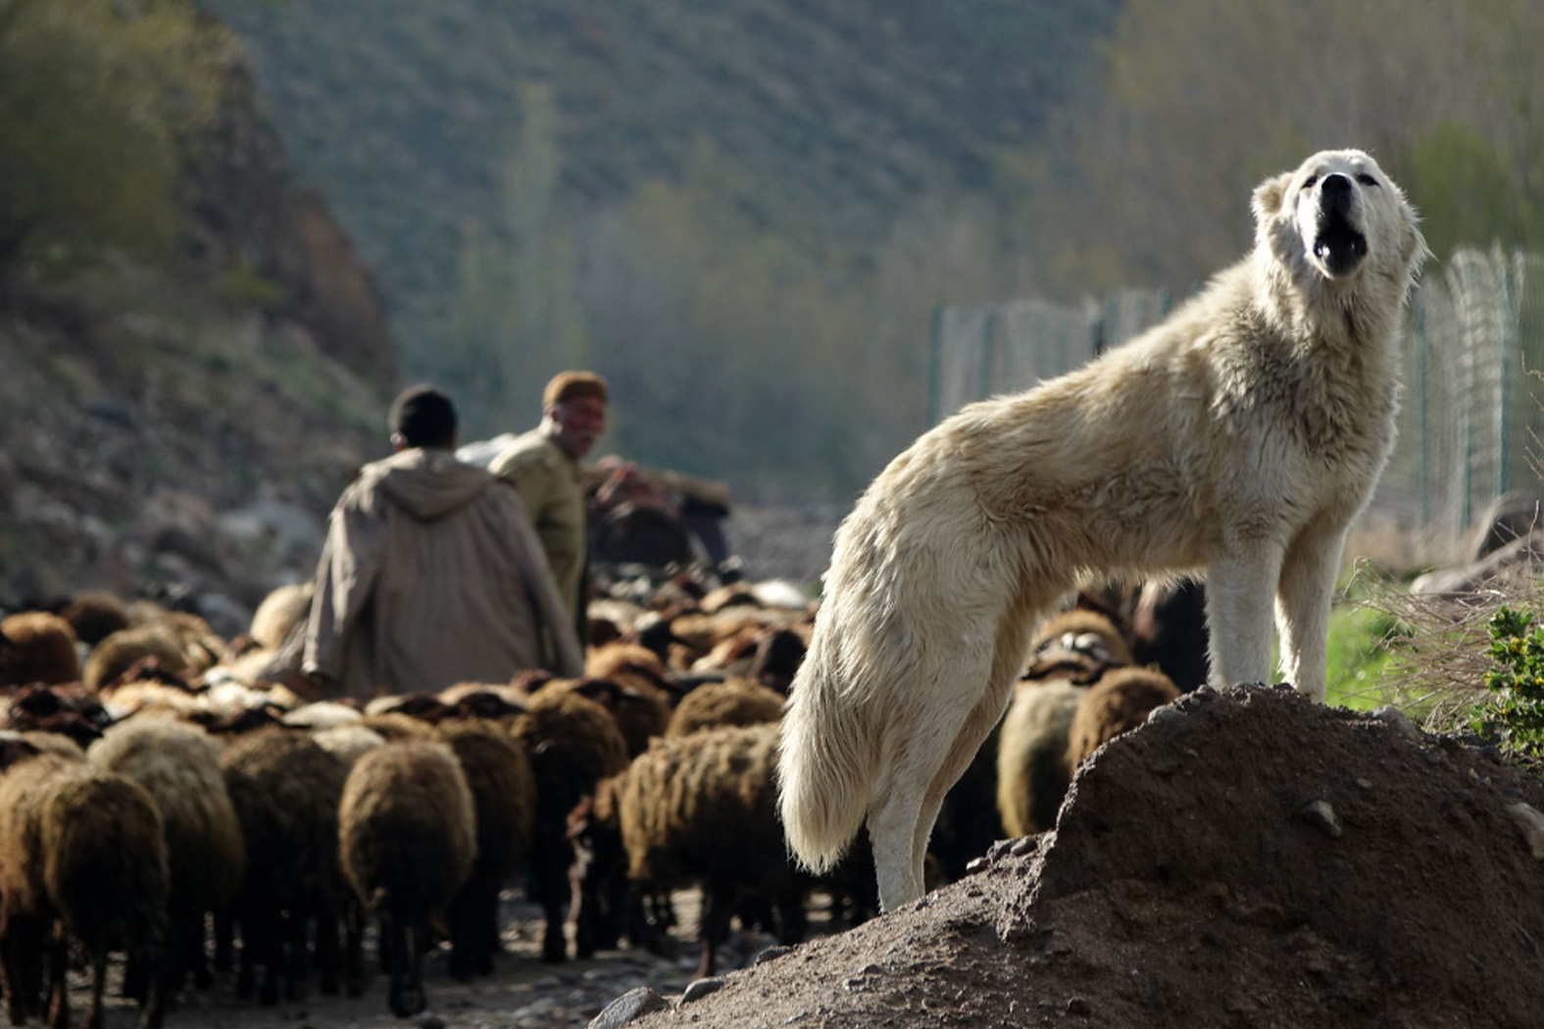
Echinococcosis
Outline
Overview of Echinococcus infections
  2 types – Cystic and Alveolar
  Life cycle
  Diagnosis and management
Cases:
  50M from Turkey
  20M from Northern BC
  25F from Syria
  50M from Iran/world traveler
  34F from Williams Lake
One health
  Interdependence (improving animal health → improves human health)

Slide 3
Parasitology
Classification
Unicellular
Protozoa
  Enteric (Giardia)
  Non-Enteric (malaria)
Multicellular
Helminths
  Nematodes (roundworms)
  Trematodes (flukes)
  Cestodes (tapeworms)
Notes:
Helminths vs protozoa
Multicellular vs Unicelular
Most helminths do not multiply in the host

Slide 4
Classification
Multicellular (Helminths)
Nematodes
  Intestinal
    Ascaris
    Hookworm
    Strongyloides
    Whipworm
    Pinworm
  Tissue
    Toxocara - larva migrans
    Trichinella and Guinea w.
    Filaria
    Angiostrongyliasis
Cestodes (Tapeworm)
  Dog
  Pork
  Beef
  Fish
Trematodes (Flukes)
    Schistosomiasis
    Liver
    Lung
    Intestinal

Slide 5
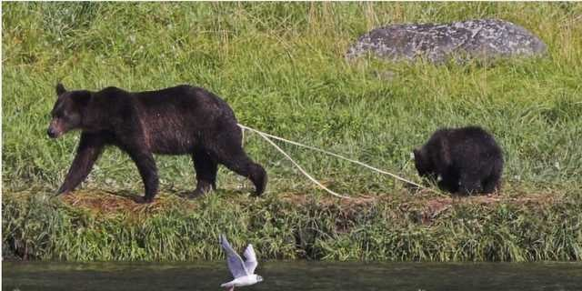
Tapeworms
> 6,000 species
Adults have a head (scolex), neck, and body (proglottids)
  Human (intestinal stage)
    Taenia (Beef and Pork)*
    Diphyllobothrium (Fish)
    Hymenolepis (Rat)
  Dog (intestinal stage)
    Dipylidium
    Echinococcus
Adult worm -- definitive host
Cysts -- intermediate host
Notes:
> 6,000 species

Slide 6
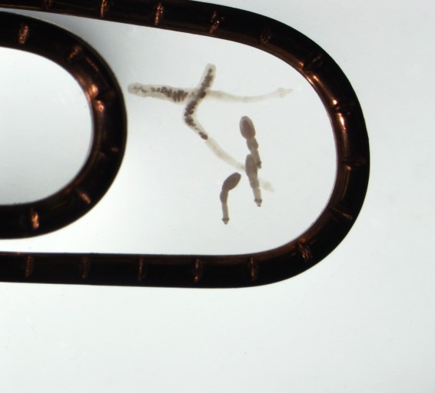
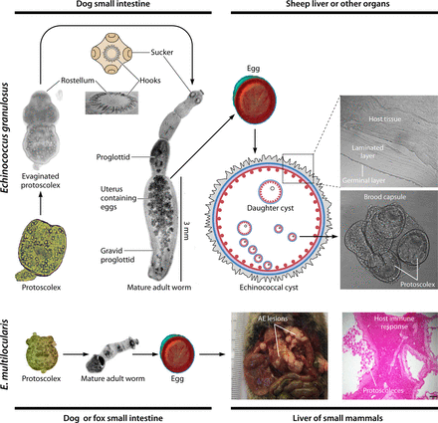
Echinococcus
Dog tapeworm
E. granulosus
E. multilocularis
Notes:
The adult tapeworm inhabits the small intestine of the definitive host. The definitive host may be infected with thousands of worms. E. granulosus worms are usually 2 to 7 mm long and consist of a scolex with suckers and hooks as well as at least three proglottid segments. E. multilocularis worms are up to 4 mm long with two to six proglottic segments.
Eggs are highly resistant and can remain infective for a year in a moist environment at low temperature. For example, eggs of E. multilocularis can remain viable for 16 months in water at a temperature of 4°C (39.2°F) [4]. Eggs are sensitive to desiccation.

Slide 7
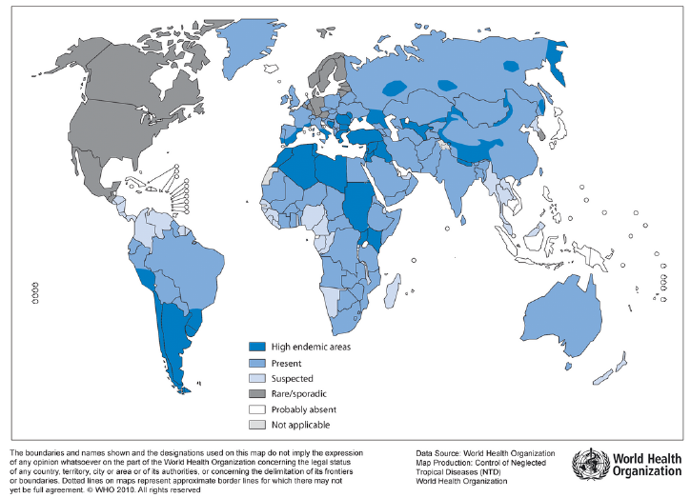
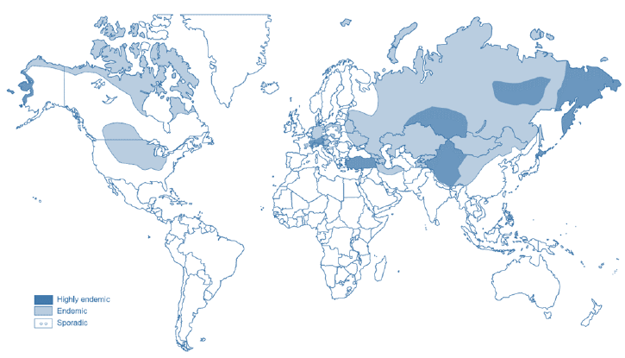
Echinococcus
Epidemiology
> 1 million people affected
  Most are Cystic Echinococcus
Notes:
About 18 000 new cases of AE occur annually
Endemic regions
Prevalence as high as 10% in parts of Peru, East Africa, Central Asia and China
> 30% of slaughtered animals

Slide 8
Echinococcosis
Basic life cycle
Carnivore (dog, wolf, fox, coyote)
  Definitive host
  Adult tapeworm in intestine
  Sheds eggs in stool
Ungulate (sheep, moose, caribou) or rodent (mouse, vole)
  Intermediate host
  Ingests eggs
  Develops cysts in liver and lungs

Slide 9
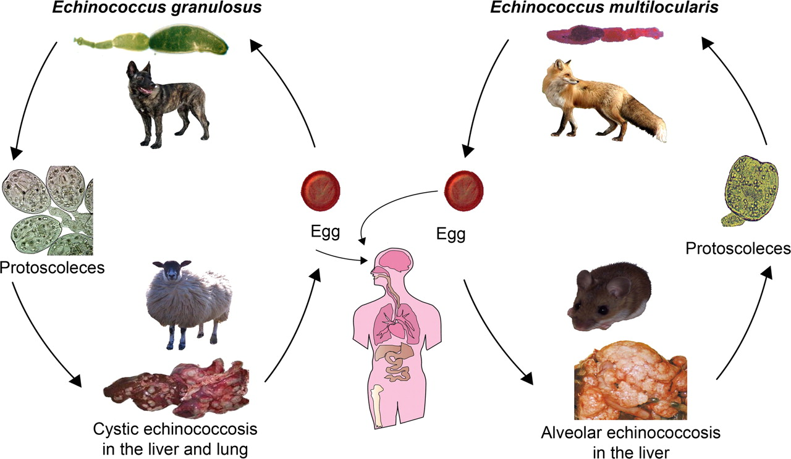
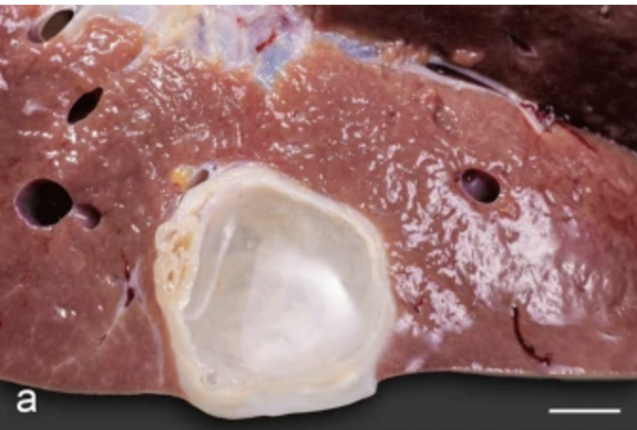
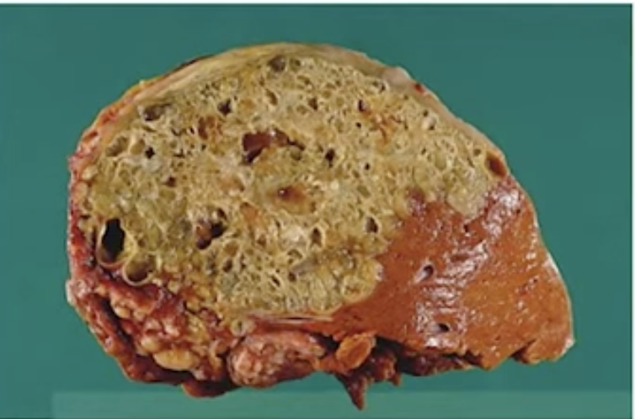

Slide 10
Echinococcosis
Basic life cycle
Cystic echinococcus
  Pastoral
    E. granulosus senso stricto (G1-3)
  Sylvatic
    E. canandensis (G8-10)
Avleolar echinococcus
  Fox tapeworm
    E. multilocularis
    → coyotes in Calgary
Notes:
E. vogeli, E. oligarthus,
Rural South America – rare

Slide 11
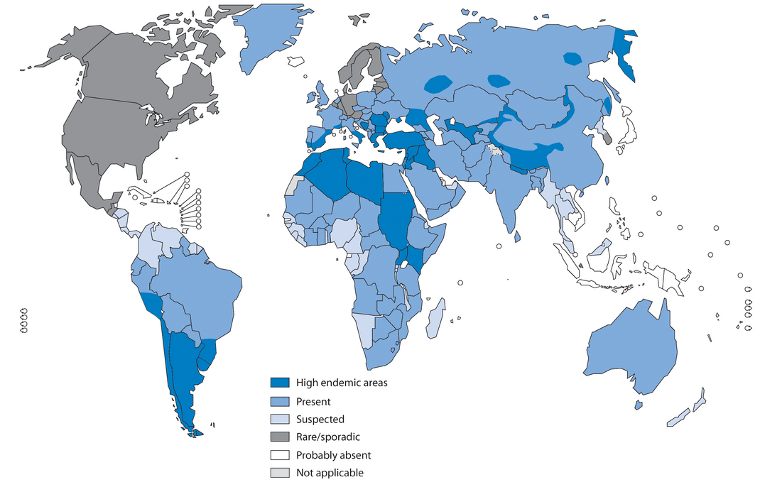
Cystic echinococcus
Notes:
Among the 18,235 estimated new AE cases per year globally, 91% occur in China (7),
with human prevalence of 3% in some areas (25). AE is also endemic in Central Asia,
with high endemicity of both E. multilocularis and E. granulosus in Kazakhstan and
Kyrgyzstan (26–29). In Europe, the prevalence of E. multilocularis in definitive and
intermediate hosts increased markedly within the first 15 years of this century, and the
geographic distribution of fox infections is far broader than earlier reported; urban
foxes may be involved in transmission (13, 17, 30–33). Human cases have been found
in European countries previously considered to be free of AE, and the situation in the
Baltic region has become worrisome; in addition, AE incidence has doubled in the
previously recognized areas of endemicity of France, Switzerland, Germany, and Austria
(13, 34–36).

Slide 12
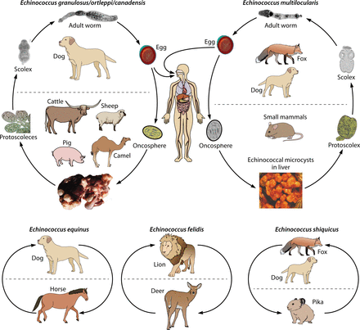
Notes:
Carnivores (canids and felids) serve as definitive hosts for the adult tapeworms, and their herbivorous prey (ungulates, rodents, and lagomorphs) act as intermediate hosts for the metacestodes;

Slide 13
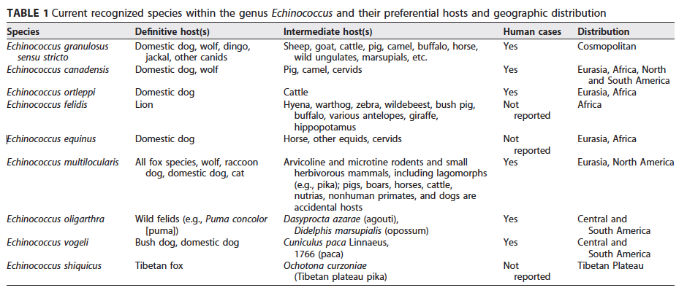
Echinococcus species
Notes:
E. granulosus senso lato → Cystic echinococcus
E. granulosus senso stricto
Dogs, wolves – Sheep, goats, cattle, pig, etc.
E. canadensis
Dogs, wolves – Sheep, caribou, deer
E. ortleppi
Dogs – cattle
E. multilocularis → Alveolar echinococcus
Dogs, coyotes, fox - Small mammals
E. vogeli, E. oligarthus → Neotropical/polycystic
Rural South America – rare
Dogs, wild cats (puma)

Slide 14
Cystic echinococcus
Space occupying, non-infiltrative
Grows slowly
Liver ~80%
Lung ~20%
Generally not associated with eosinophilia

Slide 15
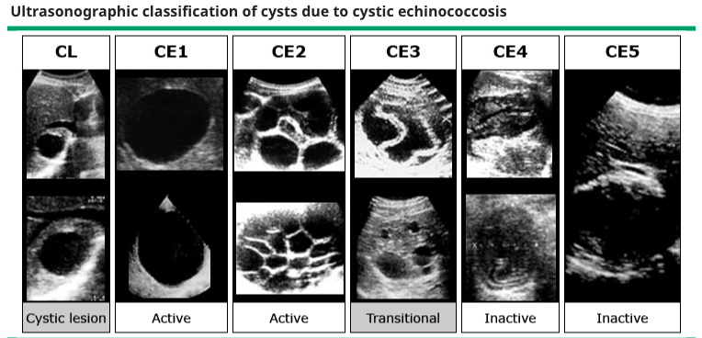
Notes:
(Panel CL) Consists of unilocular, cystic lesion(s) (CL) with uniform anechoic content. The cyst wall is not clearly visible; lesions are usually round but may be oval. If these lesions are caused by cystic echinococcosis at an early stage of development, they are usually not fertile. Definitive diagnosis cannot be made by ultrasound findings alone.
(Panel CE1) Consists of unilocular, simple cyst with uniform anechoic content. The cyst wall is visible; lesions are round or oval. Cyst may exhibit fine echoes due to shifting of brood capsules called hydatid sand ("snow flake sign").
(Panel CE2) Consists of multivesicular, multiseptated cysts. The cyst wall is normally visible; lesions are round or oval. Septations produce "wheel-like" structures. The presence of daughter cysts is indicated by rosette-like or honeycomb-like structures. Daughter cysts may partly or completely fill the unilocular mother cyst.
(Panel CE3) Consists of a unilocular cyst which may contain daughter cysts. Anechoic content with detachment of laminated membrane from the cyst wall may be visible as floating membrane or as "water-lily sign" which is indicative of wavy membranes floating on top of remaining cyst fluid. The cyst form may be less round because of decreased intracystic pressure. The cyst which may degenerate further or may give rise to daughter cysts.
(Panel CE4) Consists of heterogenous hypoechoic or hyperechoic degenerative contents; no daughter cysts are present. A "ball of wool" sign may be seen, which is indicative of degenerating membranes. Most cysts of this type are not fertile. Definitive diagnosis cannot be made by ultrasound findings alone.
(Panel CE5) Cysts characterized by a thick calcified wall that is arch shaped, producing a cone shaped shadow. The degree of calcification varies from partial to complete. These cysts are not fertile in most case. Definitive diagnosis cannot be made by ultrasound findings alone.

Slide 16
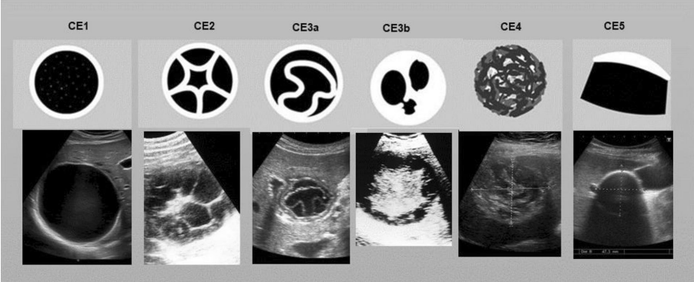
Classification of CE

Slide 17
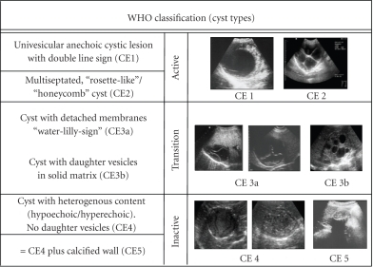

Slide 18
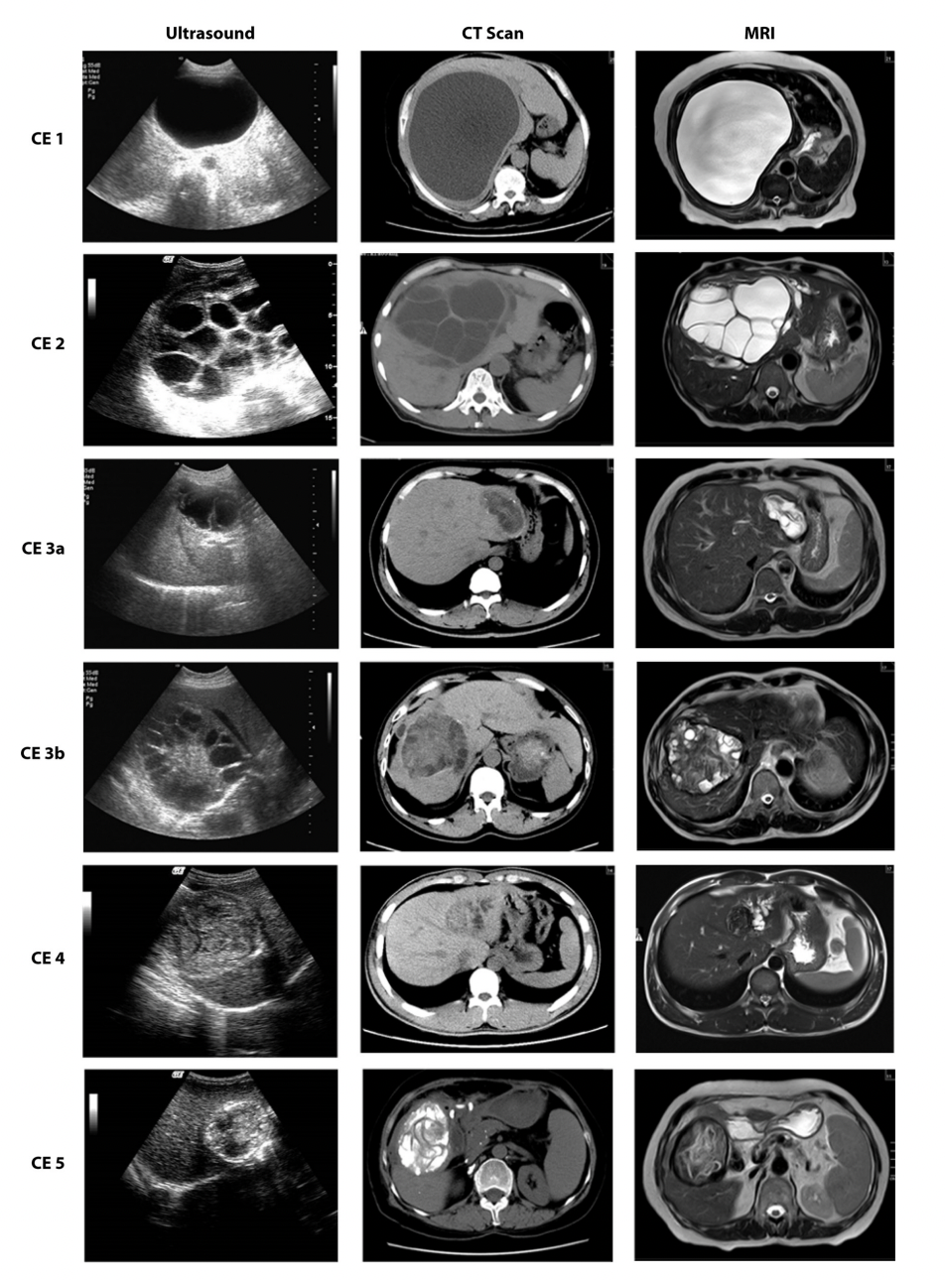

Slide 19
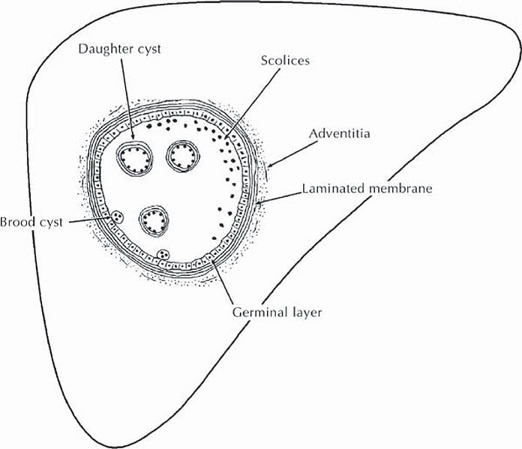

Slide 20
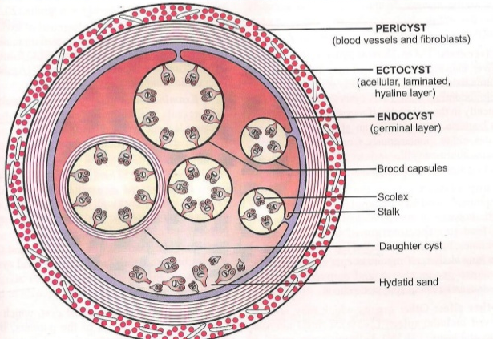
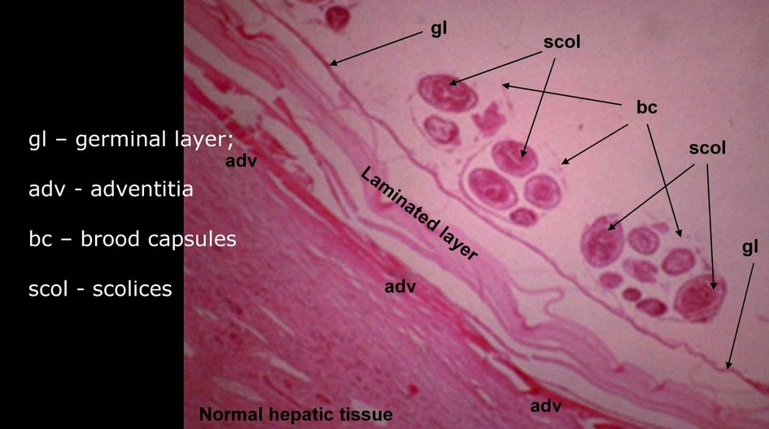


Slide 21
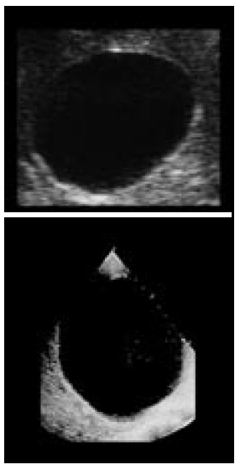
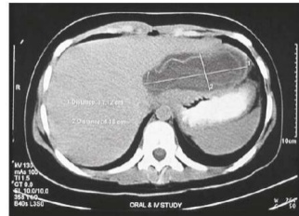
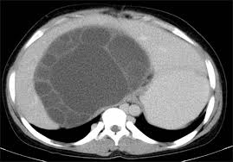
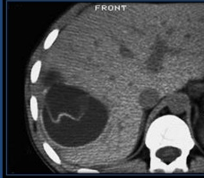
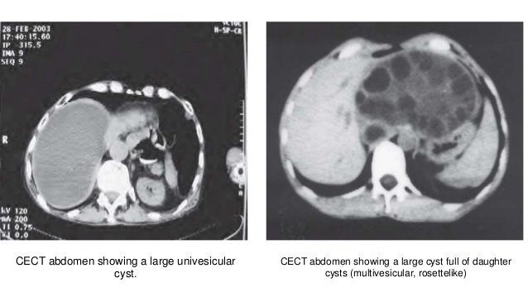
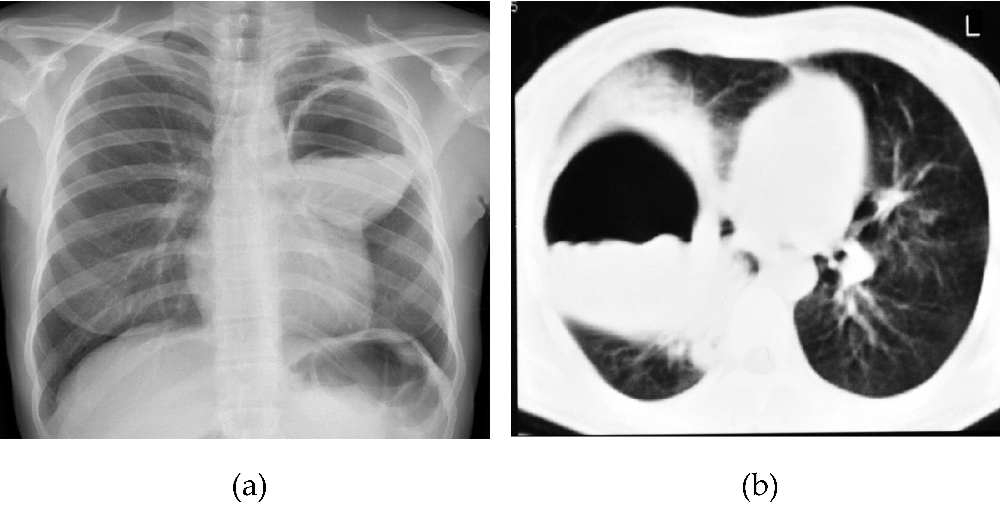
Radiographic features
Notes:
Population screening has shown that CE liver cysts in humans grow very slowly, with more than half of cysts showing no change in size in 10 years and one-third growing less than 3 cm; mean cyst growth in cases with a prolonged follow-up was 0.7 cm

Slide 22
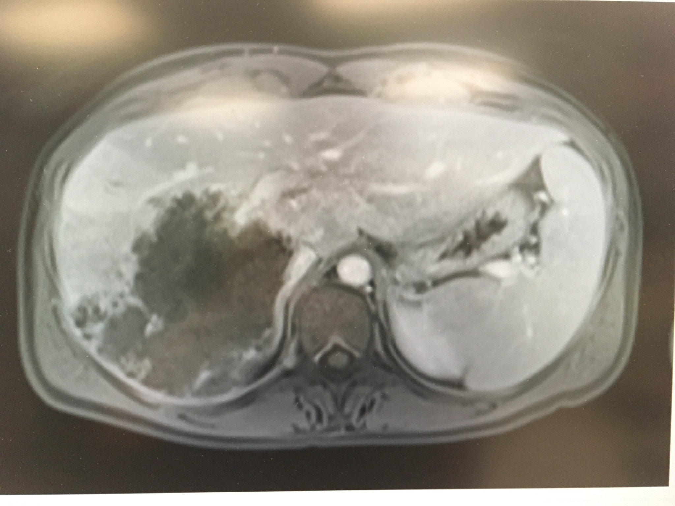
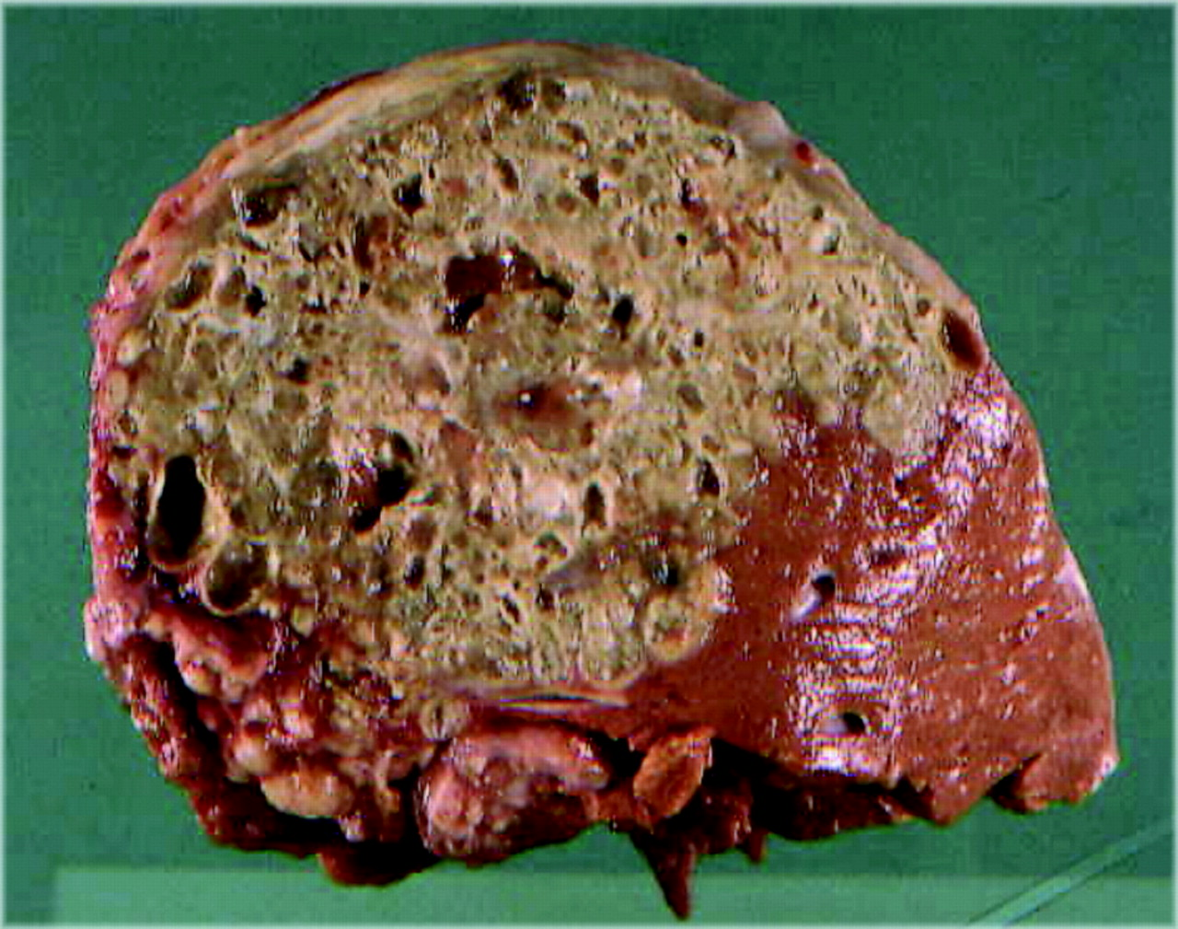

Slide 23
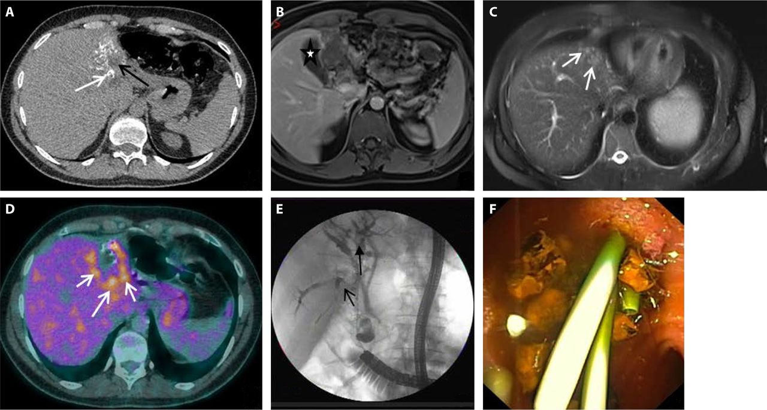
Alveolar Echinococcus
MRI T2 images of small cysts can be pathognomonic for AE
Serology is helpful
Hao Wen et al. Clin. Microbiol. Rev. 2019; doi:10.1128/CMR.00075-18
Notes:
Complementarity of imaging techniques for the diagnosis and preoperative assessment of alveolar echinococcosis (AE) lesions in a patient with portal vein and bile duct invasion by the parasitic lesions. (A) On computed tomography (CT) scanning, the lesion shows the characteristic heterogeneous aspect of AE, with hyperdense calcifications (white arrow) and hypodense area (central necrosis) (black arrow). (B) Fat-suppressed T1-weighted magnetic resonance (MR) image after gadolinium injection at the portal venous phase shows an atrophy of the left liver and invasion of the left portal vein and of the left intrahepatic biliary tree. The lesion is at the contact of the gallbladder (white star) which is not invaded. (C) T2-weighted MR images show the presence of hyperintense microcysts (white arrows), pathognomonic of AE, but also a solid component (Kodama type II).

Slide 24
Serology
85% sensitive for liver cystic echinococcosis
  Less sensitive for lung cysts
>90% for alveolar echinococcosis

Slide 25
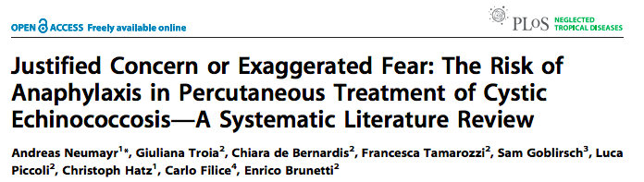
Reviewed ~6,000 published cases managed with percutaneous aspiration
  1.7% transient anaphylactic reaction
  0.04% lethal anaphylactic reaction
..”the risk of severe anaphylactic reactions resulting from percutaneous treatment of echinococcal cysts has been widely exaggerated and the actual risk may be lower than that following administration of certain antibiotics.”
PLoS Negl Trop Dis 5(6): e1154. 2011

Slide 26
Treatment
Cystic echinococcosis
Individualized
  No known “best treatment”
Options:
  Watch and wait
  Albendazole
  IR-guided procedures
    PAIR – Percutaneous Aspiration Instillation Reaspiration
    McCAT – Modified Catheterization Technique
    PeVAC – Percutaneous Evacuation
  Surgery
    Endo-cystectomy - evacuating the cyst
    Peri-cystectomy - resecting the intact cyst en-bloc
    Lobectomy – anatomic liver resection

Slide 27
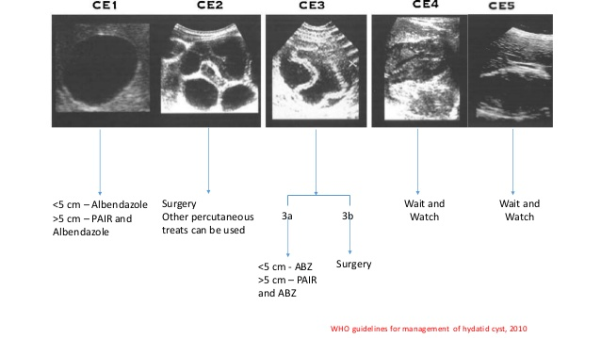
Cystic Echinococcus
WHO guidelines (2010)

Slide 28
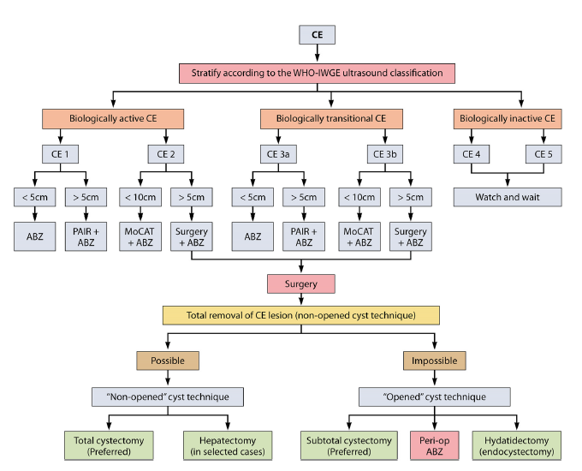

Slide 29
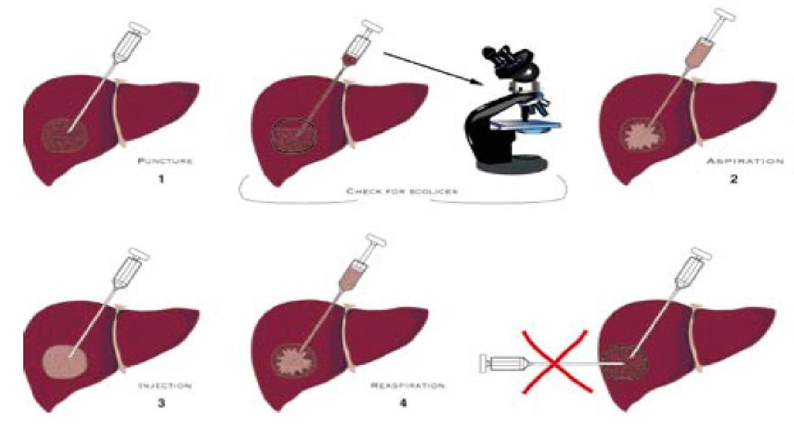
PAIR procedure
Notes:
Hypertonic saline – 15-20%
Chlorhexidine 5%
Hydorgen peroxide 3%
Povidone-iodine 10%
Ethyl alcohol 70-95%

Slide 30
Indications for PAIR
  Nonechoic lesion greater than or equal to 5 cm in diameter
  Cysts with daughter cysts and/or with membrane detachment
  Multiple cysts if accessible to puncture
  Infected cysts
  Patients who refuse surgery.
  Patients who relapse after surgery.
  Patients in whom surgery is contraindicated
  Patients who fail to respond to chemotherapy alone
  Children over 3 years.
  Pregnant women
Contraindications for PAIR
  Non cooperative patients
  Inaccessible or risky location of the liver cyst
  Cyst in spine, brain, and/or heart
  Inactive or calcified lesion
  Cyst communicating with the biliary tree

Slide 31
Darinage for massive liver cysts
For cysts larger than 10 cm, the preferred approach is often the placement of a drainage catheter into the cystic cavity, which is then removed when the drainage volume falls below 10 ml
Notes:
Men S, Yücesoy C, Edgüer TR, Hekimoğlu B. Percutaneous treatment of giant abdominal hydatid cysts: long-term results. Surg Endosc 2006;20(10):1600-1606.

Slide 32
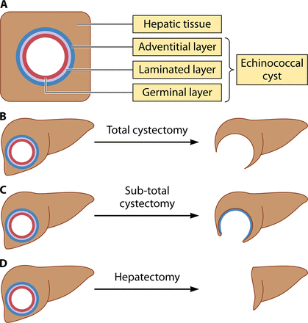
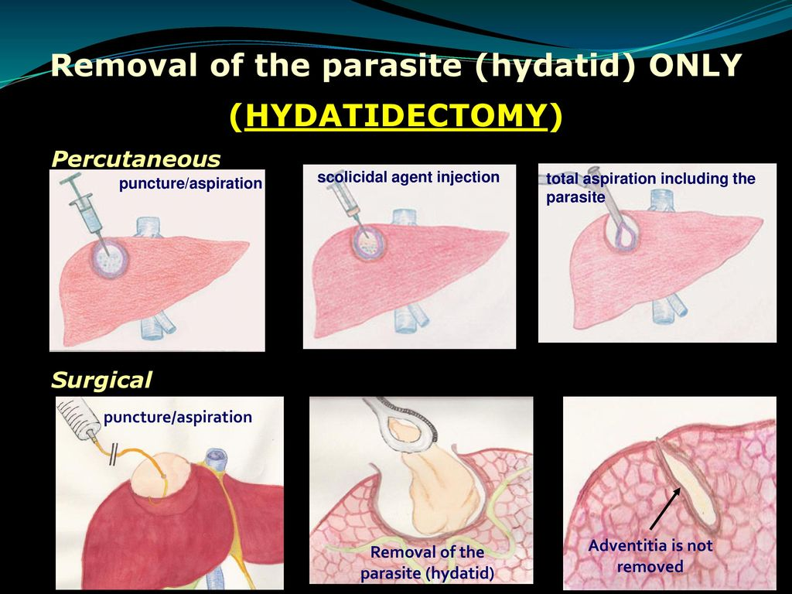
Surgical interventions

Slide 33
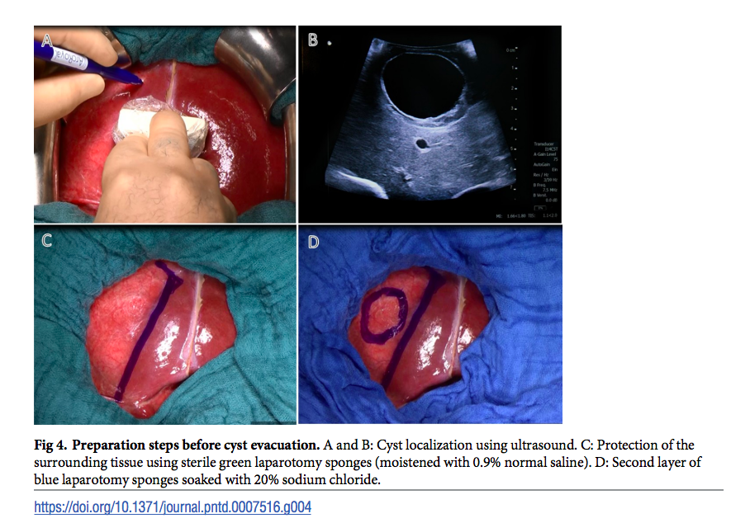

Slide 34
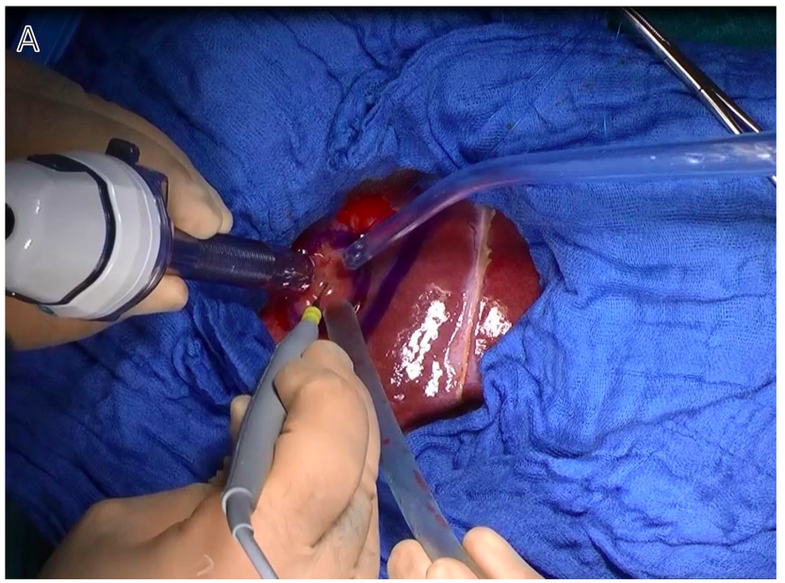
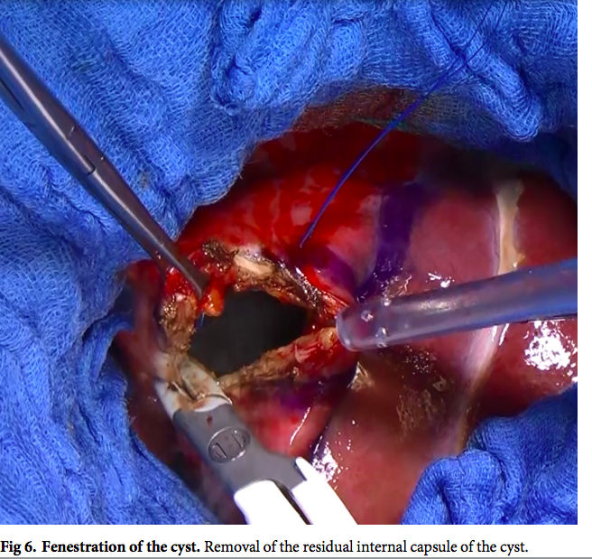
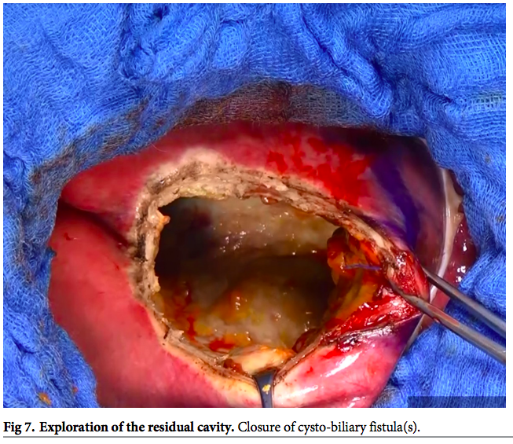
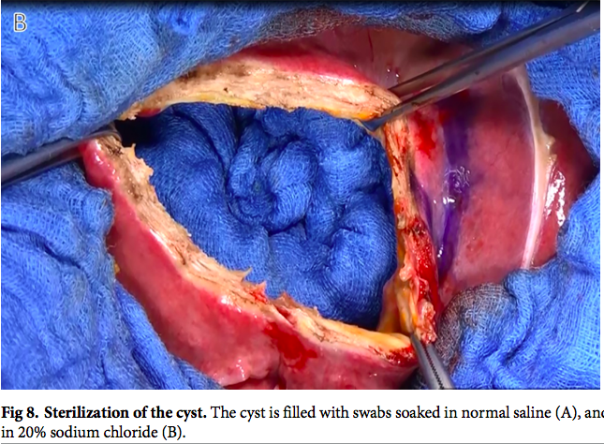
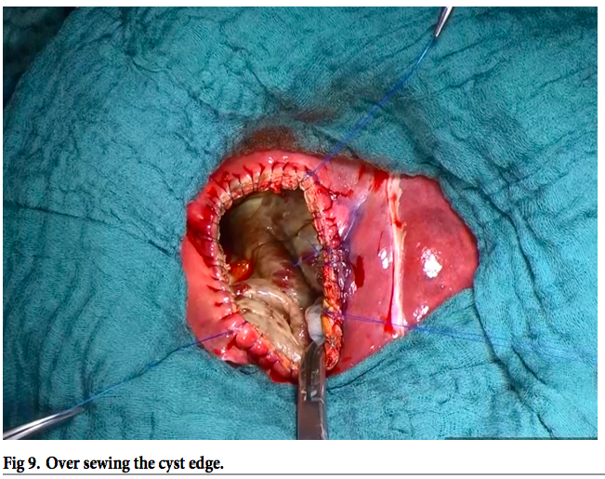
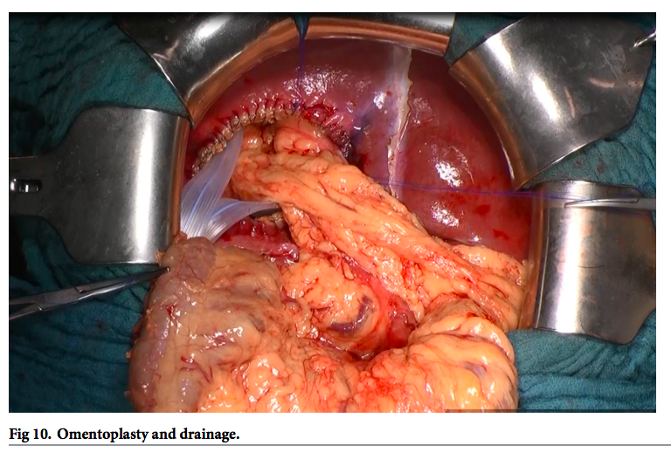

Slide 35
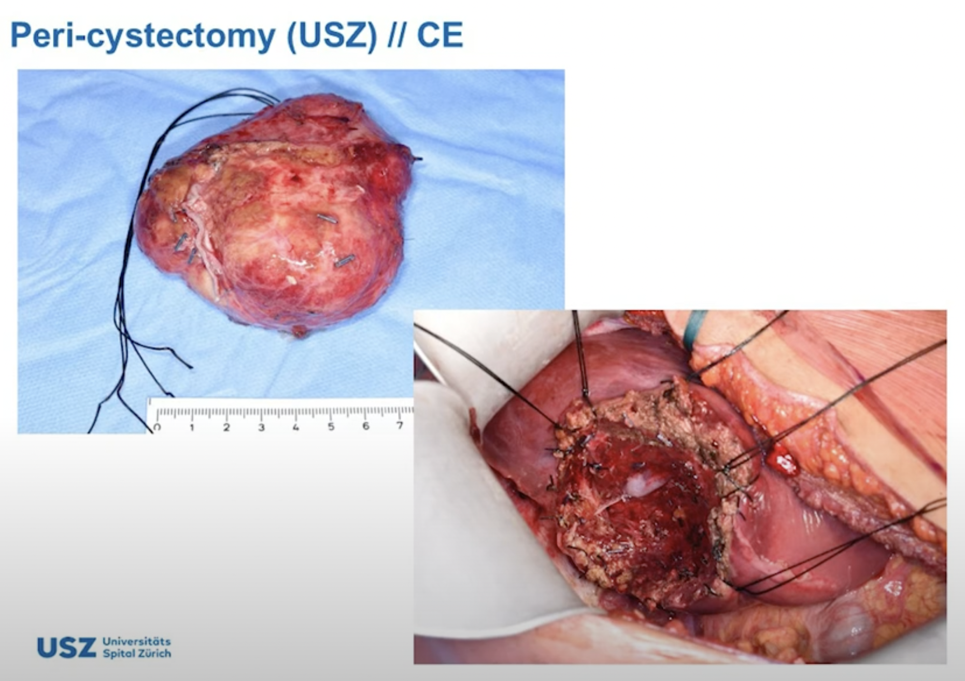
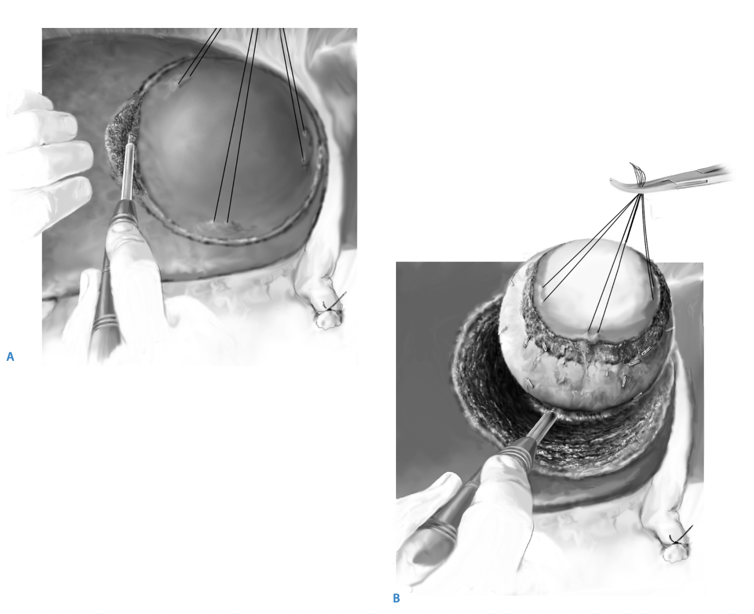
Notes:
https://link.springer.com/content/pdf/10.1007/978-3-540-68866-2_50.pdf

Slide 37
E. multilocularis
Can be lethal without treatment
  Cancerous
  Surgical resection and lifelong albendazole
  Increased risk with immunocompromise
Historically very rare human cases in Canada:
    Several in Alaska (1950s), 1 Manitoba (1928)
2009 a small dog in Quesnel diagnosed with Alveolar Echinococcus
2012 found to be relatively common in stool of coyotes in Calgary…
2013 first case in human in Alberta
    Since then > 20 cases in Alberta…

Slide 38
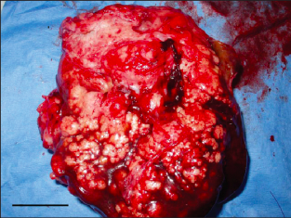
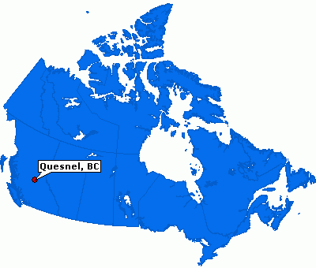
E. multilocularis
Case in Quesnel in domestic dog
Environment scan in surrounding community:
  37% of coyotes infected
  17% of red foxes infected
Liver mass from Shi-tzu/Bichn Frise dog in Quesnel
Notes:
https://www.ncbi.nlm.nih.gov/pmc/articles/PMC3398525/

Slide 39
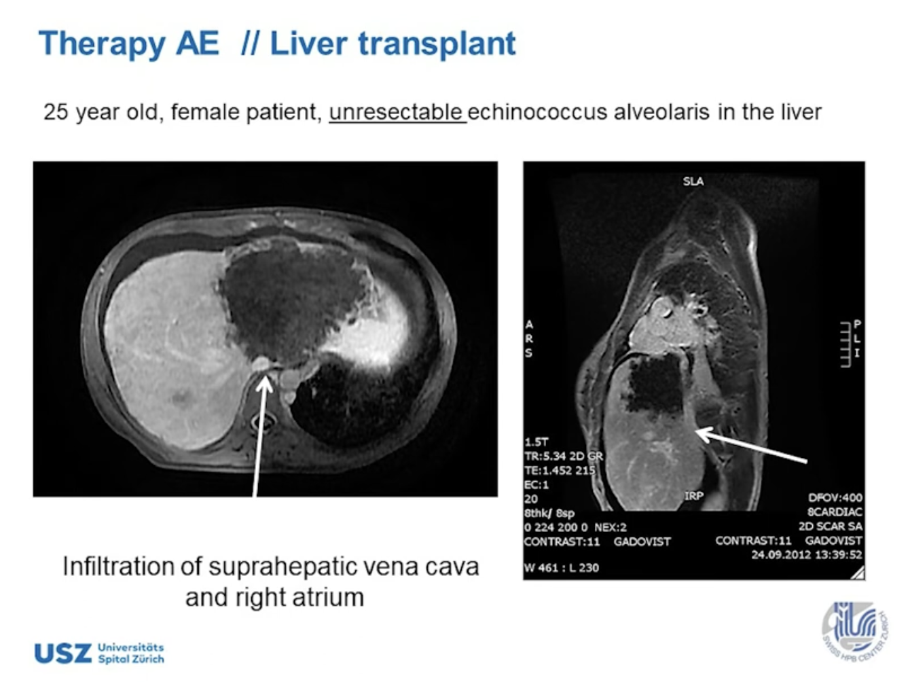
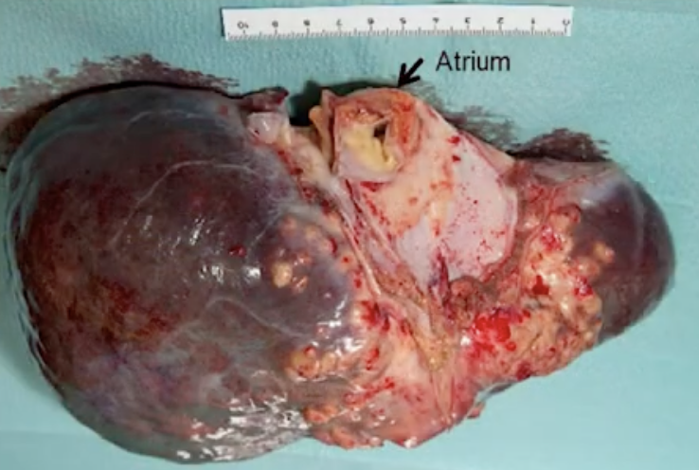

Slide 40
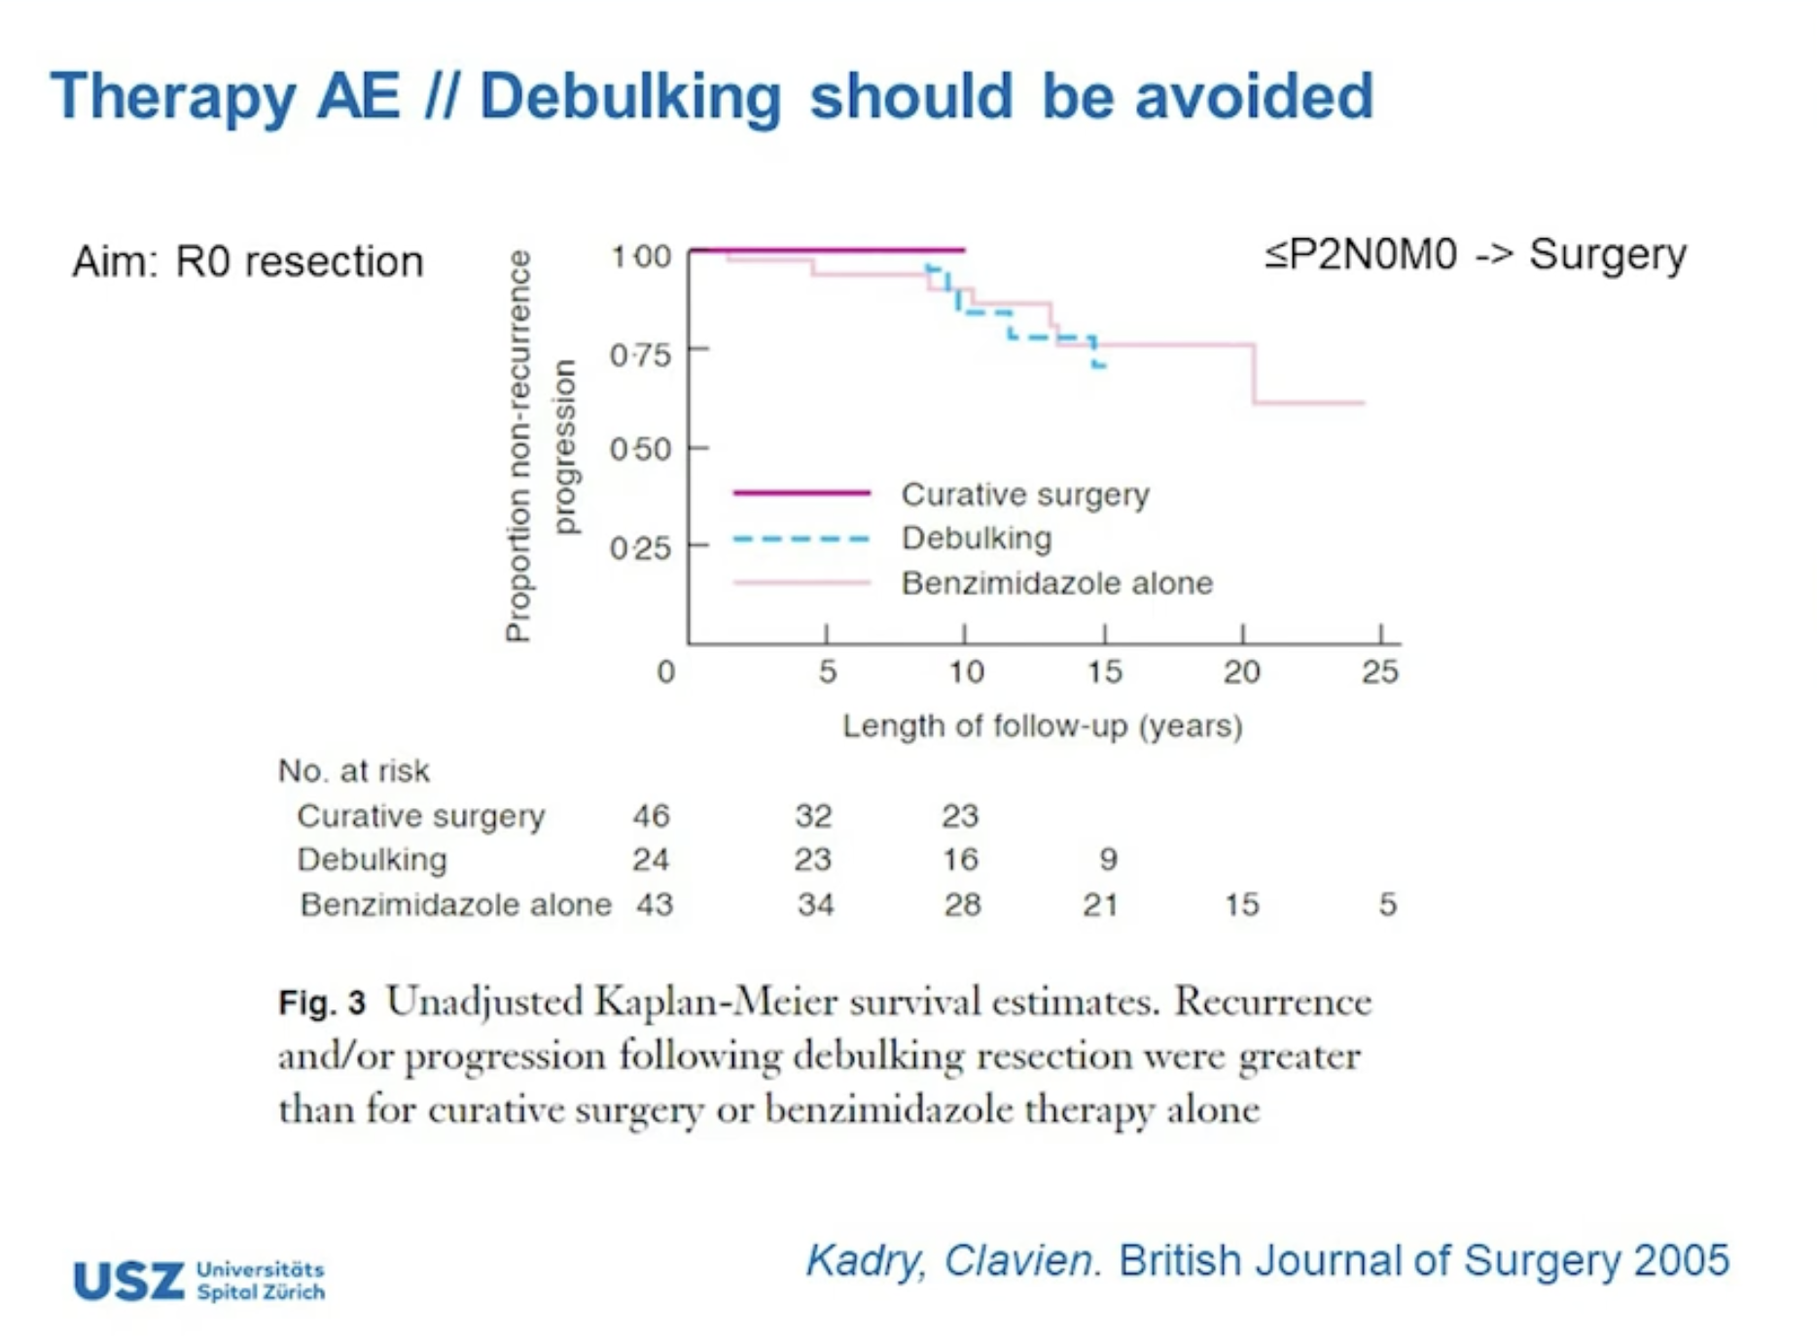
https://www.youtube.com/watch?v=sNJ2ENU7EGE

Slide 41


E. Multilocularis
BC case
54F from Williams Lake
  Incidental finding of liver lesions
    CT done as part of work-up to be kidney donor for her father
      Complex microlobulated, microcystic, liver lesions, predominantly peripheral – but also adjacent to portal veins and pancreas
    Biopsy – necrotizing granulomatous inflammation and layered eosionphilic material
      PCR positive - Echinococcus multiocularis

Slide 42
50M world traveler
Incidental finding
50M, born in Iran
Relative is radiologist in Iran – screening exam on a visit back home
Cyst seen
Back in Canada CT scan and MRI done (2019)
July 2020 – transient episode of fevers of generalized itchiness
September 2020 – aspiration of the cyst….

Slide 43






50M world traveler
Incidental finding
2017 2019

Slide 44

50M world traveler
Incidental finding
2020 MRI done privately
  2 cystic lesions similar in size to CT/MRI in 2019
  Interval development of a linear hypointense sepentine, consistent with a water-lily sign (characteristic feature of cystic echinococcus)

Slide 45

50M world traveler
Sept 2020
Technically successful aspiration and core biopsies of segment V cyst
Microscopy:
  E. granulosus scoleces seen
Histopath:
  Inflamed, partially necrotic fibrous
  tissue with adjacent hyalnized
  membrane
.

Slide 46

50M world traveller
Oct 2020
CT scan

Slide 47
50M world traveler
Incidental finding
2020
Started albendazole
Plans made for PAIR
Patient opted to defer PAIR, pending follow-up imaging….
Notes:
9856 168 508

Slide 48




50M world traveler
Incidental finding
2020
Started albendazole
Plans made for PAIR
Patient opted to defer PAIR, pending follow-up imaging….
Notes:
9856 168 508

Slide 49


Hydatid disease
Complications…
49M from Philippines with history of international travel
  Underwent surgical for a massive liver cyst
    discovered incidentally during work-up for mitral valve disease
4 years later…

Slide 50


Hydatid disease
Complications…
49M from Philippines with history of international travel
  Underwent surgical for a massive liver cyst
    discovered incidentally during work-up for mitral valve disease
  Histology = bile duct cyst and eosinophilic amorphous materials
4 years later…
https://doi.org/10.1016/j.ijscr.2022.107036

Slide 51

Hydatid disease
Complications…
49M from Philippines with history of international travel
  Underwent surgical for a massive liver cyst
    discovered incidentally during work-up for mitral valve disease
4 years later…

Slide 52


50M – single liver cyst CE1 – PAIR w 20% NS
  8 months later – RUQ pain and jaundice
  Recurrent episodes of cholangitis
  4 years later – liver transplant
  Rare – but can happen…
https://jag.journalagent.com/ymj/pdfs/YMJ_17_1_379_384.pdf
Notes:
n fact; formalin, hydrogen peroxide, povidone iodine and hypertonic saline may be effective but most can have unacceptable side effects limiting their use
ecurrent cholangitis attacks. Eventually, the patient was referred to our clinic for evaluation of secondary biliary cirrhosis.

Slide 53

Notes:
268mg/dL

Slide 54

Notes:
3 cases
166
174
Postoperatively, a few hours after waking up, the patient presented with confusion, hallucinations, and restlessness, followed by drowsiness. The patient was afebrile with a stable hemodynamic state. The postoperative biological assessment showed a sodium plasma level of 166 mmol/l
The sodium plasma level was assessed and the result was 174 mmol/l.

Slide 55


20M with acute abdominal pain, fever, and eosinophilia
20M from Northern BC
Notes:
Liver enzymes virtually normal as well. Serolgy for echinococcus positive.

Slide 56
20M with acute abdominal pain, fever, and eosinophilia
20M from Northern BC
Summer 2017
  Sudden onset RUQ pain, vomit
  Fever and leukocytosis
    WBC 29, (with eosinophilia, 4.2)
    CRP 290
    Mild elevation of LFTs
  Urticarial-like rash
  Troponin 2.5
Chest x-ray and AXR normal
What next?
Notes:
Liver enzymes virtually normal as well. Serolgy for echinococcus positive.

Slide 57
20M with acute abdominal pain, fever, and eosinophilia
20M from Bella Coola
Summer 2017
  Sudden onset RUQ pain, vomit
  Fever and leukocytosis
    WBC 29, (with eosinophilia, 4.2)
    CRP 290
    Mild elevation of LFTs
  Urticarial-like rash
  Troponin 2.5
EKG - sinus tachcardia and non-specific T wave changes
Echo - normal
CT angiogram - normal
Cardiac MRI - normal
Notes:
Liver enzymes virtually normal as well. Serolgy for echinococcus positive.

Slide 58


20M with acute abdominal pain and fever, urticaria and eosinophilia

Slide 59


He also had an MRI…

Slide 60
20M with acute abdominal pain, fever, and eosinophilia
Following admission
  Blood cultures all negative
  Fevers (39) gradually reduced
  Troponin came down
Discharged home with plan to follow-up with general surgery for intervention
Albendazole x 3 months
Serology:
  June 12: negative (EIA)
  June 19: positive (EIA) → Echinococcus granulosus

Slide 61


What next?
Albendazole – how long?
  Add praziquantel?
Surgical resection?
  Laparoscopic surgery?
Percutaneous drain?
PAIR?

Slide 62


12 months later…
MRCP

Slide 63
12 months later…
Feeling well
Waiting for general surgery appointment
Cyst decreased from 11cm - 10 cm in 12 months

Slide 64


3 years later…

Slide 65
52M with chest pain
52M from Iran, immigrated to Canada 2013
  Lived in Isfahan, 2nd largest city
  Then 2 years in Turkey 2011- 2013
  Was a truck driver, now on medical disability due to anxiety/depression
In 2013, presented to hospital with atypical chest pain
  CXR/CT as follows….

Slide 66


52M with chest pain

Slide 67


52M with chest pain

Slide 68
52M with chest pain
Chest pains resolved
  Normal cardiac work-up
    CT angiogram
    Echo
Cyst was felt to be a benign pericardial cyst…

Slide 69

52M with chest pain
5 years later
  Presented to ER with acute right chest pain and fever
CXR → Pneumothorax

Slide 70


52M with chest pain

Slide 71



52M with chest pain
Chest tube inserted

Slide 72


Hooklets and scolices in pleural fluid

Slide 73

What to do next?

Slide 74


What to do next?

Slide 75
What to do next?
Ruptured pulmonary echinococcal cyst into the pleural space…
Developed fevers, increasing chest pain
Went to OR
  Thoracotomy
  Decortication
    Wash out of pleural space with hypertonic saline
  Wedge resection of cyst and parts of RUL and RML
Notes:
March 7 to Eagle Ridge hospital March 24 OR
April 4 discharge

Slide 76



Did well post-op
Completed 6 months of albendazole
Notes:
Cystic echinococcus (Hydatid disease)
Pulmonary cyst
Complications
Rupture into pleural space – empyema
Rupture into bronchi – “salty” sputum
Bronchopleural fistula
Surgical management

Slide 77
Echinococcosis
Basic life cycle
Cystic echinococcus
  Pastoral
    E. granulosus senso stricto (G1-3)
  Sylvatic
    E. canandensis (G8-10)
Avleolar echinococcus
  Fox tapeworm
    E. multilocularis
    → coyotes in Calgary
Is this a more benign form?
Notes:
E. vogeli, E. oligarthus,
Rural South America – rare

Slide 78


Northern Canada
180 cases
More lung
More benign?
If asymptomatic – no intervention
50% pulmonary – spontaneous rupture and did well
29/109 lung admitted to hospital
  23 surgery
6/71 liver admitted to hospital
  3 surgery
Meltzer et al. CMAJ ‘56
Notes:
Meltzer et al. Followed 109 patients for many years.
50% ruptured their cyst spontaneously with minimal complications
They recommended repeated radiological observations and restricted surgery to the rapidly growing cyst, secondary infection of the cyst, empyema, or uncertain diagnosis.
Pinch and Wilson Followed 25 patients in Alaska for many years
Similar results
15/25 cases ruptured their cyst producing few symptoms, no anaphylactic shock, no seeding of daughters cysts and minor complications only.
Meltzer H, Kovacs L, Orford T, et al: Echinococcosis in North American indians and eskimos. Can Med Assoc J 75:121-1281956
Pinch LW, Wilson JF: Non-surgical management of cystic hydatid disease in Alaska. Ann Surg 17845-48.1973

Slide 79

Another case
25F immigrated from Syria to Canada in 2016
CXR for immigration screening:
  Cyst/rounded mass in the left perihilar region.
  Stable on repeat CXR and no cough, fever.
Planned for CT and further investigations in Canada…

Slide 80


2016 – feeling well
CT chest….
Ovoid heterogenous cystic lesion next to T7-T8
  Peripheral calcification
  Destruction of medial left 8th rib and inferoposterior T7 vertebral body
  Possible extension into T7-8 neural foramen
Unilocular cystic lesion in the overlying soft tissue
  4 x 3 x cm
Heterogenous soft tissue lesions next to left heart border
  2 x 3 x2 cm
Notes:
Concerning for schwanoma +/- meningocele

Slide 81




CT Nov 2016

Slide 82



Nov 2016
MRI…
Multicystic lesion next to T7 verterbal body
  Destruction of medial 8th rib and inferoposterior T7 vertebral body
Unilocular cystic component posterior to T4-6

Slide 83
Additional investigations and next steps
Dec 2016 - Echinococcus serology POSITIVE
Jan 2017 - CT abdo/pelvis NORMAL

Slide 84
Additional investigations and next steps
Dec 2016 - Echinococcus serology POSITIVE
Jan 2017 - CT abdo/pelvis NORMAL
Feb 2017 - U/S guided aspirate of the more superficial component
  40ml straw coloured fluid
  Hooklets seen on microscopy
  PCR positive for Echinocccus granulosus

Slide 85
Additional investigations and next steps
Dec 2016 - Echinococcus serology POSITIVE
Jan 2017 - CT abdo/pelvis NORMAL
Feb 2017 - U/S guided aspirate of the more superficial component
  40ml straw coloured fluid
  Hooklets seen on microscopy
  PCR positive for Echinocccus granulosus
Prescribed albendazole 400mg BID x 6 months….

Slide 86
CT Nov 2017
After aspiration of superficial component and 6 months of albendazole….
Complex cystic lesion next to T7 slightly smaller
  6 x 4 cm --> 5 x 3 cm
  No new osseous destruction
Unilocular cyst next to T7 has resolved
Heterogenous soft lesion next to left heart border resolved

Slide 87




Nov 2017
Nov 2016
Nov 2017

Slide 88
What happens next
2019
Sudden onset pain over T7 with band-like numbness along left side of chest wall
Sent to ER for urgent CT…
Cystic mass has increased in size:
  Now measures 7 x 4 cm
    Previously 5 x 3 cm (Nov 2017)
  Slight progression of bone destructive changes of medial left 8th rib and T7

Slide 89
Next steps
MRI
  Confirms findings of the CT June 2019
  Multiloculated cystic mass, abuts the left T7-8 neural foramen
Pain completely resolves on its own after 3 days
Restarts anti-parasitic treatment
  Albendazole 400 BID + Praziquantel 600 BID
BMC Infect Dis. 2018; 18: 306.

Slide 90

CT October 2019
After 3 months of albendazole + praziquantel
Cystic lesion slightly smaller 6 x 3.5 cm
  Previously 7 x 4 cm (June 2019)
  Unchanged bone destruction
  Being reviewed by thoracic and spine surgery
  Options for percutaneous management?

Slide 91




MRI May 2022

Slide 92


Spinal Cystic Echinocccus
Review – PLOS 2013
PLoS Negl Trop Dis 7(9): e2458.

Slide 93

PAIR for paraspinal cyst
69F in Turkey
Severe back pain and leg weakness
  Cyst resection, partial corpectomy and posterior instrumented fusion 2 years ago
MRI = 2 cysts at T12 with cord compression
  PAIR with 20% saline
  Albendazole post-PAIR
Turkish Neurosurgery 2011, Vol: 21, No: 4, 685-687
Notes:
Albendazole 400BID - duration of albendazole not reported

Slide 94

PAIR for multiloculated paraspinal cyst
50M in Israel
Progressive quadriparesis
  5 years ago resection of liver cyst + albendazole x 2 months
CT = multilocular cyst at C2 with cord compression
  PAIR with 20% saline
  Premedicated with hydrocortisone
  Full recovery
  Albendazole x 3 months
  OK at 1 year
Notes:
Bone erosion, extension into the spinal canal and paravertral next to vertebral artery

Slide 95


Terrace – BC
37M previously well
March 2022 – new onset RUQ pain, and pleuritic chest pain

Slide 96
Terrace – BC
37M previously well
Feb 2022 – new onset RUQ pain, and pleuritic chest pain
  Mild eosinophilia
  IR-guided aspirate – many hooklets, scolices

Slide 97
Terrace – BC
March 2022 – PAIR
  Fluid aspirated – many scolices, PCR positive
  Completed 1 month of albendazole (transaminitis)
April 2022 – CT scan
  Similar in size – some air (?post-procedure)
June 2022 – PAIR again
  Fluid aspirated - no scolices, PCR negative
  2 weeks of albendazole

Slide 98


Terrace – BC
November 2022
Feeling well

Slide 99

Whitehorse – Yukon
38M previously well
New onset RUQ pain, fevers, eosinophilia

Slide 100

Whitehorse – Yukon
38M previously well
New onset RUQ pain, fevers, eosinophilia
  Fevers and pain resolve on their own
  Trial of albendazole
1-2 weeks later – RUQ pain and fever recur

Slide 101
Whitehorse – Yukon
38M previously well
New onset RUQ pain, fevers, eosinophilia
  Fevers and pain resolve on their own
  Trial of albendazole
1-2 weeks later – RUQ pain and fever recur
Comes to VGH – perc drain
  Many scolices
  A few days later drain out
  Didn’t get PAIR this time

Slide 102
Whitehorse – Yukon
Repeat CT scan Nov 2022
Segment 5 Hydatid cyst decreased in size
  50 x 44 x 48 mm, previously 63 x 56 x 55 mm.
Less avid enhancement of the wall
is internal fluid signal with crescentic hyperdensity and a punctate focus of calcification.

Slide 103
Take home
2 main species / diseases
  E. granulosus → CE
  E. multilocularis → AE
Diagnosis:
  Characteristic imaging
  Serology is helpful
  Aspiration carries risk, albeit low, of anaphylaxis
Treatment individualized (CE):
  Watch and wait
  Albendazole
  PAIR
  Surgical

Slide 104
Extra slides

Slide 105
Cystic echinococcus

Slide 106
Cystic echinococcus
Features
  70% R-lobe and solitary
  Asymptomatic or symptoms due to mass effect
  Grows slowly 1-2cm per year; up to 30cm
  Serology: 90% of liver cysts; only 65% of lung cysts
Complications from rupture
  Anaphylaxis
  Biliary obstruction - cholangitis

Slide 107

Surgical interventions

Slide 109


Hao Wen et al. Clin. Microbiol. Rev. 2019; doi:10.1128/CMR.00075-18
Notes:
Imaging of cystic echinococcosis. The description of ultrasound images is according to the WHO Informal Working Group on Echinococcosis (WHO-IWGE) international classification (86) and corresponding images were obtained from plain computed tomography (CT) scanning and T2-weighted magnetic resonance imaging (MRI) in representative cases. In the international classification, types CE1 and CE2 correspond to “active stages,” types CE3a and b to the “transitional stage,” and types CE4 and CE5 to “degenerating stages” (CT and MRI images provided by Liu Wenya, Department of Radiology, First Affiliated Hospital of Xinjiang Medical University, Urumqi, People’s Republic of China).

Slide 110


Slide 111

CT scan showing a rupture hydatid cyst of the liver in the peritoneum

Slide 112


Slide 113



Slide 114


One Health
Advocacy
Catching, transporting, and then hunting coyotes in a fenced enclosure is not only cruel it carries increased risk for spread of E. multilocularis

Slide 115
Mr. Mobayen was seen today in followup in the infectious disease clinic regarding his cystic echinococcosis - with two relative;y large (approximately 5 to 10cm) cysts in the liver.
I last saw Mr. Mobayen in clinic October 23, 2023. Please refer to that clinic note, and initial consult note September 7, 2020, for further details and background.
To briefly review
- In 2017, he had a CT scan of the abdomen done which showed no focal liver lesions.
- In 2019, while visiting friends and relatives in Tehran, he underwent a screening abdominal ultrasound. This ultrasound documented 2 large liver cysts.
- In 2020, in Canada, he had an ultrasound-guided aspirate of the cyst (September 3, 2020). The aspirated fluid had scolices, consistent with Echinococcus granulosus.
- He was initially planned for PAIR procedure, an IR-drainage procedure. However, he opted instead to try medical management with albendazole.
- October 2021 - he completed approximately 1 year of albendazole.
Today, over the phone, he reports feeling well - no abdominal, GI or constitutional symptoms
March 22, 2024 - ultrasound abdomen (done at radiology clinic, 700 West Broadway) - reported no change in the size and appearance of the 2 liver cysts compared with the previous scan in June 2023.
Impression and recommendations
In summary, Mr. Mobayen is doing well, he is asymptomatic, he has 2 relatively large echinococcal liver cysts - that are stable in size over the past 2-3 years.
He requires ongoing clinical and radiographic monitoring. Current plan is for ultrasound every 6 months, watching for potential re-growth of the cysts, or significant change in the appearance indicating that they are no longer viable. Earlier imaging if any interval clinical change.
Follow-up in approximately 6 months, after the repeat ultrasound.

