Slide 1
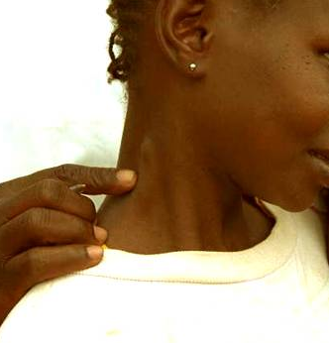
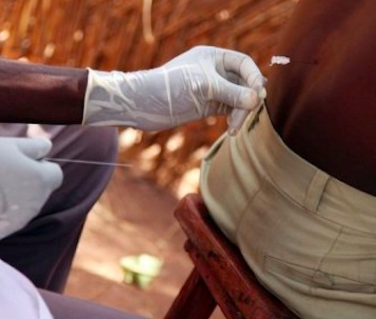
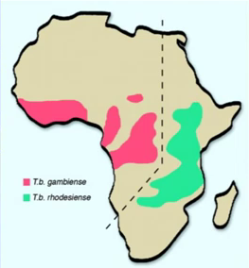
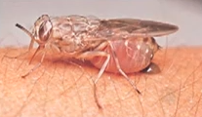
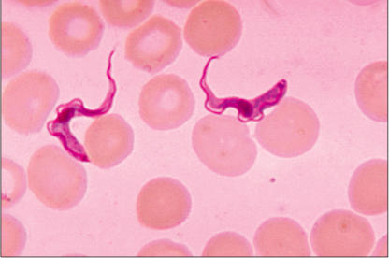
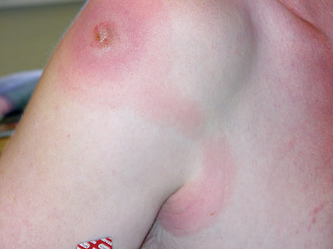

Human African Trypanosomiasis
African Sleeping Sickness
Notes:
https://www.theguardian.com/world/2018/nov/16/congo-drc-sleeping-sickness-upside-tropical-disease-ntd?CMP=share_btn_tw
Trypanosomiasis, Human African (sleeping sickness)
Fact sheet N°259 Updated June 2013
HAT is caused by the protozoan parasites Trypanosoma brucei gambiense (west and central Africa) and Trypanosoma brucei rhodesiense (east and southern Africa), and transmitted by the tsetse fly. The disease progresses from a haemolymphatic first stage to
a meningoencephalitic second stage. Since 1949, the mainstay of treatment for second-stage HAT has been melarsoprol. This arsenical derivative causes severe adverse reactions, in particular reactive encephalopathy, which affects 5–10% of treated patients, and is fatal in 10–70% of cases.2 Moreover, increasing melarsoprol failure rates have been reported in several sites
Human African trypanosomiasis (HAT), or sleeping sickness, is
a vector-borne disease caused by two sub-species of the parasitic
protozoa Trypanosoma brucei (i.e. T. b. gambiense and T. b. rhodesiense).
Trypanosomes are transmitted to humans by the infected bite of
various species of tsetse fly (genus Glossina). Transmission of the
disease only takes place in sub-Saharan Africa, in discrete areas of
endemicity, or ‘foci’, within the geographic distribution of the
tsetse fly. The Gambian form of sleeping sickness is normally
characterized by a long asymptomatic period and it is found in
western and central Africa. The Rhodesian form, which is
encountered in eastern and southern Africa, displays a much
more rapid onset of overt symptoms and a faster progression.

Slide 2
Human African Trypanosomiasis
Overview and epidemiology
Clinical presentation, diagnosis, treatment
  Differences between:
      East African (rhodesiense)
      West African (gambiense)
  Clinical stages:
      Hemolymphatic
      Meningoencephalitic
  Treatment
      Fexinidazole
Cases
Notes:
According to the WHO, 5.6 million people are at high risk of infection with this disease. And the DRC alone notifies nearly 85% of cases in Africa.
In 2021, the country recorded 387 cases. In view of these statistics, the elimination of sleeping sickness in the DRC remains a major challenge. But it is true that in recent years, progress has led to therapeutic advances, in particular, the administration since January 2020 of fexinidazole, a new effective oral treatment, acting at all stages of the disease.
Human African trypanosomiasis also called sleeping sickness, is one of the most neglected tropical diseases in the world. It is transmitted by a vector, the tsetse fly, and is generally fatal if left untreated

Slide 3
Classification
Parasites
  Protozoa
    Enteric (Giardia)
    Non-Enteric (Malaria)
  Helminths
    Nematodes (roundworms)
    Trematodes (flukes)
    Cestodes (tapeworms)

Slide 4
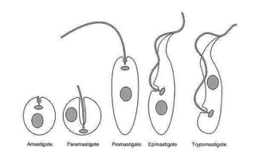
Classification
Protozoa
Enteric
  E. histolytica
    E. Dispar
  Giardia lamblia
    Dientameba fragilis
  Apicomplexa
    Cryptosporidium
    Cyclospora
    Isospora belli
  Other
    Blastocystis hominis
    Microsporidia
Non-enteric
  Toxoplasma gondii
  Plasmodium spp.
  Hemoflagellates
    Leishmania
    Trypanosoma
  Trichomonas
  Free-living amoebas

Slide 5
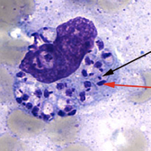
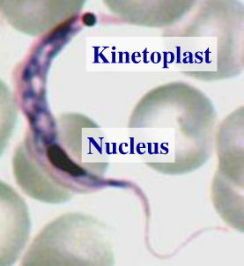
Hemoflagellates
Leishmaniasis
  New World (L (V) Braziliensis, MCL)
  Old World
Trypanosomiasis
  African trypanosomiasis (T. brucei)
  South American trypanosomiasis (T.cruzii)
Notes:
HAT, VL and Chagas disease are all transmitted by insects—tsetse flies, sandflies and triatomine bugs re- spectively

Slide 6
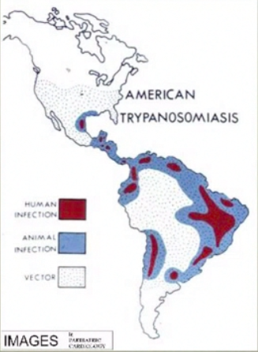
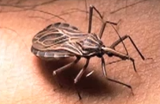
Trypanosomiasis
African trypanosomiasis (T. brucei)
    - East African (Rhodesiense)
    - West African (Gambiense)
South American trypanosomiasis (T.cruzii)
Notes:
HAT, VL and Chagas disease are all transmitted by insects—tsetse flies, sandflies and triatomine bugs re- spectively

Slide 7
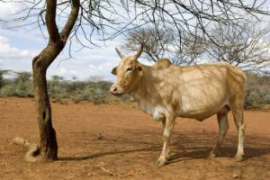
African Trypanosomiasis
Human African Trypansomiasis (HAT)
  T. brucei rhodesiense (r-HAT)
  T. brucei gambiense (g-HAT)
Animal African Trypanosomiasis (Nagana)
  T. brucei brucei

Slide 8
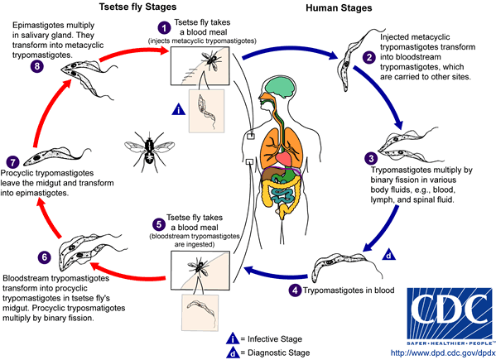
Life cycle
< 1% of flies carry infective parasites
Notes:
The biological cycle of human African trypanosomiasis is very fragile because transmission through the tsetse fly is complex and slow. As a result, even in countries where the disease is endemic, less than 0·1% of flies carry mature parasites. The prevalence in man is also low apart from in epidemic foci. If the density of flies and infected individuals is lower than crucial limits, transmission can break down. This situation is more likely to occur for disease due to T b gambiense (small animal reservoir) than for that caused by T b rhodesiense (substantial reservoir of domestic and wild animals).
In lab conditions it has been observed that the majority of ingested trypanosomes fail to develop, and only 2%–5% of the flies ingesting trypanosomes produce metacyclic forms

Slide 9
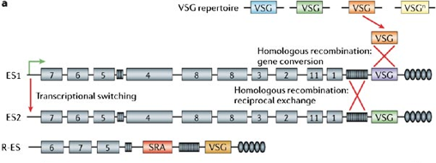
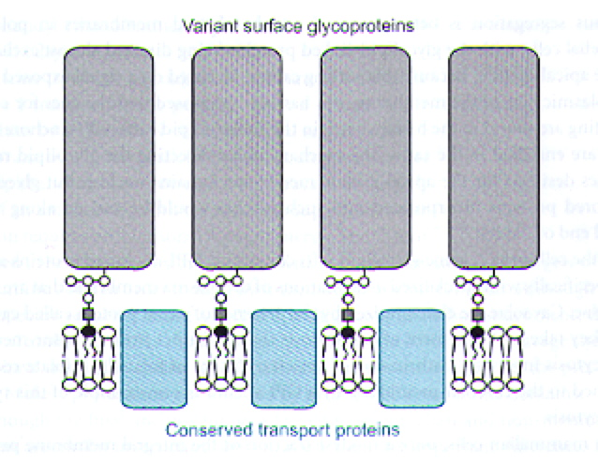
Antigenic variation of surface glycoproteins (VSG)
Help T.brucei evade host immune response
Trigger high IgM levels
Each trypanosome is covered with ~10 million copies of a single VSG
Notes:
The high degree of antigenic variation of surface glycoproteins on
T. brucei provokes a robust IgM response

Slide 10
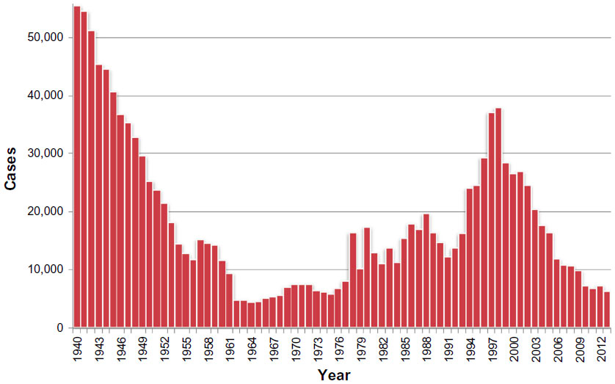
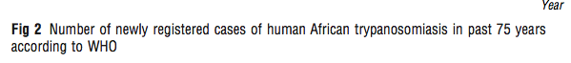
Epidemiology
Case burden
WHO reported cases:
1995:
  300,000 estimated; 30,000 reported
2010:
  30,000 estimated;
  10,000 reported
2020:
  663 reported
Notes:
In 1995, WHO Expert Committee estimated that 60 million people were at risk with an estimated 300 000 new cases per year in Africa, with fewer than 30,000 cases diagnosed and treated.
In 2004, the number of new reported cases fell to 17 616 and WHO considered in that due to increased control, estimated cumulative rate to be between 50 000 and 70 000 cases
In 2009, the number of new cases reported dropped below 10 000 (9 878) for first time in 50 years and the estimated number of actual cases is currently 30 000. This trend has been maintained in 2010, with 7139 cases reported.
https://www.ncbi.nlm.nih.gov/pmc/articles/PMC8765662/

Slide 11
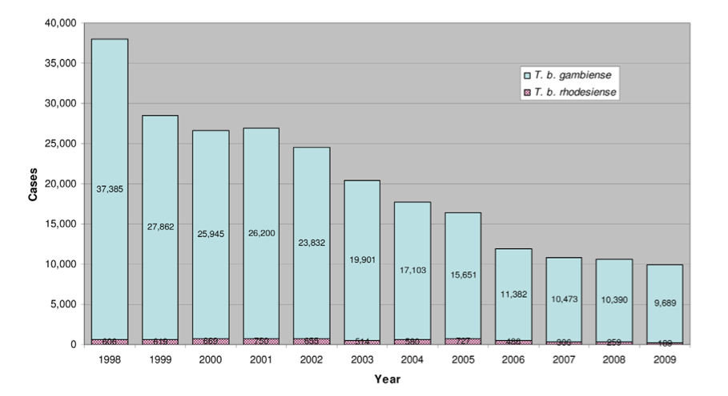
Epidemiology
Case burden
Notes:
Simarro PP, Diarra A, Ruiz Postigo JA, Franco JR, Jannin JG (2011) The Human African Trypanosomiasis Control and Surveillance Programme of the World Health Organization 2000–2009: The Way Forward. PLoS Negl Trop Dis 5(2): e1007. doi:10.1371/journal.pntd.0001007

Slide 12
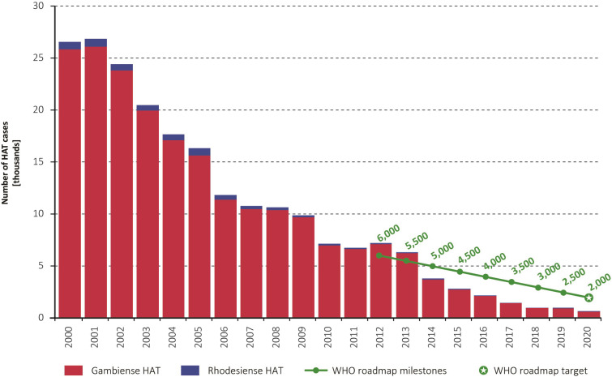

Slide 13
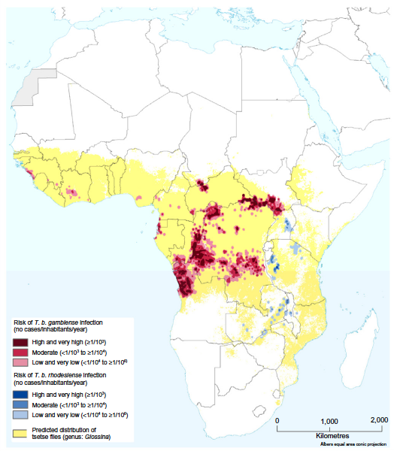
Epidemiology
Geographical regions at risk - “foci”
98% of cases are g-HAT
Notes:
Simarro PP, Cecchi G, Franco JR, Paone M, Diarra A, et al. (2012) Estimating and Mapping the Population at Risk of Sleeping Sickness. PLoS Negl Trop
Dis 6(10): e1859. doi:10.1371/journal.pntd.0001859
Abstract
Background: Human African trypanosomiasis (HAT), also known as sleeping sickness, persists as a public health problem in
several sub-Saharan countries. Evidence-based, spatially explicit estimates of population at risk are needed to inform
planning and implementation of field interventions, monitor disease trends, raise awareness and support advocacy.
Comprehensive, geo-referenced epidemiological records from HAT-affected countries were combined with human
population layers to map five categories of risk, ranging from ‘‘very high’’ to ‘‘very low,’’ and to estimate the corresponding
at-risk population.
Results: Approximately 70 million people distributed over a surface of 1.55 million km2 are estimated to be at different
levels of risk of contracting HAT. Trypanosoma brucei gambiense accounts for 82.2% of the population at risk, the remaining
17.8% being at risk of infection from T. b. rhodesiense. Twenty-one million people live in areas classified as moderate to very
high risk, where more than 1 HAT case per 10,000 inhabitants per annum is reported.
Discussion: Updated estimates of the population at risk of sleeping sickness were made, based on quantitative information
on the reported cases and the geographic distribution of human population. Due to substantial methodological differences,
it is not possible to make direct comparisons with previous figures for at-risk population. By contrast, it will be possible to
explore trends in the future. The presented maps of different HAT risk levels will help to develop site-specific strategies for
control and surveillance, and to monitor progress achieved by ongoing efforts aimed at the elimination of sleeping sickness.

Slide 14
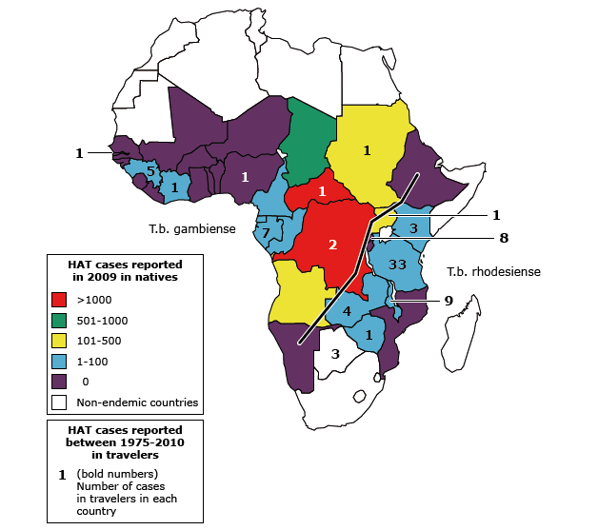
Incidence of HAT
Residents vs. travellers
Notes:
rhodesiense HAT usually affects more affluent populations of non-DEC, whereas gambiense HAT is normally detected in African migrants with limited economic means. In some cases, these people are in precarious situations and may not be covered effectively by the health system in non-DEC, which can contribute to a delayed diagnosis.

Slide 15
Incidence of HAT
Residents vs. travellers
Most cases in tourists/travelers are r-HAT
Notes:
rhodesiense HAT usually affects more affluent populations of non-DEC, whereas gambiense HAT is normally detected in African migrants with limited economic means. In some cases, these people are in precarious situations and may not be covered effectively by the health system in non-DEC, which can contribute to a delayed diagnosis.

Slide 16
Cases diagnosed in non-endemic countries
2011– 2020
  33,000 cases of HAT diagnosed globally
    98% were g-HAT
  49 cases of HAT diagnosed in non-endemic countries
    35 cases r-HAT
      mainly in tourists visiting wildlife areas in E and S Africa
    14 cases g-HAT
      mainly in African migrants from W and C Africa
Notes:
During 2011–2020, a total of 33 096 HAT cases were reported globally, of which 32 275 (97.5%) were gambiense HAT and 821 (2.5%) were rhodesiense HAT [3]. Cases detected in non-DEC represent only 0.15% of the number of cases reported globally, but they constitute 4% of all rhodesiense HAT cases.

Slide 17
Comparison of East and West HAT
 | T.b. rhodesiense | T.b. gambiense
Geography | Eastern and Southern Africa | Central and Western Africa
Global case burden (in traveller’s) | 2% (80%) | 98% (20%)
Reservoir (mostly) | Zoonotic | Anthroponotic
Clinical presentation - Characteristic features | Chancre ++ Acute – days-weeks (6 months to death) | Chancre +/- Indolent – months-years (3 years to death)
Diagnosis | Blood smear ++ | Blood smear +/- LN aspirate + Serology (CATT)
Treatment Stage 1 Stage 2 | Suramin Melarsoprol | Pentamidine Melarsoprol

Slide 18
Comparison of East and West HAT
 | T.b. rhodesiense | T.b. gambiense
Geography | Eastern and Southern Africa | Central and Western Africa
Global case burden (in traveller’s) | 2% (80%) | 98% (20%)
Reservoir (mostly) | Zoonotic | Anthroponotic
Clinical presentation - Characteristic features | Chancre ++ Acute – days-weeks (6 months to death) | Chancre +/- Indolent – months-years (3 years to death)
Diagnosis | Blood smear ++ | Blood smear +/- LN aspirate + Serology (CATT)
Treatment Stage 1 Stage 2 | Suramin (pentamidine) Melarsoprol | Pentamidine (suramin) Melarsoprol

Slide 19
Comparison of East and West HAT
 | T.b. rhodesiense | T.b. gambiense
Geography | Eastern and Southern Africa | Central and Western Africa
Global case burden (in traveller’s) | 2% (80%) | 98% (20%)
Reservoir (mostly) | Zoonotic | Anthroponotic
Clinical presentation - Characteristic features | Chancre ++ Acute – days-weeks (6 months to death) | Chancre +/- Indolent – months-years (3 years to death)
Diagnosis | Blood smear ++ | Blood smear +/- LN aspirate + Serology (CATT)
Treatment Stage 1 Stage 2 | Suramin (pentamidine) Melarsoprol | Pentamidine (suramin) Eflornithine (NECT)

Slide 20
Comparison of East and West HAT
 | T.b. rhodesiense | T.b. gambiense
Geography | Eastern and Southern Africa | Central and Western Africa
Global case burden (in traveller’s) | 2% (80%) | 98% (20%)
Reservoir (mostly) | Zoonotic | Anthroponotic
Clinical presentation - Characteristic features | Chancre ++ Acute – days-weeks (6 months to death) | Chancre +/- Indolent – months-years (3 years to death)
Diagnosis | Blood smear ++ | Blood smear +/- LN aspirate + Serology (CATT)
Treatment Stage 1 Stage 2 | Suramin (pentamidine) Melarsoprol * Fexinidazole | Pentamidine (suramin) Eflornithine (NECT) * Fexinidazole

Slide 21
Clinical presentation
2 stages +/- chancre
Hemolymphatic
  Fever
  Headache, arthralgia
  Chancre
  Lymphadenopathy
Meningoencephalitic
  Variable CNS manifestations
  Headaches, sleep disorder, neuropsychiatric
  Sensory and motor disorders

Slide 22
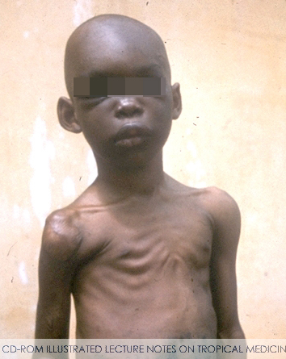
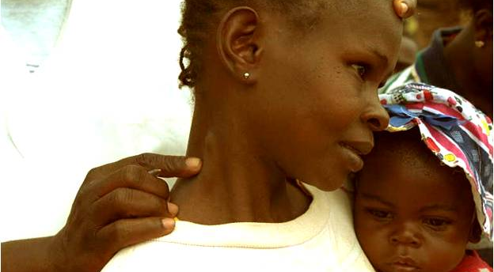
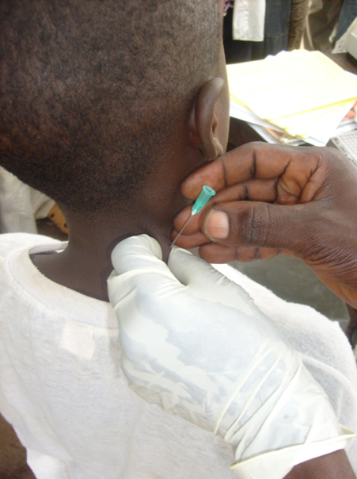
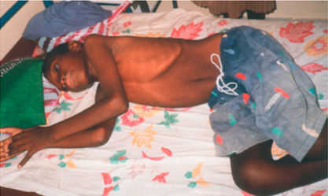
G-HAT
West African Trypanosomiasis
Notes:
The primary lesion is a painful trypanosomal chancre that appears between 5 and 15 days after the initial bite. After a variable period, which is typically a few weeks in the case of T b rhodesiense HAT and several months in the case of T b gambiense HAT, the parasites cross the blood–brain barrier and enter the CNS. Once this has happened the disease has entered the late, or encephalitic, stage (also known as the CNS stage or stage 2). Pathologically, the late stage is characterised by a meningoencephalitis

Slide 23
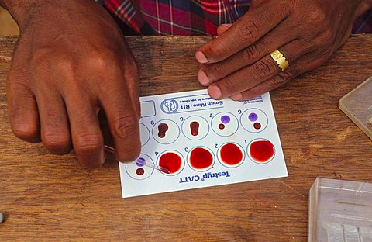
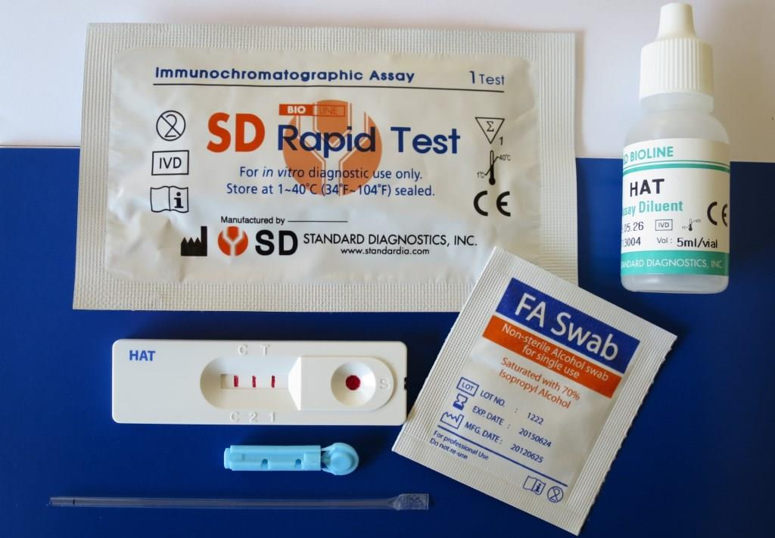
G-HAT
West African Trypanosomiasis
CATT test
New RDTs

Slide 24
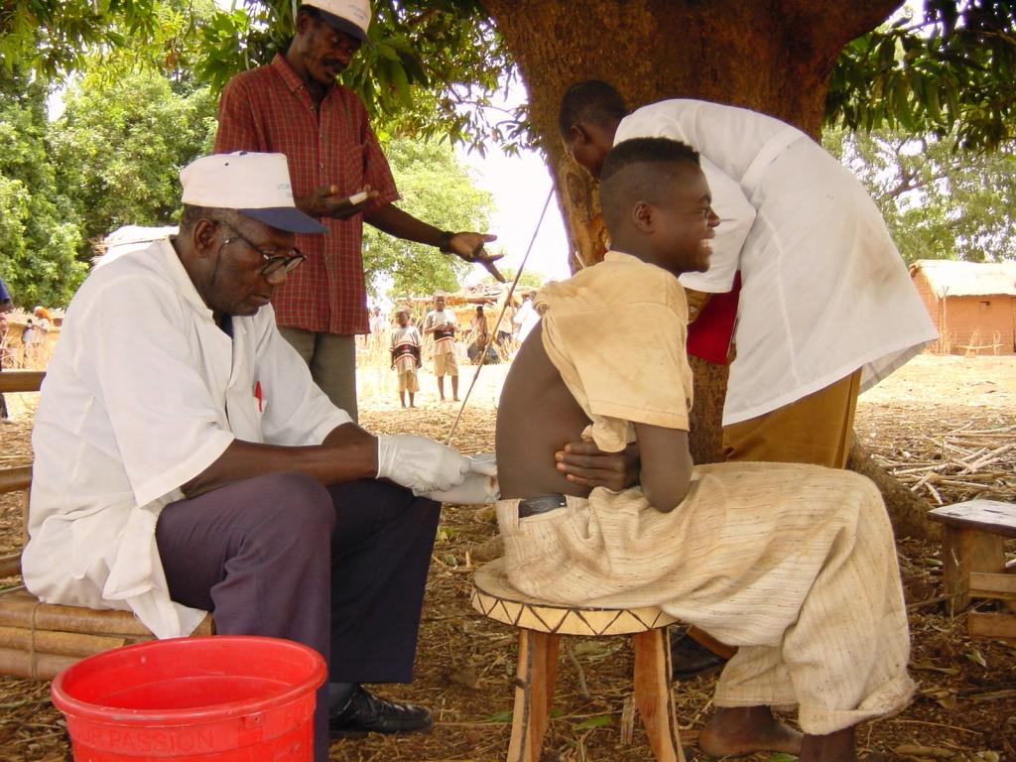
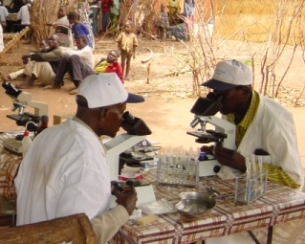
G-HAT
West African Trypanosomiasis
LP to stage the disease

Slide 25
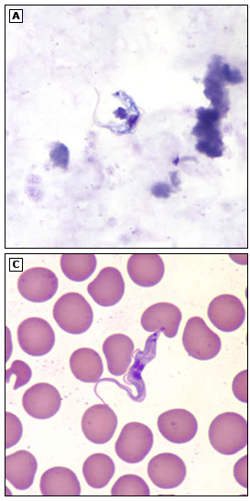
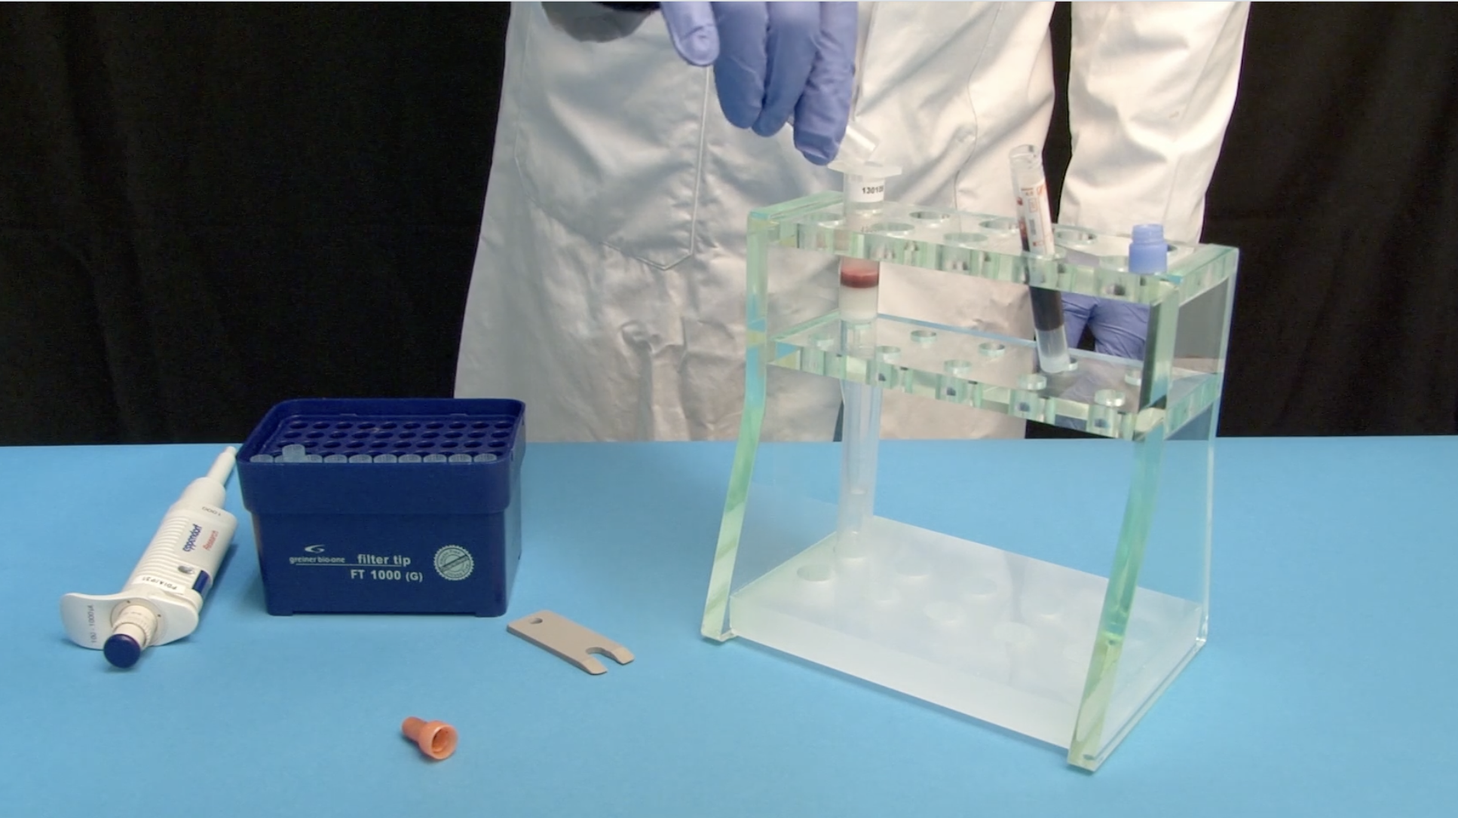

Slide 26
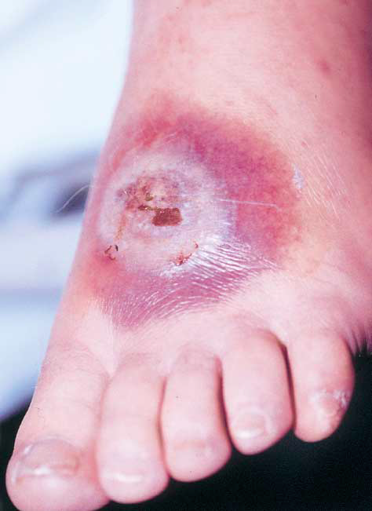
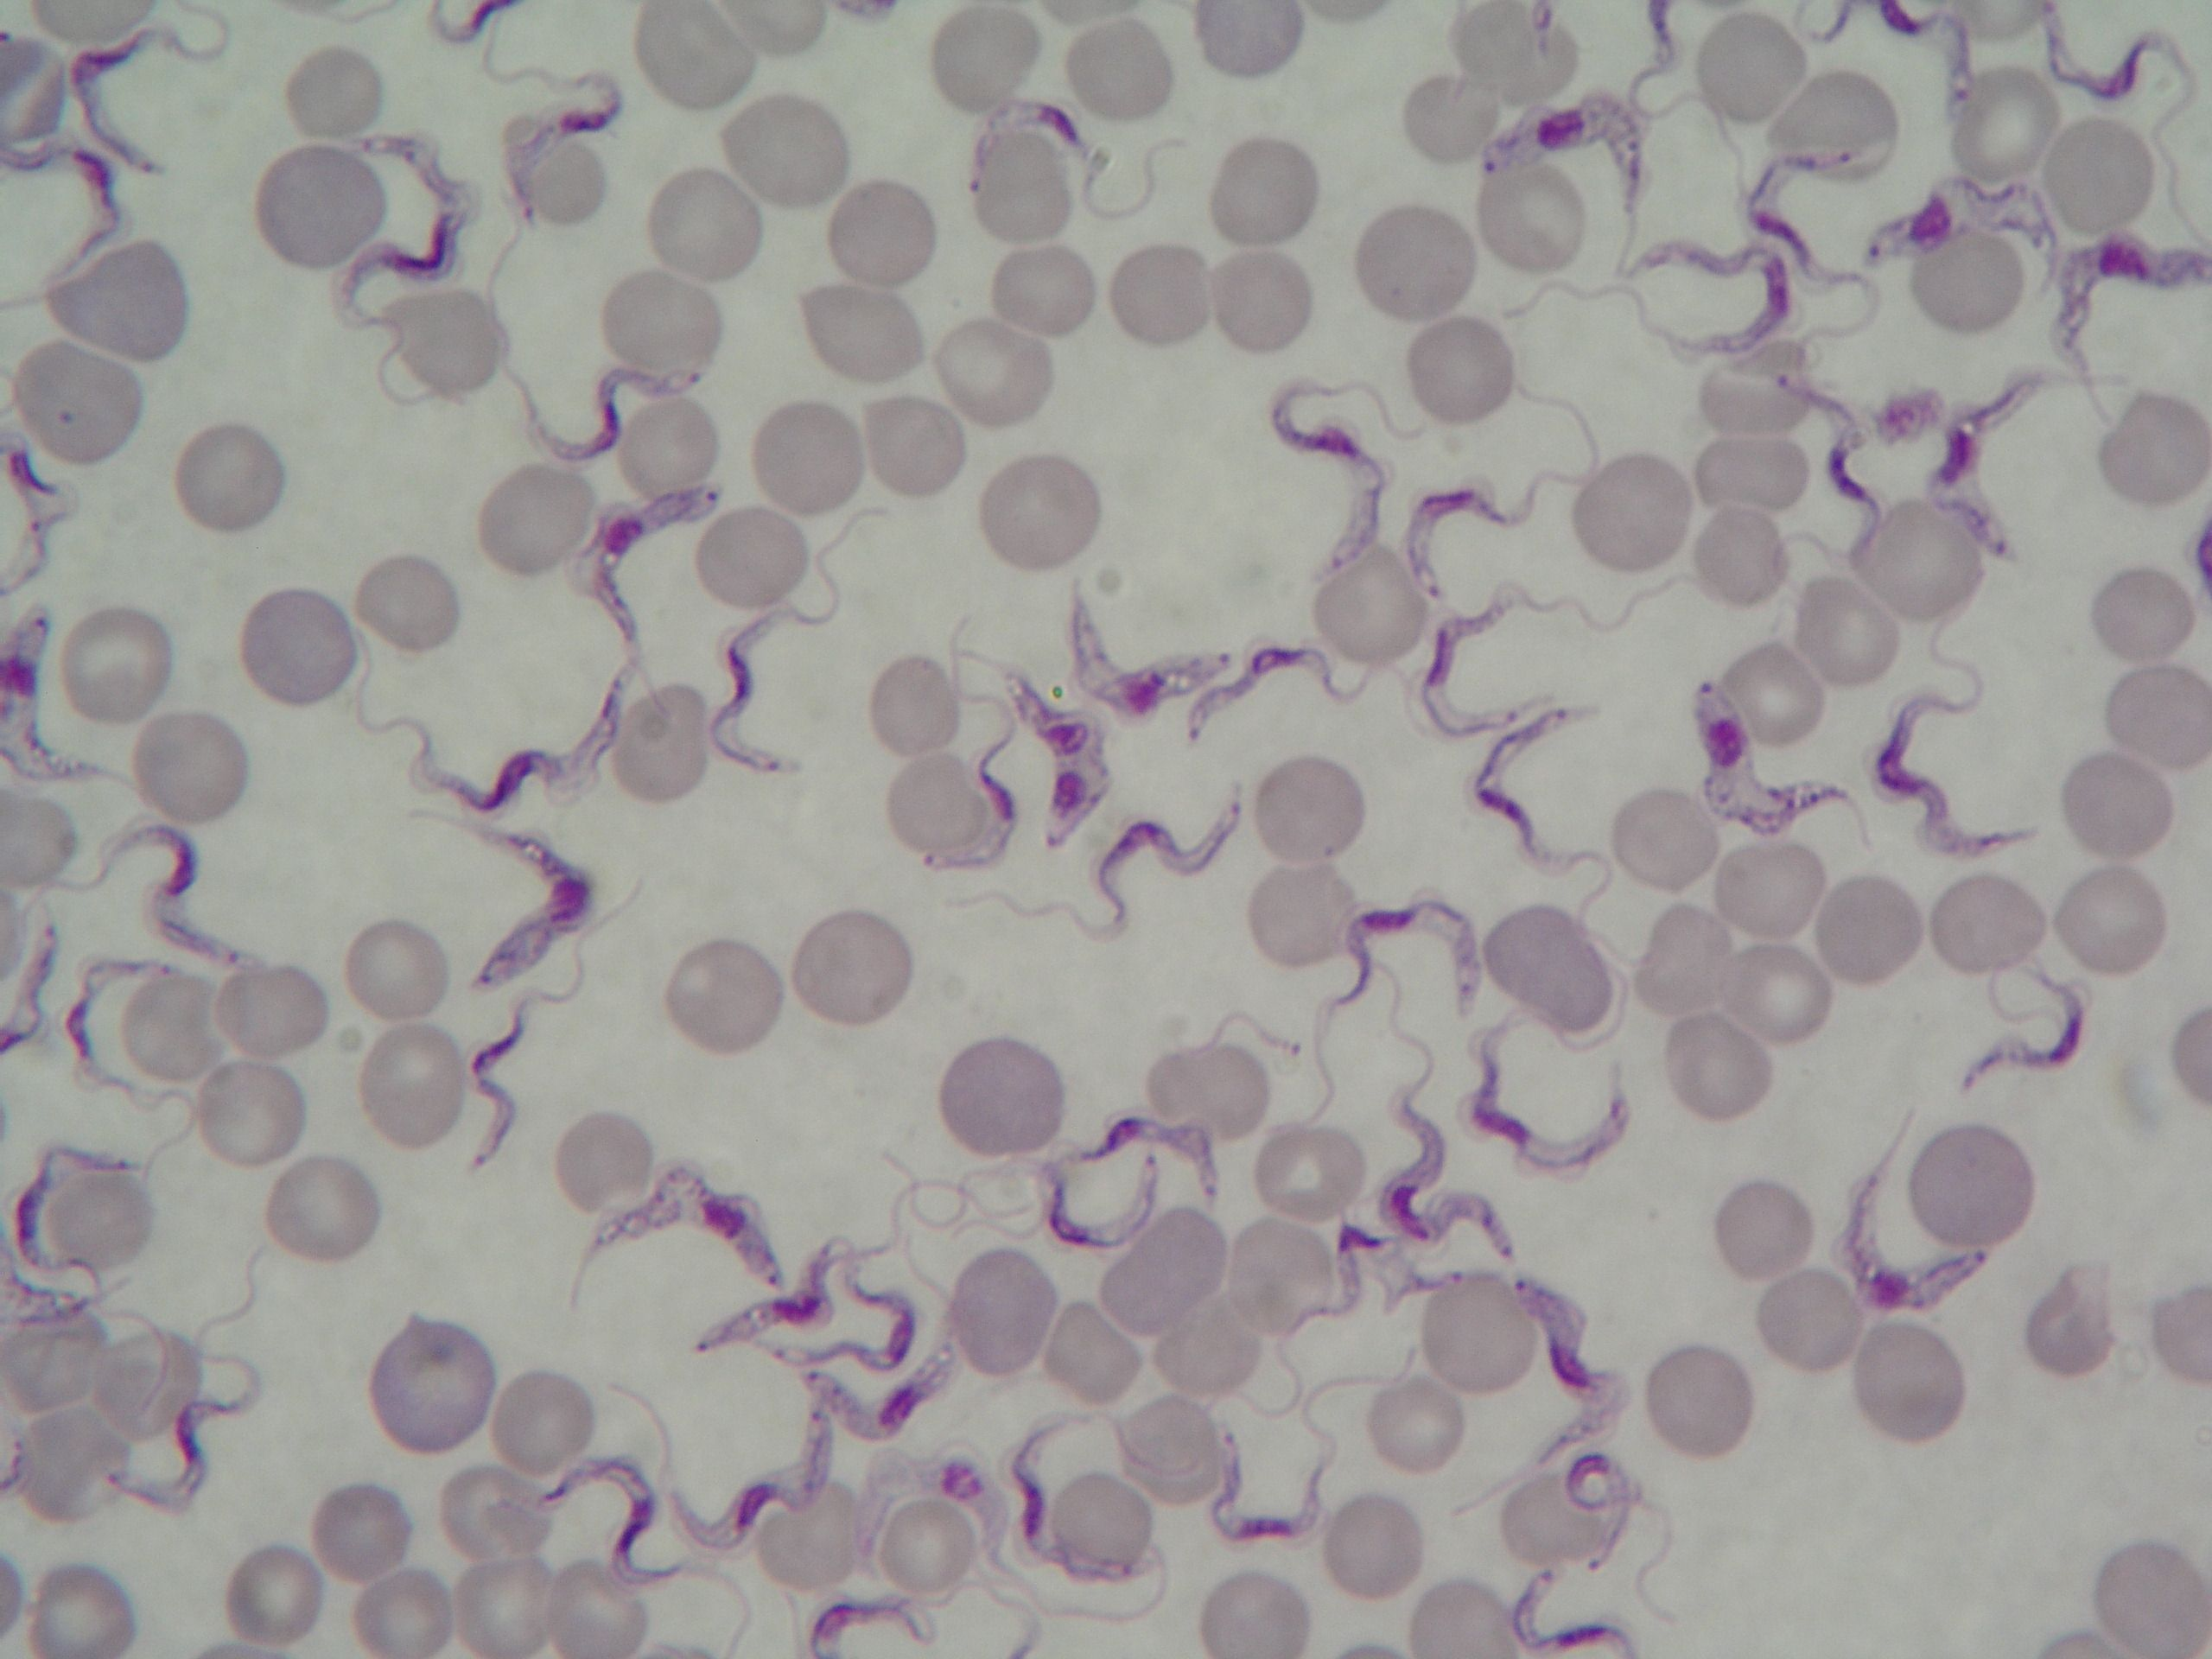
R-HAT
East African Trypanosomiasis

Slide 27
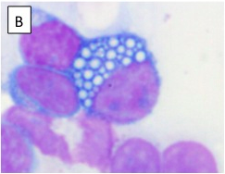
Criteria for CNS involvement
Mott cell in CSF
WHO criteria are:
  Parasites seen in CSF
  > 5 WBC per μl
  Critical distinction because CSF involvement requires specific therapy with CSF penetration
    MELARSOPROL (arsenic in antifreeze) for r-HAT
    EFLORNITHINE for g-HAT

Slide 28
Treatment
Suramin 1916
Pentamidine 1936
Melarsoprol 1948
Eflornithine
  eflornithine (difluoromethyl-ornithine, DFMO), an irreversible inhibitor of ornithine decarboxylase
  Not effective against T rhodesiense
  IV with QID dosing x 4 days
NECT (nifurtimox-eflornithine combination therapy
  14 ather than 56 feusions
Fexnidazole

Slide 29
Treatment
Depends on subspecies and stage…
 | First line | Alternative
Early stage
T.b. rhodesiense | Suramin
Late stage
T.b. rhodesiense | Melarsoprol
Notes:
Treatment of T. b. rhodesiense infection
First stage:
• suramin IV – 5 mg/kg intravenously as a test dose, followed by 20 mg/kg on
day 3, 10, 17, 24, and 31.
Second stage:
• melarsoprol IV – 2.2 mg/kg per day for 10 consecutive days given in hospital
by slow IV injection to prevent thrombophlebitis and necrosis at the injection
site.

Slide 30
Treatment
Depends on subspecies and stage…
 | First line | Alternative
Early stage
T.b. rhodesiense T.b. gambiense | Suramin Pentamidine
Late stage
T.b. rhodesiense T.b. gambiense | Melarsoprol Eflornithine (NECT)
Notes:
The primary lesion is a painful trypanosomal chancre that appears between 5 and 15 days after the initial bite. After a variable period, which is typically a few weeks in the case of T b rhodesiense HAT and several months in the case of T b gambiense HAT, the parasites cross the blood–brain barrier and enter the CNS. Once this has happened the disease has entered the late, or encephalitic, stage (also known as the CNS stage or stage 2). Pathologically, the late stage is characterised by a meningoencephalitis

Slide 31
Treatment
Depends on subspecies and stage…
 | First line | Alternative
Early stage
T.b. rhodesiense T.b. gambiense | Suramin Pentamidine | Pentamidine Suramin
Late stage
T.b. rhodesiense T.b. gambiense | Melarsoprol Eflornithine (NECT) | ----------- Melarsoprol
Notes:
The primary lesion is a painful trypanosomal chancre that appears between 5 and 15 days after the initial bite. After a variable period, which is typically a few weeks in the case of T b rhodesiense HAT and several months in the case of T b gambiense HAT, the parasites cross the blood–brain barrier and enter the CNS. Once this has happened the disease has entered the late, or encephalitic, stage (also known as the CNS stage or stage 2). Pathologically, the late stage is characterised by a meningoencephalitis

Slide 32
Treatment
Pentamidine
  IV/IM – once daily x 7 days
Suramin
  IV - begin with test dose, then day 1,3, 7,14,21
Melarsoprol
  IV – once daily x 10 days
Eflornithine (NECT)
  IV – q6h x 14 days
  IV – q12h x 7 days in combination with nifurtimox
Fexinidazole
  PO – once daily x 10 days
Notes:
African trypanosomiasis, early hemolymphatic stage with normal CSF: 1 gram IV on days 1, 3, 7, 14, and 21.

Slide 33
Treatment
anti-HAT medicines are freely available
WHO is the sole distributor
Pentamidine
  IV/IM – once daily x 7 days
Suramin
  IV - begin with test dose, then day 1,3, 7,14,21
Melarsoprol
  IV – once daily x 10 days
Eflornithine (NECT)
  IV – q6h x 14 days
  IV – q12h x 7 days in combination with nifurtimox
Fexinidazole
  PO – once daily x 10 days
Notes:
African trypanosomiasis, early hemolymphatic stage with normal CSF: 1 gram IV on days 1, 3, 7, 14, and 21.

Slide 34
Treatment
Pentamidine
  IV/IM – once daily x 7 days
Suramin
  IV - begin with test dose, then day 1,3, 7,14,21
Melarsoprol
  IV – once daily x 10 days
Eflornithine (NECT)
  IV – q6h x 14 days
  IV – q12h x 7 days in combination with nifurtimox
Fexinidazole
  PO – once daily x 10 days
Risk of encephalopathy
occurs in 10%
50% fatality
Notes:
African trypanosomiasis, early hemolymphatic stage with normal CSF: 1 gram IV on days 1, 3, 7, 14, and 21.

Slide 35
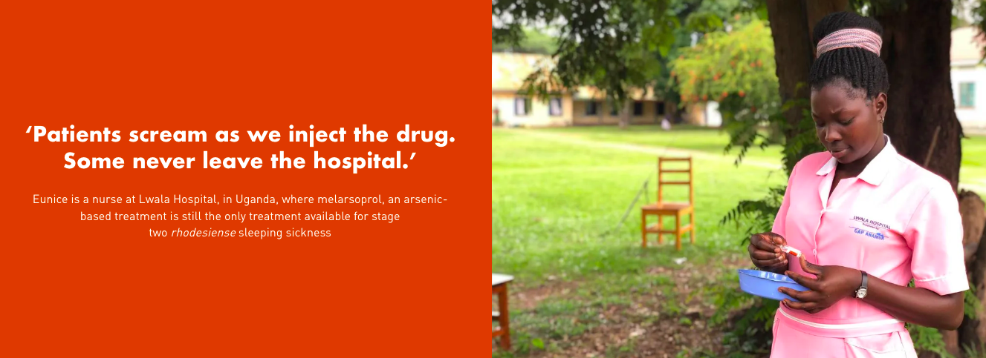

Slide 36
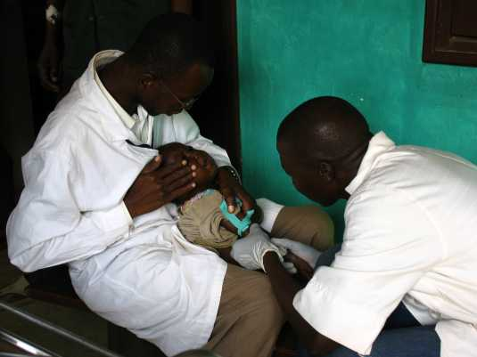
Melarsoprol
Arsenic derivative in propylene glycol

Slide 37

Eflornithine story
Began as a cancer drug
Found to be effective against T.b.gambiense
  But, not financially lucrative
  In 1990’s production stopped
Found to be effective against hirsutism
  Financially lucrative
WHO/MSF worked with drug companies to ensure production and access for HAT
Notes:
Th e shift to melarsoprol-free treatment has increased the
average cost to treat one patient with second-stage gambiense sleeping sickness from
US$ 30 in 2001 to US$ 440 in 2010.

Slide 38
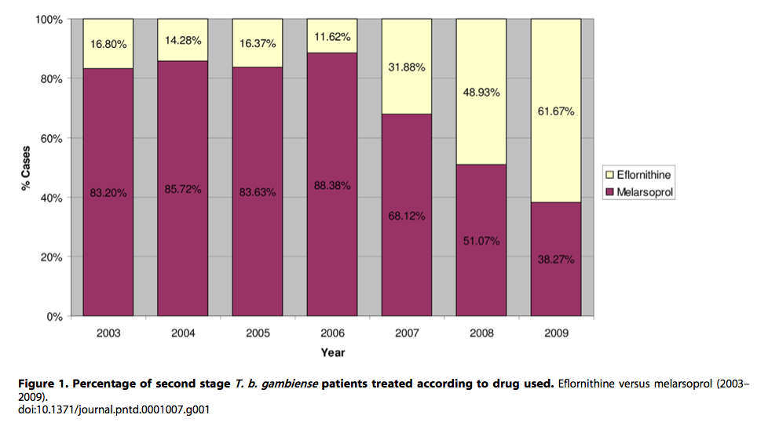
Eflornithine story
Despite documented efficacy since the 1980s and safer than melarsoprol, uptake has been slow…
Notes:
Simarro PP, Diarra A, Ruiz Postigo JA, Franco JR, Jannin JG (2011) The Human African Trypanosomiasis Control and Surveillance Programme of the World Health Organization 2000–2009: The Way Forward. PLoS Negl Trop Dis 5(2): e1007. doi:10.1371/journal.pntd.0001007

Slide 39
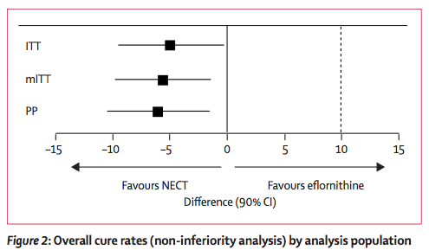
NECT
Nifurtimox-eflonithine combination therapy
Mulitcentre RCT in DRC, Lancet 2009
    14 days eflornithine IV q6h
      Vs
    7 days eflornithine IV q12h
    + 10 days nifurtimox
Notes:
Background Human African trypanosomiasis (HAT; sleeping sickness) caused by Trypanosoma brucei gambiense is a fatal disease. Current treatment options for patients with second-stage disease are toxic, ineffective, or impractical. We assessed the efficacy and safety of nifurtimox-eflornithine combination therapy (NECT) for second-stage disease compared with the standard eflornithine regimen.
Methods A multicentre, randomised, open-label, active control, phase III, non-inferiority trial was done at four HAT treatment centres in the Republic of the Congo and the Democratic Republic of the Congo. Patients aged 15 years or older with confirmed second-stage T b gambiense infection were randomly assigned by computer-generated randomisation sequence to receive intravenous eflornithine (400 mg/kg per day, every 6 h; n=144) for 14 days or intravenous eflornithine (400 mg/kg per day, every 12 h) for 7 days with oral nifurtimox (15 mg/kg per day, every 8 h) for 10 days (NECT; n=143). The primary endpoint was cure (defined as absence of trypanosomes in body fluids and a leucocyte count ≤20 cells per μL) 18 months after treatment. Efficacy analyses were done in the intention-to-treat (ITT), modified ITT, and per-protocol (PP) populations. The non-inferiority margin for the difference in cure rates was defined as 10%. This study is registered with ClinicalTrials.gov, number NCT00146627.
Findings One patient from the eflornithine group absconded after receiving the first dose, without any type of assessment done, and was excluded from all analyses. In the ITT population, 131 (91·6%) of 143 patients assigned to eflornithine and 138 (96·5%) of 143 patients assigned to NECT were cured at 18 months (difference –4·9%, one-sided 95% CI –0·3; p<0·0001). In the PP population, 122 (91·7%) of 133 patients in the eflornithine group and 129 (97·7%) of 132 in the NECT group were cured at 18 months (difference –6·0%, one-sided 95% CI –1·5; p<0·0001). Drug- related adverse events were frequent in both groups; 41 (28·7%) patients in the eflornithine group and 20 (14·0%) in the NECT group had major (grade 3 or 4) reactions, which resulted in temporary treatment interruption in nine and one patients, respectively. The most common major adverse events were fever (n=18), seizures (n=6), and infections (n=5) in the eflornithine group, and fever (n=7), seizures (n=6), and confusion (n=2) in the NECT group. There were four deaths, which were regarded as related to study drug (eflornithine, n=3; NECT, n=1).
Interpretation The efficacy of NECT is non-inferior to that of eflornithine monotherapy. Since this combination treatment also presents safety advantages, is easier to administer (ie, infusion every 12 h for 7 days vs every 6 h for 14 days), and potentially protective against the emergence of resistant parasites, it is suitable for first-line use in HAT control programmes.

Slide 40
Fexinidazole
RCT of 394 patients with CNS stage g-HAT in DRC
  Treatment success
    91% Fexinidaole vs. 98% NECT
  Subgroup > 100 WBC/µL of CSF (severe second-stage)
    86.9% fexinidazole vs. 98.7% NECT
Difficult trial:
  Remote areas
  Took 4 years
  Screened > 500,000 people to get 394 patients for the trial
Lancet 2018
Notes:
Only patients in whom parasites were found in at least one body fluid (ie, blood or lymph node fluid), with a cerebrospinal fluid white blood cell count higher than 20 cells per μL or trypanosomes in the cerebrospinal fluid were eligible
Between October, 2012, and November, 2016, more than half a million people were screened to identify 419 patients who were pre-screened. Of these, ten (2%) patients were not eligible
(91% vs 98%), but this difference was within the predetermined acceptability margin of 13% (–6·4%, 97·06% CI –11·2 to –1·6; p=0·0029),

Slide 41
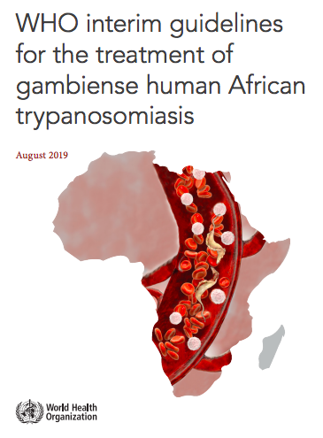
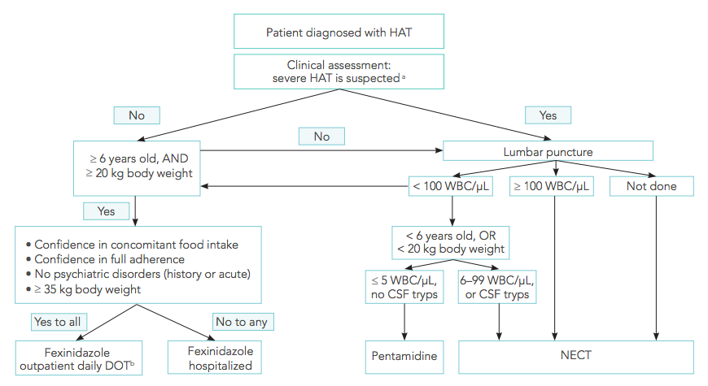
Notes:
For second-stage HAT, data from a randomized clinical trial comparing fexinidazole with NECT showed that in patients with > 100 WBC/µL of CSF (severe second-stage), the treatment success rates at 18 months were 86.9% with fexinidazole versus 98.7% with NECT, significantly in favour of NECT. In patients with ≤ 100 WBC/µL of CSF, success rates were 98% with fexinidazole and 95.9% with NECT, with no significant difference. The overall safety data were not substantially different for both treatments.

Slide 42
Fexinidazole r-HAT
45 participants with r-HAT
    Uganda (n=2) and Malawi (n=43)
  10 first-stage
    All treatment success and no relapse at 12 months
      (N/V can occur, take with food)
  35 second-stage
    33 (94%) treatment success and no relapse period.
      1 relapsed at week 9 (treated with melarsoprol)
      1 died during treatment from acute kidney injury
Notes:
. All ten patients in the first stage had treatment success at the end of their hospitalisation and at their 12-month follow-up evaluation. Serious adverse events did not occur in any participants with first-stage HAT. T

Slide 43
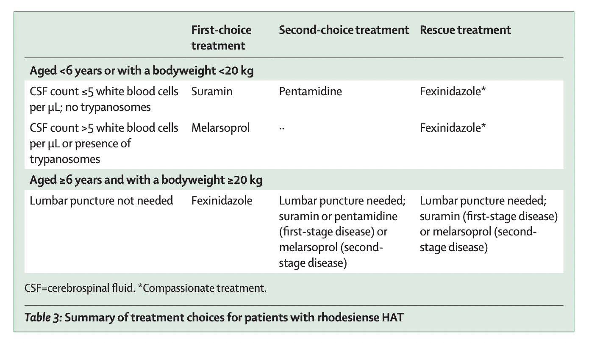

Slide 44
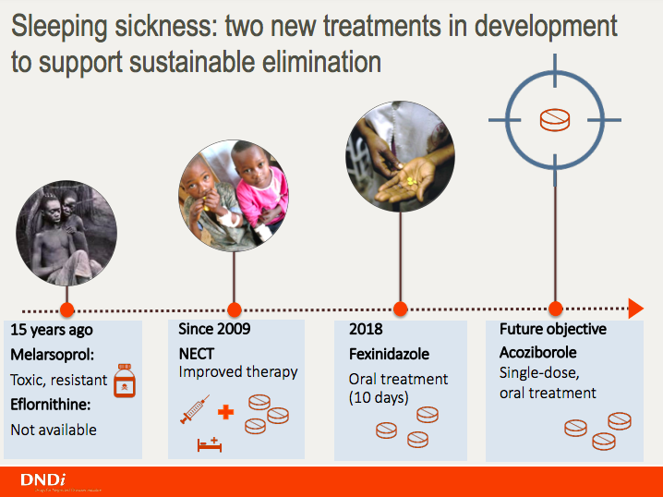

Slide 45
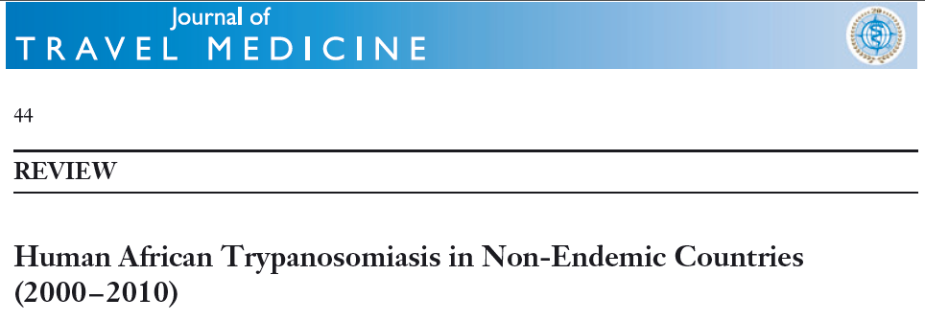
94 HAT cases reported in non-DECs
  72% T.b. rhodesiense
    82% 1st stage
  28% T.b. gambiense form
    23% 1st stage
4 cases of T.b. rhodesiense (stage 1) were successfully treated with pentamidine only
J Travel Med 2012; 19: 44–53

Slide 48
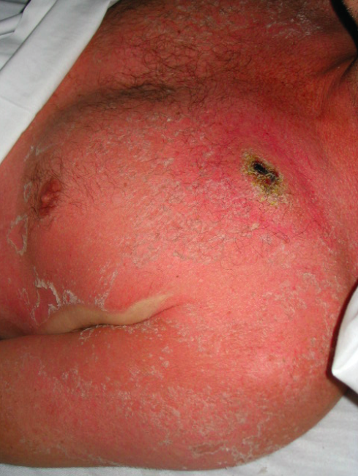
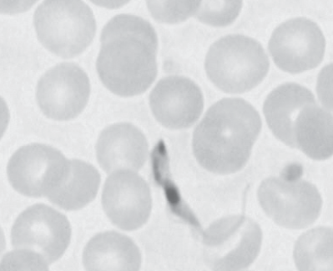
Case
Calgary
52M returned from safari in Tanzania:
  2-days of fever, headache, conjunctivitis and left subclavicular chancre
  Blood smear
    Negative for malaria
    Positive for trypanosmiasis
Davis, CJIDMM ‘12

Slide 49
Case
Calgary
52M returned from safari in Tanzania:
  2-days of fever, headache, conjunctivitis and left subclavicular chancre
  Blood smear
    Positive for trypanosmiasis
  Next steps?
  Treatment with suramin:
  Marked improvement within 48hours
  CSF examination “normal”
Notes:
Stage 1 = Suramin
Test dose on day 0
20mg/kg on days 1,3,7,14,21
Stage 2 = Melarsoprol
Previously: 3mg/kg IV daily x 3 days, then 3 days rest – then repeat 3 times
Now: 2mg/kg IV daily x 10 days

Slide 50
Case
Vancouver
63M, businessman
  Uganda 2- weeks
  Safari holiday in QE park
On return to Vancouver:
  Fever, headache
  Rash his shoulder

Slide 51
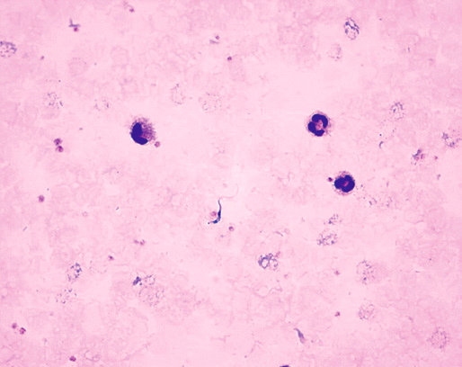
Case
Vancouver
Thick blood film
Pentamidine monotherapy

Slide 52
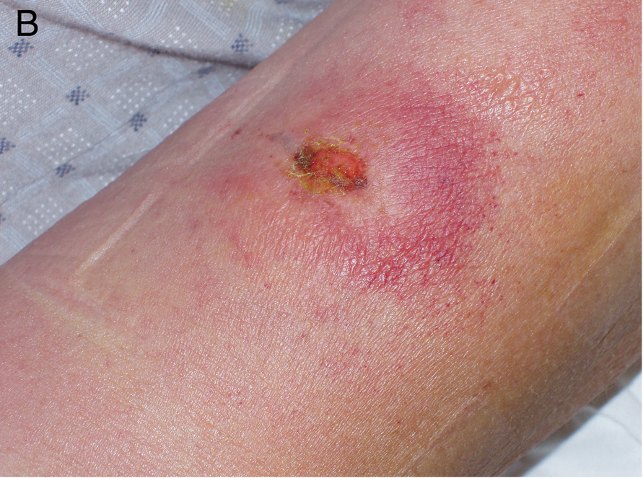
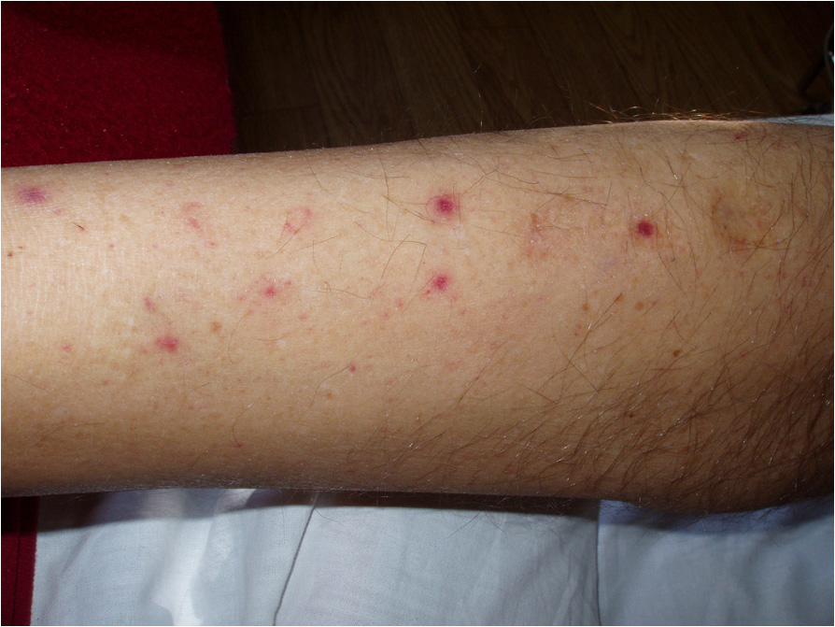
Case
Poland
61M tourist trip to East Africa
  Single tsetse fly bite during a safari trip to the Queen Elizabeth National Park in Uganda
On admission very sick:
  41ºC
  Bleeding from gums, from venipuncture sites and many ecchymoses
  Jaundice
  Respiratory distress
  Renal failure
Notes:
. Laboratory investigations showed leucopenia, thrombocytopenia, haemolytic anaemia, hyperbilirubinaemia, hypoglycaemia, elevated creatinine and urea, high activity of aminotransferases, elevated levels of inflammatory markers, hypoproteinaemia, proteinuria, abnormal clotting and bleeding times, low fibrinogen level, metabolic acidosis, and electrolyte disturbances
tified on the basis of the characteristic serum resistance-associated gene using a polymerase chain reaction, and a seroconversion of specific immunoglobulin M and G antibodies in the peripheral blood by enzyme-linked immunosorbent assay.
Serological tests for T. brucei gambiense subspecies were negative. A severe clinical course of acute rhodesiense trypanosomiasis with renal failure, respiratory distress, disseminated intravascular coagulation syndrome, haemolysis, liver insufficiency and myocarditis was confirmed. Intensive anti-parasitic and symptomatic treatment was
immediately instituted, including intravenous pentamidine, plasmaphereses, oxygen therapy, blood transfusion,
catecholamine administration, and fluid infusions, as well as haemostatic, hepatoprotective

Slide 53
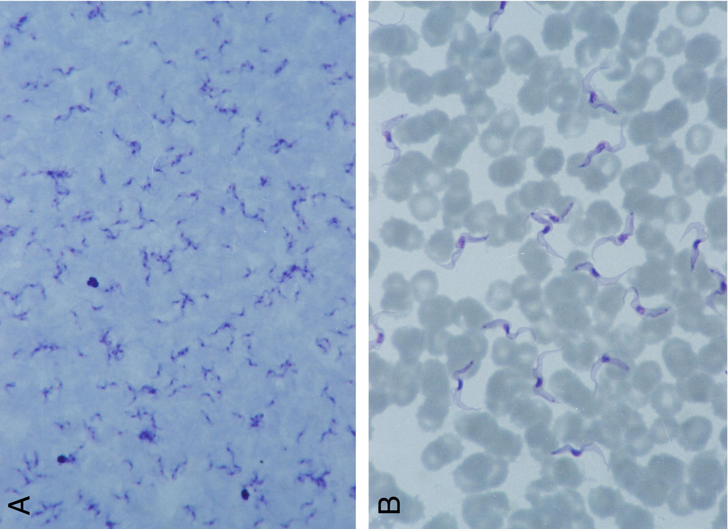
Case
Poland
Pentamidine monotherapy

Slide 54
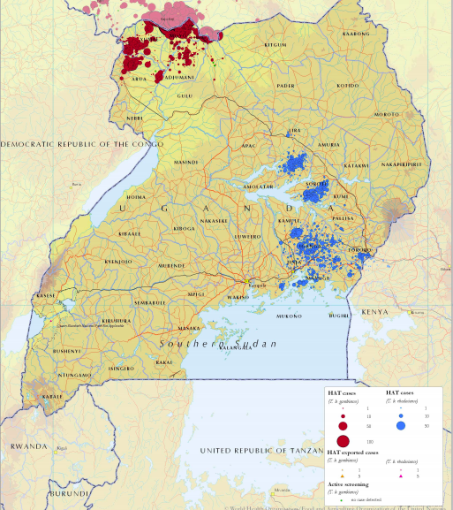
Uganda
Tourist
QE Falls park

Slide 55
Refugee
42M, Former human rights leader from DRC
  Was prisoner and tortured during the civil war
15 months after arrival to Canada as refugee presented to the hospital with:
  Emotional distress and an inability to cope
  labile affect and tangential speech
  auditory and visual hallucinations; people trying to kill him
Sertraline, Olanzapine, Clonazepam x 3 months
Developed suicidal ideation and returned to hospital
NEJM ‘01

Slide 56

Refugee
HIV negative
Abnormal MRI
Abnormal SPEP
  Elevated IgG and IgM
Bilateral posterior cervical lymphadenopathy
  Myoclonus, parkinsonian gait
CSF = 219 RBC, 342 WBC (92% lymphocytes)
NEJM ‘01

Slide 57

Refugee
Repeated LP:
  Rare trypanosomes
  MOTT cells
Also:
  CATT test positive
  PCR of blood and CSF positive
Treated with eflornithine
  Did well
NEJM ‘01
Notes:
Panel A shows a trypanosome in the cerebrospinal fluid, adjacent to a number of blood cells. Panel B shows a morular cell of
Mott (arrow). Mott cells are plasma cells with globular cytoplasmic inclusions that contain immunoglobulin proteins.

Slide 58
Humanitarian worker
34F worked for Red Cross in South Sudan 2014
  Evacuated back to Canada due to political instability and PTSD.
  Struggled for months with PTSD/depression, increasing fatigue and SOBOE
Multiple cardiac investigations showed conduction abnormalities and myocarditis
CATT +ve
LP normal cell count
PCR positive
Pentamidine
AICD
Notes:
pristine (-ve smear and cells) so she was treated for hemolymphatic stage I with IV Pentamidine.

Slide 59

Prevention
Public health efforts
CATT screening outreach campaigns
Insecticide
Traps

Slide 60
East or West
Acute?
Zoonosis?
NECT?
Causes of > 98% of all HAT cases?
Pentamidine?

Slide 61
In 1998, the WHO estimated that there were 300 000 new cases of HAT in Africa.6 HAT occurrence then declined progressively with these combined measures with just 3796 reported cases/year with < 15 000 estimated cases in 2014
A historic low of under 2000 cases were reported in 2017 and under 1000 cases in 2018.8 Most of the reported cases (mainly gambiense disease) over the last 5 years have been in the Democratic Republic of Congo (DRC) which reported 61% of the cases (mean of 522 cases/year)
reasonable to treat gambiense HAT which is in the milder, early part of the encephalitic stage (with a CSF WBC of 100 per cu mm) should instead be treated with NECT as first line therapy

Slide 62

Comparison of East and West

Slide 63


Slide 64

Human African trypanosomiasis, HAT, or sleeping sickness, is endemic
in Congo DR especially in the western and southern provinces
  https://doi.org/10.1371/journal.pntd.0010047

