Slide 1
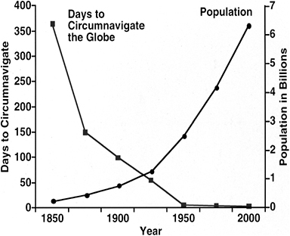
Immigration screening
UBC Tropical medicine rounds
Jan Hajek
September 2024
Notes:
Immigrant Services Society
Parasites –
Protozoa
Helminths
Ectoparasites

Slide 2
Immigration screening
Overview of the numbers and trends of immigrants and refugees
Overview of the Canadian IME
3 clinical cases
Ukraine
Melilla and Ceuta
Nell Toussaint
Notes:
Globalism - Is there increasing freedom of mobility for capital/commodities and less for people?

Slide 3
First… continuing on from the Eosinophilia topic last week
64F from southeastern Australia
  January 2021 - admitted to hospital with 3 weeks of abdominal pain and diarrhea, cough and night sweats
  eosinophil count of 9.8 × 109 cells/L
  Prior travel to South Africa, Asia, and Europe > years earlier.

Slide 4
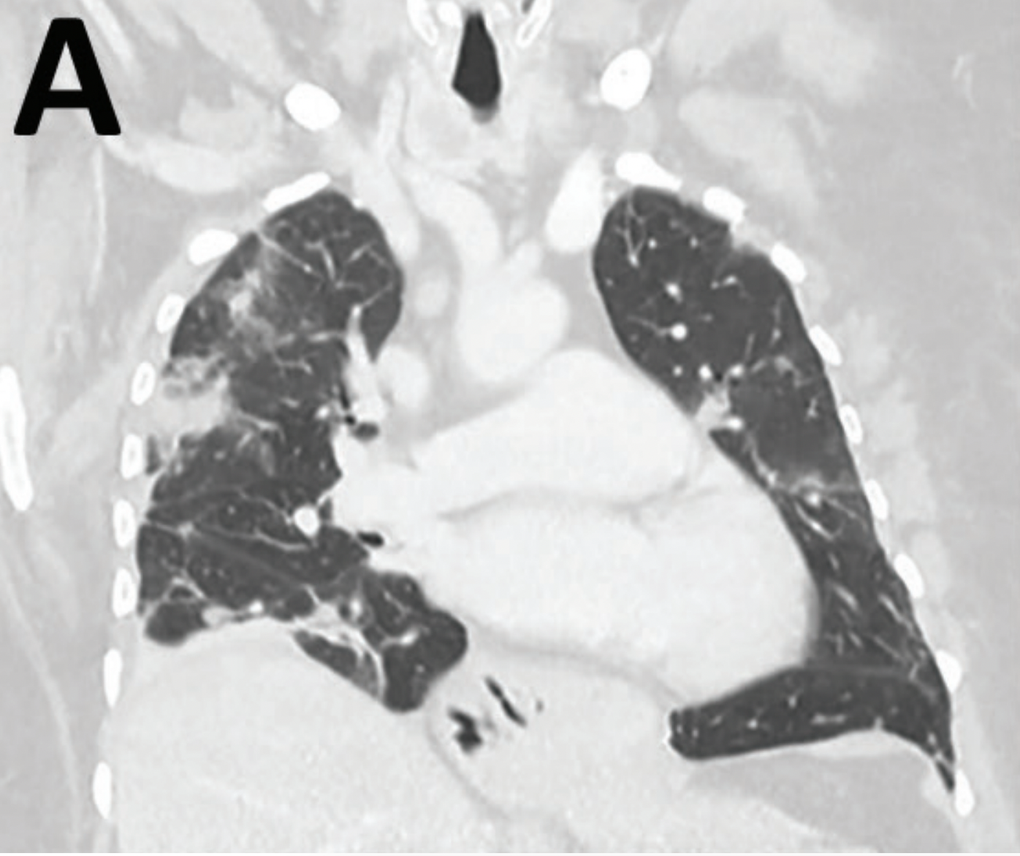
Eosinophilia case – in Australia
Imaging
  Abnormal chest CT
BAL
  Eosinophils
  Negative cytology, O&P
Strongyloides, Schistosomiasis, Fasciola serology
  Negative
Notes:
multifocal pulmonary opacities with surrounding ground-glass changes, as well as hepatic and splenic lesions. Bronchoalveolar lavage revealed 30% eosinophils without evidence of malignancy or pathogenic microorganisms, including helminths. Serologic testing was negative for Strongyloides. Autoimmune disease screening results were negative. The patient’s diagnosis was eosinophilic pneumonia of unclear etiology; she began taking prednisolone (25 mg/d) with partial symptomatic improvement.

Slide 5
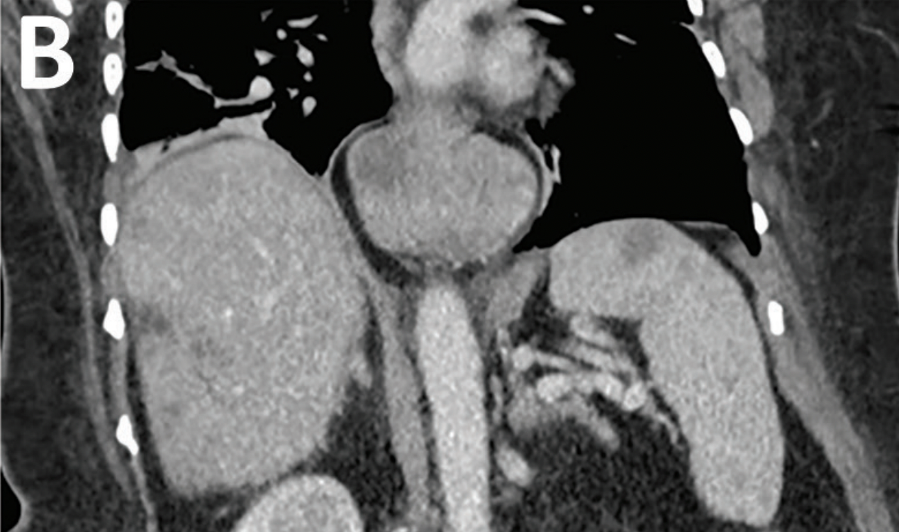
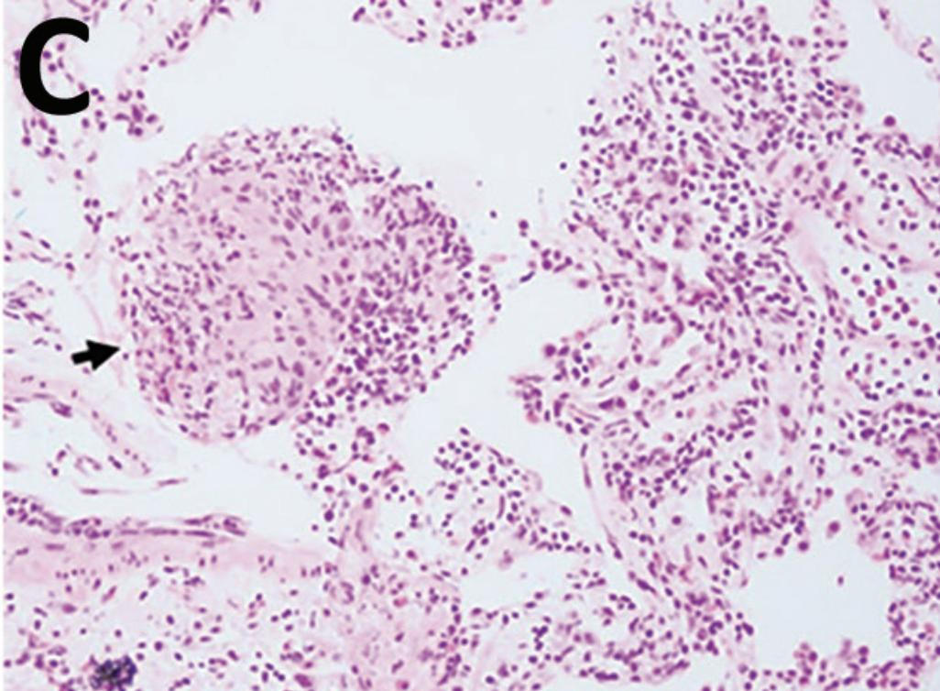
Eosinophilia case – in Australia
3 weeks later, still on prednisone – cough persisted and fevers recurred…
lesions within the liver and spleen
eosinophilic granulomas
- but no vessel changes, not EGPA

Slide 6
Eosinophilia case – in Australia
Further studies
  monoclonal T-cell receptor gene rearrangement – probable T-cell driven HES
More prednisolone (50 mg/d) and mycophenolate (1 g 2×/d)
Ivermectin, just in case serology was false negative
Mid-2021 – improving CRT chest
Couldn’t reduce prednisone below 20 mg daily without a flare of respiratory symptoms
January 2022 – added mepolizumab (IL-5 monoclonal antibody)

Slide 7
Eosinophilia case – in Australia
Further studies
  monoclonal T-cell receptor gene rearrangement – probable T-cell driven HES
More prednisolone (50 mg/d) and mycophenolate (1 g 2×/d)
Ivermectin, just in case serology was false negative
Mid-2021 – improving CRT chest
Couldn’t reduce prednisone below 20 mg daily without a flare of respiratory symptoms
January 2022 – added mepolizumab (IL-5 monoclonal antibody)

Slide 8
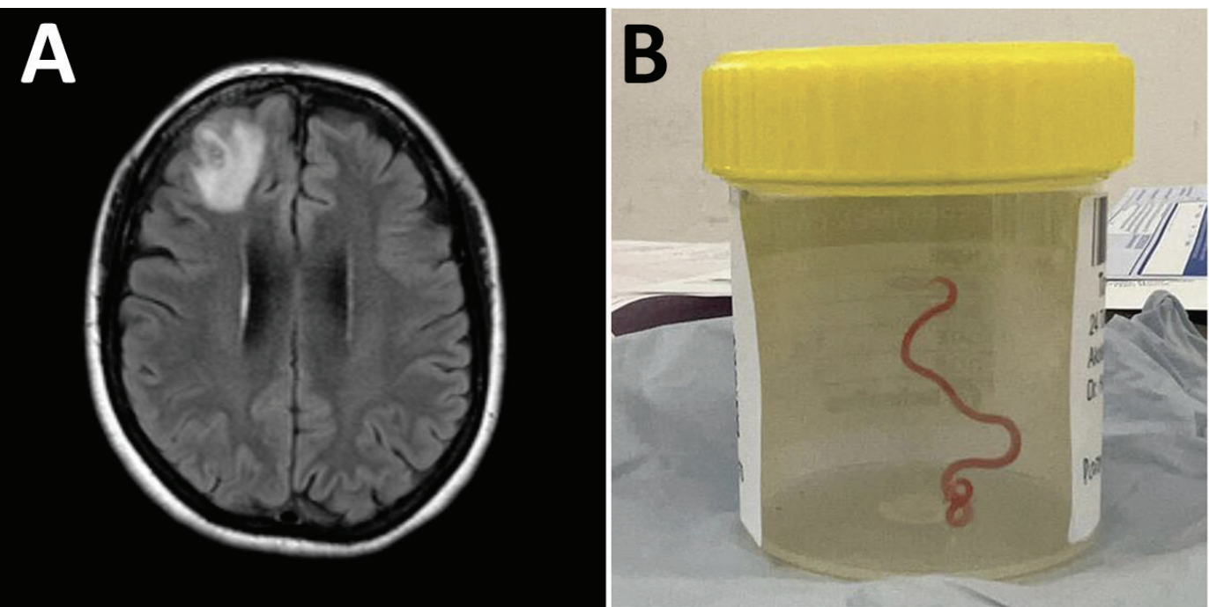
Eosinophilia case – in Australia
June 2022 – returned to hospital with forgetfulness

Slide 9
Eosinophilia case – in Australia
June 2022 – returned to hospital with forgetfulness

Slide 10
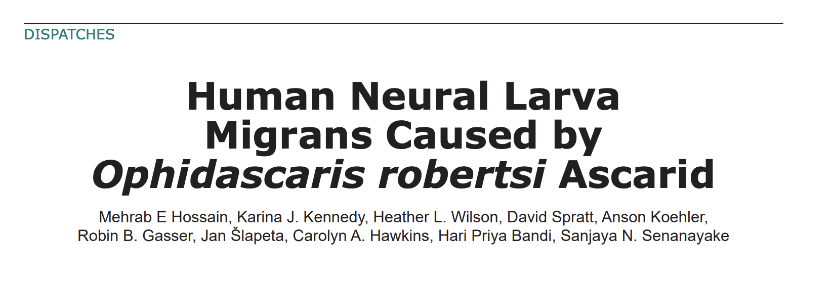
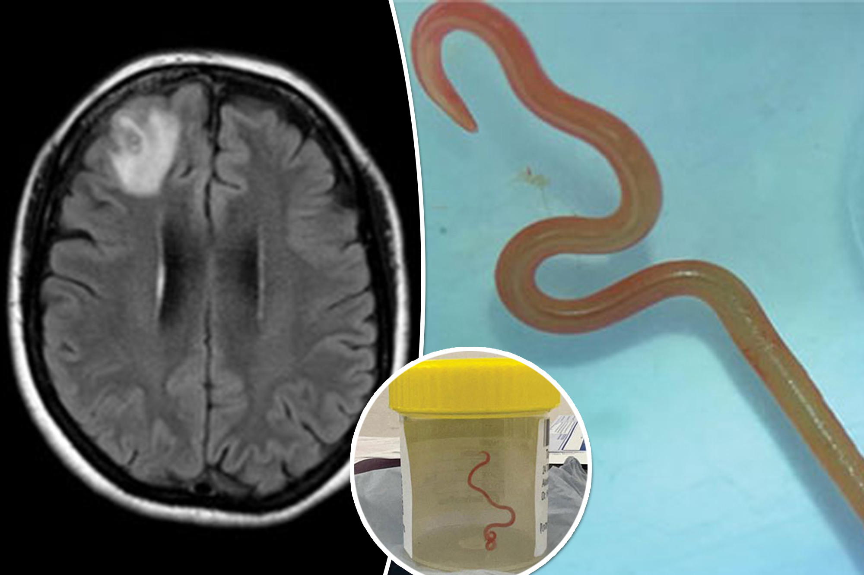
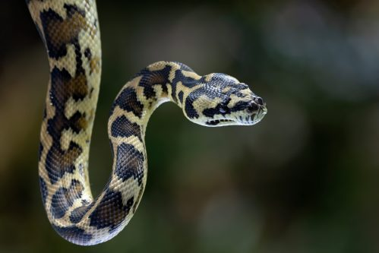
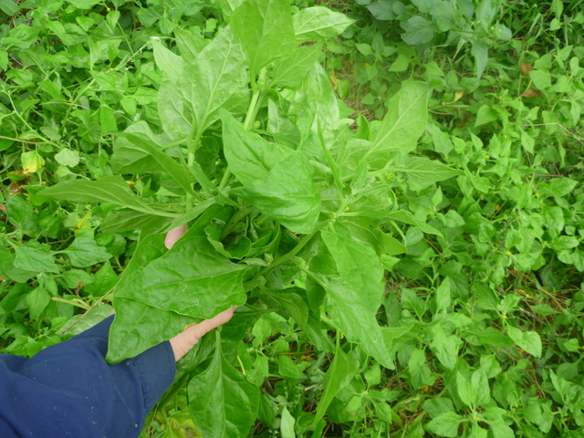
Carpet python
Warrigal greens
4 weeks of albendazole
10 weeks tapering course of dexamethasone
Repeat CT resolution of pulmonary and hepatic lesions

Slide 11

My previous job (2009)
Medical policy advisor for Citizenship and Immigration Canada
Recent case of MDR-TB in a new immigrant to Canada
  CIC was motivated to better address TB and infections
Interesting work
  Large group refugee movements
Challenging political climate

Slide 12


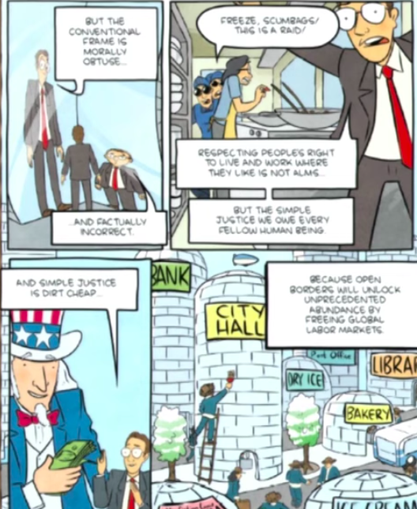
Right not charity
Labor mobility = ⬆$

Slide 13
Why medical screening
Protect public health
Assist refugees/migrants in integrating
Avoid potential complications of diseases
Cost effectiveness?

Slide 14
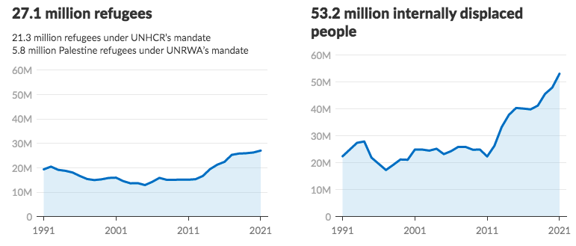
Immigration
Numbers - Global estimates
270 million international migrants (3.5% of global population)
  27 million are refugees (10% of all international migrants)
50 million have been forcibly displaced (IDPs)
https://www.unhcr.org/figures-at-a-glance.html
Notes:
3.4% of the world’s population residing in a country other than their county of birth (IOM

Slide 15
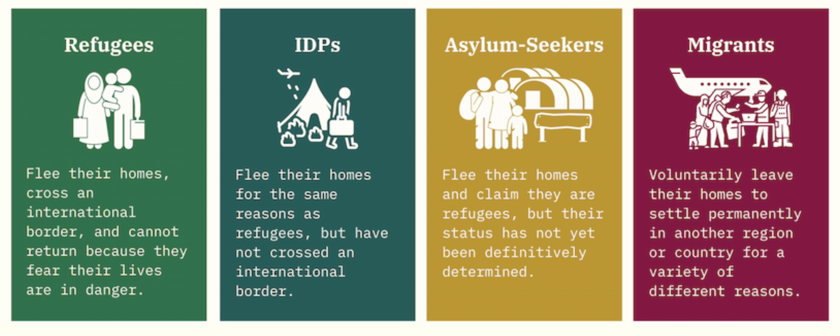

Slide 16
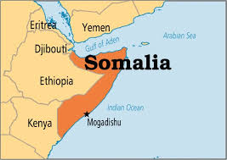
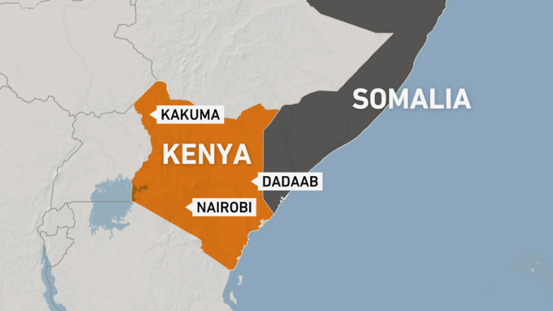
Case…
33M born in Mogadishu, Somalia
  2008 → Dadaab; 2009 → Kakuma; 2019 → Nairobi
  May 2021 → Canada
Notes:
https://borgenproject.org/ten-facts-about-somali-refugees/
Civil war resulted in a complete breakdown of the formal education system in Somalia. Somalia has one of the world’s lowest enrollment rates for primary school-aged children, where as few as 25% of children have access to primary education, and secondary school enrollment is estimated at 6%
Literacy among Somalis is low. Among adults (15 years of age or older), male literacy is approximately 49.7%, while literacy among women is substantially lower at 25.8% ⁹.

Slide 17
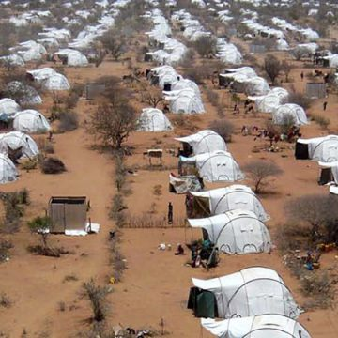
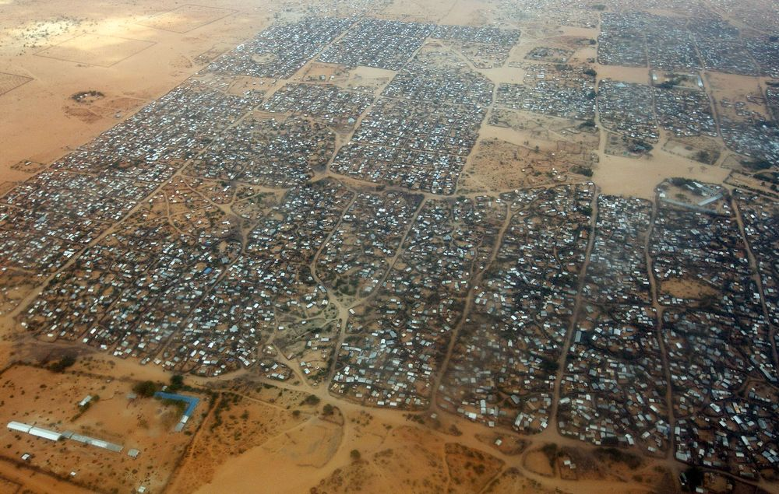
Kenya demands that UNHCR close Dadaab and Kakuma camps – home to 400,000 people (2012)
https://www.aljazeera.com/news/2021/4/5/no-other-home-refugees-in-kenya-camps-devastated-over-closure
Notes:
https://www.aljazeera.com/news/2021/4/5/no-other-home-refugees-in-kenya-camps-devastated-over-closure
One of the two refugee camps in northern Kenya, Dadaab, close to the sensitive border with war-racked Somalia, was set up in 1991. In 2011, amid famine and chaos in Somalia, it was the world's largest camp.
Dadaab, the largest refugee camp in the world, was home to more than half a million Somalis in 2015. The camp is located in northeastern Kenya and was initially set up as a temporary living situation for refugees fleeing conflict in Somalia and Sudan. Unfortunately for many, the camp has become more permanent. Refugees are often stuck in camps for several decades, unable to emigrate to another country or return to their own. Kenya now plans to close the camp as it has become a breeding ground for extremist groups.
Somalia’s neighboring countries host the largest number of its refugees. According to data collected by the UNHCR, there are just under 330,000 Somali refugees registered in Kenya, 241,000 in Ethiopia and 255,000 in Yemen. Thousands more have found temporary living situations in Tanzania, Uganda, Djibouti and Eritrea.
There are nearly 400,000 Somali refugees living in Dadaab for whom none of these outcomes is likely. They are among the 14 million refugees living in what the United Nations calls “protracted situations,” those in exile for more than five years. The global displaced population is now at 60 million

Slide 18
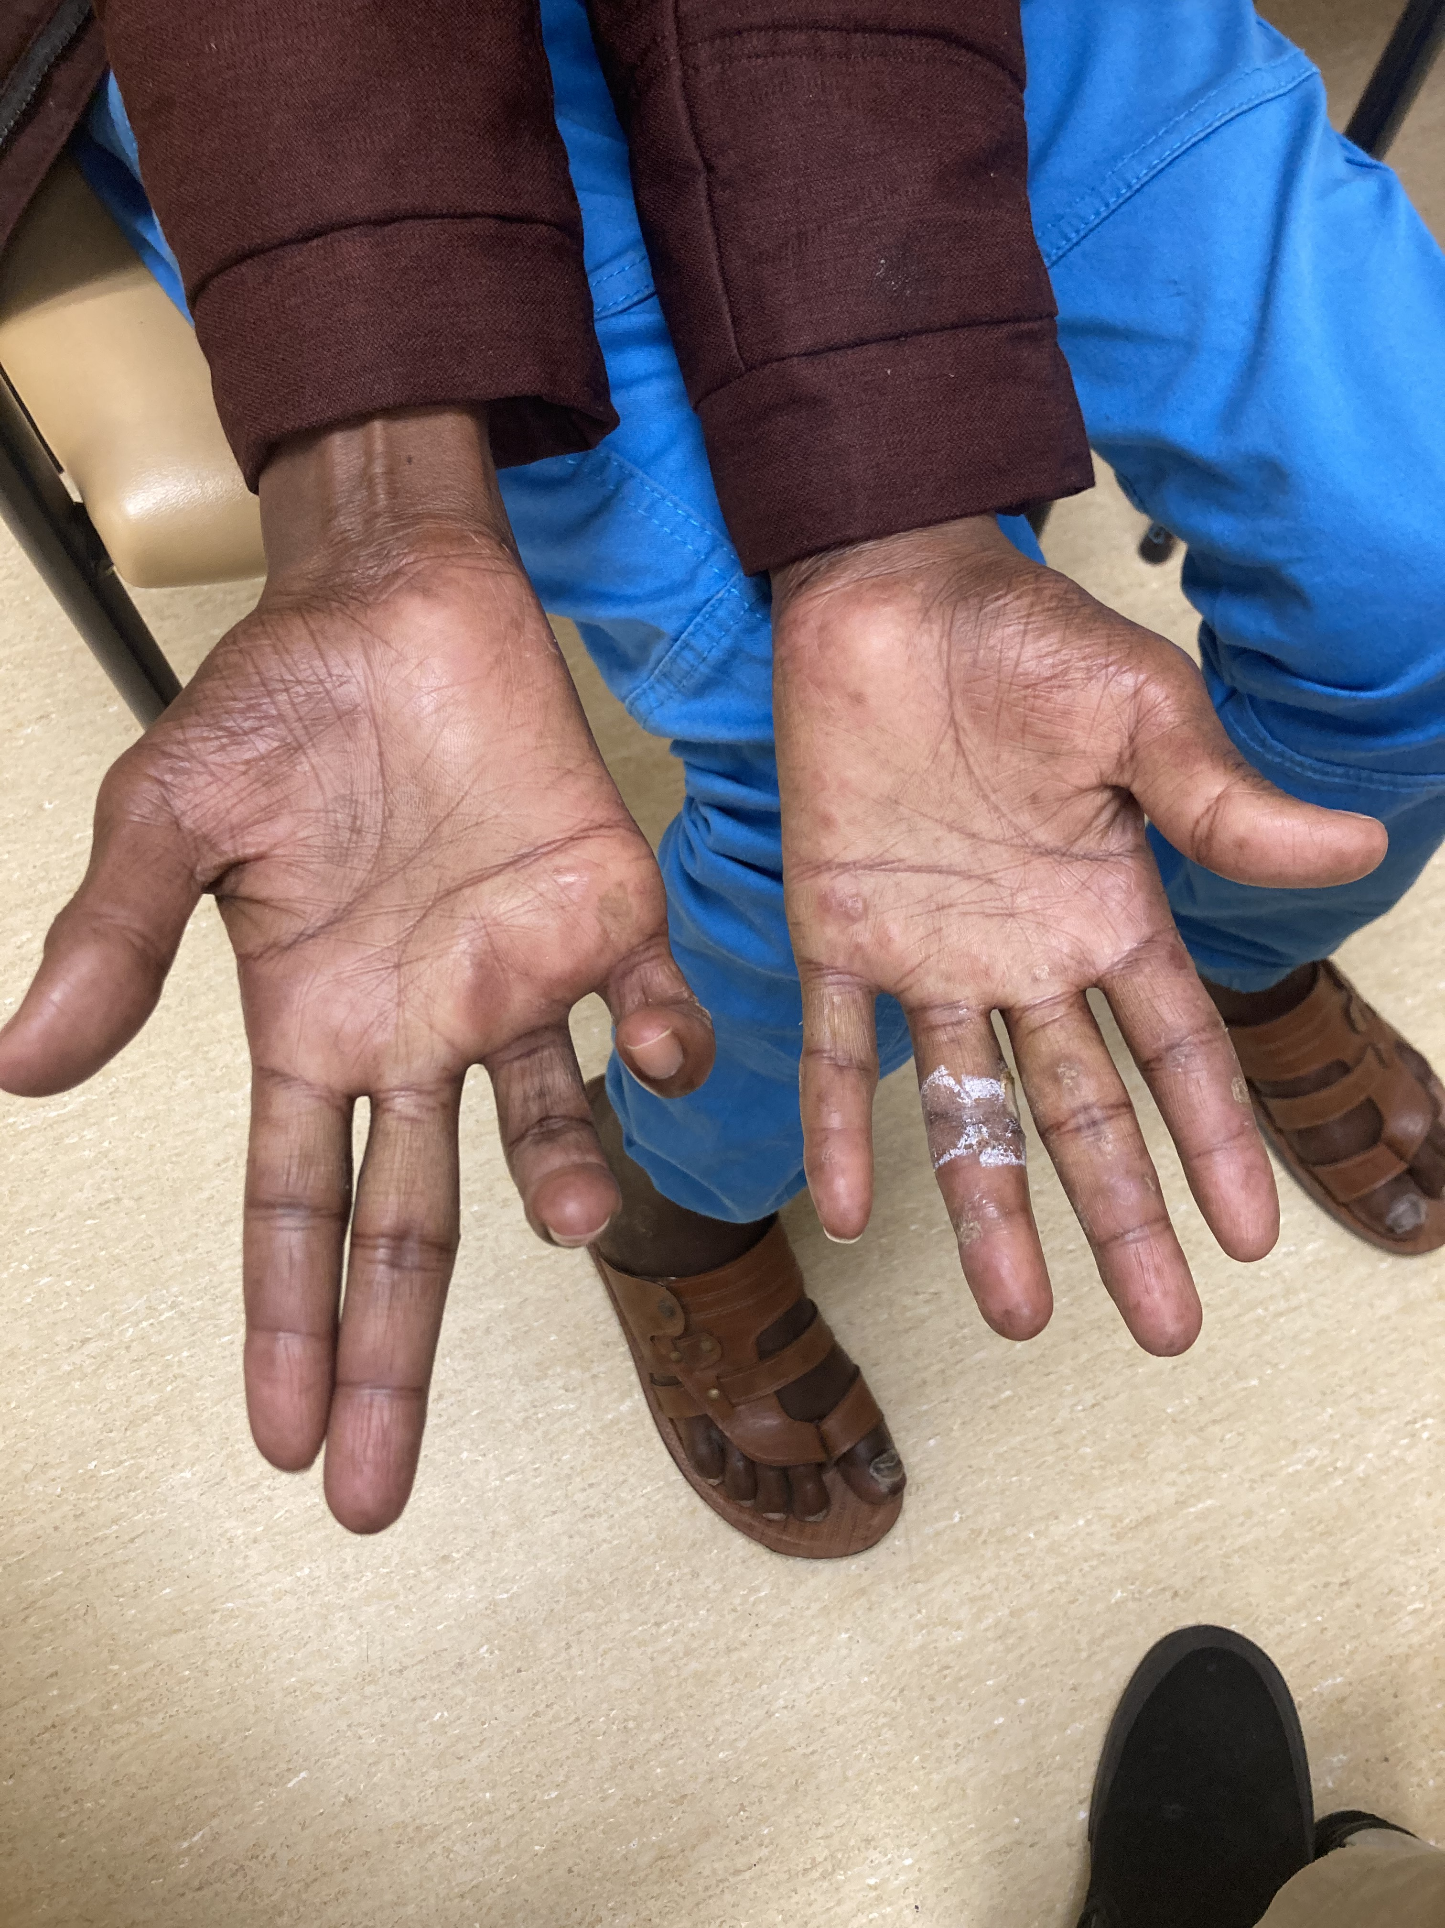
33M, refugee from Somalia
May 17 - arrived to Vancouver
May 21 – to ER; and ID clinic May 27
  Epistaxis, mild
  Dysuria x 3 months
  Right ulnar nerve palsy x 3 months

Slide 19
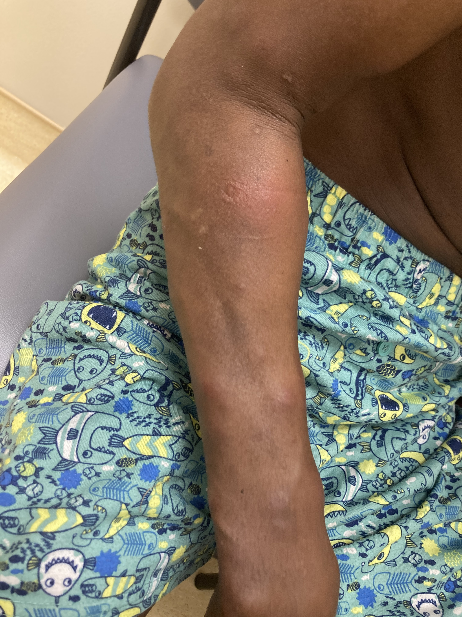
33M, refugee from Somalia
May 17 - arrived to Vancouver
May 21 – to ER; and ID clinic May 27
  Epistaxis, mild
  Dysuria x 3 months
  Right ulnar nerve palsy x 3 months
May 28 – TB skin test, doxycycline for dysuria
June 4 – to clinic/ER with fever and multiple painful lumps/nodules

Slide 20
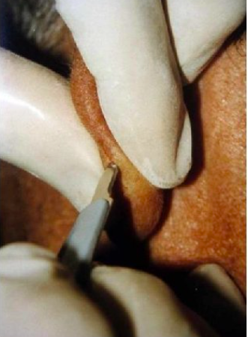
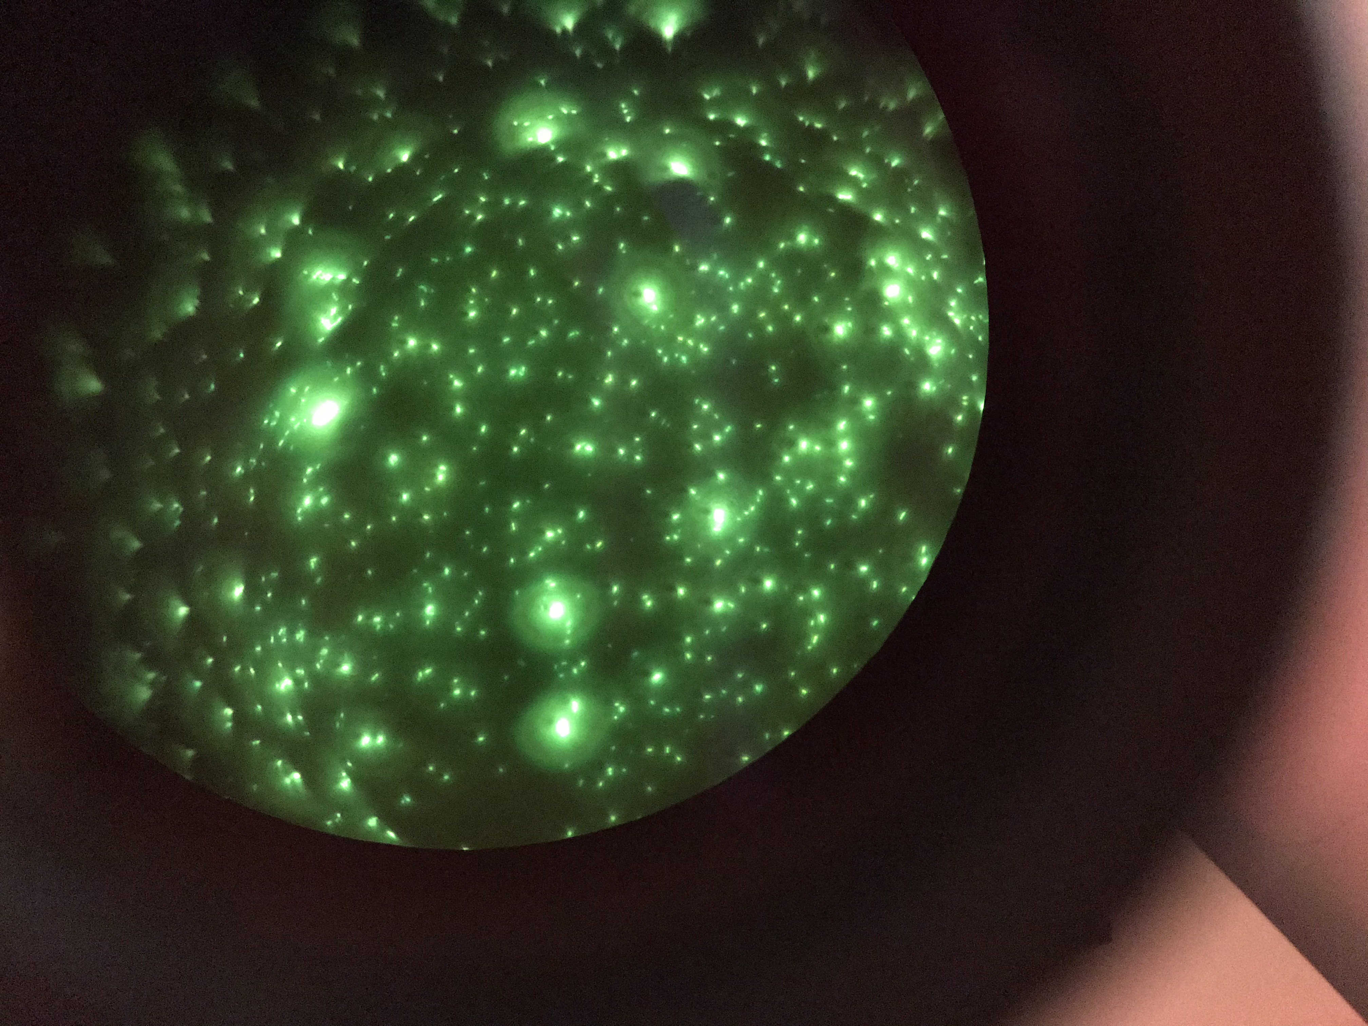
Skin slit smear and skin biopsy…
Auramine-rhodamine stain

Slide 21
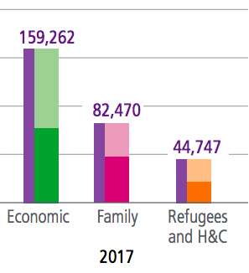
Categories of immigrants to Canada
Permanent resident (330,000)
  Family class (25%) 26%
  Economic class (60%) 53%
  Refugee and protected persons (15%)
Temporary resident (400,000)
  Visitor
  Student
  Temporary foreign worker
  Live-in caregiver
Visitor (35 million)
Notes:
In Canada there are four categories of immigrants: family class (closely related persons of Canadian residents living in Canada), economic immigrants (skilled workers and business people), other (people accepted as immigrants for humanitarian or compassionate reasons) and refugees (people who are escaping persecution, torture or cruel and unusual punishment). According to the 2001 census by Statistics Canada, Canada has 33 ethnic groups with at least one hundred thousand members each, of which 10 have over 1,000,000 people and numerous others represented in smaller amounts. 16.2% of the population belonged to visible minorities.
Refugee – a person who is forced to flee from persecution and is located outside of their home country.
Convention refugee – a person who meets the refugee definition in the 1951 Geneva Convention relating to the Status of Refugees. This definition is used in Canadian law and is widely accepted internationally. To meet the definition, a person must be outside their country of origin and have a well-founded fear of being persecuted for reasons of race, religion, nationality, membership of a particular social group or political opinion.
Refugee claimant or Asylum Seeker – a person who has fled their country and is asking for protection in another country. We don’t know whether a claimant is a refugee or not until their case has been decided.
'Claimant’ is the term used in Canadian law.
Resettled refugee – a person who has fled their country, is temporarily in a second country and then is offered a permanent home in a third country. Refugees resettled to Canada are selected abroad and become permanent residents as soon as they arrive in Canada.
Resettled refugees are determined to be refugees by the Canadian government before they arrive in Canada. Refugee claimants receive a decision on whether they are refugees after they arrive in Canada.
Protected person – according to Canada’s Immigration and Refugee Protection Act, a person who has been determined to be either (a) a Convention Refugee or (b) a person in need of protection (including, for example, a person who is in danger of being tortured if deported from Canada).
Internally displaced person – a person who is forced to leave their home, but who is still within the borders of their home country.
Stateless person – a person that no state recognizes as a citizen. Some refugees may be stateless but not all are. Similarly, not all stateless people are refugees.
You may also hear… Political refugee, Economic refugee, Environmental refugee – these terms have no meaning in law. They can be confusing because they incorrectly suggest that there are different categories of refugees.
WHAT IS THE DIFFERENCE BETWEEN A REFUGEE AND AN IMMIGRANT?A refugee is forced to flee for their lives. An immigrant chooses to move to another country.
TERMS FOR IMMIGRANTS
Immigrant – a person who has settled permanently in another country.
Permanent resident – a person granted the right to live permanently in Canada. The person may have come to Canada as an immigrant or as a refugee. Permanent residents who become Canadian citizens are no longer permanent residents.
OTHER TERMS FOR PEOPLE OUTSIDE THEIR HOME COUNTRY
Temporary resident – a person who has permission to remain in Canada only for a limited period of time. Visitors and students are temporary residents, and so are temporary foreign workers such as agricultural workers and live-in caregivers.
Migrant – a person who is outside their country of origin. Sometimes this term is used to talk about everyone outside their country of birth, including people who have been Canadian citizens for decades. More often, it is used for people currently on the move or people with temporary status or no status at all in the country where they live.
Economic migrant – a person who moves countries for a job or a better economic future. The term is correctly used for people whose motivations are entirely economic. Migrants’ motivations are often complex and may not be immediately clear, so it is dangerous to apply the “economic” label too quickly to an individual or group of migrants.
Person without status – a person who has not been granted permission to stay in the country, or who has stayed after their visa has expired. The term can cover a person who falls between the cracks of the system, such as a refugee claimant who is refused refugee status but not removed from Canada because of a situation of generalized risk in the country of origin.
You may also hear... Illegal migrant/illegal immigrant/Illegal – these terms are problematic because they criminalize the person, rather than the act of entering or remaining irregularly in a country. International law recognizes refugees may need to enter a country without official documents or authorization. It would be misleading to describe them as “illegal migrants”. Similarly, a person without status may have been coerced by traffickers: such a person should be recognized as a victim of crime, not treated as a wrong-doer.

Slide 22
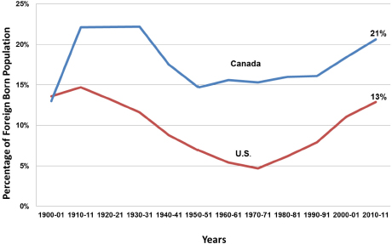
Percentage of population foreign born
Over last 100 years
23%
Toronto
- 49%
Vancouver
- 40%
2021

Slide 23
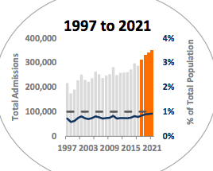
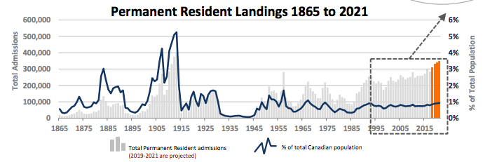
2019
341,000
2020
185,000
2021
400,000
Notes:
In 2019, Canada welcomed more than 341,000 permanent residents. Despite the challenges resulting from the COVID-19 pandemic, Canada also admitted over 184,500 new permanent residents over the course of 2020.

Slide 24
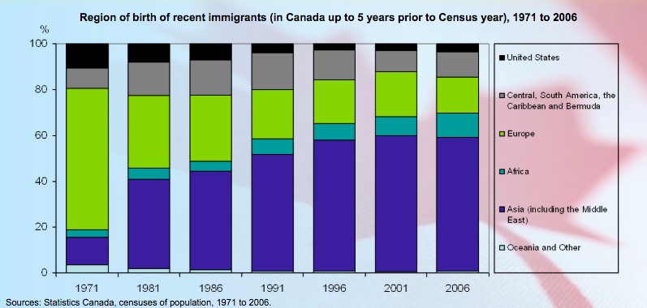

Slide 25
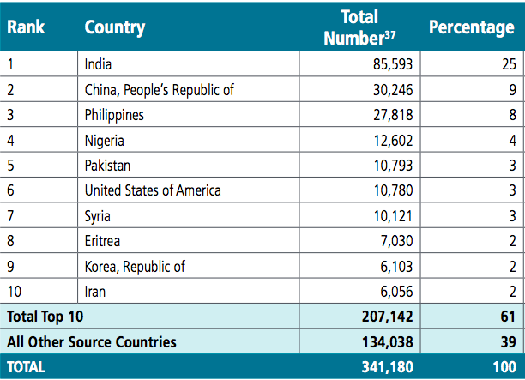
Permanent Residents Arriving in 2019

Slide 26
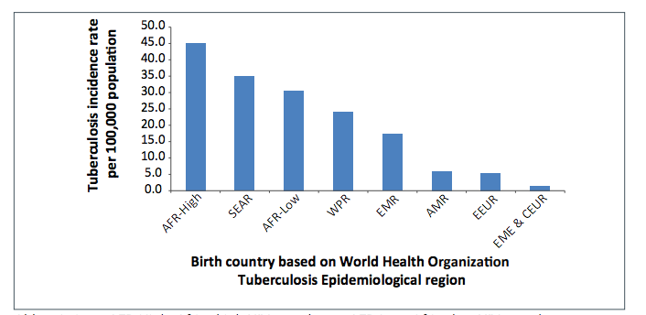
Rate of TB following immigration reflects the rate of TB in country of origin

Slide 27
TB trends in Canada
74% of all cases occur among foreign born
74%
(2019)

Slide 28
TB trends in Canada
Incidence is declining, except among Aboriginal

Slide 29
TB trends in Canada
Incidence is declining, except among Aboriginal
Number of cases / incidence
Canadian born non-indigenous 125. / 0.5
Foreign born 1,290 / 14.7
First Nations 154. / 17.1
Inuit 142 / 205.8

Slide 30
Refugees
What is a refugee?
How many refugees are there in the world?
What percent of refugees are accepted for resettlement each year?

Slide 31
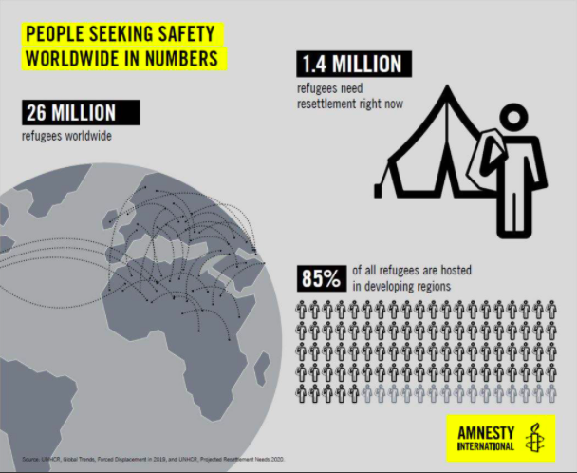
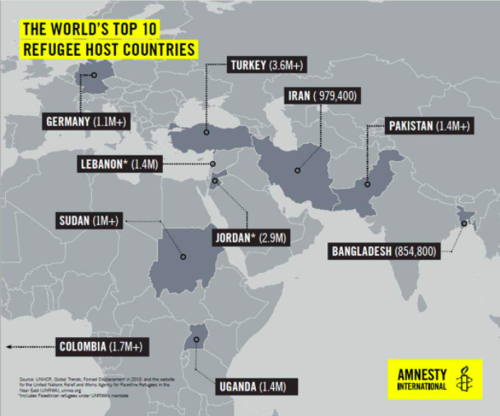
Refugees in numbers

Slide 32
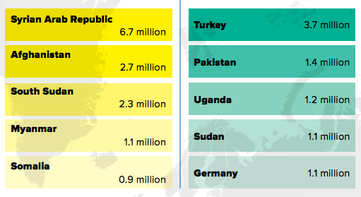
Refugee
From To
2018
Notes:
"Only 16 per cent of the world's refugees are in developed states," Casasola said.
Turkey hosted the largest number of refugees worldwide, with 3.7 million people in 2018, while Pakistan hosted 1.4 million and Uganda 1.2 million.

Slide 33
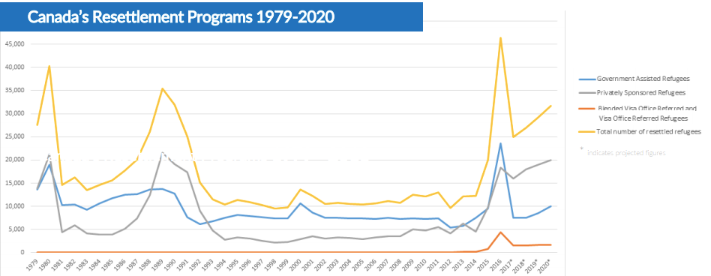
How many refugees does Canada accept?
In 2018:
  28,000
Notes:
The UNHCR's annual global trends report shows Canada took in 28,100 of the 92,400 refugees who were resettled in 25 countries during 2018; the United States was second with 22,900.
About 1.4 million refugees were in need of resettlement in 2018, but only 92,400 were resettled.
Canada welcomes about 1.5% of the world’s refugees

Slide 34
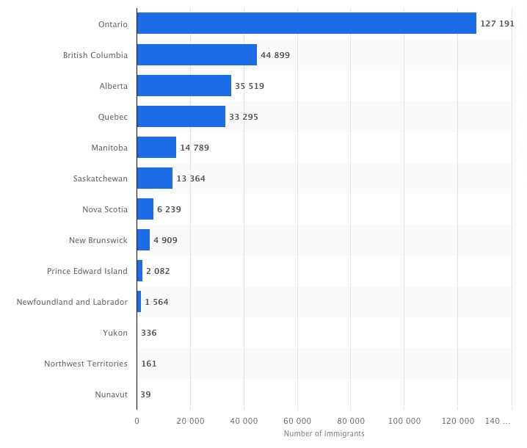
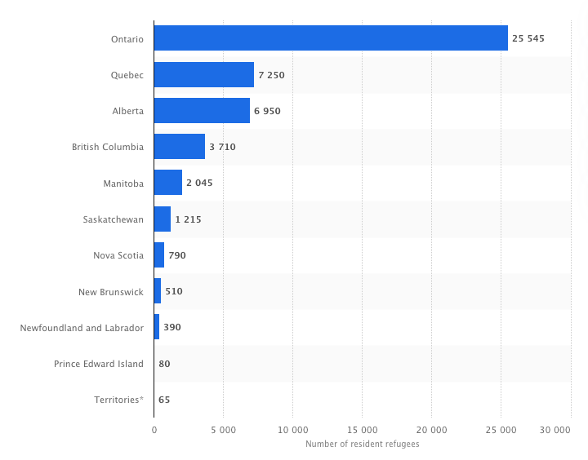
IMMIGRANTS
REFUGEES
Notes:
19% refugees (Ontario)
8% refugees (BC)

Slide 35

Refugees
True or False?
  Refugees have to pay the cost of their flights to Canada.
Notes:
Will the refugee have to pay any costs?
Yes. Refugees resettled to Canada are responsible for paying for travel documents and transportation costs to Canada. To help refugees cover these costs, they are able to access the Immigration Loans Program. For more information on the loans program, see the Refugee Sponsorship Training Program handbooks.
The Interim Federal Health Program (IFHP) covers certain pre-departure medical services for refugees coming to Canada for resettlement. This coverage includes the following services:
immigration medical exams and follow-up treatment of health conditions that would make someone inadmissible to Canada under paragraph 38(1)(a) of the Immigration and Refugee Protection Act
vaccinations
outbreak management and control
medical support needed for safe travel

Slide 36
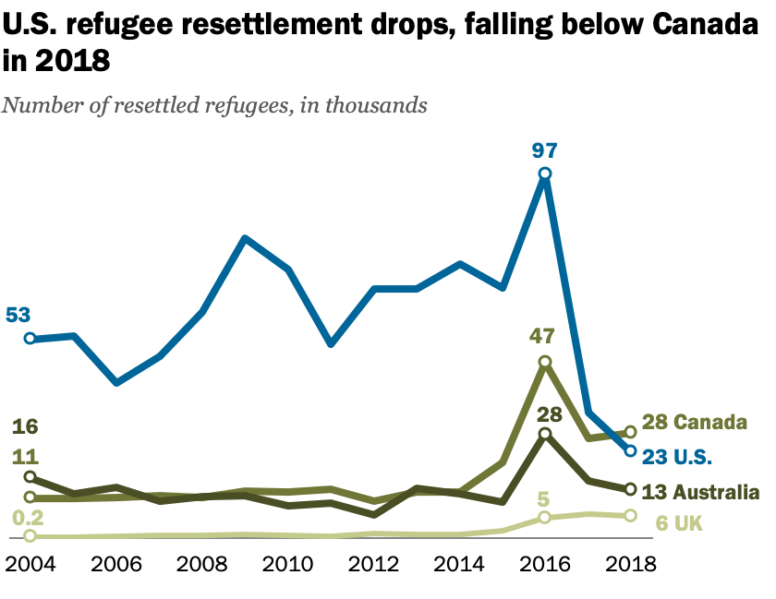
Notes:
https://www.pewresearch.org/fact-tank/2019/06/19/canada-now-leads-the-world-in-refugee-resettlement-surpassing-the-u-s/

Slide 37
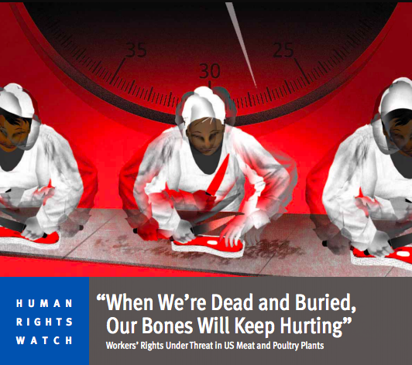
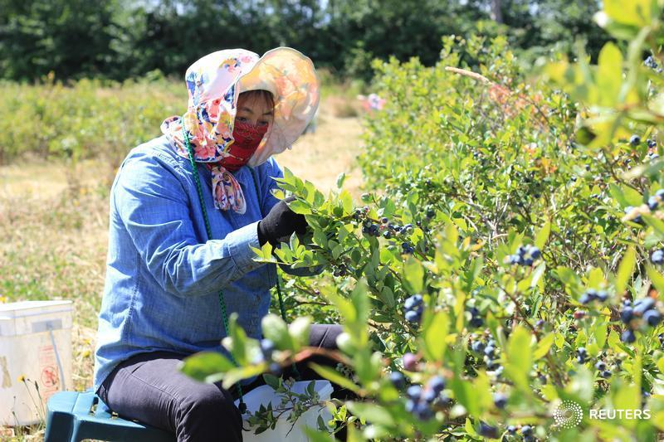
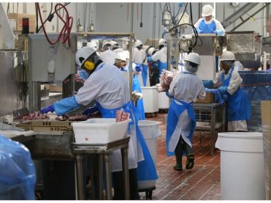
Temporary foreign worker program
“We just can’t find enough Canadians to do the job”
  Slaughterhouse, seasonal workers
Notes:
said Morreale, whose company has 950 employees, including 70 temporary foreign workers.
“The industry is such that we have difficulties attracting and retaining individuals,” said Morreale. “We have temporary foreign workers, but these are year-round jobs and we want them to stay permanently.”
Mushroom pickers
Slaughterhouse
The industry, mostly unionized, has the same pay scale for both foreign and Canadian workers, who earn between $14 and $18 an hour.
the Harper government raised the application fee employers have to pay for migrant workers from $200 to $1,000
To make the situation worse, the Liberal government changed the immigration selection system and made it more difficult for butchers to become permanent residents.
Under the old system, butchers could qualify as long as they had a job offer in Canada and possessed minimum proficiency in English or French. Now, the job offer doesn’t give them an edge.
Turnover rate around 25%

Slide 38

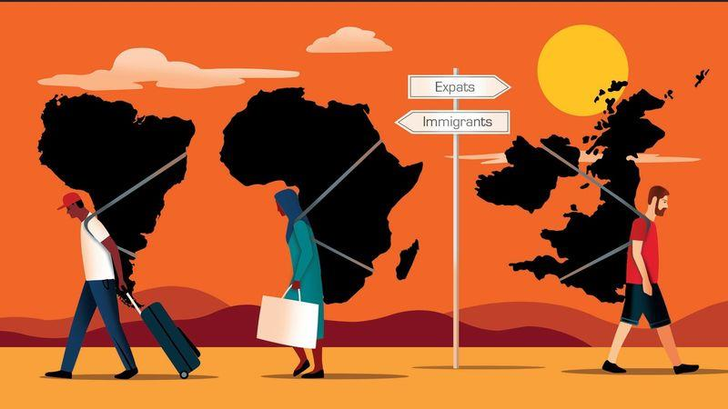
Expat or Immigrant
Notes:
Africans are immigrants. Arabs are immigrants. Asians are immigrants. However, Europeans are expats because they can’t be at the same level as other ethnicities. They are superior. Immigrants is a term set aside for ‘inferior races’.

Slide 39
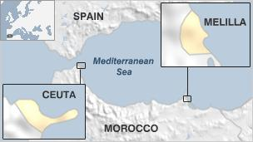
Migration to Spain
Melilla and Ceuta…
Notes:
Refugees, are by definition forcefully displaced, are at highest risk for past exposure to harmful living conditions, violence and trauma.
Refugees undergo medical screening before admission to Canada but are protected by law from exclusion on the basis of noninfectious burden of illness (through the Immigration and Refugee Protection Act).
The health risks of refugees vary greatly depending on exposures and access to care.
Specifically, refugees, low-income immigrants, and immigrants with limited English-language proficiency are at risk for a rapid decline in self reported health after arrival

Slide 40
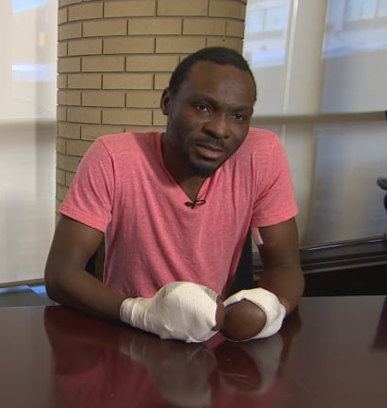
Safe third country
agreement STCA
Introduced in 2004
Cannot claim asylum in Canada if already in the US
If a migrant crosses at a regular border crossing → turned back
If a migrant crosses at an irregular border crossing → refugee claim heard
Seidu had his asylum claims rejected in the U.S. before coming to Canada.
  2015 crossed irregularly into Manitoba in the winter to claim asylum in Canada.
  2018 granted asylum

Slide 41
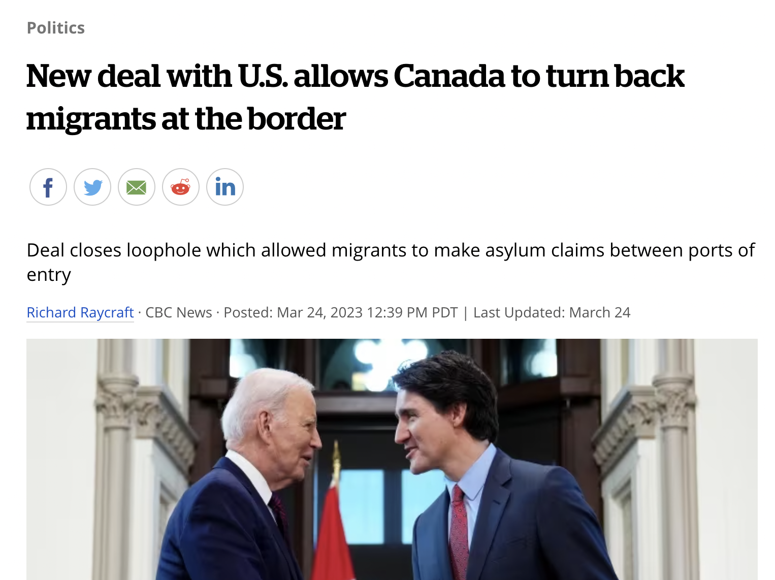
Safe third country
agreement STCA
Introduced in 2004
Cannot claim asylum in Canada if already in the US
If a migrant crosses at a regular border crossing → turned back
If a migrant crosses at an irregular border crossing → refugee claim heard

Slide 42
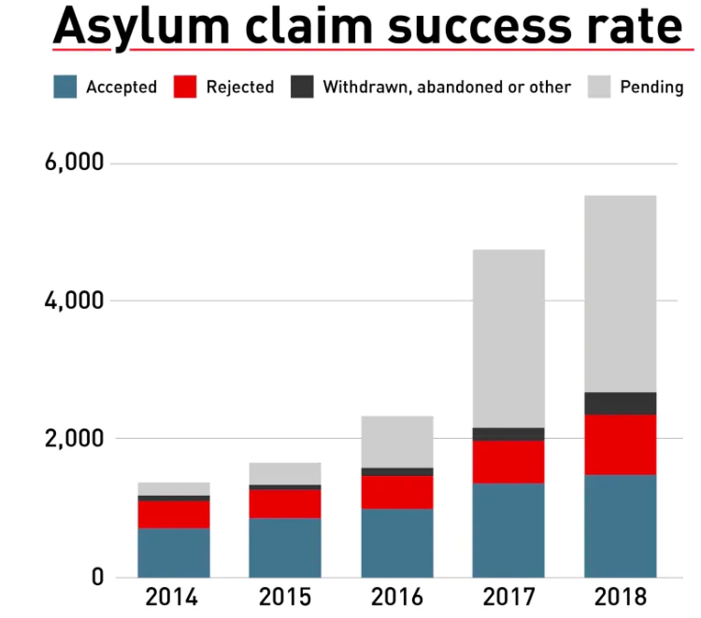
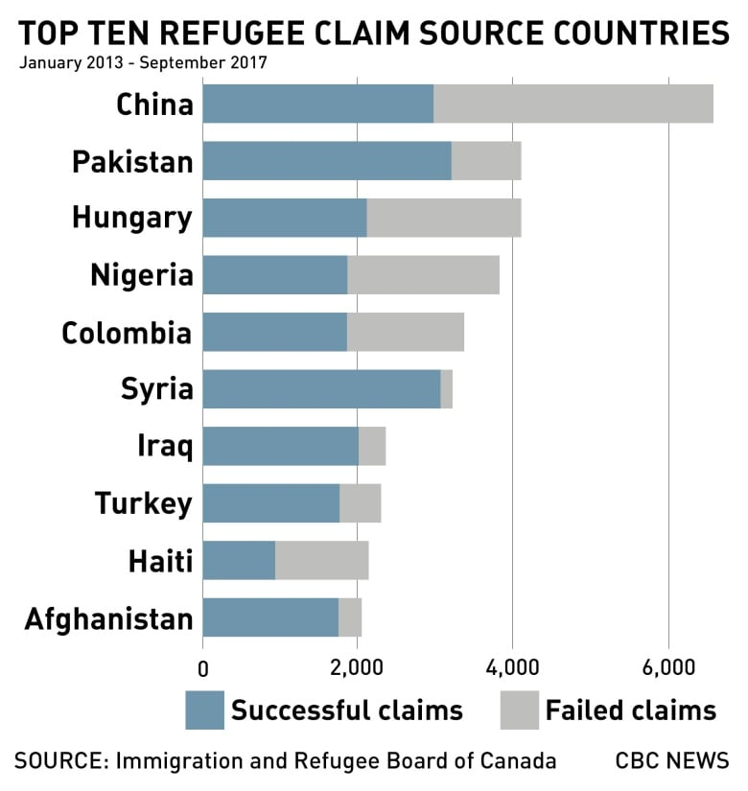
Notes:
https://www.cbc.ca/news/refugees-asylum-seekers-canada-1.5210093

Slide 43
Another case…
34F from South Africa
Immigrated with her husband – Economic class
Developed a persistent cough
What next?

Slide 44
Another case
34F from South Africa
Immigrated with her husband – Economic class
Developed a persistent cough
What next? Was she screened for TB?
- Normal CXR 8 months before travel
Does she have health coverage?
- No - waiting period for 2-3 months after arrival

Slide 45
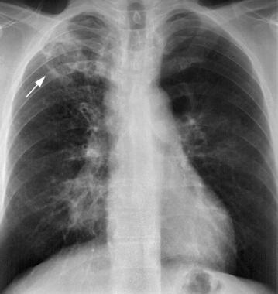
Another case
34F from South Africa
Immigrated with her husband – Economic class
Developed a persistent cough
What next? Was she screened for TB?
- Normal CXR 8 months before travel
Does she have health coverage?
- No - waiting period for 2-3 months after arrival
Sputum – AFB POS MDR-TB

Slide 46
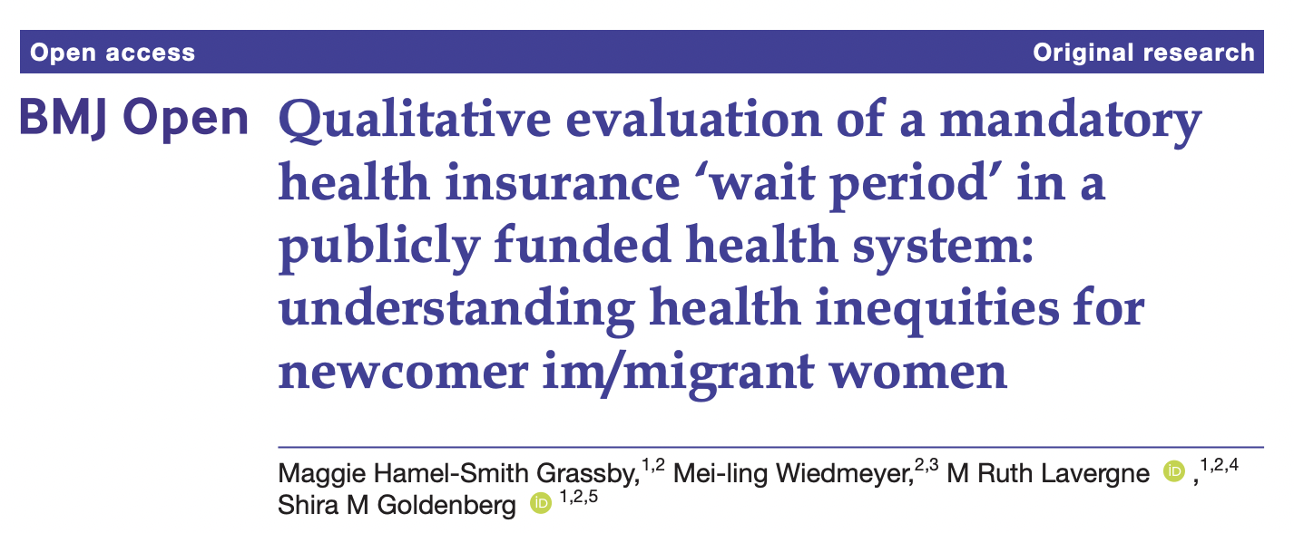
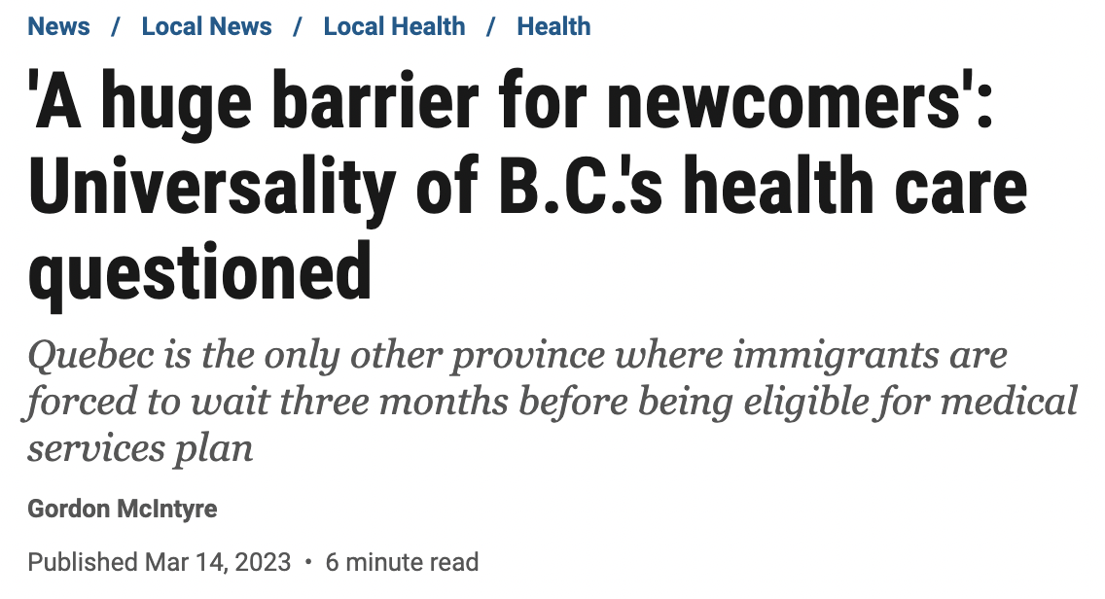
“Findings highlight severe, yet commonly overlooked, health inequities produced by a mandatory health coverage wait period within a purportedly ‘universal’ healthcare system”
https://bmjopen.bmj.com/content/bmjopen/11/8/e047597.full.pdf
Notes:
Section 11 (1)(a) of the Canada Health Act reads: “(T)he health care insurance plan of a province must not impose any minimum period of residence in the province, or waiting period, in excess of three months before residents of the province are eligible for or entitled to insured health services.”
The wait period resulted in mistrust and internalised stigma for racialised im/migrant women, for whom the policy resulted in feeling ‘undeserving’ of care.

Slide 47
Screening for TB as part of the IME (Immigration medical exam)
Guided by federal legislation (IRPA)
Screening for health grounds for exclusion:
  Is likely to be a danger to public health (communicable disease; TB)
  Is likely to be a danger to public safety (unpredictable or violent behaviour)
  Might reasonably be expected to cause excessive demand on health or social services
  The results of the IME are the property of the Canadian government, and only certain results (e.g., TB, HIV testing) are communicated to settlement workers and public health officials in Canada.

Slide 48
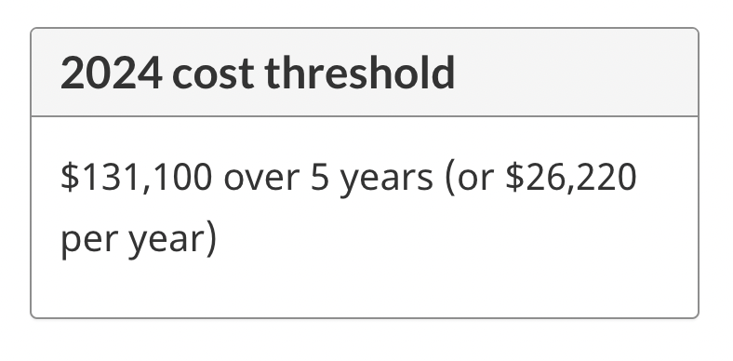
Excessive demand
Inadmissible if health care costs were more than the average Canadian
Only applies to Economic class (Family class and Refugees exempt)
January 2022
  Average healthcare costs for Canadian ~ $8,000
  3x increased cost for excessive demands → $24,000/year
    $120,000 over 5 years
    2023 -- $128,445 over 5 years (or $25,689 per year)
About 0.1% of all applicants are medically inadmissible *
Notes:
The department no longer assesses your need for special education services, social and vocational rehabilitation services, and personal support services as part of the excessive demand decision. The department also does not assess your dependants’ need for these services.
HCV is a treatable disease and cost 60,000 CAD t0 68,000 CAD for full treatment of 12 weeks only. Excessive demand threshold limit is 120,285 CAD covering 5 years. Recently 2 friends of mine with active HCV disease got PPR.
Liver transplant is applicable in condition of last stage of liver cirrhosis.

Slide 49
Which communicable diseases are specifically tested for in the Canadian IME?

Slide 50
Which communicable diseases are specifically tested for in the IME?
TB
Syphilis
HIV
Hepatitis B/C – based on clinical risk factors

Slide 51
Who needs an IME?

Slide 52
Who needs an IME?
Permanent resident applicants
Temporary resident (visitor) applicants if:
  Applying for < 6 months and
    Work in a job in which public health must be protected (e.g., hospital, caregiver)
    Agricultural worker from country with > 20/1000,000 TB cases per year
  Applying for > 6 months and
    From a country with >20/100,000 TB cases per year
    So, visitor applying for > 6 month VISA to Canada
      From Germany – no IME
      From Brazil – needs IME → ? admissible

Slide 53
Components of the IME
History and physical exam
Urinalysis
  ≥ 5 years
TB screening
  ≥ 11 years or positive symptom screen
Syphilis testing
  ≥ 15 years or specific risk factors
HIV testing (2002)
  ≥ 15 years or specific risk factors:
Hepatitis testing (2012)
  Based on clinical risk factors
Stool testing (abandoned in 1981)
Notes:
** substance use (includes sharing, drug snorting, smoking or injection equipment); • high-risk sexual activity or sexual partner with viral hepatitis; • household contact with an infected person especially if personal items (e.g., razors, toothbrushes, nail clippers) are shared; • receiving of unscreened blood products (screening of donated blood products for hepatitis C began in 1990 in Canada); • needle-stick injury or other occupational exposure (e.g., healthcare workers); • children born to mothers with chronic hepatitis B or C infection; • tattoos and body piercing; • history of incarceration; • HIV or other sexually transmitted infection; and • haemodialysis.

Slide 54
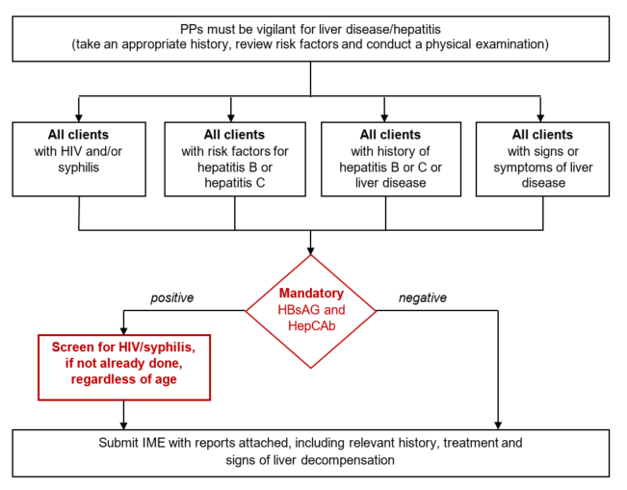

Slide 55
TB screening
Canadian guidelines
CXR > 11 years old
    Permanent residents
    Temporary residents > 6 months from higher incidence countries
  If CXR normal → OK
  If CXR abnormal → need to rule-out TB
    Sputum cultures and a repeat CXR in 3 months
    or
    Repeat CXR in 6 months
  If found to have active TB
    Documented completion of TB treatment that meets Canadian guidelines
  If no active TB, but abnormal CXR
    Referred for post-landing immigration surveillance

Slide 56
TB screening
Canada
CXR for:
  Everyone > 11 years of age
  Everyone <11 years of age with a previous history of TB infection/treatment or recent close TB contacts.
IGRA* only if:
  Close contact with an active TB case within the previous 5 years
  HIV positive
  Head/neck cancer within the last 5 years
  Chronic renal failure (eGFR of <30 ml/min)
  SOT or BMT
*TST if < 2 years old
Notes:
A TB close contact is an individual who has shared the same air space for a prolonged period of time with a person with infectious TB. The exact duration of exposure is traditionally at least 8 hours of cumulative exposure.

Slide 57
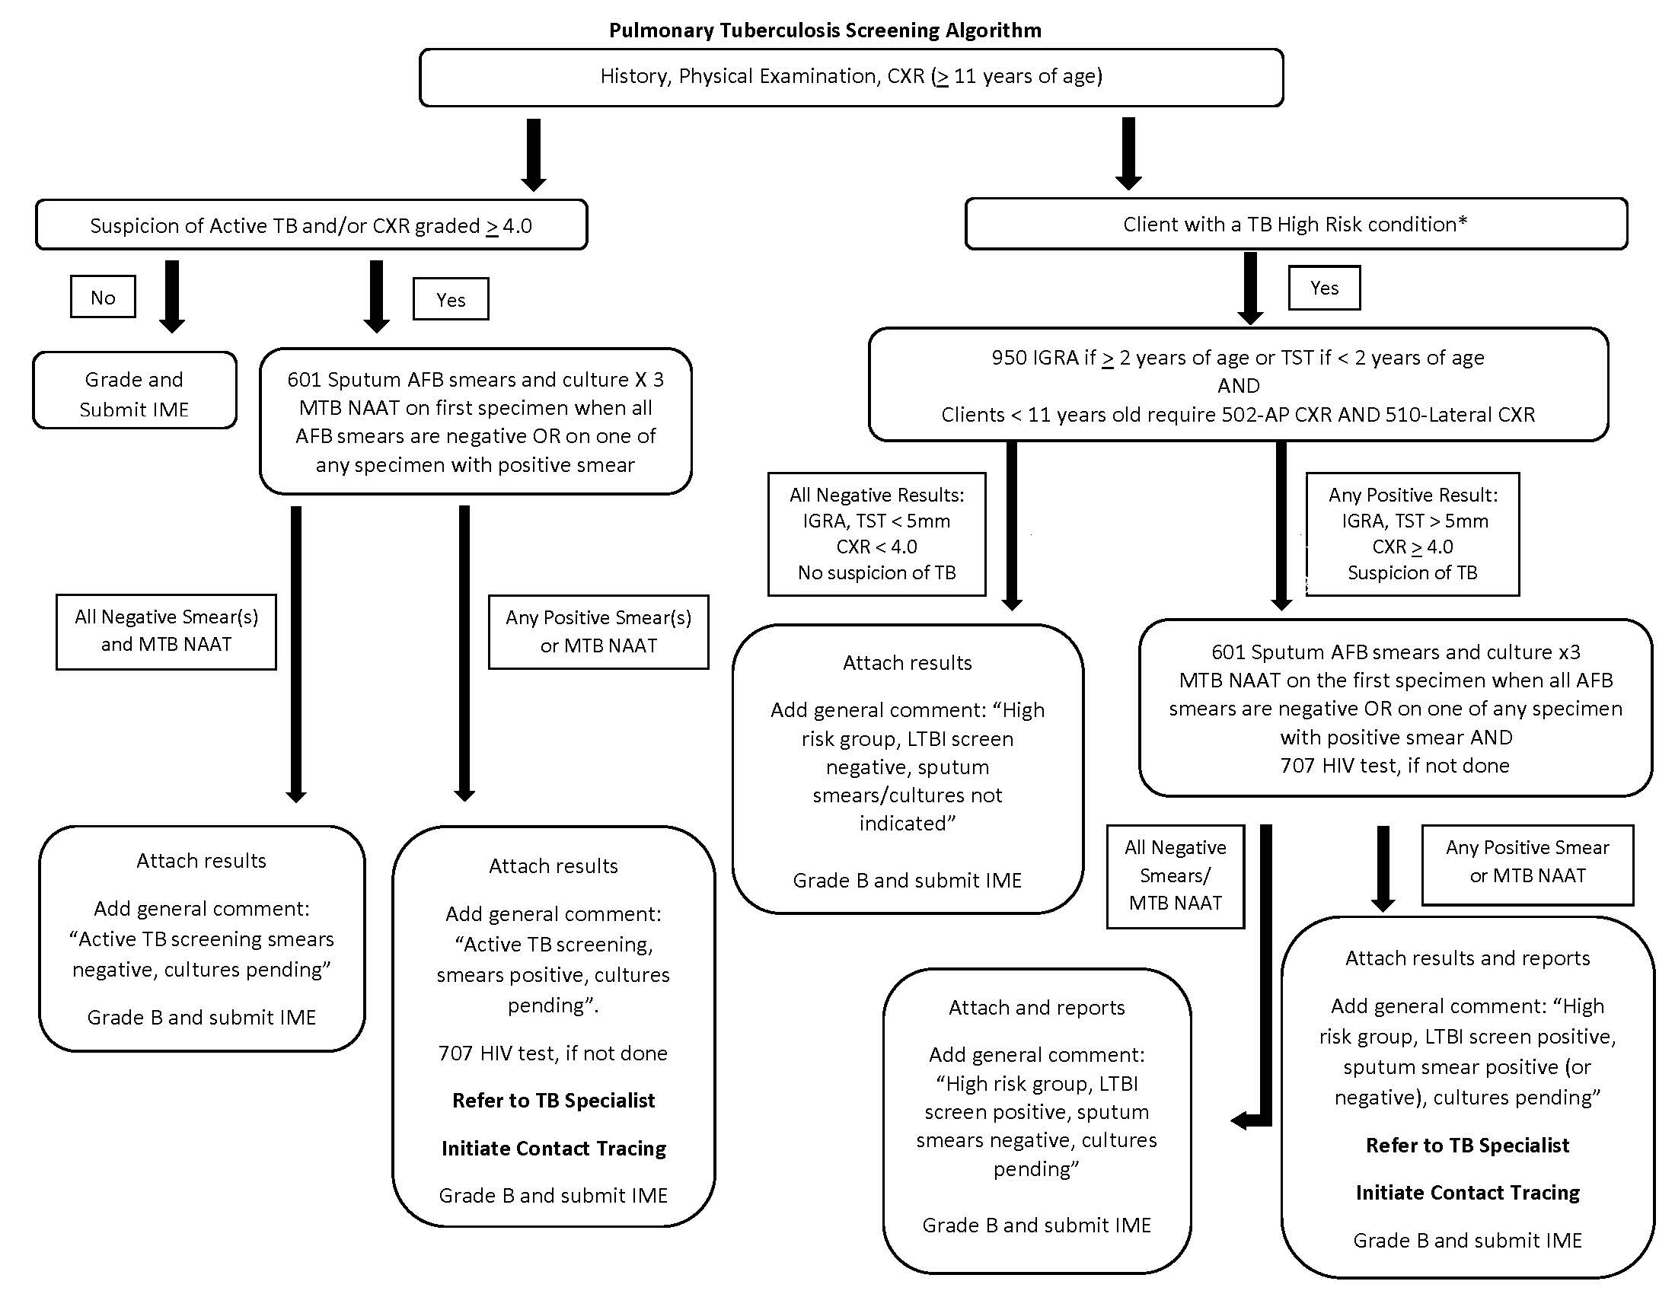
Close contact
HIV
Head/neck cancer
CRF
SOT/BMT

Slide 58
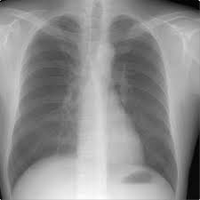
TB screening in Canada
How well does it work?
940,000 immigrants to Ontario underwent IME (2008-2011)
    940 were diagnosed with active TB (100 / 100,000)
    23,500 (2.5%) were referred for post-landing immigration surveillance PLIS
  502 developed active TB within 2 years (50/100,000)
    66% were not referred for PLIS (36/100,000)
    44% were referred for PLIS (936/100,00)
3962 cases of TB among immigrants in Ontario (2005 – 11)
  Only 6.7% were referred for PLIS
**Most cases of TB in foreign born in Canada had normal CXR at time of immigration**
Khan et al. CMAJ 2015
Notes:
330,000 immigrants who arrived to Ontario 2008-2011
157 were diagnosed with active TB (47/100,000)

Slide 59

Compared 174 cases of TB among new immigrants to Alberta that developed in:
  People with abnormal CXR suggestive of LTBI at time of immigration (61)
  People with normal CXR at time of immigration (113)
Group A – were :
  Less likely smear positive (15% vs. 50%) or cavitation (0% vs. 35%) on CXR
  More likely to be asymptomatic at time of diagnosis (74% vs. 19%)
All secondary cases and 82% of tuberculin skin test conversions occurred in contacts of Group B
Long et al. PLoS ONE 14(3): 2019
Notes:
39 (78%) referrals were diagnosed during routine surveillance follow-up. --- PREVIOUS STUDY
Less likely smear positive (15% vs. 50%), cavitation (0% vs. 35%) or extensive disease (15% vs. 59%) on CXR

Slide 60

TB screening in the United States
Overseas
CXR for everyone IGRA for everyone > 15 years old
IGRA for 2 – 14 years, from countries >20 cases / 100,000

Slide 61

Highest risk of TB occurs shortly after immigration
BUT, new residents must wait at least 2 months before provincial health insurance begins…
https://www2.gov.bc.ca/gov//msp/bc-residents…

Slide 62

Enlightened self-interest
Investing in TB control efforts overseas is a cost-effective way to reduce TB rates in the US
Schwartzman et al NEJM 2005
Notes:
Figure 1. Net Savings or Added Costs of Implementing a Strategy of Radiographic Screening plus Either Expansion of the DOTS Program or Tuberculin Skin Testing over a 20-Year Period among Migrants from Mexico to the United States.
Schwartzman and colleagues⁴ use the tools of decision analysis to argue that, since the majority of new cases of tuberculosis in this country arise among recently infected immigrants, predominantly from Mexico and the Philippines, America's enlightened self-interest would be well served by investing in programs to expand the World Health Organization's directly observed treatment, short course (DOTS), in Mexico and a handful of other countries.

Slide 63
Required screening…
 | United States | Canada
TB | Yes | Yes
HIV | No Removed 2010 | Yes Introduced 2002
Syphilis | Yes | Yes
Gonorrhea | Introduced in 2016 | Not done
Hansen’s disease | Yes – physical exam | Not specially mentioned
Parasites | Refugees – presumptive treatment | No
Vaccine requirements | Yes | No
Notes:
Chancroid, LGV and granuloma inguinale
Removed in 2016
Not done

Slide 64

Routine vaccination of U.S.-bound refugees before travel to the United States is not legally required.
https://www.cdc.gov/immigrantrefugeehealth/laws-regs/vaccination-immigration
Notes:
*On December 14, 2009, the human papillomavirus (HPV) and zoster vaccines were removed from the list of required vaccines for immigrant applicants. All other vaccinations on this list remain.
Routine vaccination of U.S.-bound refugees before travel to the United States is not legally required. However, routine vaccinations are strongly recommended and offered overseas as part of this Vaccination Program to protect health, prevent travel delays due to disease outbreaks, and, for children, to allow more rapid integration into schools after arrival in the United States.

Slide 65


Immunizations, refugees
Covered by IFHP, IOM

Slide 66
HIV
United States
1987 – US designates HIV as a dangerous contagious disease
  Anyone HIV positive in inadmissible to US
Removed in US in 2010
  No longer determined to be grounds for inadmissibility
  Not spread by casual contact, through the air, or from food or water.
  “Is there a significant health risk from casual contact with HIV-infected aliens?”
Canada
Introduced in Canada 2002
  Inadmissible because of excessive demand at that time
Notes:
In 2010 - Active tuberculosis, infectious syphilis, gonorrhea, infectious leprosy, chancroid, lymphogranuloma venereum, and granuloma inguinale.
In 2016 -- Specifically, this final rule revised the definition of “communicable disease of public health significance” by removing chancroid, granuloma inguinale, and lymphogranuloma venereum as health conditions that prevent entry into the United States;

Slide 67
Another case
64M, construction worker, immigrated from Cuba, 20 years ago
  PMH - rheumatoid arthritis (MTX, HCQ, and sulfasalazine)
  To ER with a few-weeks of acute on chronic epigastric pain, diarrhea, decreased appetite, and general malaise.
    Admitted for “gastroenteritis”
  2 days later – fever and pneumonia
    COVID +ve, increased FiO2 needs → ICU
  6 days later – stool test from admission +ve
    3 months ago – eosinophilia (0.7)
    2017 - negative stool O&P
Hamze et al. TD TMV 2023
Notes:
On day 6 post ICU admission, a stool ova and parasites (O&P) test that was submitted two days after admission resulted positive for S. stercoralis larvae. Strongyloides serology (using EUROIMMUN ELISA kits) was also positive at an optical density of 3.335 (cut off is >1.1). By the time the Infectious Diseases service were consulted, he was on Day 6 of dexamethasone and still intubated requiring 100% FiO2 and haemodynamic support. He was febrile at 38.5 degrees Celsius (101.3 fahrenheit) and had persistent diarrhea. His abdomen was non-tender and there were no new rashe

Slide 68
Another case
64M, construction worker, immigrated from Cuba, 20 years ago
  PMH - rheumatoid arthritis (MTX, HCQ, and sulfasalazine)
  To ER with a few-weeks of acute on chronic epigastric pain, diarrhea, decreased appetite, and general malaise.
    Admitted for “gastroenteritis”
  2 days later – fever and pneumonia
    COVID +ve, increased FiO2 needs → ICU
  6 days later – stool test from admission +ve
    3 months ago – eosinophilia (0.7)
    2017 - negative stool O&P
Hamze et al. TD TMV 2023
Notes:
On day 6 post ICU admission, a stool ova and parasites (O&P) test that was submitted two days after admission resulted positive for S. stercoralis larvae. Strongyloides serology (using EUROIMMUN ELISA kits) was also positive at an optical density of 3.335 (cut off is >1.1). By the time the Infectious Diseases service were consulted, he was on Day 6 of dexamethasone and still intubated requiring 100% FiO2 and haemodynamic support. He was febrile at 38.5 degrees Celsius (101.3 fahrenheit) and had persistent diarrhea. His abdomen was non-tender and there were no new rashe

Slide 69



Slide 70


Stool O&P screening
Removed from the IME in 1981
Before 1981, Canada was the only country in the world that required stool exam for O&P
  Ministry of Health of British Columbia (unpublished, 1981).
Keystone JS. Can Med Assoc J 1981;125:415- 16
Notes:
A Canadian study specifically demonstrated a lack of self-clearance and ongoing local transmission when refugees were tested at 6 months after arrival in Canada without screening or treatment of intestinal parasites.
Effect of screening and treatment on imported intestinal parasite infections: results from a randomized, controlled trial.Gyorkos TW, Frappier-Davignon L, MacLean JD, Viens P
Am J Epidemiol. 1989 Apr; 129(4):753-61.

Slide 71
Screening for Strongyloides
Refugees from SE Asia to Canada
232 SE Asian refugees screened for Strongyloides
    Vietnam, Laos, Indonesia
  77% seropositive
  30% stool positive
 | Stool POSITIVE N= 40 (25%) | Stool NEGATIVE N= 122 (75%)
Serology POSITIVE | 95% | 70%
Serology NEGATIVE | 5% | 30%
Eosiniophilia (<10%) | 30% | 50%
Eosinophilia (>10%) | 70% | 50%
Am J Epidemiol 1990; 132:257-64

Slide 72
Somalia
Barawan refugees, 1990s
CDC and IOM screened Barawan refugees awaiting resettlement
  38% intestinal parasites
  25% multiple parasites
May 1999
  CDC introduced pre-departure treatment
  Albendazole within 72 hours of departure for all refugees from sub-Saharan Africa

Slide 73

US - Pre-departure treatment for parasites

Slide 74

US - Pre-departure treatment for parasites

Slide 75

Evaluation of US pre-departure treatment of stool parasites
4,370 untreated refugees
  20.8% had ≥ 1 stool nematode
22,586 albendazole-treated refugees
  4.7% had ≥ 1 stool nematode
Notes:
4,370 untreated refugees
20.8% had ≥ 1 stool nematode
22,586 albendazole-treated refugees
4.7% had ≥ 1 stool nematode
Albendazole-treated refugees had:
Fewer stool positive for nematodes (prevalence ratio, 0.19),
Similar rates of giardia (5% Africa, 17% SE Asia)
2% Schistosomiasis
On the basis of these findings, the CDC has expanded its presumptive therapy recommendations to include treatment with praziquantel and ivermectin in certain refugee populations before departure for the United States

Slide 76

Strongyloidiasis :
  Screen and treat refugees newly arriving from low income countries in Southeast Asia and Africa with serology
Schistosomiasis:
  Screen and treat refugees newly arriving from Africa with serology
CMAJ 2011
Notes:
Treat if positive with ivermectin (first line) or albendazole (if contraindications to ivermectin).
for schistosomiasis and treat if positive with praziquantel

Slide 77

Presumptive treatment for malaria
60% of Liberian refugees, were parasitemic 4 weeks after arrival. (1997-9)
1999 US CDC recommended presumptive therapy for malaria
  All refugees from sub-Saharan Africa
2012 treatment changed from Fansidar (SP) to Coartem (AL)
Canada does not recommend routine screening or pre-departure treatment for malaria
  Rarely provided as part of particular large group refugee movements

Slide 78

Dr. Martin Cetron

Slide 79

Ukraine
~ 12 million people have fled their homes since Russia's invasion of Ukraine
~ 5 million left the country, ~ 7 million internally displaced
  Russia, Poland, Germany, Czech Republic…
~ 100,000 arrived to Canada ( Feb – Sept 2022)
Canada–Ukraine Authorization for Emergency Travel (CUAET)
  3-year visas
  Processed within 14 days, all processing fees waived
  Includes work permit, primary education, and provincial health insurance
  No required pre-arrival immigration examination.
  Tests for TB, HIV and syphilis may be required to be completed within 90 days of arrival
Afghanistan
  Canada pledged to resettle 40 000 Afghan refugees — August 2021
  only 19,395 have made it here since August 2021
Notes:
are exempt from completing an immigration medical exam (IME) overseas, if applicable, but may be required to complete and pay for a medical diagnostic test within 90 days of arrival in Canada to screen for reportable communicable diseases (chest x-ray or suitable alternative and blood test)

Slide 80

Nell Toussaint
Came to Canada as a visitor from Grenada in 1999
  Found work and stayed after VISA expired.
In 2005 she tried to apply for PR
  Could not afford additional $554 processing fee
  Lost money to dishonest immigration consultant
In 2006 started getting sick
  Developed diabetes and hypertension
  In 2008, hospital admission for uncontrolled hypertension,
  Denied U/S for leg swelling → in 2009 admitted with PE
She went to court
  Federal Court agreed that her life and long term health had been put at risk
  But they held that the violation of the right to life was justified, in order to promote compliance with immigration law
  Ruled that she suffered “by her own conduct”—by remaining in Canada illegally

Slide 81
Nell Toussaint
In 2018, she went to Human Rights Committee:
  Government should not deny access to essential health care because of irregular immigration status
  “required to provide access to existing health care services that are reasonably available and accessible when a lack thereof would expose a person to a reasonably foreseeable risk that can result in death”

Slide 82


Evidence-based clinical guidelines for immigrants and refugees
Uses EBM to inform immigration screening
CMAJ, September 6, 2011, 183(12)

Slide 83
Case
49F, from Honduras admitted with 3-week history of progressive altered mental status, headache, and right-sided weakness.
MRI brain - two ring-enhancing lesions associated with edema
HIV positive, CD4 count of 38
MRI-guided biopsy of the left parietal lesion
diagnosed with Toxoplasmosis
sulfadiazine and pyrimethamine, discharged home after 14 days
- however, reported to be nonadherent with her medications.

Slide 84
Case – 49F from Honduras
Returned to hospital - altered mental status and right-sided weakness
MRI of the brain showed worsening ring-enhancing lesions
Sulfadiazine, pyrimethamine, and steroids
Day 5 – getting worse, CT head worse
LP performed…

Slide 85

Case – 49F from Honduras
Returned to hospital - altered mental status and right-sided weakness
MRI of the brain showed worsening ring-enhancing lesions
Sulfadiazine, pyrimethamine, and steroids
Day 5 – getting worse, CT head worse
LP performed…

Slide 86

Case – 49F from Honduras
Review of prior brain biopsy
  intracellular organisms with rod-shaped kinetoplast, consistent with T. cruzi amastigote
Benznidazole
Recovered well

Slide 87


Slide 88
Malaria among refugees and immigrants
August 2000, plane with 224 refugees (Tanzania → Quebec)
  Within 4 weeks 15 cases of malaria (7%)
Introduced screening for 3 groups:
  The remaining 209 refugees already in Quebec
  100 other refugees immediately on arrival
  200 other refugees pre-departure (all empirically treated post-test)
PCR documented 18% positive
  Microscopy 50% sensitive
  RDT 30% sensitive
JCM, June 2004, p. 2694–2700 Vol. 42, No. 6

Slide 89
This is an extreme eg - what if owners of a live animal wildlife market, were upset by many trespassers taking photos in the back of their stall at the market - and raised alarm about #infections and the need to improve #biosecurity in order to pass another anti-trespass law

Slide 90
TB - Australian study
Cost-effectiveness of implementing TB infection screening:
  offshore TST (i.e., mandated prior to migration) and treatment in Australia
  - vs –
  onshore TST (i.e., passively after arrival, by GPs) and treatment in Australia
Offshore was more cost-effective
  Offloaded costs of screening to migrants
Questions the benefit achieved when TPT is administered “en masse” to a population at low risk of progressing to TB disease
https://pubmed.ncbi.nlm.nih.gov/34216207/
Notes:
Am J Epidemiol
. 2022 Jan 24;191(2):271-274.

Slide 91

Slide from CDC - Dr. Marty Cetron

Slide 92
Part of the complete history for every patient
Where were you born?
Have you lived in any countries other than Canada?
Have you travelled to SE Asia, India or Africa?

