Slide 1
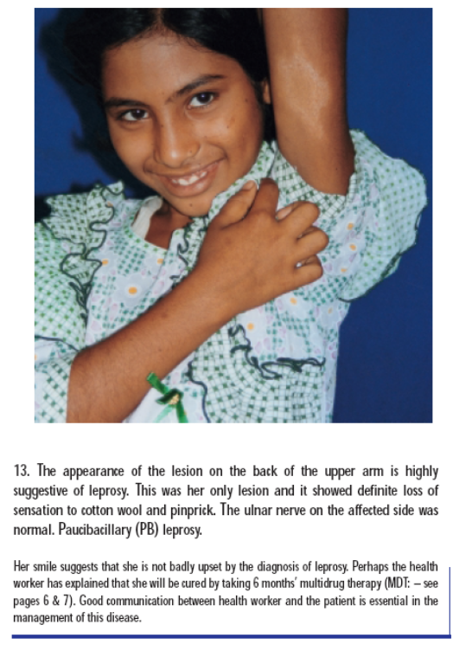
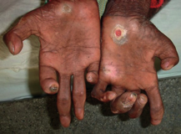
Tropical and Geographic Medicine
Short Course 2024
Leprosy
Hansen’s Disease
Jan Hajek
Mycobacterium leprae infection

Slide 2
Take home points
What are the 3 cardinal (diagnostic) signs of leprosy?
What is the difference between
  Tuberculoid, Borderline, and Lepromatous?
What is a reaction?
What to look for on exam of patient with leprosy
What is the treatment for leprosy?
Notes:
Koch – 1882
Hansen – 1873
M. leprae
CMI – spectrum
Treatment
MDT
Diagnosis
Late presentation
Stigma
Disease of poverty

Slide 3
What is Leprosy Hansen’s Disease?
Chronic mycobacterial infection caused by Mycobacterium leprae
Affects the skin and peripheral nerves
Can be disabling, disfiguring, and stigmatizing
Clinical manifestations depend on the cell mediated immune response

Slide 4
Mycobacterium leprae
Relatively avirulent bacteria
Cannot be cultured in vitro
  Divides slowly (14 days --- vs. 24 hours TB --- vs. 20 min E coli)
Prefers cool areas of the body (25 – 30ºC)
  Skin (earlobes)
  Superficial peripheral nerves
Natural reservoirs
  Humans, non-human primates, armadillos
Notes:
tropism for macrophages and Schwann cells.
preference for growth in cooler regions of the body
Schwann cells can express HLA class 2 molecules and present mycobacterial peptides to CD4 cells.
Swelling within the inflexible perineurium leads to ischaemia, further nerve damage, and eventually fibrosis with axonal death
Survives for 9 days in the environment

Slide 5
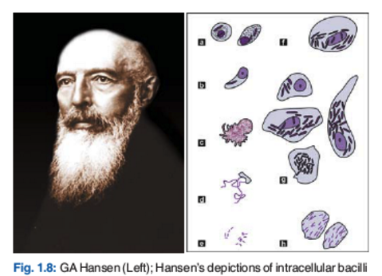
Hansen’s Disease
Hansen
1873

Slide 6
How is Hansen’s Disease transmitted?
Likely spread through respiratory droplets
Incubation
  6 months – 30 years (average 3 years)
Most people exposed/infected do not get disease
Risk of disease is increased in:
  Household contacts (5%)
  (HIV does not increase risk)
Notes:
M. leprae PCR positive in 5% of household contacts
The carriage of
5-10X higher in MB contacts
2-4x higher in PB contacts
Our previous study showed that the risk of leprosy among household contacts was 1300 times as high as that in the general population.1

Slide 7
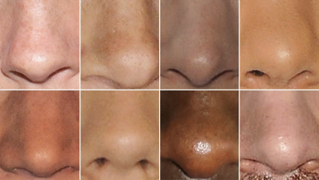
Transmission
Asymptomatic carriers
~50% of asymptomatic household contacts had M. leprae detectable by PCR in their nasal mucosa
Clinical Infectious Diseases 2016;63(11):1412– 20
Notes:
Araujo S, Freitas LO, Goulart LR, Goulart IM. Molecular evidence for the aerial route of infection of Mycobacterium leprae and the role of asymptomatic carriers in the persistence of leprosy. Clin Infect Dis 2016; 63:1412–20.
Mohanty PS, Naaz F, Katara D et al. . Viability of Mycobacterium leprae in the environment and its role in leprosy dissemination. Indian J Dermatol Venereol Leprol 2016; 82:23–7.
Gama RS, Gomides TAR, Gama CFM, et al. High frequency of M. leprae DNA detection in asymptomatic household contacts. BMC Infect Dis 2018; 18:153. doi:10.1186/s12879-018-3056-2.
Beyene D, Aseffa A, HarboeMet al. Nasal carriage of Mycobacterium leprae DNA in healthy individuals in Lega Robi village, Ethiopia. Epidemiol Infect, 2003; 131: 841–848.

Slide 8
Epidemiology
2 million people living with permanent disability from leprosy
Prevalence (number of patients on treatment) decreased in last 50 years:
  1980 – 10 million
  1990 - 5 million
  2000 - 500,000
  2010 – 200,000
Incidence has not changed as much
  200,000 new cases are being reported every year
  3 new cases / 100, 000
Pockets of high endemicity still remain in many countries
Disease of poverty
WHO leprosy
Notes:
The global statistics show that 220 810 (95%) of new leprosy cases were reported from 16 countries and only 5% of new cases are from the rest of the world.
Pockets of high endemicity still remain in some areas of many countries but a few are mentioned as reference: Angola, Bangladesh, Brazil, China, Democatic Republic of Congo, Ethiopia, India, Indonesia, Madagascar, Mozambique, Myanmar, Nepal, Nigeria, Philippines, South Sudan, Sri Lanka, Sudan and the United Republic of Tanzania.
In 1991 WHO's governing body, the World Health Assembly (WHA) passed a resolution to eliminate leprosy by the year 2000. Elimination of leprosy is defined as a prevalence rate of less than 1 case per 10 000 persons. The target was achieved on time and the widespread use of MDT reduced the disease burden dramatically.
Since 1995, the World Health Organization (WHO) has provided treatment free of charge to all leprosy patients worldwide
Over the past 20 years, more than 14 million leprosy patients have been cured, about 4 million since 2000.
The prevalence rate of the disease has dropped by 90% – from 21.1 per 10 000 inhabitants to less than 1 per 10 000 inhabitants in 2000.
Dramatic decrease in the global disease burden: from 5.2 million in 1985 to 805 000 in 1995 to 753 000 at the end of 1999 to 189 018 cases at the end of 2012.
Leprosy has been eliminated from 119 countries out of 122 countries where the disease was considered as a public health problem in 1985.
So far, there has been no resistance to antileprosy treatment when used as MDT.
Efforts currently focus on eliminating leprosy at a national level in the remaining endemic countries and at a sub-national level from the others.

Slide 9
Historical Trends
pre-1950
  Incurable → isolation and stigma
1950’s
  Dapsone monotherapy
  Taken for life
1980’s
  Multidrug therapy introduced (6 – 24 months)
  Rifampin, Dapsone, Clofazimine
1990’s
  WHO called for eliminating leprosy as a public health problem by 2000
    < 1 case on treatment/10,000
2000’s
  WHO simplified the diagnosis
  Integrated, decentralized approach
Notes:
Lockwood DN. Rifampicin/minocycline and ofloxacin (ROM) for
single lesions: what is the evidence? Lepr Rev 1997; 68: 299–300.
Since 1995, WHO has provided free multidrug therapy worldwide in collaboration with private foundations. As treatment improved and became more widely available, in 1991, the World Health Assembly passed a resolution with the goal of eliminating leprosy as a public health problem by the year 2000, just 9 years later. In that resolution, the elimination of leprosy was defined as decreasing the prevalence rate to less than 1 case per 10,000 persons (from the then current figure of 21.1 per 10,000 persons). It is believed that this target was met as scheduled

Slide 10
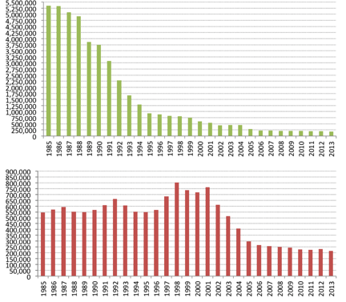
Historical Trends
Multidrug therapy was very effective
Prevalence quickly dropped
But, incidence of new cases has been slower to change
India
Brazil
Global trends in Registered Prevalence and New Case Detection (1985–2013) – WHO
Notes:
620,000 cases in 2002 to
212, 000 cases in 2006 – coincided with the WHO deciiosn to decrease treatment duration from 2 years to 1 year

Slide 11
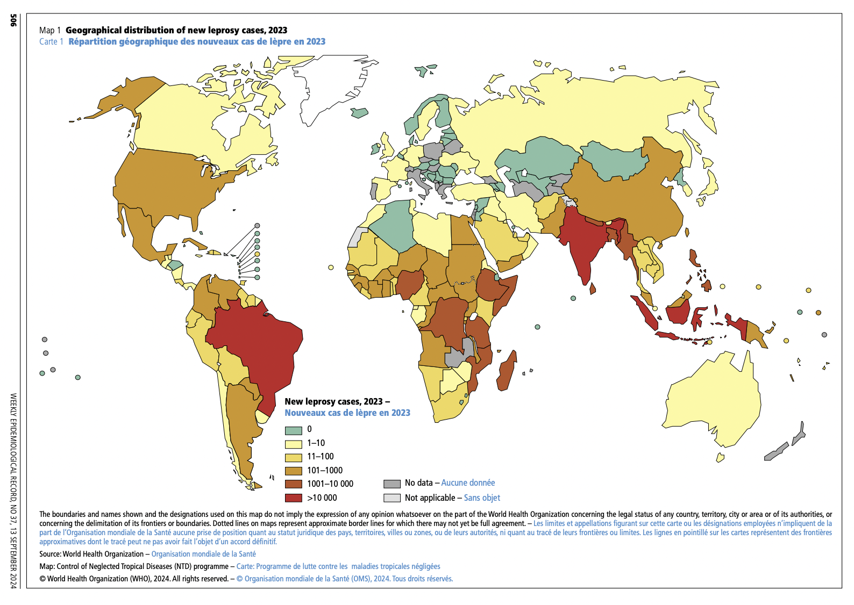
Epidemiology
80% in 3 countries (India, Brazil, Indonesia)
  95% in 14 countries
WHO
Notes:
It should be noted that 6 countries reported >1000 cases annually in the Region, while India alone accounted for 58.85% of the global leprosy burden
India reported the highest number of new cases (126,913) followed by Brazil (31,044) and Indonesia (16 856
pockets of high endemicity still remain in some foci in Angola, Brazil, the Central African Republic, India, Madagascar, Nepal and the United Republic of Tanzania
5 countries > 80% of cases
The leprosy burden is now concentrated in the five most endemic countries
(Brazil, India, Madagascar, Mozambique, and Nepal)
account for > 80% of prevalence
The combined prevalence rate in these countries is about 4 per 10 000 inhabitant

Slide 12
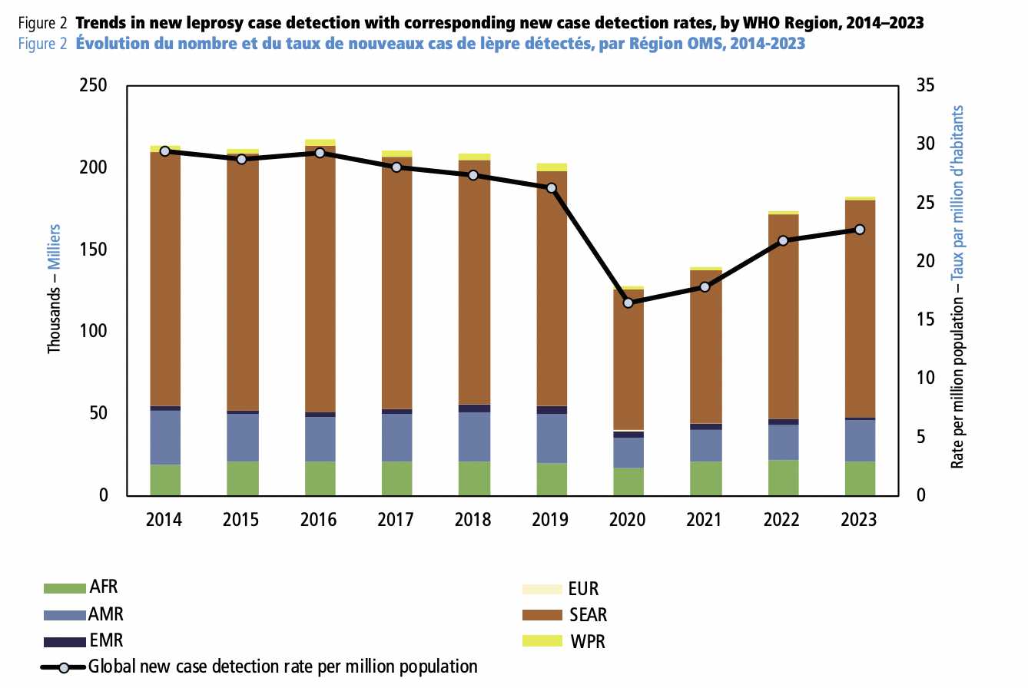
Incidence
200,000 new cases diagnosed each year
  Reduction during COVID-19
WHO
Notes:
It should be noted that 6 countries reported >1000 cases annually in the Region, while India alone accounted for 58.85% of the global leprosy burden
India reported the highest number of new cases (126,913) followed by Brazil (31,044) and Indonesia (16 856
pockets of high endemicity still remain in some foci in Angola, Brazil, the Central African Republic, India, Madagascar, Nepal and the United Republic of Tanzania
5 countries > 80% of cases
The leprosy burden is now concentrated in the five most endemic countries
(Brazil, India, Madagascar, Mozambique, and Nepal)
account for > 80% of prevalence
The combined prevalence rate in these countries is about 4 per 10 000 inhabitant

Slide 13
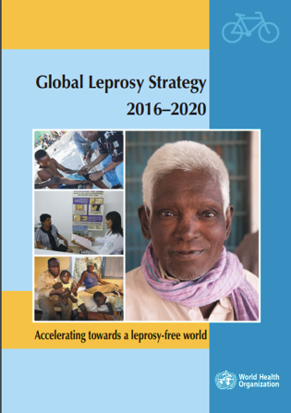
WHO strategy
Increased emphasis on:
  Contact tracing and case finding
  Prophylaxis
  Reducing stigma
New targets
  Neurological disabilities:
    Reduction in new diagnosis with disability to < 1 / million people.
  Stigma
    Zero countries with discriminatory legislation
Notes:
“Accelerating towards a leprosyfree world”
Yet the current strategy is innovative as it gives, in addition to a solid medical component, increased visibility and weight to the human and social aspects affecting leprosy control. Reducing stigma and promoting inclusiveness will reinforce better and earlier diagnosis. Innovative approaches include focus on children, women and other vulnerable populations, strengthened referral systems, systematic tracing of household contacts, monitoring drug resistance, working towards a simplified treatment approach and assessing the role of post-exposure prophylaxis. It provides linkages with broader health and development agendas including universal health coverage and the sustainable development goals.
The target of G2D rate is less than one per million population.

Slide 14
Clinical features…

Slide 15
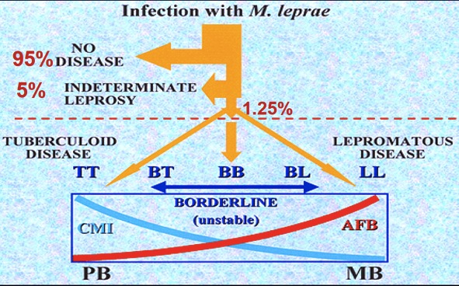

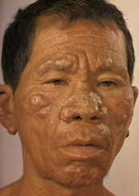
Leprosy Spectrum
Notes:
Tuberculoid leprosy (TT stage)
Sharply demarcated hypopigmented macular skin lesions
Lepromatous leprosy (LL).
skin involvement is extensive and bilateral across the host's body, with polymorphic lesions -- nodules, macules, papules, and plaques

Slide 16
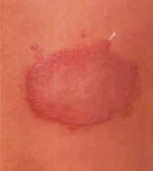
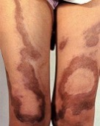
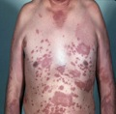
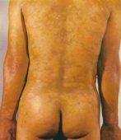
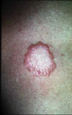
Ridley Jopling classification
TT | BT | BB | BL | LL
Tuberculoid | Borderline |  |  | Lepromatous
Well-defined Anaesthetic Nerve thickening | Ill-defined Satellite | Circinate, Bizarre Punched out Multiple nerves | Symmetrical Skin infiltration Innumerable | Symmetrical Skin infiltration Glove-stocking
1 – 5 lesions |  | > 5 lesions
No AFB, well formed granulomas |  |  | Many AFB

Slide 17
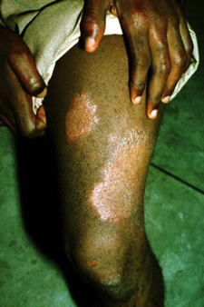
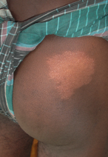
Tuberculoid
Few lesions (1 – 5)
Asymmetric
Well-defined
Hypo-aesthetic
May be thickening of nearby nerve

Slide 18
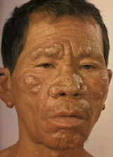

Lepromatous
Many lesions, diffuse
Symmetrical
Skin infiltration
Normal sensation in the skin lesions
Glove stocking sensory loss
  Leonine facial appearance
  Thickened earlobes
  Loss of eyebrows

Slide 19
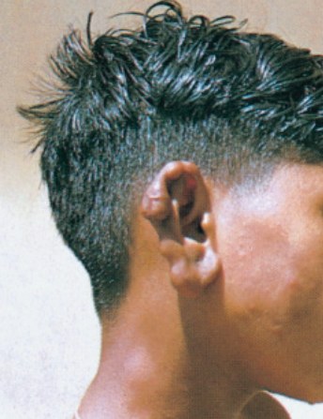
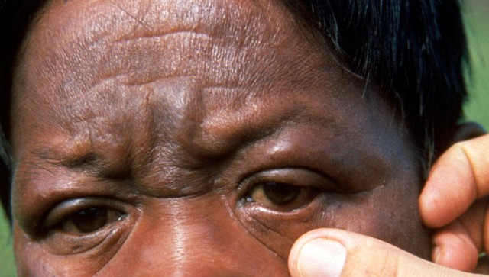
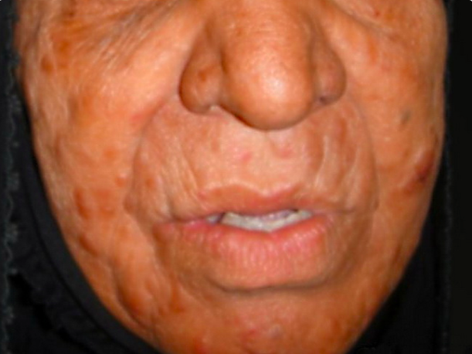
Multibacillary
Lepromatous

Slide 20
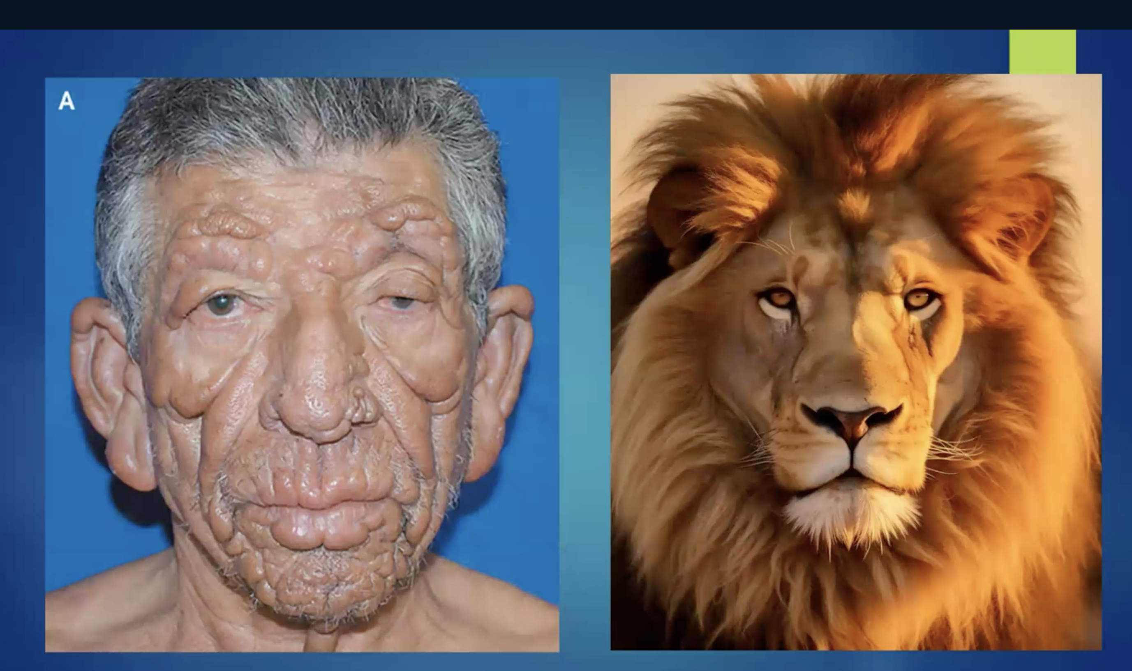

Slide 21
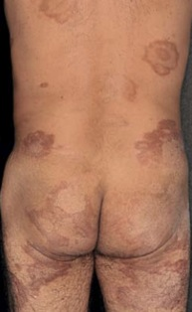

Borderline
Features in between or mixed between tuberculoid and lepromatous poles

Slide 22
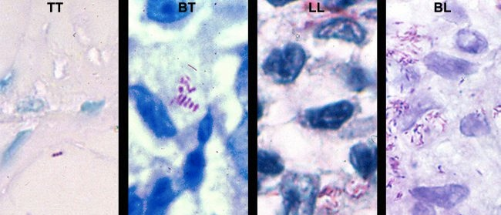
Skin slit smears
A measure of bacillary burden
Tuberculoid
Paucibacillary
0 – few AFB
Lepromatous
Multibacillary
Many AFB

Slide 23
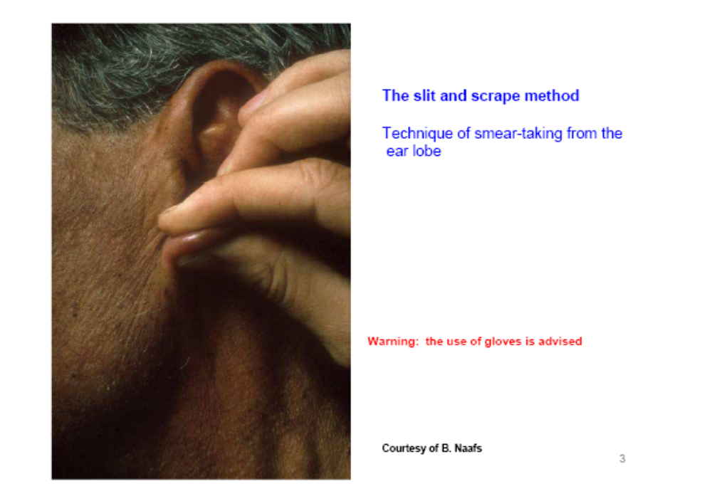
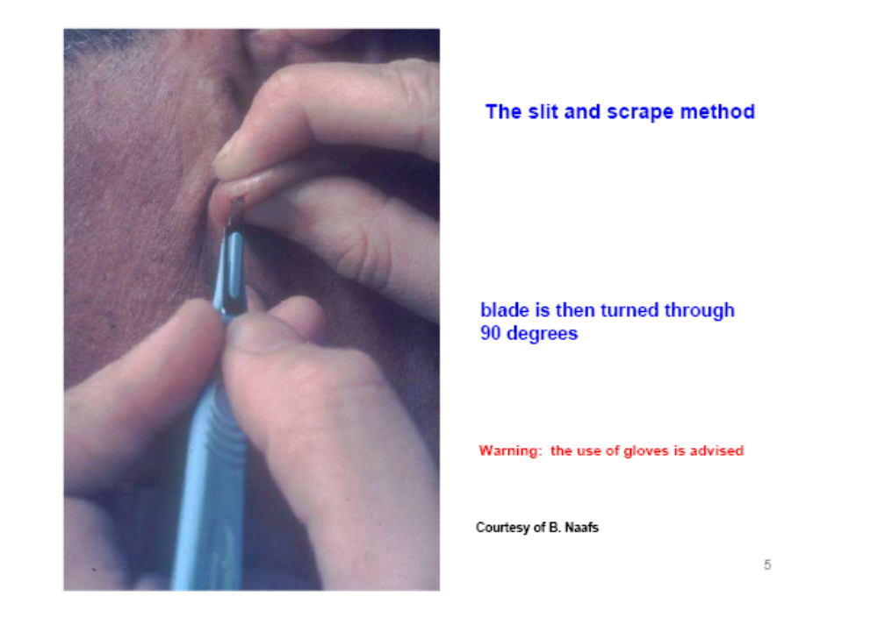
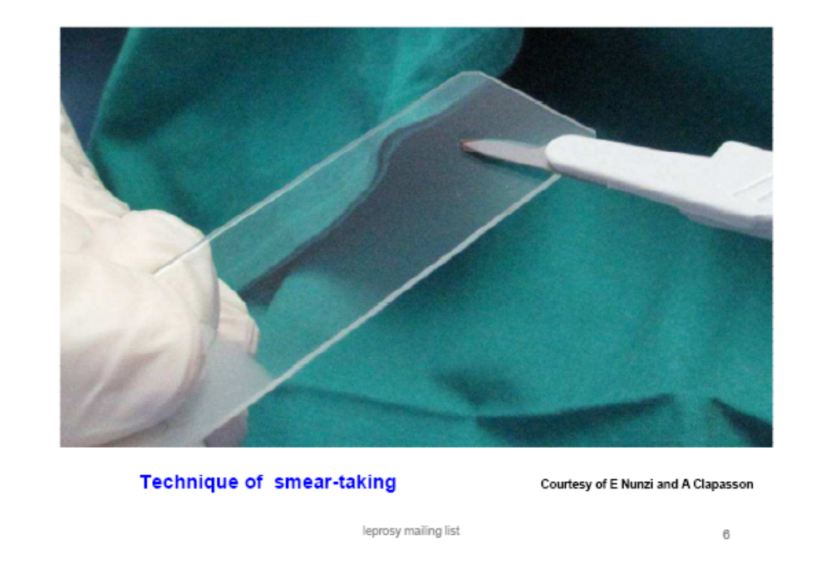
Performing skin slit smears
Take samples from earlobe and skin lesion

Slide 24
Diagnosis
3 cardinal signs
  Anaesthetic skin patch
  Thickened peripheral nerve
  Positive skin slit smear (AFB)

Slide 25
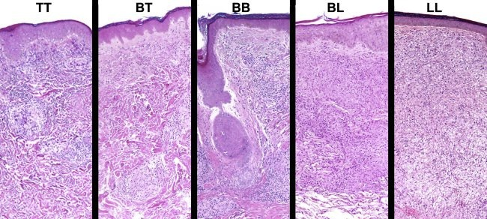
Skin biopsy
Biopsies, if available, are excellent for diagnosis
Notes:
Lepromatous leprosy (LL): When macrophage and foam cell collections present with numerous bacilli interspersed with sparse number of lymphocytes.
Borderline lepromatous (BL) leprosy: When there were macrophage granulomas, numerous lymphocytes and moderate numbers of bacilli.
Borderline tuberculoid (BT) leprosy: When lympho-epithelioid granuloma presents with occasional Langhans giant cells.
Tuberculoid leprosy (TT): When immature epithelioid cells are present together with Langhans giant cells and numerous lymphocytes.

Slide 26
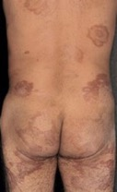
WHO Simplified Diagnosis
2 steps….
1. Hypo-aesthetic patch of skin → Hansen’s
2. How many lesions?
1 – 5 = Paucibacillary
> 5 = Multibacillary
No need for biopsy or skin slit smears
Lepromatous may still need skin slit smears

Slide 27
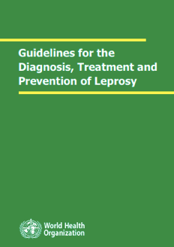
Why is classification important?
Previous WHO recommendations
  Paucibacillary 6 months, 2 drugs
  Multibacillary 12 months, 3 drugs
Current WHO recommendations - 2018
  Paucibacillary 6 months, 3 drugs
  Multibacillary 12 months, 3 drugs

Slide 28
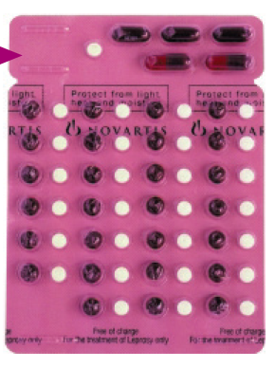
Treatment – 2018
WHO blister packs
3 drugs for everyone
Rifampin
Dapsone
Clofazimine
- 6 months PB
- 12 month MB

Slide 29
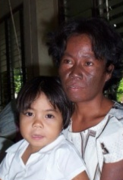
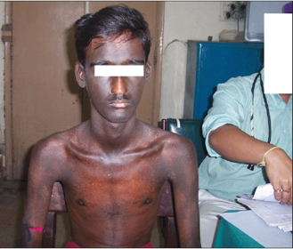
This is a side effect of….
Rifampin
Dapsone
Clofazimine

Slide 30
Variations
Multibacillary
Drug | WHO | USA | Toronto
Dapsone | 100/d | 100/d | 100/d
Rifampin | 600/m | 600/d | 600/d
Clofazimine | 50/d | 50/d | -
Ofloxacin | - | - | 300/d
Duration | 1y | 2y | 2y
Alternative effective antibiotics: - Minocycline
- Moxifloxacin
- Clarithromycin
Notes:
Clinical examinations are performed at the following intervals after MDT is complete:
1. Paucibacillary (PB) - Annually up to two years
2. Multibacillary (MB) - Annually up to three years

Slide 31
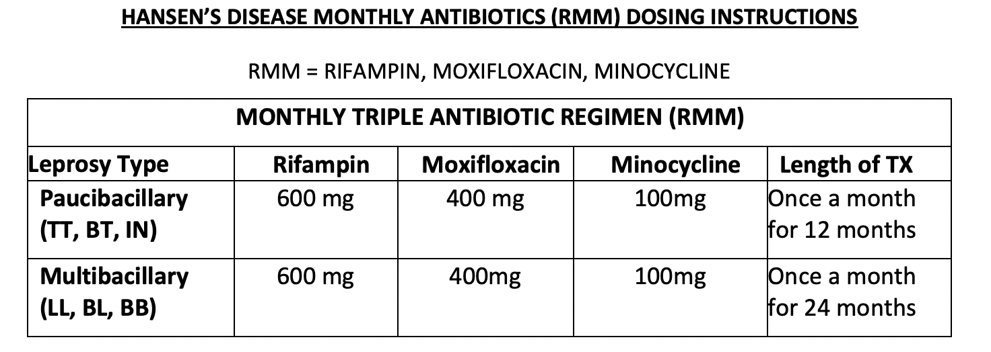
Newer treatment regimens
RMM
  Rifampin + Moxifloxacin + Minocycline
  Monthly x 12 - 24 months
Notes:
ROM -
single lesion
previously untreated
skin smear negative
peripheral nerves not involved
RMM
Ther Adv Infect Dis. 2022;9:20499361221135885.
https://www.ncbi.nlm.nih.gov/pmc/articles/PMC9647311/

Slide 32
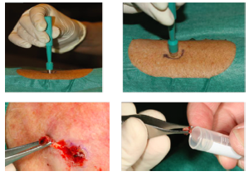
Antibiotic Resistance
Rare
Molecular testing (PCR) for mutations
      Dapsone folP1
      Rifampin rpoB
      FQ gyrA
WHO

Slide 33
Reactions
Type 1
  Upgrading of CMI
    Inflammation of pre-existing skin lesions
    Neuritis (tender, painful nerves)
      - Typically within the first 2 months of diagnosis/treatment
Type 2
  Erythema Nodosum Leprosum (ENL) → Ag-Ab complexes
    Crops of new nodules
    Fever, arthralgia, orchitis, nephritis, uveitis, etc
      - Can happen years later, often recurs
Notes:
Reactions occur in 30% of MB patients
ENL occurs in 50% of LL patients

Slide 34
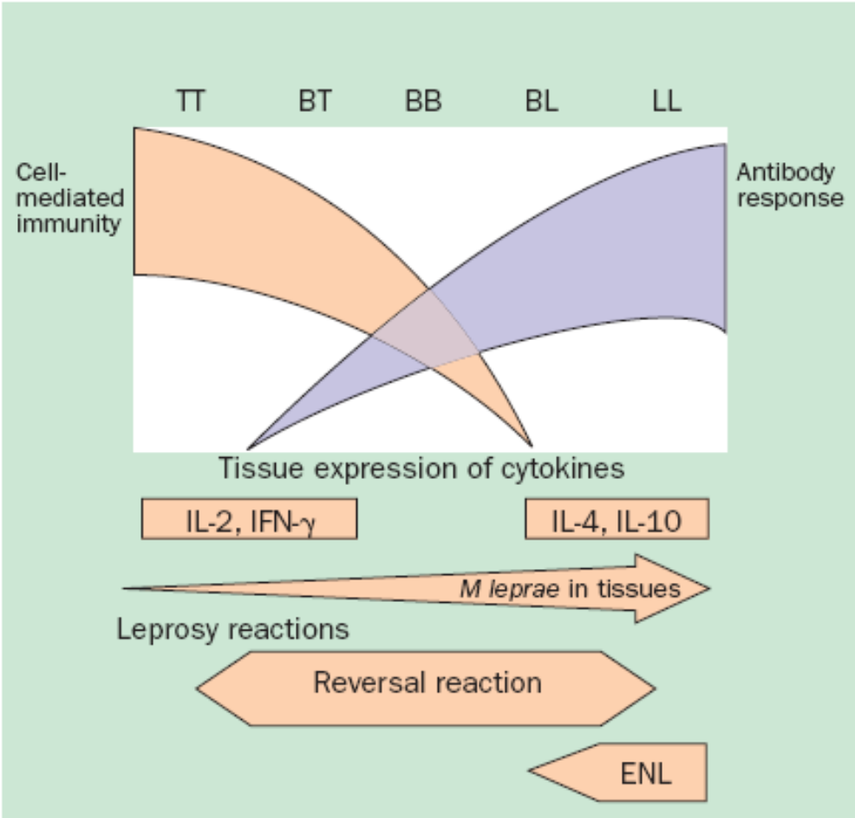

Reactions

Slide 35
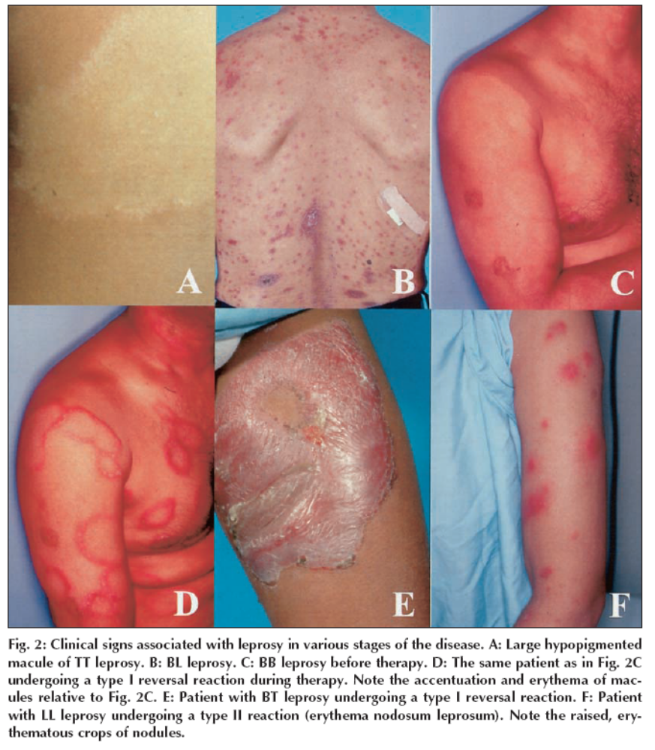
Type 1 reaction
Upgrading CMI
Boggild, CMAJ

Slide 36
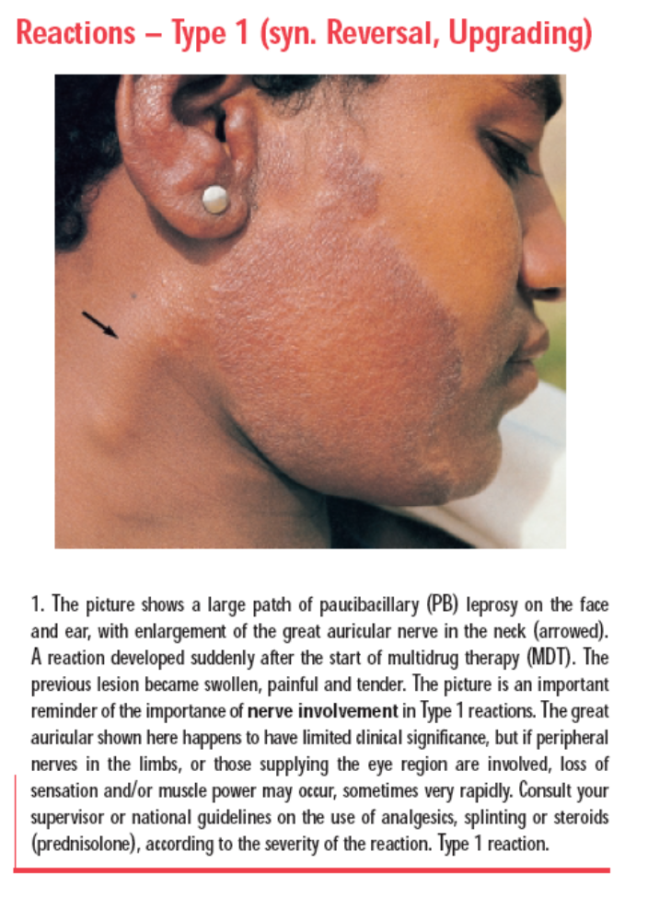
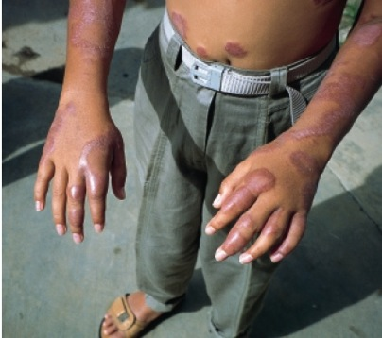
Type 1 reaction
Upgrading CMI
WHO

Slide 37
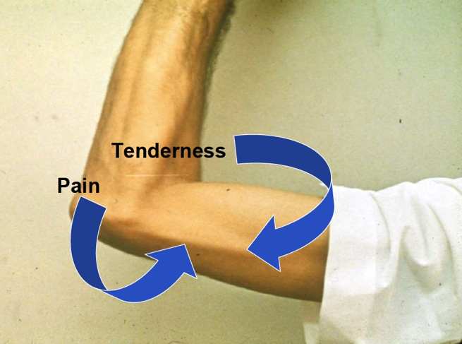
Type 1 reaction
Upgrading CMI
Keystone

Slide 38
Type 1 reaction
Upgrading CMI
Occur in ~30% of patients
Can be present at the time of diagnosis
Nerve can be tender or painless
New onset nerve dysfunction = urgency
  Treated with steroids

Slide 39
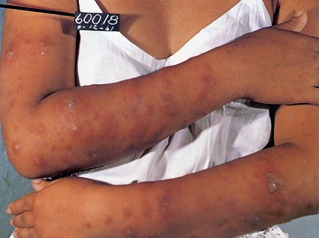
Type 2 reaction
ENL
Keystone

Slide 40
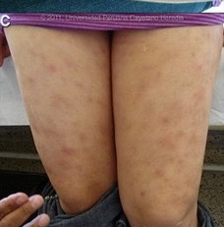
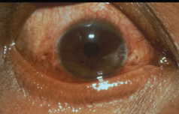
Type 2 reaction
ENL
Gorgas course

Slide 41
Treatment of reactions
Type 1 (Upgrading)
  Steroids:
    Prednisone 1mg/kg; tapering over 5 months
Type 2 (ENL)
  Steroids
  Thalidomide (anti-TNF properties)
Notes:
No firm consensus on best regimens
Typically prednisone start with 1 – 1.5mg/kg
Begin to taper when symptoms and nerve function begin to improve (e.g., by 5mg q 2weeks)
* strongyloides, TB, hepatitis B, diabetes…
Optimal duration is not clear – some suggest 24 weeks better than 12 weeks
Relapse rate after steroids is 20 – 50%

Slide 42
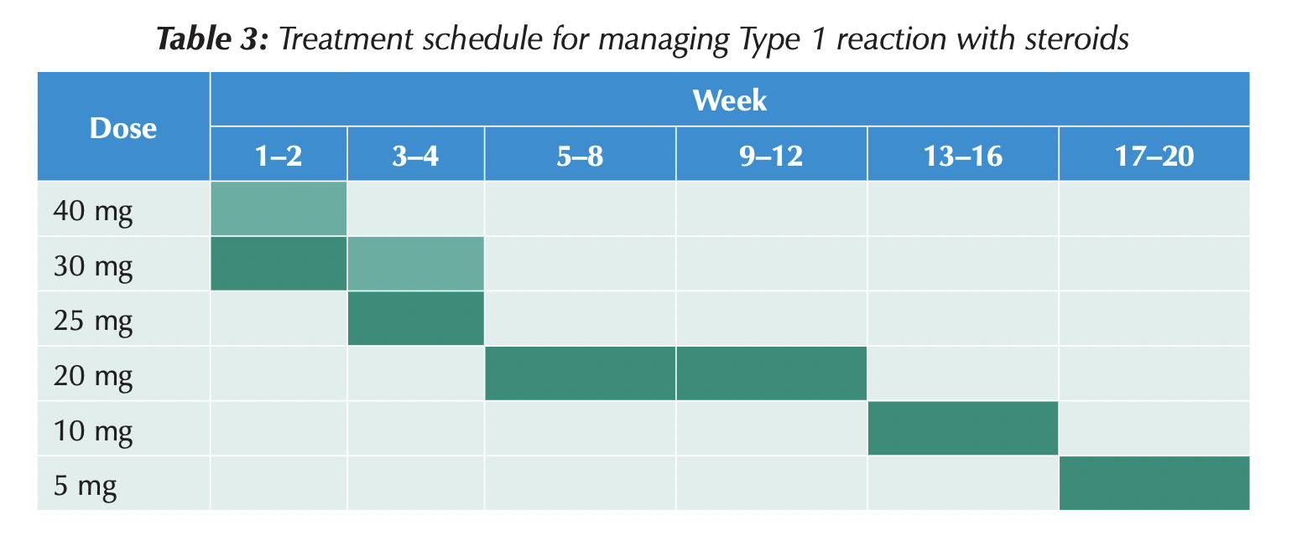

Slide 43
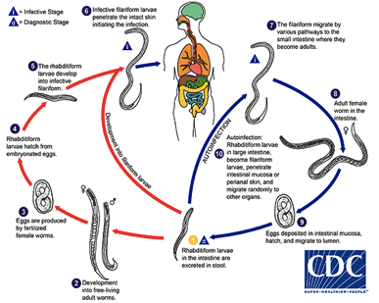
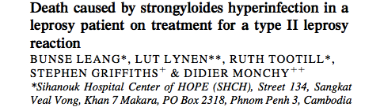
Steroids and Strongyloides
Preventable
Ivermectin or albendazole
Lepr Rev 2004:75;398

Slide 44
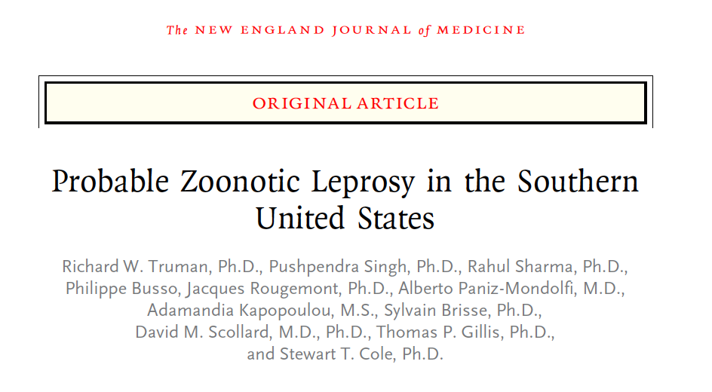
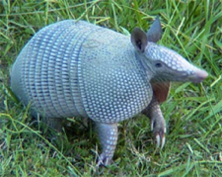

Leprosy – a zoonosis!
Notes:
Truman, R. W. et al. Probable zoonotic leprosy in the Southern United States. The New England journal of medicine 364, 1626–1633 (2011).

Slide 45
Nonimmigrant Canadian man with leprosy
Annual visits to Florida
The M. leprae isolate was identified as armadillo-associated genotype 3I-2-v1.
DOI: https://doi.org/10.3201/eid2401.170547
Notes:
2014, a 69-year-old nonimmigrant man from Atlantic Canada who had a 10-month history of nonscaly, annular, polycyclic plaques over his trunk and extremities sought treatment. His lesions were red-brown and 4–5 cm in diameter
He also had innumerable erythematous papules and plaques measuring 0.5–2 cm. These lesions were predominantly symmetric with poorly defined borders; skin was normal between lesions

Slide 46

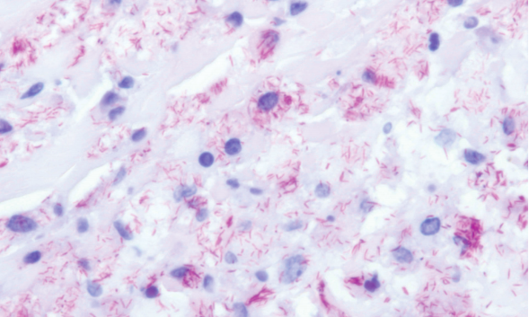
Red squirrels in the UK…
Vet Rec. 2014 Sep 20;175(11):285-6.
Notes:
Avanzi, C. et al. Red squirrels in the British Isles are infected with leprosy bacilli. Science (New York, N.Y.) 354, 744–747 (2016).

Slide 47
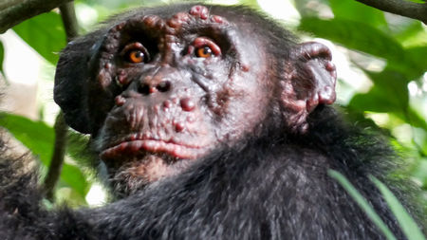
Chimpanzees in West Africa
Notes:
https://www.sciencemag.org/news/2020/11/leprosy-ancient-scourge-humans-found-assail-wild-chimpanzees

Slide 48
Clinical Assessment
4 questions to address:
Is it leprosy?
What is the classification?
Is there any nerve impairment?
Is there need for steroids?

Slide 49
Clinical Assessment
Skin
  Look for patches or thickened skin
  Check sensation in patches
  Count skin patches
Nerves
  Examine superficial nerves
  Check sensation in face, hands and feet
  Check strength of face, hands and feet
Skin slits and biopsy
Notes:
First, talk to the person
Examine the patient
Examine the skin
Test the feeling in the skin patches
Feel the nerves
Examine the hands and feet for nerve damage
Perform a skin smear if available

Slide 50

Leprosy Assessment
Skin patch with loss of sensation

Slide 51

Also look for characteristic features of lepromatous leprosy
Gorgas course

Slide 52


Lepromatous leprosy
JAMA. 2017;317(1):81-82.
Notes:
41-year-old man who had immigrated to the United States from Costa Rica 10 years prior presented with a 2-year history of tingling and pain in his hands and feet. He had no other symptoms and reported taking no medications. Findings on skin examination included near-complete loss of eyebrows and eyelashes, a scaly plaque on the right shin, and mild bilateral erythema of the earlobes, distal fingers, and toes (Figure). He also had right axillary and bilateral inguinal lymphadenopathy.

Slide 53

Leprosy Assessment
Examine nerves
Thickened
Tender
Functional deficit

Slide 54




Testing for muscle strength

Slide 55

Testing for sensory deficits

Slide 56


Examine the eyes

Slide 57



Documentation
US NHDP

Slide 58

Contact tracing and prophylaxis
Active case finding
Single dose Rifampin 600 mg x 1
  57% effective
1,000 patients newly diagnosed w leprosy
20,000 contacts
RIFAMPIN
PLACEBO
30/10,000
0.3%
60/10,000
0.6%
30/10,000
0.3%
30/10,000
0.3%
BMJ 2008; 336: 761-764
Notes:
howed an overall protective effect of 57% with single-dose rifampin in the first 2 years after administration.³ However, this trial also revealed two serious drawbacks of postexposure prophylaxis with rifampin. The least benefit was observed among the participants at the highest risk, household contacts; neighbors and social contacts received the main benefits of rifampin. In addition, after 2 years, the percentage of new cases in the rifampin group was the same as that in the placebo group. Despite these and other concerns,

Slide 59


Contact Tracing and Prophylaxis
Notes:
The NHDP does NOT recommend chemoprophylaxis for contacts.
There is no vaccine available and chemoprophylaxis is impractical in most situations. Thus, at present, there is no practical means of primary prevention, (i.e. the detection and protection of persons at risk).
A systematic review found BCG vaccination at birth effective at reducing risk of leprosy
(pooled reduction in risk 55%), though the magnitude of the effect varied

Slide 60

Contact tracing and prophylaxis
Active case finding
Single dose Rifapentine 600mg x 1
  92% effective
4 years: 0.05% rifapentine (1 new case / 2,004 contacts)
0.19% rifampin (5 new cases / 2,609 contacts)
0.63% control (18 new cases / 2,837 contacts)
N Engl J Med 2023 May 18; 388:1843.
Notes:
This cluster-randomized controlled trial assessed the effectiveness of single-dose rifapentine compared to single-dose rifampin and no intervention in preventing infections among household contacts of patients with leprosy. Overall, 207 leprosy clusters consisting of 7,450 household contacts were randomized to receive a single dose of rifapentine, a single dose of rifampin, or no intervention. The primary outcome was the cumulative incidence rate of leprosy among household contacts by four years. Secondary outcomes included cumulative incidence at two years and safety outcomes. By four years, the cumulative incidence rate was 0.09% among participants who received rifapentine, 0.33% in those who received rifampin, and 0.55% in those who got no intervention. Per intention-to-treat analysis, the cumulative incidence of leprosy for the rifapentine group was 84% lower than that for the control group (incidence ratio, 0.16; 95% confidence interval [CI] 0.03 to 0.87, p=0.02). However, there was no significant difference in cumulative incidence between the rifampin and the control group (incidence ratio, 0.59; 95% CI, 0.22 to 1.57; p=0.23). There was no significant difference between these groups at the two-year follow-up. No severe adverse events were noted among any of the groups. There were very few relapse cases of episodes among the index patients across all groups, all of whom were subsequently treated and followed. These results demonstrated rifapentine as a potential leprosy post-exposure prophylaxis for household contacts.
In the per-protocol analysis, the cumulative incidence at 4 years was 0.05% in the rifapentine group (1 new case among 2,004 household contacts), 0.19% in the rifampin group (5 new cases among 2,609 contacts), and 0.63% in the control group (18 new cases among 2,837 contacts.

Slide 61

You see this rash..
The next step is:
  Check sensation
  Skin biopsy
  Its probably ringworm – give a trial of topical antifungal therapy
Notes:
Erythematous borderline tuberculoid leprosy macule
with satellite lesions.

Slide 62
The rash has reduced sensation..
The next step is:
  Skin biopsy
  Its Hansen’s – start treatment
  Get blood tests first to confirm the diagnosis
Notes:
Erythematous borderline tuberculoid leprosy macule
with satellite lesions.

Slide 63
One month later she returns with weakness in foot dorsiflexion…
The next step is:
  It is a side effect, stop the treatment
  Continue treatment but add steroids
  Get a biopsy of peroneal nerve
Notes:
Erythematous borderline tuberculoid leprosy macule
with satellite lesions.

Slide 64


Could this be leprosy?
How would you diagnose it?
Blood test (for antibodies)
Skin test (lepromanin skin test)
Skin slit smears (from the ears)
Skin biopsy of the ulcer edge (foot)
Gorgas, Peru

Slide 65


Could this be leprosy?
Skin slit smears were positive (5+)
Gorgas, Iquitos, Peru

Slide 66

A 72-year-old female with multibacillary Hansen’s disease (nodular lepromatous)

Slide 67
Leprosy
Take home points
What are the 3 cardinal signs of leprosy?
What is the difference between
  Tuberculoid, Borderline, and Lepromatous?
What is a type 1 reaction?
What is a type 2 reaction?
What is the treatment for leprosy?

Slide 68


References
Excellent resources….
WHO guidelines – 2018
WHO website – leprosy section, guidelines
SASAKAWA Atlas – 2019
https://www.smhf.or.jp/data01/atlas_english.pdf

Slide 69


Recognizing neglected skin diseases: WHO pictorial training guide
https://www.who.int

Slide 70

Excellent online courses
PPT slides, followed by MCQs

Slide 71

We can endure losing fingers and toes, eyes and nose, but what we cannot endure is to be rejected by those nearest and dearest
Lepr.Rev. 2005; 76:119-26.
Notes:
Rafferty J. Curing the stigma of leprosy. Lepr.Rev. 2005; 76:119-26.

Slide 72



Case…
33M born in Mogadishu
  2008 → Dadaab, 2009 → Kakuma, 2019 → Nairobi
  May 2021 → Canada
Not actually the patient
Notes:
https://borgenproject.org/ten-facts-about-somali-refugees/
Civil war resulted in a complete breakdown of the formal education system in Somalia. Somalia has one of the world’s lowest enrollment rates for primary school-aged children, where as few as 25% of children have access to primary education, and secondary school enrollment is estimated at 6%
Literacy among Somalis is low. Among adults (15 years of age or older), male literacy is approximately 49.7%, while literacy among women is substantially lower at 25.8% ⁹.

Slide 73


Kenya has demanded that UNHCR close Dadaab and Kakuma camps – home to 400,000 people
Notes:
https://www.aljazeera.com/news/2021/4/5/no-other-home-refugees-in-kenya-camps-devastated-over-closure
One of the two refugee camps in northern Kenya, Dadaab, close to the sensitive border with war-racked Somalia, was set up in 1991. In 2011, amid famine and chaos in Somalia, it was the world's largest camp.
Dadaab, the largest refugee camp in the world, was home to more than half a million Somalis in 2015. The camp is located in northeastern Kenya and was initially set up as a temporary living situation for refugees fleeing conflict in Somalia and Sudan. Unfortunately for many, the camp has become more permanent. Refugees are often stuck in camps for several decades, unable to emigrate to another country or return to their own. Kenya now plans to close the camp as it has become a breeding ground for extremist groups.
Somalia’s neighboring countries host the largest number of its refugees. According to data collected by the UNHCR, there are just under 330,000 Somali refugees registered in Kenya, 241,000 in Ethiopia and 255,000 in Yemen. Thousands more have found temporary living situations in Tanzania, Uganda, Djibouti and Eritrea.
There are nearly 400,000 Somali refugees living in Dadaab for whom none of these outcomes is likely. They are among the 14 million refugees living in what the United Nations calls “protracted situations,” those in exile for more than five years. The global displaced population is now at 60 million

Slide 74
33M, refugee from Somalia
May 17 - arrived to Vancouver
May 21 – to ER
  Epistaxis
  Dysuria

Slide 75

33M, refugee from Somalia
May 17 - arrived to Vancouver
May 21 – to ER
  Epistaxis
  Dysuria
May 27 – seen in Trop Med clinic
  R. Ulnar nerve palsy x ≥ 3 months
  Inguinal adenopathy
  → Doxycycline
May 28 - TB skin test
June 4 – back to clinic
  Fever and painful nodules
Not actually the patient

Slide 76
33M, refugee from Somalia
May 17 - arrived to Vancouver
May 21 – to ER
  Epistaxis, mild
  Dysuria x 3 months
May 27 – seen in Trop Med clinic
  R. Ulnar nerve palsy x ≥ 3 months
  Inguinal adenopathy
  → Doxycycline
May 28 - TB skin test
June 4 – back to clinic
  Fever and painful nodules
Not actually the patient

Slide 77
33M, refugee from Somalia
May 17 - arrived to Vancouver
May 21 – to ER
  Epistaxis → polysporin/vaseline
  Dysuria → ceftriaxone/azithro and referred to Trop Med
May 27 – seen in Trop Med clinic
  R. Ulnar nerve palsy x ≥ 3 months
  Inguinal adenopathy
  → Doxycycline
May 28 - TB skin test
June 4 – back to clinic
  Fever and painful nodules
Not actually the patient

Slide 78
33M, refugee from Somalia
May 17 - arrived to Vancouver
May 21 – to ER
  Epistaxis, mild
  Dysuria x 3 months
May 27 – seen in Trop Med clinic
  R. Ulnar nerve palsy x ≥ 3 months
  Inguinal adenopathy
  → Doxycycline
May 28 - TB skin test
June 4 – back to clinic
  Fever and painful nodules
Urinalysis - bland (no WBC, no RBC)
Urine G/C pcr - negative
Urine schisto - negative
HIV - negative
Syphilis - negative
WBC 9.5, Hb 114, Plt, 480
Creatinine 50

Slide 79
33M, refugee from Somalia
May 17 - arrived to Vancouver
May 21 – to ER
  Epistaxis, mild
  Dysuria x 3 months
May 27 – seen in Trop Med clinic
  R. Ulnar nerve palsy x ≥ 3 months
  Inguinal adenopathy
  → Doxycycline
May 28 - TB skin test
June 4 – back to clinic
  Fever and painful nodules
Urinalysis - bland (no WBC, no RBC)
Urine G/C pcr - negative
Urine schisto - negative
HIV - negative
Syphilis - negative
WBC 9.5, Hb 114, Plt, 480
Creatinine 50

Slide 80

33M, refugee from Somalia
May 17 - arrived to Vancouver
May 21 – to ER
  Epistaxis, mild
  Dysuria x 3 months
May 27 – seen in Trop Med clinic
  R. Ulnar nerve palsy x ≥ 3 months
  Inguinal adenopathy
  → Doxycycline
May 28 - TB skin test
June 4 – back to clinic
  Fever and painful nodules

Slide 81
33M, refugee from Somalia
May 17 - arrived to Vancouver
May 21 – to ER
  Epistaxis, mild
  Dysuria x 3 months
May 27 – seen in Trop Med clinic
  R. Ulnar nerve palsy x ≥ 3 months
  Inguinal adenopathy
  → Doxycycline
  May 28 - TB skin test
June 4 – back to clinic
  Fever and painful nodules
No rash; wounds back of hands
Ulnar nerves easily palpable – not-tender
Decrease sensation over 4th and 5th fingers
For follow-up next week…

Slide 82
33M, refugee from Somalia
May 17 - arrived to Vancouver
May 21 – to ER
  Epistaxis, mild
  Dysuria x 3 months
May 27 – seen in Trop Med clinic
  R. Ulnar nerve palsy x ≥ 3 months
  Inguinal adenopathy
  → Doxycycline
  May 28 - TB skin test
June 4 – back to clinic
  Fever and painful nodules
No rash; wounds back of hands
Ulnar nerves easily palpable – not-tender
Decrease sensation over 4th and 5th fingers
For follow-up next week…

Slide 83
33M, refugee from Somalia
May 17 - arrived to Vancouver
May 21 – to ER
  Epistaxis, mild
  Dysuria x 3 months
May 27 – seen in Trop Med clinic
  R. Ulnar nerve palsy x ≥ 3 months
  Inguinal adenopathy
  → Doxycycline
May 28 - TB skin test (routine)
June 4 – back to clinic
  Fever and painful nodules

Slide 84
33M, refugee from Somalia
May 17 - arrived to Vancouver
May 21 – to ER
  Epistaxis, mild
  Dysuria x 3 months
May 27 – seen in Trop Med clinic
  R. Ulnar nerve palsy x ≥ 3 months
  Inguinal adenopathy
  → Doxycycline
May 28 - TB skin test (routine)
June 4 – back to clinic
  Fever and painful nodules

Slide 85

33M, refugee from Somalia
June 4 – fever (39⁺) multiple painful lumps/nodules
  No skin lesions (except wounds on hands)
  No painful/tender peripheral nerves

Slide 86

Skin slit smear and skin biopsy…

Slide 87

Skin slit smear and skin biopsy…
Auramine-rhodamine stain

Slide 88
Skin slit smear and skin biopsy…
Biopsy:
  lymphohistiocytic infiltrate
  admixed neutrophils
  focal small aggregates of foamy histiocytes,
  numerous acid fast bacilli present
  well-formed granulomas not present.
Auramine-rhodamine stain

Slide 89


What about the doxycycline and the TST?
Type 1 reactions
  Upgrading of CMI
Type 2 reactions
  Immune complex–mediated
Notes:
https://journals.sagepub.com/doi/pdf/10.1177/1203475418808759

Slide 90
Treatment regimen
Admitted to hospital
Prednisone 40
  Much better the next day
  Dysuria much improved as well
Rifampin 600
Moxifloxacin 400
Minocycline 100
Notes:
Our patient began to respond to prednisone within 2 days, with such a rapid response being typical for ENL and more delayed in type 1 reactions

Slide 91


Clinical course

Slide 92


Clinical course

Slide 93
Clinical course
Prednisone slowly tapered
  June 40mg OD
  July 30mg OD
Doing well, nodules gone, nerve function stable / unchanged
  July missed 2 doses of prednisone → RELAPSE
  - fever and painful nodules returned
  - no change in strength
  - no tender nerves or new skin lesions

Slide 94
Clinical course
Prednisone slowly tapered
  June 40mg OD
  July 30mg OD
Doing well, nodules gone, nerve function stable / unchanged
  July missed 2 doses of prednisone → RELAPSE
  - fever and painful nodules returned
  - no change in strength
  - no tender nerves or new skin lesions

Slide 95
Clinical course
Prednisone increased to 40, then again slowly tapered
  July 40mg OD
  September 20mg OD
Doing well, nodules gone, nerve function stable / unchanged
  September 15 mg OD → RELAPSE
  - painful nodules returned
  - no change in strength
  - no tender nerves or new skin lesions

Slide 96
Clinical course
Prednisone increased to 40, then again slowly tapered
  July 40mg OD
  September 20mg OD
Doing well, nodules gone, nerve function stable / unchanged
  September 15 mg OD → RELAPSE
  - painful nodules returned, no fever
  - no change in strength
  - no tender nerves or new skin lesions

Slide 97
Clinical course
Dose of prednisone increased to 40mg
Painful nodules resolved – felt better
What next?
  Thalidomide?
  Clofazimine?

Slide 98
Additional considerations
33M with new diagnosis of multibacillary Hansen’s disease
  Prior episodes of recurrent epistaxis
Living with his wife and 7 young children…

