Slide 1
Tropical Medicine Rounds
Leishmaniasis (visceral)
June 13, 2025

Slide 2
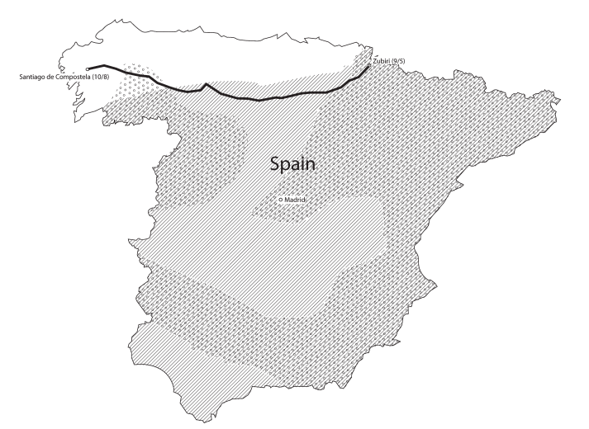
Case report
73M presented to ER in Northern California
  3 weeks of progressive fatigue, fever, chills, drenching night sweats, and anorexia.
  No respiratory or joint symptoms,
  HTN and remote history of prostate cancer
Lives in suburban Northern California
  No sick contacts, no contact with animals
  1 month ago trip to Whistler, BC
  1 year walked along Camino de Santiago in Spain
J Travel Med 2014; 21: 429–432
Notes:
through the autonomous communities of Catalonia, Aragon, Navarre, La Rioja, Castile-León, and Galicia (Figure 1), which he undertook 11 months prior to presentation

Slide 3
Case report
73M in northern California with 3 weeks fever
  Previous travel to BC (1 month ago) and Spain (1 year ago)
Investigations:
  Pancytopenia – WBC 2, Hb 80, Plt 50,000
  ALT 300
  Ferritin 25,000
  Blood cultures negative, HIV negative
  CT = mild-moderate hepatosplenomegaly

Slide 4
Case report
73M in northern California with 3 weeks fever
  Previous travel to BC (1 month ago) and Spain (1 year ago)
Investigations:
  Pancytopenia – WBC 2, Hb 80, Plt 50,000
  ALT 300
  Ferritin 25,000
  Blood cultures negative, HIV negative
  CT = mild-moderate hepatosplenomegaly
  Urine Histoplasma Ag borderline positive 0.9 ng/mL (< 0.7 ref)
  Fibrinogen low, TG elevated, sIL-2r elevated 50,000

Slide 5
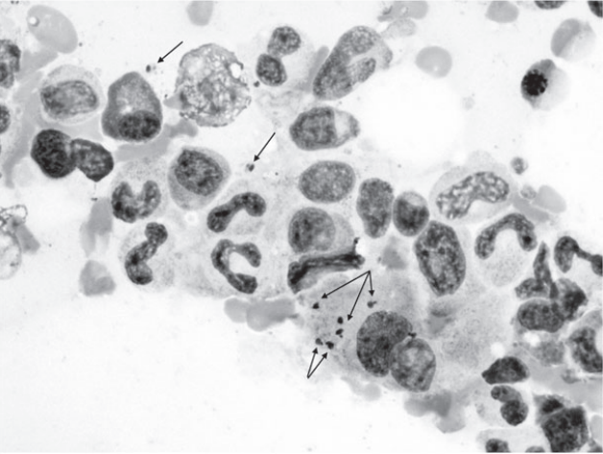
Case report
Notes:
The next day, review of the bone marrow biopsy slides revealed granulomas filled with apoptotic debris, intracellular and extracellular microorganisms consistent with amastigotes, and rare red blood cells phagocytized by macrophages
The immunofluorescent antibody test for Leishmania donovani performed at the Centers for Disease Control and Prevention (Atlanta, GA) was positive

Slide 6
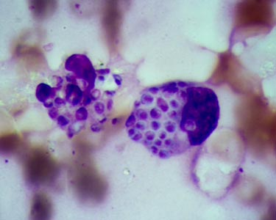
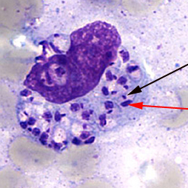
Bone marrow aspirate
Histoplasmosis
Leishmaniasis
Notes:
Fibrinogen: 149-353 mg/dL
Triglyceride levels in the blood are usually less than 150 mg per deciliter (mg/dL).

Slide 7
Case report
L-amB 3mg/kg x 7days
→ did well
J Travel Med 2014; 21: 429–432
Notes:
The next day, review of the bone marrow biopsy slides revealed granulomas filled with apoptotic debris, intracellular and extracellular microorganisms consistent with amastigotes, and rare red blood cells phagocytized by macrophages
Hemophagocytic lymphohistiocytosis (HLH) associated with visceral leishmaniasis (VL) is a very rare phenomenon. We report the first known North American case in a 21 month old boy. He was initially diagnosed with Epstein Barr virus (EBV) triggered HLH and treated with the international treatment protocol, HLH-2004. Stem cell transplant was planned due to repeated reactivations of disease, but his pretransplant bone marrow revealed an unexpected protozoan-Leishmania donovani. Treatment with liposomal amphotericin B led to resolution of all manifestations of HLH. We discuss how the clinical and laboratory features of both entities can closely mimic each other and are extremely difficult to differentiate. This case also raises the question of whether to screen all children with suspected HLH for Leishmania in a non endemic area.

Slide 8
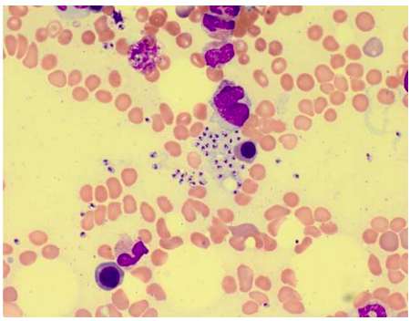
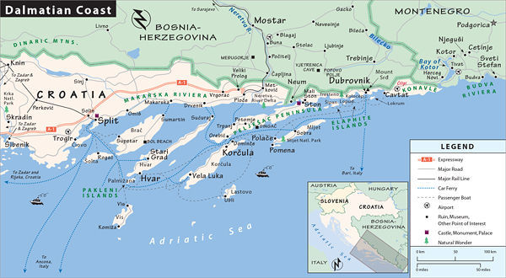
Case report
2 year old with VL-HLH discovered pre-BMT
Born in Calgary, Canada, parents from Croatia and Chile
  Well until 21 months when developed 4 week history of fevers
    Diagnosed and treated for HLH → relapsed; planned for SCT
    Diagnosed with VL on 3rd bone marrow
J Pediatr Hematol Oncol 2013;35:e127–e129
Notes:
Detailed questioning revealed travel overland from Germany to Croatia, with the majority of the 6-week trip spent on the Dalmatian Coast when the patient was 7 months old. In addition, the family reported poor appetite, pallor, and some loss of weight starting at 17 months of age. A careful review of the slides from previous bone marrows confirmed the presence of the organisms, although far less numerous. A single organism was found on the initial bone marrow after several hours of retrospective searching. He was started on liposomal amphotericin B. He showed dramatic improvement within the next 4 weeks, including resolution of fever, regression of splenomegaly, resolution of pancytopenia, and more gradual normalization of ferritin. At 6-month follow-up, he continues to do well clinically with no splenomegaly and stable blood counts.

Slide 9

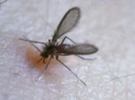
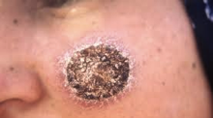
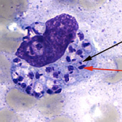
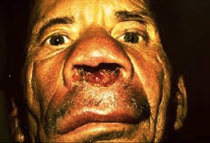
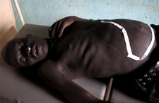
Tropical and Geographic Medicine
Short Course
Leishmaniasis
Jan Hajek
Cutaneous
Mucosal
Visceral
Notes:
Leishmaniasis is caused by parasitic protozoa of the genus Leishmania.
Humans are infected via the bite of phlebotomine sandflies, which breed in forest areas, caves, or the burrows of small rodents.
There are four main types of the disease:
1) In cutaneous forms, skin ulcers usually form on exposed areas, such as the face, arms and legs. These usually heal within a few months, leaving scars.
2) Diffuse cutaneous leishmaniasis produces disseminated and chronic skin lesions resembling those of lepromatous leprosy. It is difficult to treat.
3) In mucocutaneous forms, the lesions can partially or totally destroy the mucous membranes of the nose, mouth and throat cavities and surrounding tissues.
4) Visceral leishmaniasis, also known as kala azar, is characterized by high fever, substantial weight loss, swelling of the spleen and liver, and anaemia. If left untreated, the disease can have a fatality rate as high as 100% within two years.

Slide 10
Outline
Tropical and Geographic Medicine
Short Course
Leishmaniasis overview
  Epidemiology, parasite, classification,
Cutaneous (CL) and Mucosal Leishmaniasis (ML)
Visceral Leishmaniasis (VL)
  Presentation, diagnosis, treatment
  Two cases

Slide 11
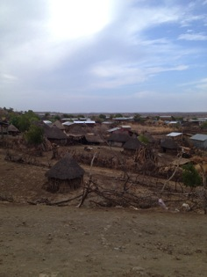
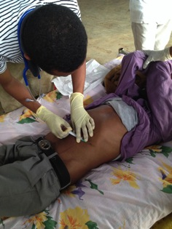

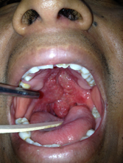
Leishmaniasis
Introduction (my experiences)
Gorgas courses
Peru
Kala-azar project with MSF
North-western Ethiopia
MSF TeleMedicine
Weekly case discussions with Patna, Bihar

Slide 12
Leishmaniasis
Overview
Mainly affects the poorest people on earth
  Associated with malnutrition, population displacement, poor housing
50,000 – 90,000 VL cases
  90% occur in 3 regions (5 countries)
    India/Bangladesh; Ethiopia/S Sudan; Brazil
~1 million CL cases
  More widely distributed than VL
  Most cases (70%) occur in 2 regions
Notes:
WHO estimates that 300,000 cases of VL per year
50,000 deaths
Many go missed
90% of all cases in just 6 countries
India (Bihar), Bangladesh
Sudan, South Sudan and Ethiopia
Brazil

Slide 13
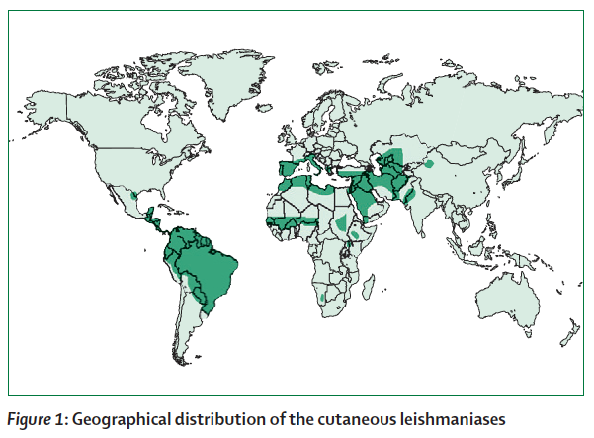
Cutaneous Leishmaniasis
Lancet, 2007
Notes:
VL cases:
90% in 3 regions
NE India and Bangladesh
Ethiopia and South Sudan
Brazil
0.7 to 1.2 million CL cases
more widely distributed
3 key epidemiological regions:
Americas (Brazil, Colombia, etc))
Mediterranean basin
Middle East - Central Asia (Afghanistan, Iran, Syria)

Slide 14
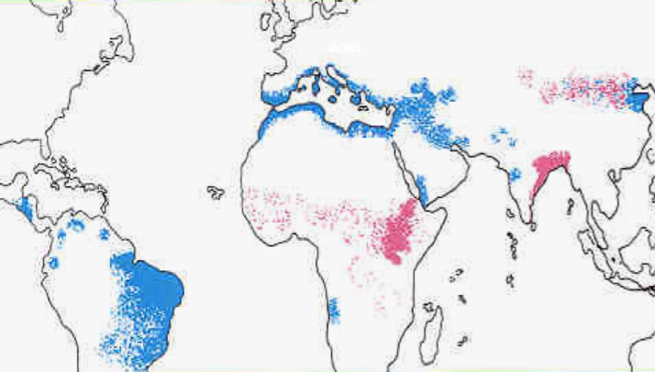
Visceral Leishmaniasis
L. donovani
L. infantum/chagasi
WHO, 2010
Notes:
Data source & Map production: WHO/NTD/IDM HIV/AIDS, Tuberculosis and Malaria (HTM) World Health Organization, October 2010
90% of all VL occurs in:
Bangladesh, India, Nepal,
Brazil
Sudan

Slide 15
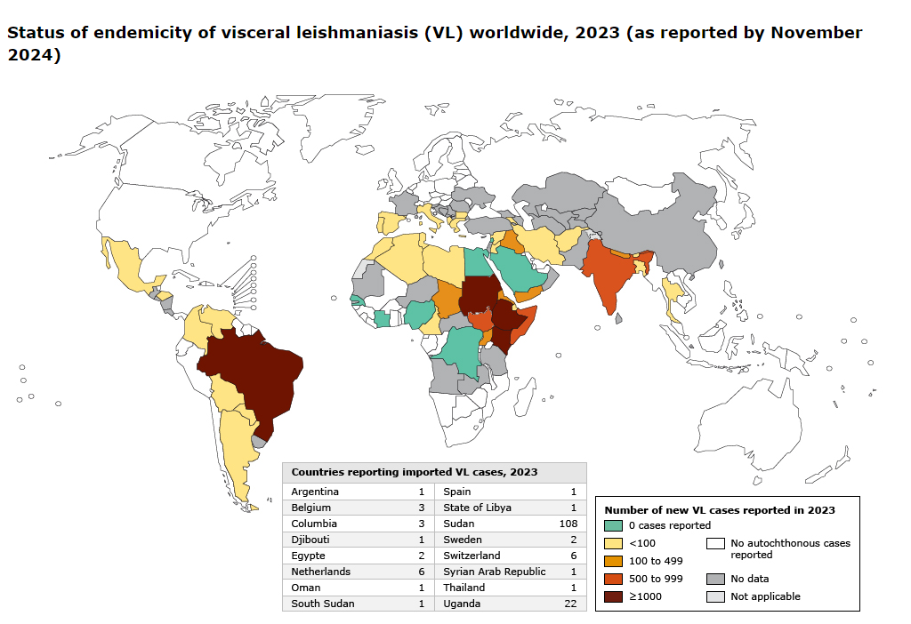

Slide 16
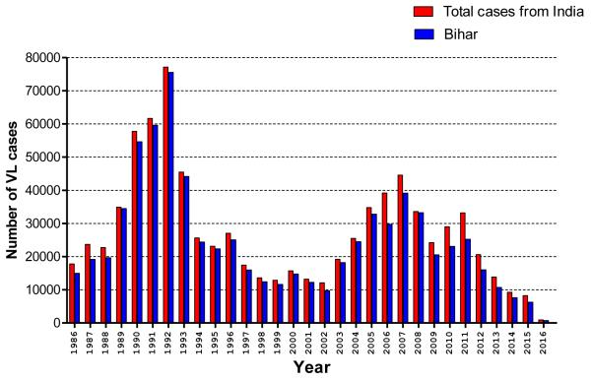

Slide 17
Classification
Parasites
  Protozoa
    Enteric (Giardia)
    Non-Enteric (Malaria)
  Helminths
    Nematodes (roundworms)
    Trematodes (flukes)
    Cestodes (tapeworms)

Slide 18
Classification
Protozoa
Enteric
  E. histolytica
    E. Dispar
  Giardia lamblia
    Dientameba fragilis
  Cryptosporidium
    Cyclospora
    Isospora belli
  Other
    Blastocystis hominis
    Balantidium coli
    Microsporidia
Non-enteric
  Plasmodium spp. (malaria)
  Leishmania
  Trypanosomes
  Toxoplasma gondii
  Trichomonas
  Free-living amoebas

Slide 19
Leishmania
Kinetoplastid
Amastigote stage
kinetoplast (black arrow)
kDNA
nucleus (red arrow)
CDC/DPDx
Notes:
Light-microscopic examination of a stained bone marrow specimen from a patient with visceral leishmaniasis—showing a macrophage (a special type of white blood cell) containing multiple Leishmania amastigotes (the tissue stage of the parasite). Note that each amastigote has a nucleus (red arrow) and a rod-shaped kinetoplast (black arrow). Visualization of the kinetoplast is important for diagnostic purposes, to be confident the patient has leishmaniasis. (Credit: CDC/DPDx)

Slide 20
Leishmania
Lives in the phagolysosome in macrophages
Obligate intracellular pathogen
Tolerate the hostile environment in the phagolysosome
TB
  Prevent phagolysosomal fusion, makes pores that allow exit of important molecules
Toxoplasma
  Non-phagocytic uptake, and generates a vacuole around it and lives within cytoplasm
Trypanosomiasis
  Phospholipases that make a hole in the phagolysosome and escape into cytoplasm
Notes:
Obligate intracellular
Phagolysosome of macrophages
Amastigotes are susceptible to Ab and Complement-mediated damage
They get rapidly phagocytosed – then tough it out in the phagolysosome

Slide 21
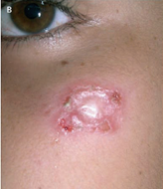
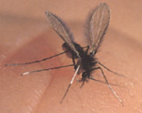
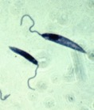
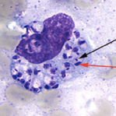
Leishmania parasite life cycle
Sandfly Promastigotes | Human Amastigotes

Slide 22
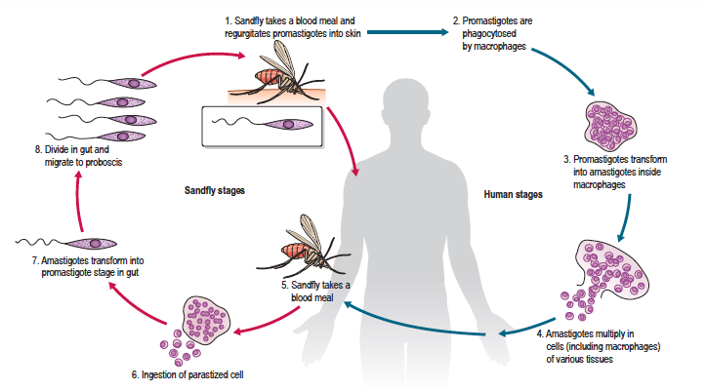
Life cycle

Slide 23

The vector
Sandflies
2-3mm in size
Notes:
Phlebotomus - Old World
Lutzomyia - New World
Characteristics:
Small (1/3 the size of mosquito)
Gets through most mosquito nets
Generally bites in the evening and night
Can be urban or rural
Poor flying ability
Uses hopping movements, doesn’t fly in the wind
There are some 500 known phlebotomine species, but only about 30 have been found to transmit leishmaniasis.
Wings held in upright V
Only the female sandfly transmits the parasites.
Female sandflies need blood for their eggs to develop, and become infected with the Leishmania parasites when they suck blood from an infected person or animal.
Over a period of between 4 and 25 days, the parasites develop in the sandfly. When the infectious female sandfly then feeds on a fresh source of blood, it inoculates the person or animal with the parasite, and the transmission cycle is completed.

Slide 24
The vector
Sandflies
  Small
  Usually bite in the evening/night
  Can be urban or rural
  Poor flying ability
2-3mm in size
Notes:
Phlebotomus - Old World
Lutzomyia - New World
Characteristics:
Small (1/3 the size of mosquito)
Gets through most mosquito nets
Generally bites in the evening and night
Can be urban or rural
Poor flying ability
Uses hopping movements, doesn’t fly in the wind
There are some 500 known phlebotomine species, but only about 30 have been found to transmit leishmaniasis.
Wings held in upright V
Only the female sandfly transmits the parasites.
Female sandflies need blood for their eggs to develop, and become infected with the Leishmania parasites when they suck blood from an infected person or animal.
Over a period of between 4 and 25 days, the parasites develop in the sandfly. When the infectious female sandfly then feeds on a fresh source of blood, it inoculates the person or animal with the parasite, and the transmission cycle is completed.

Slide 25

Life cycle
Can be zoonotic or anthroponotic

Slide 26

Visceral Leishmaniasis
L. donovani
L. infantum/chagasi
WHO, 2010
Notes:
Data source & Map production: WHO/NTD/IDM HIV/AIDS, Tuberculosis and Malaria (HTM) World Health Organization, October 2010
90% of all VL occurs in:
Bangladesh, India, Nepal,
Brazil
Sudan

Slide 27
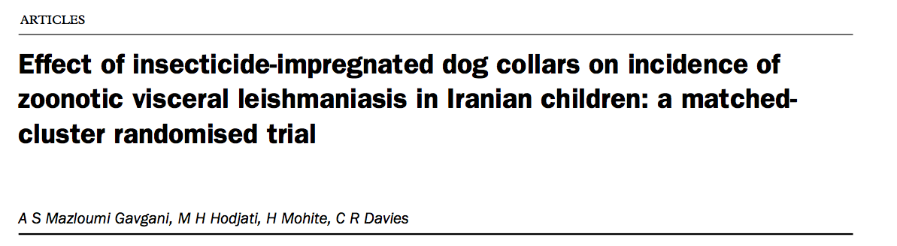
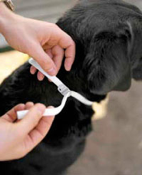

Deltamethrin-impregnanted dog collars
Collars
Villages that used the collars had:
50% decrease in seroconversion in dogs
50% decrease in seroconversion in children
Lancet 2002
Notes:
Background Deltamethrin-impregnated dog collars reduce sandfly bite rates on dogs, and are effective in killing sandflies that attempt to feed. Because domestic dogs are the principal reservoir hosts of zoonotic visceral leishmaniasis, we tested whether community-wide application of dog collars could protect children against infection with Leishmania infantum, the parasite that causes the disease.
Methods 18 villages were paired, matched by preintervention child prevalence of L infantum infection. Within pairs, villages were randomly assigned to either control or intervention. All domestic dogs in intervention villages were provided with collars for the transmission season. The main outcome measure was incidence of L infantum infection after 1 year measured by seroconversion. Secondary outcomes were leishmanin skin test (LST) conversion and seroconversion in dogs.
Findings The seroconversion rate in children was 1·49% (17/1141) in the intervention villages and 2·41% (26/1078) in control villages (odds ratio 0·57, 95% CI 0·36–0·%
, p=0·017). LST conversion was also lowered, but not significantly (odds ratio 0·66, 0·41–1·08, p=0·096). The seroconversion rate in dogs in intervention villages was also significantly reduced (0·46, 0·30–0·70, p=0·0003).
Interpretation Community-wide application of deltamethrin- impregnated dog collars not only protects domestic dogs from L infantum infections, but might also reduce the risk of L infantum infection in children. These dog collars could have a role in control of visceral leishmaniasis and replace controversial dog culling programmes in some countries. However, the effectiveness of dog collars will depend on the importance of wild versus domestic canids as reservoir hosts of L infantum.
Lancet 2002; 360: 374–79
Maroli M, Mizzoni V, Siragusa C, et al. Evidence for an impact on the incidence of canine leishmaniasis by the mass use of deltamethrin-impregnated dog collars in southern Italy. Med Vet Entomol 2001; 15: 358-363.

Slide 28

Consensus statement regarding the usefulness of dog culling as a means of controlling visceral leishmaniasis.
The statement highlighted the futility of culling infected dogs, whether healthy or sick, as a measure to control the domestic reservoir of L. infantum and reduce risk for visceral leishmaniasis.
Emerging Infectious Disease 2019
Notes:
At the 13th Symposium of the Companion Vector-Borne Diseases World Forum in Windsor, UK, March 19–22, 2018, we consolidated a

Slide 29
Classification
  Cutaneous vs Visceral
  New World vs Old World
Notes:
HAT, VL and Chagas disease are all transmitted by insects—tsetse flies, sandflies and triatomine bugs re- spectively
Tissue/blood protozoa
Like malaria and toxoplasma
More closely related to trypanosomes

Slide 30
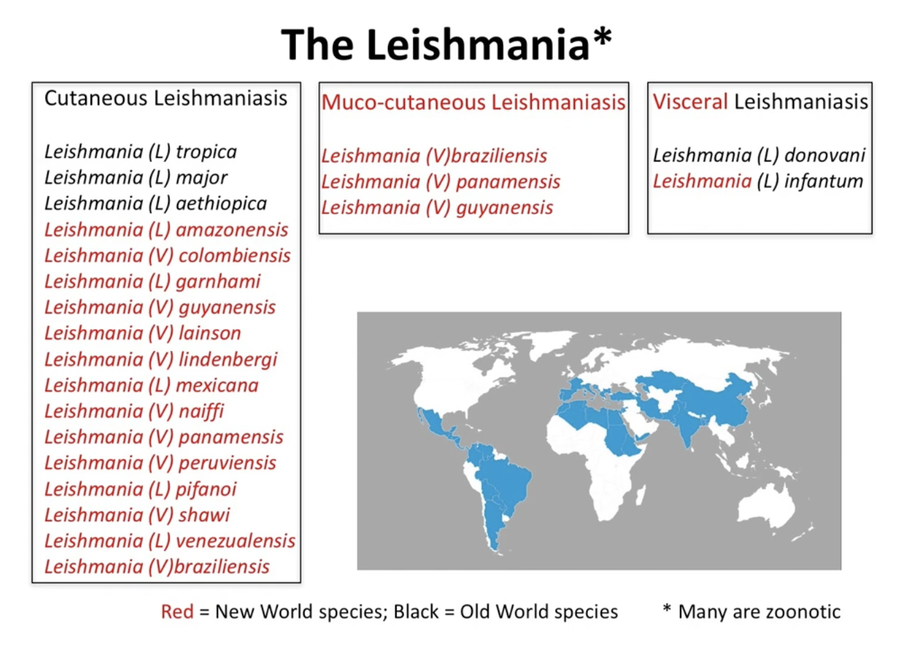
Notes:
L (V) amazonensis

Slide 31
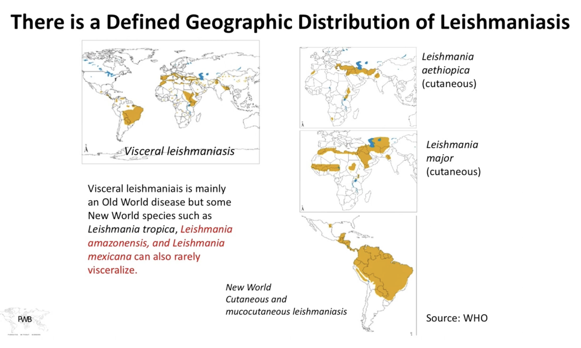
Geographic distribution

Slide 32
Classification
L. donavani
L. infantum/chagasi
L. major
L. tropica
L. aethiopica
L. (V). braziliensis
L. (L). mexicana
Visceral leish
Old World VL
New World CL

Slide 33
Classification
OLD WORLD
NEW WORLD
family
TRYPANOSOMATIDAE
L.donovani
L. infantum (chagasi)
L. donovani
L. donovani
L. infantum
Leishmania
L.(L) mexicana
L.(L) amazonensis
Others
L. Leishmania
Leishmania
LEISHMANIA
L. major
L. major
L. tropica
L. tropica
L. aethiopica
L. aethiopica
L.(V) braziliensis
L.(V) guyanensis
Others
L. Viannia
SPECIES
COMPLEX
SUBGENUS
GENUS
SUBGENUS
COMPLEX
SPECIES
Notes:
More than 20 species of Leishmania can cause disease in humans
One species can cause more than one syndrome
Each syndrome can be caused by multiple different species

Slide 34
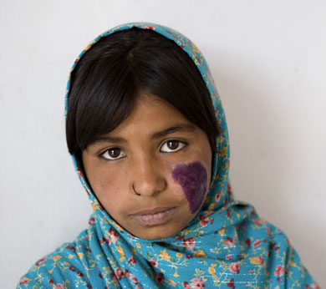
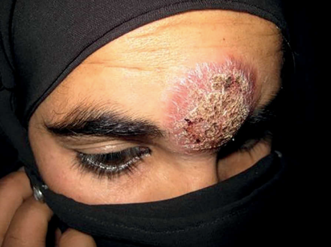
Old World CL
Stigma
Photo: Chris Black, WHO

Slide 35
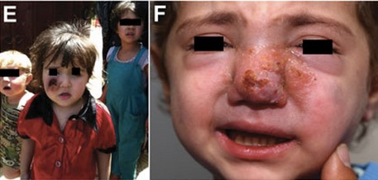
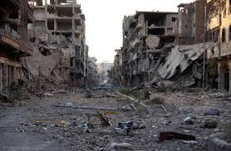
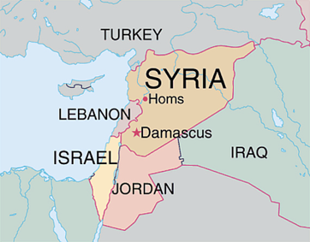
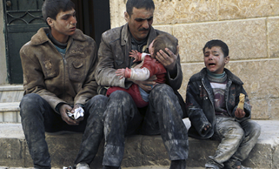
Massive outbreak of CL related to conflict and displacement in Syria
Notes:
The recent conflict in Syria, has lead to a massive national outbreak of CL that has spread to bordering regions. In the 1980s, circumstances during the Sudanese civil war lead to a massive epidemic of VL; an estimated 1/3rd of the 300,000 people living in the West Upper Nile region died of VL.

Slide 36
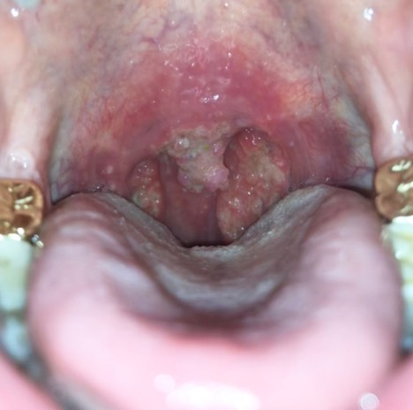
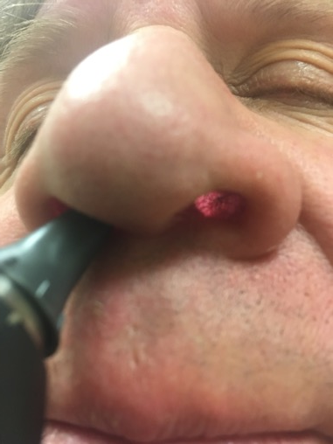
New World CL - MCL – L. braziliensis
Progressive, slowly destructive
Treatable and +/- preventable
Notes:
Importantly, yearly follow-up is recommended in patients treated for L braziliensis for up to a decade to ensure any progression to mucocutaneous leishmaniasis is identified early.

Slide 37
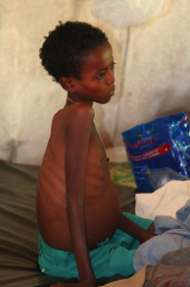
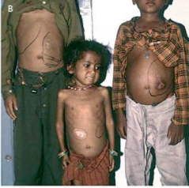
Visceral leishmaniasis
Kala-azar
  Disseminated disease
    Systemic febrile illness
    Lethal if not treated
But most infections asymptomatic (~TB)
  Controlled by immune system
  Minority get active disease
Can present years later as opportunistic infection in setting of immunosuppression
Lancet 2005; 366: 1561–77
Notes:
Most infections are asymptomatoc
Controlled by the immune sysem
Miniority get active disease

Slide 38
VL - Clinical presentation
Triad
  Fever for ≥ 2 weeks
  Splenomegaly
  Pancytopenia
  Weight loss
  Hypergammaglobulinemia
Gradual wasting and immunocompromise
  Death often from secondary infection
+/- Additional features
    Lymphadenopathy
    Epistaxis
    Diarrhea
Notes:
Tuberculosis
Typhoid
Malaria

Slide 39
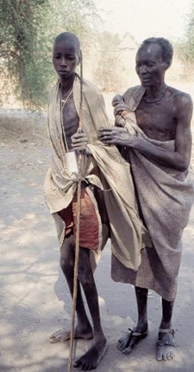
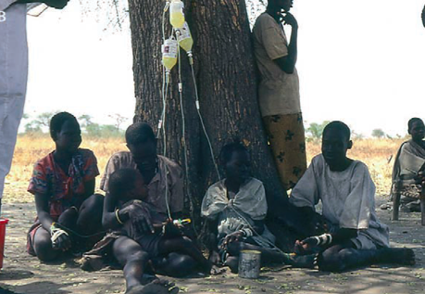
Strong association with poverty
Outbreaks with conflict and forced migration
Lancet 2005; 366: 1561–77
Notes:
The disease is most common in agricultural villages where houses are frequently constructed with mud walls and earthen floors, and cattle and other livestock live close to humans. People are considered to be the sole reservoir of the Leishmania parasites in this region.
In East Africa, there are frequent outbreaks of visceral leishmaniasis in the northern acacia–balanite savanna and the southern savanna and forest areas where sandflies live around termite mounds. Humans are considered the main reservoir of the Leishmania parasites causing visceral leishmaniasis in this part of Africa. Cutaneous leishmaniasis occurs in the highlands of Ethiopia and other places in East Africa, where increased human–fly contact occurs in villages built on rock hills or river banks, which are the natural habitat of hyraxes.
PLoS Negl Trop Dis. 2013 Nov 7;7(11):e2543

Slide 40
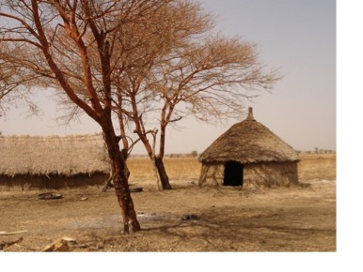
Epidemiology
NE India (Bihar)
East Africa
PLoS Negl Trop Dis. 2013 Nov 7;7(11):e2543
Lancet 2005; 366: 1561–77

Slide 41
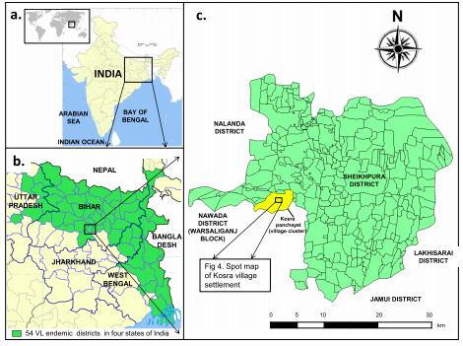
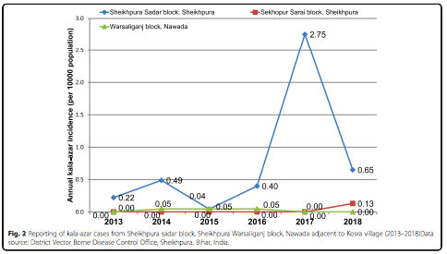
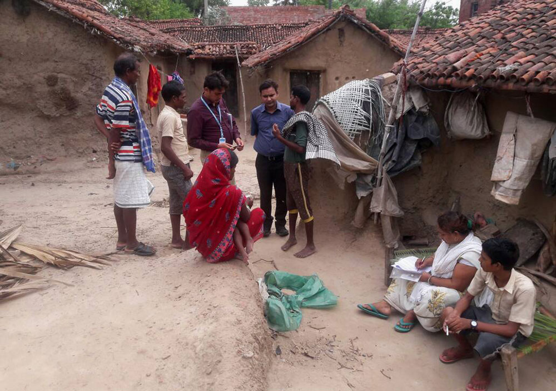
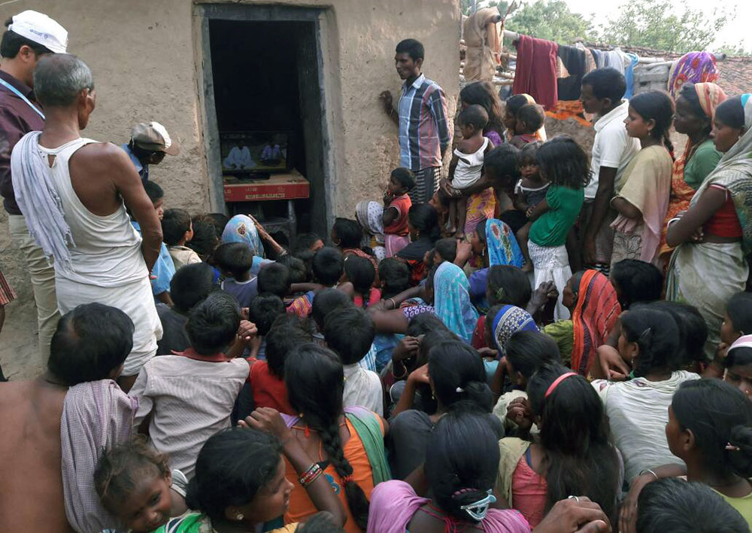
Outbreak in village in Bihar
Intensely clustered outbreak of visceral leishmaniasis (kala-azar) in a setting of seasonal migration in a village of Bihar, India
Kumar et al. BMC Infectious Diseases 2020
Notes:
https://scroll.in/pulse/840670/in-this-bihar-village-a-sudden-surge-of-kala-azar-has-hit-dalit-migrant-workers
Kumar et al. BMC Infectious Diseases (2020) 20:10

Slide 42
2 additional important clinical features
Post kala-azar dermal leishmaniasis (PKDL)
  Macular, papular, nodular rash
  Typically on the face
  Occurs months to years after apparent cure of VL
    L. donovani (India and East Africa)
HIV co-infection
  VL is an opportunistic infection
  100 – 1,000 X higher risk of disease
    Very high rates of relapse
    Poor response to treatment
Notes:
It has been shown that HIV infection may increase the risk
of developing VL by 100 up to 2,300 times in endemic
areas

Slide 43
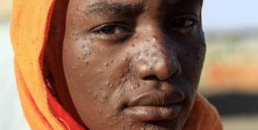
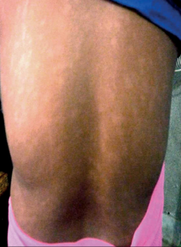
PKDL
L. donovani
  East Africa (Ethiopia, Kenya, Sudan)
      Early, can start during treatment
      Frequently (50%)
      Usually papular
      Often heals spontaneously
  Indian subcontinent (Bihar)
      Later, 1-3 years after treatment
      Infrequently (5%)
      Rarely heals spontaneously
      Usually macular
MSF and Lancet 2018
Notes:
Fardos, who has a rash all over her body, a symptom of post-kala azar dermal leishmaniasis (PKDL), looks into the camera in the village of Tabarak Allah, in Al-Gedaref State, Eastern Sudan January 3, 2011. – Reuters Photo

Slide 44
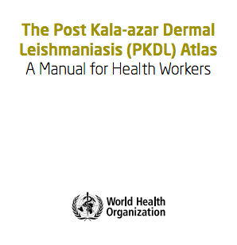
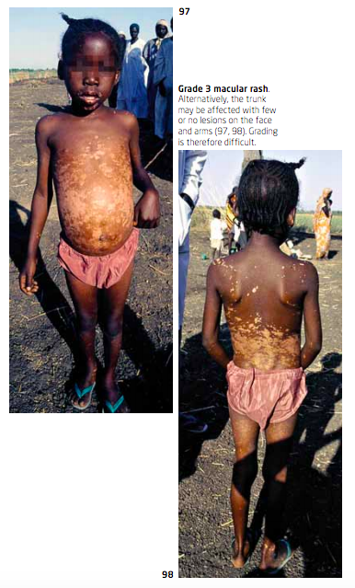
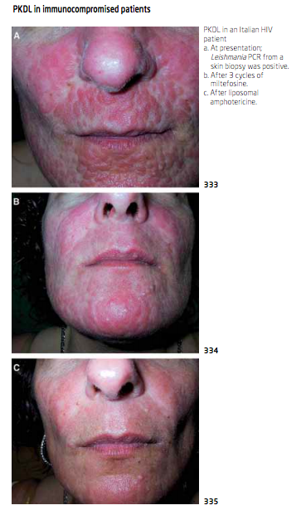
PKDL
Protean manifestations

Slide 45
VL
Diagnosis
Clinical suspicion
Serological tests
  rK39
  DAT
  ELISA, IFA
Parasitological tests
  Sample collection:
    Splenic aspirate
    Bone marrow aspirate
    Lymph node aspirate
  Detection methods:
    Microscopy
    Culture
    PCR
Notes:
Fever
Weight loss
Splenomegaly
Pancytopenia
Hypergammaglobulinemia

Slide 46

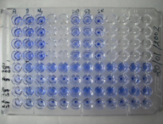
Serology
Very useful test for diagnosis
rK39
  Rapid dipstick
DAT (Direct agglutination test)
  More sensitive than rK39
  48 hours - uses a microtitre plate
ELISA and IFA
  Laboratory based (not for field settings)
    Similar performance to DAT and rK39
Notes:
Chappuis et al. BMJ 2006; 333: 723-7

Slide 47
Serology
Drawbacks
Remains positive after cure
Detect asymptomatic infections
  ~30% of people in endemic areas, with no history of VL, may have positive serology
    Positive test ⧣ mean active disease
    Cannot differentiate relapse
rK39 is less sensitive in East Africa, especially in patients with HIV
Notes:
About 20-30% of healthy individuals living in the endemic areas test positive with DAT, and an illness mimicking VL might be mistaken for VL if DAT is positive in this particular individual.

Slide 48
Diagnostic algorithm for VL
MSF - India
Kala-azar suspect:
- Fever > 2 weeks
- Splenomegaly
rK39
Not kala-azar
- search for other
diagnosis
Kala-azar
- treat

Slide 49

Diagnostic algorithm for VL
MSF - India
MSF, Kala-azar manual (2013)

Slide 50

Diagnostic algorithm for VL
MSF – East Africa

Slide 51
VL
Parasitological tests
  Near 100% specificity
    Reliable for diagnosis of relapse
  Needs technical expertise
    Risk of bleeding
Sensitivity (microscopy):
  Splenic aspirate (90%)
  BM aspirate (75%)
  LN aspirate (50%)

Slide 52


Splenic aspirate

Slide 53

PCR on peripheral blood
PCR on peripheral blood may be better than all other parasitological and serologic tests…
Italy

Slide 54


Asymptomatic infection
Brazil study
136 asymptomatic people evaluated:
  10% PCR positive peripheral blood
  endemic with active L. infantum transmission
Notes:
Part of a population-based study
At baseline, 97 and 39
individuals, according to PCR/hybridization results, were classified
as positive or negative for L.infantum infection, respectively; all
positive participants were asymptomatic [6]. They were reevaluated
in 2001 (present investigation); during this period, none
of the infected participants had progressed to clinical disease.
Blood samples from 22 non-infected individuals and from 8
patients with clinical VL, all of them residents of the metropolitan
region of Belo Horizonte, were also assayed for comparison and
laboratory techniques quality control.

Slide 55
Treatment options
Top 3
Sb^{v} (sodium stibogluconate / pentavalent antimony)
L-amB (liposomal amphotericin)
Miltefosine
Others exist:
  Paromomycin
  Pentamidine

Slide 56

Pentavalent antimony (Sb^{v})
Heavy metal - #51
  Toxic and poorly tolerated
Historical standard (1940s)
70 – 90% effective for CL
  Two “brands”:
    Sodium stibogluconate (SSG) – Pentostam
    Meglumine antimonate (MA) – Glucantime
  Administration:
    20mg/kg IV, IM x 20 – 30 days
    Can be given intralesional for CL
  Side effects:
    Arthalgia, myalgia, GI upset
    Pancreatitis
      Monitor amylase
    Cardiotoxicity, Arrhythmia
      Monitor QT
Everlasting pill
WHO technical report series; no. 949, 2010
Notes:
Arthalgia, myalgia, GI upset
Monitor amylase, lipase; stop if amylase >4xULN, or if lipase >15xULN
monitor EKG; stop if QT >0.5s)
Administration of the
first-line chemotherapy of pentavalent antimonials (Sb5+) is
burdened by a high cost, a 20-day treatment course under expert
supervision, frequent side effects [3–6], and rising clinical
resistance

Slide 57
Sb^{v}
Has been standard of care for years, but…
In India (Bihar), very high rates of resistance
  30% failure rates in 1980
  60% failure rates in 2000
In East Africa, side effects and poor efficacy especially in patients with HIV
  3% mortality – if HIV negative
  30% mortality – if HIV positive
Notes:
Mishra M, Biswas UK, Jha AM, Khan AB. Amphotericin vs.sodium stibogluconate in first line treatment of Indian kala-azar. Lancet. 1994;344:1599–600.

Slide 58


Miltefosine
Breakthrough – oral drug for VL
RCT of 299 patients with VL in Bihar, India
    AmB 1mg/kg x 15 doses on alternate days
    MIL 100mg/day x 28 days
  100% initial cure rate at 1 moth
    3% relapse at 6 months in MIL group
    0% relapse in AmB group
Oral medication
  Developed as an anti-cancer drug
  N Engl J Med 2002; 347:1739.
Notes:
Sundar S, Jha TK, Thakur CP, et al. Oral miltefosine for Indian visceral leishmaniasis. N Engl J Med 2002; 347:1739.

Slide 59
Miltefosine
Decreasing efficacy over the next 10 years…
120 patients in Nepal (HIV negative)
  Treated with miltefosine x 28 days
  96% initial cure rate at 1 month
  BUT…
    10% relapse at 6 months
    20% relapse at 12 months
    Rijal et al. CID 2013;56:1530-8

Slide 60

L-amB
Single 10mg/kg dose - effective in India
RCT of 410 patients in India
  L-amB 10mg/g IV x 1 dose
  AmB deoxycholate 1mg/kg x 15 doses every other day
  96% cure rates at 6 months
    Less adverse effects in the L-amB group
N Engl J Med 2010; 362: 504–512.
Notes:
Sundar S, Chakravarty J, Agarwal D, Rai M, Murray HW. Single-dose liposomal amphotericin B for visceral leishmaniasis in India. N Engl J Med 2010; 362: 504–512.

Slide 61


But, in East Africa and HIV, even at high doses, L-amB had poor activity
Patients treated at an MSF clinic in Northern Ethiopia
L-amB 5m/kg x 6 doses (30mg/kg total dose)

Slide 62
What about combination therapy?
L-amB + miltefosine
  Becoming standard of care for HIV-associated VL
MSF
Lancet. 2011 Feb 5;377(9764):477-86.
Notes:
Sundar S, Sinha PK, Rai M, Verma DK, Nawin K, Alam S, Chakravarty J, Vaillant
M, Verma N, Pandey K, Kumari P, Lal CS, Arora R, Sharma B, Ellis S,
Strub-Wourgaft N, Balasegaram M, Olliaro P, Das P, Modabber F. Comparison of
short-course multidrug treatment with standard therapy for visceral leishmaniasis
in India: an open-label, non-inferiority, randomised controlled trial. Lancet.
2011 Feb 5;377(9764):477-86.

Slide 63

HIV and VL
CD4 < 200 = 50% chance of relapse
MSF, Kala-azar manual (2013)
Notes:
Alvar J, Aparicio P, Aseffa A et al. The relationship between leishmaniasis and AIDS: the
second 10 years. Clin Microbiol Rev 2008;21:334–59.

Slide 64
HIV and VL
Secondary prophylaxis recommended (until CD4 > 350)
  Very little clinical trial to guide recommendations
Suggested regimens
  L-amB 3mg/kg every 2-4 weeks
  Paromomycin?
  Miltefosine?
Follow PCR…

Slide 65

Recent RCT of combination Rx
MIL 28 days:
10% relapse at 6 months
15% PKDL at 5 years
L-amB + MIL 14 days:
0% relapse
0% PKDL

Slide 66



MSF Kalar-azar program
Abdurafi, Ethiopia

Slide 67

VL Case
45M, migrant worker in Abdurafi
  1 previous episode of VL
  2 previous episodes of TB
  New diagnosis of HIV
    CD4 175, not yet on treatment
Presents with
  Fever x 3 weeks
  Weight loss
  Splenomegaly
  Generalized weakness, cough, diarrhea

Slide 68
VL Case
Migrant worker in Ethiopia
Initial labs:
  Pancytopenia
  Malaria smear negative
Next step?

Slide 69


He underwent splenic aspirate
Microscopy:
> 100 parasites per HPF

Slide 70
Diagnosed with VL, relapse, HIV+
How should he be treated?

Slide 71
Diagnosed with VL, relapse, HIV+
How should he be treated?
  He started combination treatment:
    L-amB 5mg/kg every other day x 6 doses
    PLUS
    Miltefosine 100mg/day x 28 days

Slide 72
Diagnosed with VL, relapse, HIV+
How should he be treated?
  He started combination treatment:
    L-amB 5mg/kg every other day x 6 doses
    PLUS
    Miltefosine 100mg/day x 28 days
After 2 weeks he was feeling better - but cough persisted….

Slide 73
After 2 weeks he was feeling better but still coughing
Sputum AFB negative x 3
CXR left lower lobe infiltrate
What next?

Slide 74


After 2 weeks he was feeling better but still coughing
Sputum AFB negative x 3
CXR left lower lobe infiltrate
Sputum GeneXpert…

Slide 75
Massive splenomegaly
Differential diagnosis
Hyperreactive malarial splenomegaly syndrome
Visceral leishmaniasis
Schistosomiasis (portal HTN - no fever)
Hematological malignancies

Slide 76
Leishmaniasis
Vector borne (sandfly)
Intra-macrophage protozoan infection
CL → Non healing skin lesion
VL → Fever, splenomegaly, weight loss, pancytopenia
Visceral
Cutaneous
New World
Old World
MCL
MCL
Notes:
Obtain clinical specimens:
Scraping
Biopsy
Needle aspiration
Investigate for presence of leishmania parasite:
Microscopy (smear or histopathology)
Culture
PCR

Slide 77
MSF Telemedicine case
Patna - January 8, 2020
36yo Female. 24kg
CD4 80 while on PI-based 2nd line ARV
History of previous treatment for MDR-TB and VL
Fevers, weight loss
WBC 3, Hb 5, platelets 20
What next?

Slide 78

Excellent review
Lancet Nov 2018

